Slide 1
Welcome to Title II-A Tuesdays!
Reflecting to Move Forward
May 2025
Please put your district name next to your username
In the chat: If you could choose to have one superpower, what would it be?

Slide 2

Our Time Together Today
Reflecting to Move Forward
  Reconciliation: Did we do what we had planned?
  Evaluation: What did we learn?
  Consultation: What will we do next?
  Resources

Slide 3
Did we do what we had planned?

Slide 4

Reflection #1
What is one celebration/ highlight/strength you can share about how Title II-A funds made a difference in your district this year?

Slide 5

Reconciliation Basics: What, Why & Who
What: Ensuring actual spending aligns to narrative
Why: Demonstrate that each award is used as intended
  Identify transaction errors
  Ensure that award expenditures are complete
  Plan for remaining funds as carryover
  Who: Fiscal and program staff
Oregon Department of Education
Notes:
Reconciliation is also helpful when the district is selected for monitoring. We often find that districts have activities in their expenditure report that are allowable but not approved. Reconciling ensures that your fiscal documentation matches your narrative.

Slide 6
Reconciliation Basics: When and How
When: At least annually (quarterly is better)
  Any time a new activity is added
  If the change is 10% or more
How: It depends.
  Current year narratives: Choose REVISE in CIP Budget Narrative dashboard
  Approved Carryover Narratives: Complete the Carryover Revision Request form
Oregon Department of Education
Notes:
Reconciliation is also helpful when the district is selected for monitoring. We often find that districts have activities in their expenditure report that are allowable but not approved. Reconciling ensures that your fiscal documentation matches your narrative.

Slide 7
What did we learn?
Notes:
Once you can answer the question “Did we do what we had planned?”, you are ready to look at evaluation

Slide 8

Reflection #2
Is there an area where you want to strengthen your district’s systems around Title II-A?
Data collection?
Data analysis?
Goals, Strategies, & Activities?
Evaluation?
Other?

Slide 9

Reminder: Why evaluation matters
Accountability requirements
Understanding program implementation
  Improvement
  Learning
  Monitoring
Understanding program impact
  Performance
  Replication or Expansion
  Discontinuation
Notes:
There are a variety of reasons to evaluate professional learning.
Professional Learning is an investment of money, time, and effort and is a strategy that crosses federal and state programs. Why wouldn’t we want to know if our investment paying off?

Slide 10

Evaluating Programs
Review data from both district and participating private school programs
  Did we make progress toward our outcomes (student and educator) and how do we know?
  Which strategies had the best results?
  Will we continue, expand, or change strategies, based on the results?
Notes:
Whatever measures you choose, whatever change you are hoping to facilitate through the implementation of professional learning strategies, the final step involves reviewing the data to see what was learned.
It is important to identify how and when you will review the data so this step does not get lost. Often much of the focus is on implementation because it can be such a heavy lift. But implementation without reflection can lead to a wasted investment.

Slide 11
Evaluating Process
Review your approach and consider adjustments
  Did we collect all the data we planned to?
  Was it the right data?
  How will the data inform next steps?

Slide 12
What will we do next?

Slide 13

We need to acknowledge…
Allocations for 2025-2026 have not been provided
Uncertainty around president’s “skinny” budget proposal
Decisions about staffing cannot wait
Notes:
Normally we would take this time to talk about what you are thinking about for next year. Not having any idea what you allocation is makes this particularly difficult, on top of which messaging from the president’s skinny budget does not make clear what the future of Title II-A is. And districts have staffing decisions that must be made now.

Slide 14
What we know for sure
Funding for 2025-2026 (FY 25)
  Overall funding for ESSA is the same as 2024-25
  Still waiting for Office of Management and Budget (OMB) to provide Title II-A appropriation to USED
Funding for 2026-2027 (FY 26)
  President’s budget proposal is not the end of the story
  The appropriations process takes time and requires Congressional approval
  The skinny budget tells us the administration’s funding priorities, but nothing has been decided yet
Notes:
For 2026-27 we are on the very first step of a long journey.

Slide 15

Reflection #3
How can our team support you during this time of uncertainty?

Slide 16

Consultation under ESSA
Districts must meaningfully consult with a wide array of partners when designing their Title II-A programs
  Administrators
  Teachers
  Paraprofessionals
  Instructional support personnel
  Parents/Guardians
  Community members and partners
  Tribes and tribal organizations
Notes:
So, assuming that Title II-A will be funded for next year, districts will want to make sure they are consulting on how they plan to use the funds. ESSA requires that districts consult with a wide array of individuals to gather input and feedback on the district’s plan for the use of funds [2102(b)(3)]. This does not have to be separate process specific to each program.

Slide 17
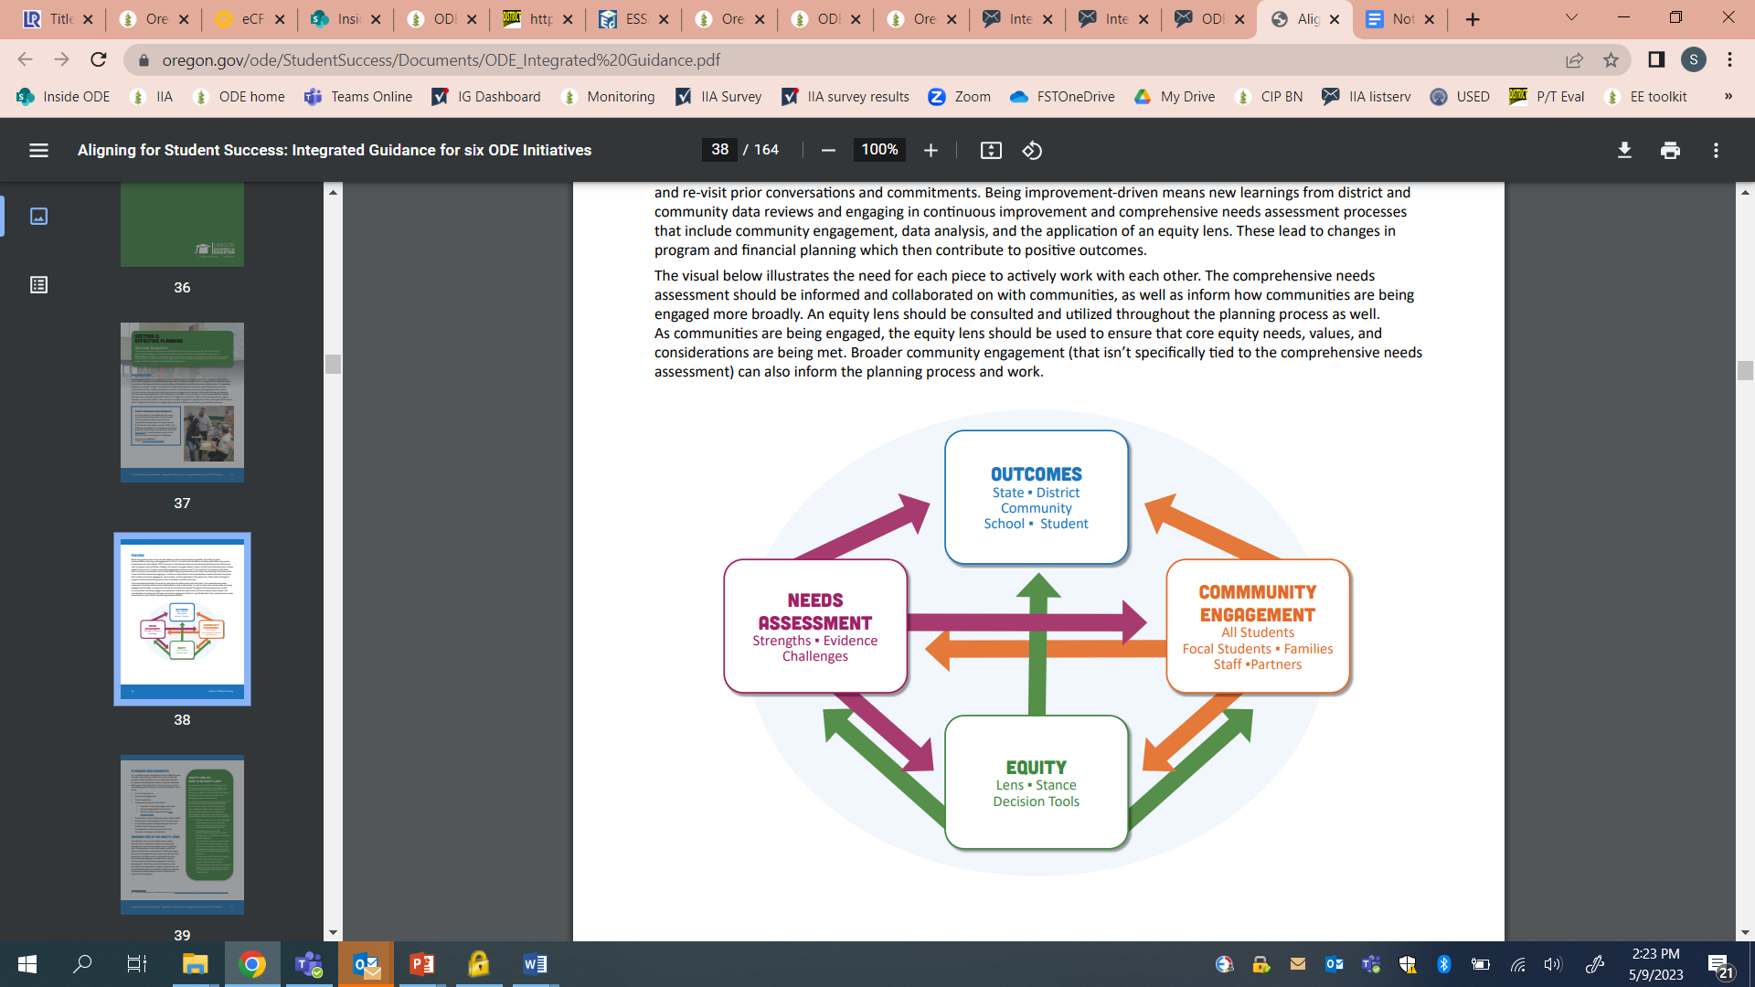
Use Integrated Programs Work
Consultation as part of Integrated Programs work can satisfy the requirements for consultation for Titles II-A, as long as:
  the groups named in ESSA are included, and
  there is explicit discussion of the use of Title II-A funds.
The title “CIP” (Continuous Improvement Plan) Budget Narrative is intentional
Notes:
The applications for federal funds are called “CIP (Continuous Improvement Plan) Budget Narrative” for a reason. The intention is for the district to share how it is using its federal funds to support the district’s larger plan for improvement.
ESEA requires that districts consult with a wide variety of groups as part of the decision making process for how II-A and IV-A funds will be spent. However, engagement does not have to be a process that is specific to these programs. Whatever comprehensive needs assessment and engagement process the district uses can meet the needs assessment and consultation requirement for Title II-A and IV-A consultation with 2 caveats:
It must include the individuals listed on the previous slide
Engagement must include discussion of how the district is proposing to use Title II-A funds.
An important caveat is around ensuring that activities meet the intent of the program and that they do not represent a supplanting situation.

Slide 18

Consider “What if”?
What activities funded with Title II-A does our community most value?
What activities have had the biggest impact?
What would we prioritize to continue if Title II-A funds were no longer available?
Notes:
Programs like Title II-A and Title III have been proposed to be zeroed out in the past and those proposals were not successful.
However, it would be advisable to talk with the community about what has been funded out of II-A previously and which of those activities the district might consider funding out of other sources if no funds are made available in the 2026-27 budget.

Slide 19

Resources
Reconciling Budget Narratives
CIP Budget Narrative Resources
Title II-A web page
Federal Programs Training page
Title II-A listserv

Slide 20

Please reach out!
Jen Engberg
Jennifer.Engberg@ode.oregon.gov
Sarah Martin
Sarah.Martin@ode.oregon.gov
Lisa Plumb
Lisa.Plumb@ode.oregon.gov
Amy Tidwell
Amy.Tidwell@ode.oregon.gov
Notes:
Jen Engberg
Clackamas, Columbia Gorge, Multnomah and Northwest Regional
Sarah Martin
Douglas, Lake, Malheur, South Coast and Southern Oregon
Lisa Plumb
Lane, Linn Benton Lincoln and Willamette
Amy Tidwell
Grant, Harney, High Desert, InterMountain, Jefferson, North Central and Region 18

