Slide 1
Title I, Part A: Methodology

Slide 2

Outcomes
Methodology Basics
Requirements & Flexibilities
Examples
Resources
Oregon Department of Education

Slide 3
Supplement Not Supplant
Federal funds cannot be used to supplant, or take the place of, funds that would have been spent if Title I-A funds were not available
Comparability is one of three fiscal tests for Title I-A
through which districts demonstrate that their use of
Title I-A funds is supplemental
ESSA Quick Reference Brief: Methodology
Title IA Fiscal Requirements
Supplement not Supplant
Comparability
Maintenance of Effort
Notes:
There are three fiscal tests for Title I-A:
Maintenance of Effort (MOE) – LEAs must maintain a consistent floor of state and local funding for free public education from year-to-year.
Supplement Not Supplant (SNS) – LEAs must distribute state and local funds to schools without taking into account a school’s participation in the Title I program.
Comparability – state and local funds are used to provide services that, taken as a whole, are comparable between Title I and non-Title schools.
Title I-A funds are required to supplement, and not supplant existing state and local funding. In plain language, this means that federal funds should add to, and not replace, state and local funds. Before ESSA, Title I-A’s ‘supplement, not supplant’ requirement was tested through three presumptions that looked at each activity supported with Title I-A funds to determine if it was something an LEA or school would have paid for with state and/or local funds if Title I-A funds were not available.

Slide 4

Methodology Basics
What: Description of the method used to allocate State and local funds to ALL schools regardless of I-A status
Why: To ensure each Title I-A school is provided with all of the money it would receive if it did not participate in the Title I program
Where: Overview page of the CIP BN
Oregon Department of Education
Notes:
The reauthorization of ESEA under the Every Student Succeeds Act (ESSA) changed the way supplement, not supplant (SNS) compliance is tested for districts and schools that receive Title I-A funds. ESSA’s revised SNS test does not look at how districts and schools spend Title I-A funds as a specific cost test, but instead looks at how districts distribute State and local funds to Title I-A schools. This is also know as the district’s “methodology”.
A district’s methodology must be “Title I neutral” in that it allocates State and local funds to schools without regard for Title I-A status.

Slide 5
Requirements and Flexibilities
Who: Every district accepting Title I-A funds except:
  Districts with only one school
  Districts with only one school per grade span
  Districts that fund ALL schools with Title I-A funds
How: Districts have broad flexibility
  There is no required way to demonstrate methodology, but it must be “calculable”
Notes:
Each district accepting Title I-A funds is required to articulate its methodology for allocating funds to schools on the Overview Page of the Title I-A Continuous Improvement Plan (CIP) Budget Narrative application. There are multiple ways a district might distribute State and local funds to its schools to satisfy the requirement that Title I-A funds be supplemental. The district is not required to implement a specific methodology to allocate State and local funds to its schools, as long as the methodology selected and implemented is neutral about the Title I status of the schools.
Methodology should include numbers to show how the calculation works.
5

Slide 6
Example 1: Distribution of State and local resources based on staffing and supplies
Category | Calculation | Amount
1 principal | 1 x $120,000 | $120,000
1 librarian | 1 x $65,000 | $65,000
2 guidance counselors | 2 x $65,000 | $130,000
21 teachers | 21 x $65,000 | $1,365,000
Instructional materials and supplies | 450 x $825 | $371,250
Total School Allocation |  | $2,051,250
Notes:
This form of equitable distribution is referred to as a “resource” based formula.
Mountain View School District Methodology
1 teacher per 22 students ($65,000/teacher)
1 principal/school ($120,000)
1 librarian/school ($65,000)
2 guidance counselors/school ($65,000/guidance counselor)
$825/student for instructional materials and supplies (including technology)

Slide 7
Example 2: Distribution of State and local resources based on characteristics of the students
Category | Calculation | Amount
Allocation/student | 450 x $7,000 | $3,150,000
Allocation/student experiencing poverty | 200 x $250 | $50,000
Allocation/emergent bilingual student | 100 x $500 | $50,000
Allocation/student experiencing disability | 50 x $1,500 | $75,000
Allocation/preschool student | 20 x $8,500 | $170,000
Total School Allocation |  | $3,495,000
Notes:
This form of equitable distribution is referred to as a “weighted per pupil” funding formula.
Desert School District Methodology
Allocation/student ($7,000)
Additional allocation/student from a low-income family ($250)
Additional allocation/English Learner ($500)
Additional allocation/student with a disability ($1,500)
Additional allocation/preschool student ($8,500)

Slide 8

Resources
ESSA Quick Reference Brief: Methodology
Supplement not Supplant under Title I, Part A
Oregon Federal Funds Guide
ESSA Quick Reference Brief: Supplement not Supplant

Slide 9

Please reach out!
Jen Engberg
Jennifer.Engberg@ode.oregon.gov
Sarah Martin
Sarah.Martin@ode.oregon.gov
Lisa Plumb
Lisa.Plumb@ode.oregon.gov
Amy Tidwell
Amy.Tidwell@ode.oregon.gov
Kyle Walker
Kyle.Walker@ode.oregon.gov

Slide 10
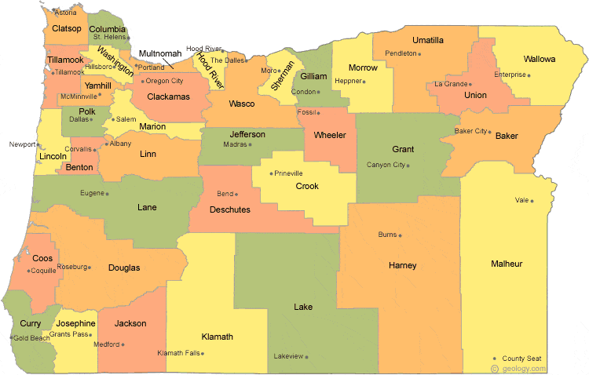
Regional Contacts by ESD
Lisa Plumb
Lane
Linn Benton Lincoln and
Willamette
Amy Tidwell
Grant
Harney
High Desert
InterMountain
Jefferson
North Central and
Region 18
Jen Engberg
Clackamas
Columbia Gorge
Multnomah and
Northwest Regional
Sarah Martin
Douglas
Lake
Malheur
South Coast and
Southern Oregon

