Slide 1
Title I-A “101”
Session 2: February 5, 2025
Please put your district name next to your username.

Slide 2

Planning our journey
Quarterly webinars
  August
  November
  February
  May
Formula Grants Calendar is our map
Our goal is to travel to our destination in a way that will enable you to have a smooth trip this year!

Slide 3

Today’s Itinerary – Day 3
Today’s session is focused exclusively on consultation
  Equitable Services to Private Schools
  Tribal Governments
Oregon Department of Education

Slide 4
Consultation for Equitable Services

Slide 5

Equitable Services
ARE
Programs for private school participants that are designed to increase student academic achievement
Programs that are created through a collaboration between a district and a private school
Paid for by federal tax funds which are annually appropriated by the US Congress
Required under federal law to be offered to each known eligible private school
Offered to every eligible private school, but each private school decides whether or not they will participate

Slide 6
Equitable Services
Are NOT
A blank check for the private school to spend on anything they want
Must be allowable, reasonable, necessary, secular, neutral and non-ideological
Funds paid directly to the private school
The district uses funds generated by private school students to provide services
To benefit the private school in general
Meet a specific need of the private school
Show a direct impact to student academic achievement

Slide 7
Timeline of Consultation 25-26 School Year
Identify
Identify Private Schools
Consult
Summer 2025 through Fall 2026
Evaluate
Spring/Summer 2026
Invite to Consultation
Spring 2025
Upload Evidence for each Private School
Assess Needs & Provide Services
Evaluate Services
Discuss Carryover
Notes:
Frist, identify and invite private schools to consultation. This can be done many ways but one way is to use an Intent to Participate letter that is sent by certified mail. Evidence for private schools that are non-responsive to your invitation or decline services must be uploaded to the Evidence of Consultation form.
If a private school indicates an interest in participating, begin consultation. By following the ODE’s Affirmation of Consultation, you will discuss all the required topics under ESEA and have an agreed upon understanding of what services to provide. Make sure to upload all signed Affirmations to the Evidence of Consultation form.
Continue ongoing consultation throughout the school year, making sure to evaluate services provided. If any funds have not been obligated by Sept 30, 2026, make sure to discuss if carryover is appropriate.

Slide 8
Eligibility
Private School Eligibility to
Participate
Non-profit
Enroll any grade K-12
Student Eligibility to Generate an Allocation
Resides in a public school Title I-A attendance area
Students Eligibility to Receive Services
Resides in a public school Title I-A attendance area
Shows academic need
Household meets agreed upon poverty measure
Notes:
During consultation, first determine if the private school is eligible to participate in equitable services. All private schools must:
Be a non-profit
Enroll students in any grade K-12
The physical location of a private school inside the district is not a requirement
During consultation, agree upon the criteria for determining eligibility for counting students for generating the per-pupil allocation
A student must reside in a public school Title I-A attendance area
Their household must meet agreed upon poverty measure(s) – there are six possible measures
During consultation, agree upon the criteria for determining eligibility for which students will be served
A student must reside in a public school Title I-A attendance area
A student must show academic need in any academic core subject

Slide 9

Consultation is the Heart of Equitable Services
Discussions between the district and the private school
Goal of reaching agreement
Requires active participation by ALL parties
Timely
Meaningful
Ongoing
Notes:
Timely:
Before the any decision is made that could impact equitable services
During the design and development of program
So that services for private school students start around the same time as public school students
Ongoing
Meaningful:
Genuine opportunity for parties to express their views
All views are given serious, due consideration
Consultation must occur before any final decisions are made by district
Ongoing:
Throughout the implementation and assessment of services

Slide 10
Documenting Consultation
Consultation can be:
  In-person meetings
  Virtual meetings
  E-mails
  Certified mail
  Phone calls
  Completing and signing an Affirmation
Document agreements through:
  Attendance sheets
  Meeting agendas
  Virtual meeting chats
  Emails and/or read receipts
  Letters and/or mail receipts
  Phone call logs
  Uploading documents to the Evidence of Consultation form
Notes:
For consultation to occur, evidence that it occurred must be documented.

Slide 11
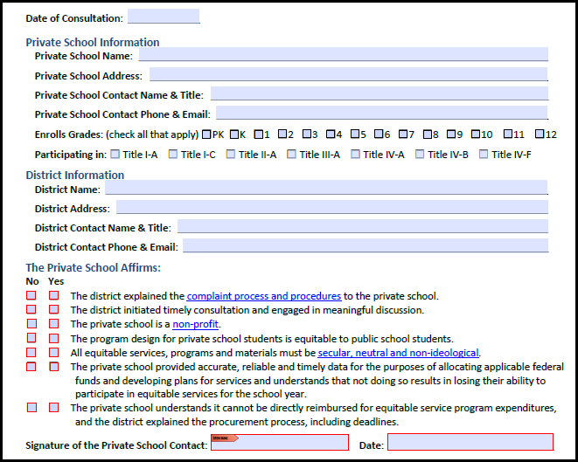
25-26 SY Affirmations
Page 1
Date
Private School information
District Contact Information
Private School Affirmations
Private School Signature and Date

Slide 12
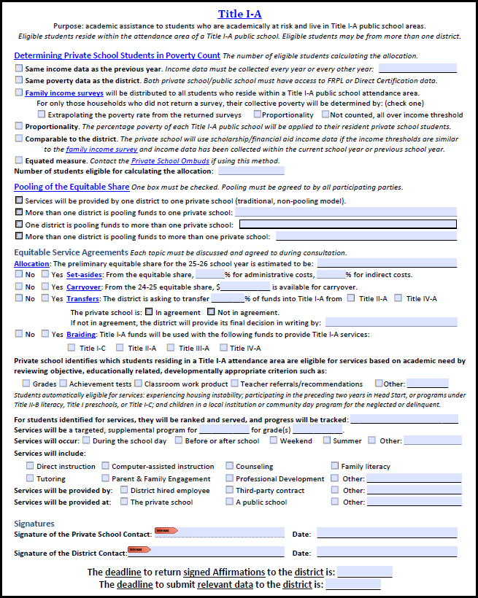
25-26 SY
Title I-A
Page 2
Determining Poverty
Pooling
Allocation
  Set-asides
  Carryover
  Transfers
  Braiding
Rank and Serve/Tracking Progress
Services
Signatures & Dates
Deadlines

Slide 13
Calculating Equitable Share in CIP BN
Calculate the Percent Poverty for Private Schools: On the targeting page, enter the number of private school students experiencing poverty for each Title I-A funded public school.
Calculate the total equitable share: On the targeting page, multiply the “Percent of SWP/TAS Poverty Students in Private Schools” by the “Title I-A grant allocation for 2025-2026 CIP Budget Narrative.”
Calculate the per-pupil allocation: On the targeting page, divide the total equitable share (from step 2) by “SWP/TAS Poverty Students in Private Schools.”
To calculate the Equitable Share for each Private School: Multiply the per-pupil allocation (from step 3) by the number of students in poverty for the private school.
Notes:
Calculation of the equitable share is based on a formula and depends on several factors including attendance area and enrollment.
The equitable share must be taken “off the top” of the Title I-A allocation before any set-asides are deducted.
The private school must provide the district with student information needed to make calculations. The data sources to be used are determined during consultation.
On this slide, data titles appearing in quotes can be found on the CIP BN Targeting page

Slide 14

What are the benefits of Equitable Services?
It’s required by ESEA
It’s a good excuse to talk to private schools on an annual basis
  Inviting private schools to consultation can start dialogues
  Dialogues help create collaborative partnerships with private schools
  Collaboration benefits everyone

Slide 15

Resources
Equitable Services webpage
  Equitable Services Toolkit
    Intent to Participate letter
    Family Income Survey
    Affirmation of Consultation
  Equitable Services Learning Modules
    Module 2: Basics of Consultation
    Module 3: Allocations, Transferability & Carryover
    Module 3b: Title IA Methods of Determining the Private School Poverty Count
    Module 4: Title I-A – Improving Basic Education
  Evidence of Consultation Form
    Private School by District List (ODE’s informal guess)
Title I-A Equitable Services NRG (2023)

Slide 16
Tribal Consultation

Slide 17
What are the requirements?
CRITERIA:
Title VI Indian Education Formula Grant was >$40K in previous fiscal year, including LEAs who are members of a consortium who received >$40K
What are the Requirements?
Consultation requirements under section 8538 of the ESEA, as amended by ESSA, require affected local education agencies (LEAs) to consult with Indian tribes, or those tribal organizations approved by the tribes located in the area served by the LEA, prior to submitting a plan or application for covered programs. This requirement is designed “to ensure timely and meaningful consultation on issues affecting American Indian and Alaska Native students.”
OR
Has 50% or more of its student enrollment made up of AI/AN+*
PLANS or APPLICATIONS:
SEA Application
Integrated Guidance
(Every two years)
Title VI Part A Formula Grant
(Completed Annually)
AND
AND
Application for SEA-Administered Covered Programs (Annually)
The consultation must be done “in a manner and in such a time that provides the opportunity for such appropriate officials from Indian tribes or tribal organizations to meaningfully and substantively contribute” to plans under covered programs. ESSA FAQ Tribal Consultation Guidance
Notes:
Time:
Who:
Script: [REVIEW SLIDE – MAKE SURE THE FIRST PURPOSE BUBBLE IS CALLED OUT FOR CONSORTIA] Then, SAY -
This slide calls out three separate plans or applications which require an affected LEA or affected LEA-C and LEAs who are members of a consortium to engage in Tribal Consultation.
Title VI Indian Education is something our districts are most familiar with in terms of tribal consultation.
The Integrated Guidance state requirement is still far newer as of the Spring of 2023 and the last time your districts engaged in Tribal Consultation for that application, the new toolkit had not been published and there were no universal trainings like this to support it.
The SEA-Administered Covered Programs, or what you might also call all other Federal Title programs besides Title VI will feel like a NEW requirement this school year, but it has been around since 2017. However, as a state agency the accountability structures to ensure affected districts are engaging in Tribal Consultation prior to them receiving their Federal Title funding has not been firmly in place until this school year.
Comment / note on consortia?
Tech Notes - none

Slide 18
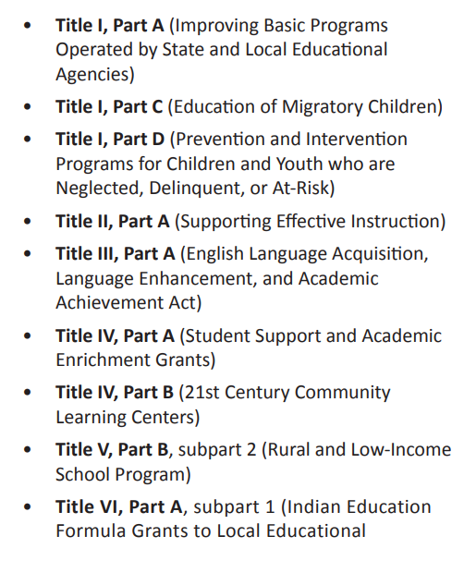
What are the Covered Programs?
Application for SEA-Administered Covered Programs (Annually)
Additional Guidance -
The SEA administers ALL Federal Title Programs except Title V, Part B SRSA and Title VI, Part A
Preliminary allocations were sent to districts mid-April and updated allocations are coming soon!
The deadline to engage in Tribal Consultation for SEA-Administered Covered Programs is Oct 1, 2025.
Common Misconception -
Engaging in Tribal Consultation for Title VI Indian Education takes care of consultation for all Federal Title Programs. FALSE
Notes:
Time:
Who: Liz
Script: SAY: Covered Programs is a term used in the ESSA consultation guidance to describe all Federal Title programs. Covered programs includes all federal title programs that are administered by the ODE.
Invitation for tribes to speak to how the district will use these funds and speak to the district improvement efforts and how we will do right by our native students and youth.
Each grant has a specific purpose - whether that is supporting the education of our students experiencing poverty, our students who are migratory, the mental health and access to Well rounded education, among others. Must work w/ tribal leaders in your district on how these funds will be used to support our native students and youth PK - 12.
ODE does not administer Title V, Part B SRSA and Title 6, Part A - these are both administered by the USDE
Preliminary allocations were sent to districts mid-April and updated allocations are coming soon! Our team is finalizing our calculations this week and I anticipate allocations will be posted in the next 2 weeks.
Allocation webpage: https://www.oregon.gov/ode/schools-and-districts/grants/ESEA/Pages/ESEA-Allocations.aspx
The deadline to engage in Tribal Consultation for SEA-Administered Covered Programs is Oct 1, 2024.
Tech Notes

Slide 19
Current State, Moving Toward, Desired State
Current State
Moving Toward
Desired State
Calendaring meetings in mid-July at the latest, for the entire school year, mapping out and sharing the purpose for each one
Using the Fall to share out on progress monitoring data for previous plans and applications, so tribes receive an accurate and holistic picture of AI/AN student success, engagement, and belonging, while also completing consultation for Covered Programs.
Use the Spring to have a more authentic consultation for IG and Title VI.
Community engagement input from AI/AN and Title VI focal groups is shared to inform the updated Integrated Guidance application.
Regularly calendared meetings, generally in the Fall and Spring, to share out on overall AI/AN and district data in alignment to an application or a plan’s goals
One meeting “tees up” the next meeting, so upcoming consultation meetings build off of the previous meeting.
A true, continuous cycle
Success not dependent on “a person” to lead the work, but becomes part of the organization’s values
Tribes become a key partner in directing the use of $5M - $25M in funding.
One-off (perhaps last minute) meetings when a Tribal Consultation deadline approaches, resulting in a district or ESD sharing on “one topic” vs. a larger picture of progress.
Info shared in a vacuum (high level student data shared in isolation from the larger district ecosystem).
Data, as referred to here, does not solely mean data from standardized assessments.
Notes:
Time:
Who: Tim
Script: [READ SLIDE]
Tech Notes

Slide 20
Technical Assistance for SY24-25 - Toolkit Resources
Where do we start? What does this look like?
Calendar meetings for the entire year liaising with the appropriate representatives identified for all local tribes.
Complete the Tribal Consultation worksheet for Covered Programs.
Do a close reading of an exemplar.
Toolkit - Page 31 - Invitation Support
Toolkit - Pages 45-50 - Tribal Consultation Worksheet,
Rubric, and Agenda
Toolkit - Pages 38-39 Lincoln County School District and
the Confederated Tribes of Siletz Indians,
Post-Consultation Story
Notes:
Time:
Who: Stacy
Script: In thinking about moving toward the desired state for authentic tribal consultation cycles and and practices, these next slides are doing to break down what a combined consultation could look like the upcoming window for Covered Programs – all state administered Federal Title programs.
You will have a breakout room coming up to gain access to these slides and hyperlinks so you can dive into the toolkit with your team or by yourself.
Tech Notes

Slide 21
Technical Assistance for SY24-25 - Toolkit Resources, Part 2
How do we start Phase 1 - Pre Consultation Preparation?
Combine consultations, but be transparent to tribes on this –
In winter/spring meet with tribes for a formal Tribal Consultation for the Federal Title programs. This is formally documented via a signed Affirmation of Tribal Consultation submitted to ODE and conduct an initial Tribal Consultation for Integrated Guidance, which is not formally documented, at the same time. How?
Share out a detailed picture of AI/AN student success and on the progress toward the Integrated Guidance goals both in the plan and from the last consultation in the Spring of 2024.
Then, use this sharing out to show how Title funds are anticipated to be used to further supplement district efforts for these respective programs and student focal groups. Seek formal guidance from tribes on the final use of Covered Program (i.e. Title) funds for SY25-26.
Planning Support for Federal Title Programs
Toolkit - Pages 15-24 - See the Possible Q’s Tribal
Leaders Can Ask District Leaders
Toolkit - Pages 31-36 - Four Phases of Consultation
Review allocations from SY23-24 here.
Preliminary Allocations can be found here.
Planning Support for Integrated Guidance
Share out on last year’s signed Tribal Consultation for IG – what were the agreements from Spring 2023?
Toolkit - Pages 25-26 - Specific Q’s to Anticipate
Toolkit - Pages 31-36 - Four Phases of Consultation
Review allocations from SY24-25 here.
Notes:
Time:
Who: [read box on left side] - to step back – we want to stop the practice of that one-off tribal consultation meeting to satisfy the requirement to receive your Federal Title funds in the Fall. Instead, use it to share out to the tribe or tribes on a deep reflection on the progress you made toward on the goals of your Integrated Guidance application, as well as a share on AI/AN student data in comparison to all other student groups using the data you have received so far for SY23-24.
Script:
Tech Notes

Slide 22
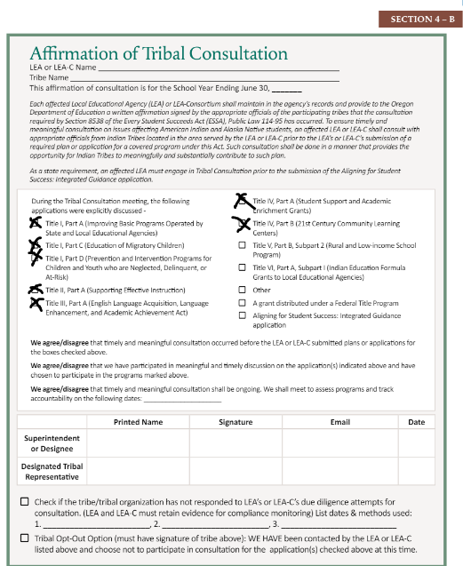
SEA-Administered Federal Title Programs Reminder - DUE OCTOBER 1, 2025
At the conclusion of the formal tribal consultation for Covered Programs (i.e. Federal Title Programs), the following forms must be submitted to Federal.Programs@ode.oregon.gov
  Signed Affirmation of Tribal Consultation for the applicable title programs ONLY
  Tribal Consultation Worksheet
  Alignment Rubric
  Other (i.e. Documents from tribe(s)
Tribal Consultation is due on or before October 1, 2025.
ODE reserves the right to withhold federal funds if Tribal Consultation is not conducted in accordance with federal requirements.
Notes:
Time:
Who:
Script: At the conclusion of formal tribal consultation for ALL covered programs, submit the following documents to the FST inbox:
Signed Affirmation of Tribal Consultation for the applicable title programs ONLY
Tribal Consultation Worksheet
Alignment Rubric
Other (i.e. Documents from tribe(s)
Due date is 10/1. (also when all pre-recs are due including equitable services).
This is a federal requirement. If your district does not engage in T-C, we reserve the right to withhold your funding.
In addition, all pre-recs, including T-C must be submitted in order to receive your planning funding (20%).
Information and forms available in the toolkit
Tech Notes

Slide 23
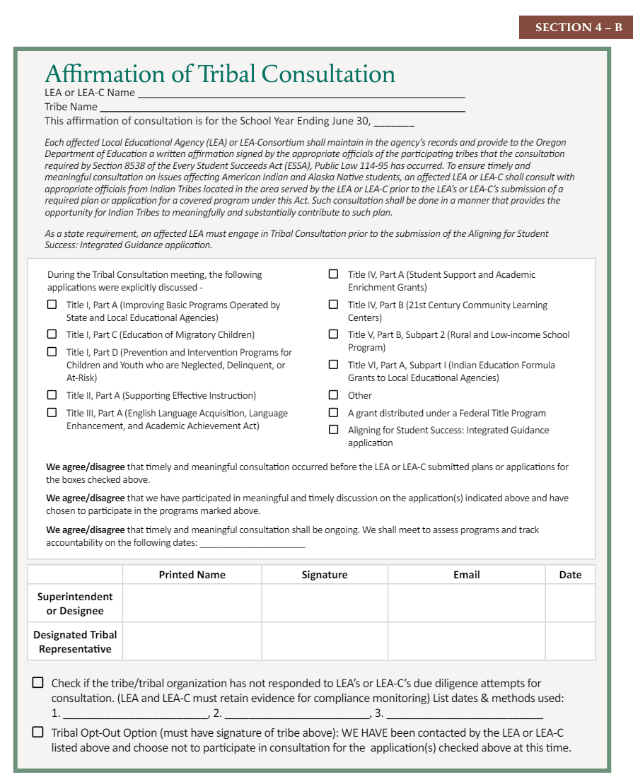
Affirmation of Consultation
Consortium Language
Federal and State requirement language
New Checkboxes for grants and Integrated Guidance
“We agree/disagree” statements
New Checkboxes for a lack of response from a tribe and to acknowledge a tribe opted-out

Slide 24
Need Additional Support?
Notes:
Who:
Script:
Tech Notes

Slide 25

Visit OIE’s Tribal Consultation Website
ODE OIE Tribal Consultation Website link
Find information on -
Current and upcoming Tribal Consultation windows
The Tribal Consultation toolkit
Updated PDFs required for Tribal Consultation -
  Affirmation of Tribal Consultation
  Tribal Consultation Worksheet
  Alignment Rubric (for Covered Programs)
Links to past trainings
List of all Title VI Awardees and all of their Covered Program funding amounts, Integrated Guidance application links, and their description of Meaningful Collaboration

Slide 26

Please reach out!
Jen Engberg
Jennifer.Engberg@ode.oregon.gov
Sarah Martin
Sarah.Martin@ode.oregon.gov
Lisa Plumb
Lisa.Plumb@ode.oregon.gov
Amy Tidwell
Amy.Tidwell@ode.oregon.gov
Janette Newton
Janette.Newton@ode.oregon.gov

