Slide 1
Welcome to Title II-A Tuesdays!
Planning for Professional Learning
October 2024
Please put your district name next to your username
In the chat: Candy corn – delicious or disgusting?

Slide 2

A thought for later…
Think of a professional learning experience offered in your district that received positive feedback.
Why you think it was well received?

Slide 3

Our Time Together Today
Planning for Professional Learning
  What is meant by “effective” professional learning?
  What does it look like?
  Breakout room discussion: Standards for Professional Learning
  Planning for Success
  Resources

Slide 4
Effective Professional Learning

Slide 5

ESSA defines Professional Learning as…
“… high quality, sustained, intensive, and classroom-focused in order to have a positive and lasting impact on classroom instruction and the teacher’s performance in the classroom and not 1-day or short-term workshops or conferences.” [ESEA Section 8101(42)]
NOTE: This definition does not just apply to Title II-A
Notes:
You’ll recognize this from our discussion last month as the definition of professional learning that is included in ESSA. It purposely calls out conferences and workshops as non-examples of effective professional learning.

Slide 6

What does effective Professional Learning look like?
Classroom focused
Incorporates active learning
Supports collaboration
Includes a clear vision of what best practices look like (modeling)
Provides coaching and expert support
Offers feedback and reflection
Is of sustained duration
Effective Teacher Professional Development
Notes:
The definition provided in ESSA aligns with what research says about effective PL. Darling-Hammond, Hyler, and Gardner (2017) conducted a comprehensive review of research to identify methodologically rigorous studies that have demonstrated a positive link between teacher PL, teaching practices, and student outcomes and identified seven common features of effective professional learning.
Job embedded content focused PL, meaning the PL is situated in teachers’ classrooms with their students, as opposed to generic PL delivered externally or divorced from teachers’ school/district contexts.
“Active learning” engages educators using authentic artifacts, interactive activities, and other strategies, preferably connected to teachers’ classrooms and students.
“Collaboration” can span a host of configurations. Collective work in trusting environments provides a basis for inquiry and reflection, allowing teachers to take risks, solve problems, and attend to dilemmas in their practice.
Modeling of instruction helps teachers to have a vision of practice on which to anchor their own learning and growth. The various kinds of modeling can include • video or written cases of teaching, • demonstration lessons, • unit or lesson plans, • observations of peers, and • curriculum materials including sample assessments and student work samples.
Teachers who receive coaching are more likely to enact desired teaching practices and apply them more appropriately than those receiving more traditional PL.
Feedback – PL models associated with gains in student learning frequently provide built-in time for teachers to think about, receive input on, and make changes to their practice.
PL that is sustained, offering multiple opportunities for teachers to engage in learning around a single set of concepts or practices, has a greater chance of transforming teaching practices and student learning than the traditional episodic and fragmented approach to PL.

Slide 7
When Effective Practices and ESSA Meet
Sustained
Principals engage in quarterly PL focused on math classroom walkthroughs as aligned to coaches’ observations
Intensive
Collaborative
Teams of teachers from across the district convene to discuss vertical progressions in the new math curriculum
Job-embedded
Data-driven
Monthly PLCs focused on teachers looking at student exit tickets and talking about misconceptions
Focused
Notes:
Here are some examples of what this can look like in schools and districts. Think back to the example you identified in the beginning. Which of these characteristics apply to the PL you thought of?

Slide 8

What are some examples from your district?
Notes:
What are some examples of PL happening in your district that reflect the criteria and qualities we have been discussing?
Teachers analyzing student work in PLCs/data teams
Content and classroom focused, collaborative
Instructional Coaching
Modeling, active learning
Systems of Induction and Mentoring
Job embedded, feedback in real time

Slide 9
A word about conferences…
Conferences and workshops are approvable when they are included as part of larger strategy, not as an end in themselves
  How is the conference part of a sustained, job-embedded plan for professional learning?
  What is the plan for delivering the content so that the learning extends beyond those who attended?
Notes:
This USED definition brings up the issue of conferences and workshops. Sending individuals to conferences is a common practice and can be a valuable one when it is part of a larger strategy. Many districts use a “train the trainer” approach sending a few individuals to bring back information.
Some questions to consider when thinking about conference attendance include:
What is the role of the conference in meeting the prioritized need? How is it part of a sustained, job-embedded plan for professional learning?
What is the plan for delivering the content so that the learning extends beyond those who attended?
If you include conference attendance as an activity and do not articulate how it will be part of a larger strategy (what will the follow up be?) your reviewer will ask you. ☺

Slide 10
District Example
“All workshops and conferences undergo a rigorous and systematic review process for approval. Each application is assessed for approval based on its alignment with a district-identified priority. Additionally, the application requires a narrative from the requestor outlining how the acquired knowledge will be disseminated among their colleagues upon completion. Principals play a crucial role in this approval process to ensure that the sharing of information is fully supported and integrated into the broader educational context.”
Notes:
This is an example of how a district explains how they ensure conference attendance meets the USED definition.

Slide 11
Planning for Professional Learning
Notes:
Now that we have a frame for what qualifies as effective professional learning, let’s talk about planning.

Slide 12

Let’s Take a Poll!
  Our district has a shared understanding/vision of what effective professional learning looks like
  Our district has a comprehensive plan for professional learning (map to guide educator learning)
  Our district has a comprehensive system for professional learning (infrastructure to support the learner and learning)
  1 – This is not in place
  2 – It’s been discussed, but is not yet in place
  3 – This is in place
  4 – This is in place and regularly updated
This Photo by Unknown Author is licensed under CC BY-SA
Notes:
Effective professional learning requires a shared vision, a plan, and a system to deliver that learning.
Our district has a shared understanding/vision of what effective professional learning looks like.
Why does this matter? PL is an investment of time and money. We want to make sure that our investment of both makes a difference.

Slide 13

Shared Vision: Standards for Professional Learning
  The standards are:
  A description of the attributes of effective professional learning
  A template for organizing professional learning
Organized around 3 categories:
  Rigorous Content for Each Learner
  Transformational Processes
  Conditions for Success
Notes:
The Standards for Professional Learning were developed by Learning Forward and an updated version was released in 2022. These standards reflect the features of effective professional learning we just discussed and can be used to help develop a shared understanding/vision of PL.
Standards within the Rigorous Content for Each Learner frame describe the essential content of adult learning that leads to improved student outcomes.
Standards within the Transformational Processes frame describe process elements of professional learning, explaining how educators learn in ways that sustain significant changes in their knowledge, skills, practices, and mindsets.
Standards within the Conditions for Success frame describe aspects of the professional learning context, structures, and cultures that undergird high-quality professional learning.

Slide 14
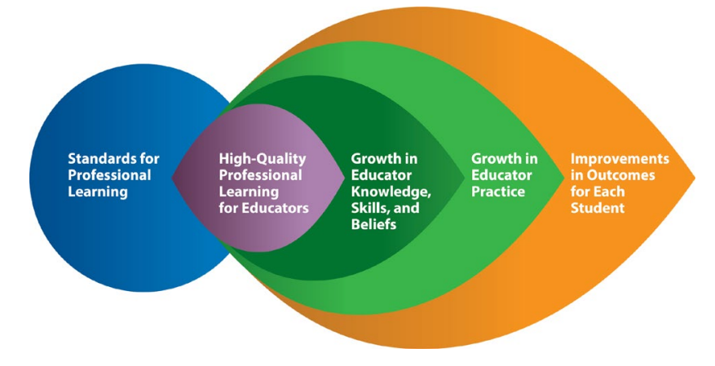
How Standards Lead to Improvement for All
Notes:
As the graphic above illustrates, Standards for Professional Learning lead to high-quality professional learning, which leads to positive changes in educator knowledge, skills, and dispositions, which lead to improvements in educator practice, which in turn lead to accelerated student results. Monitoring progress at each step contributes to continued improvement throughout the system, with student and educator data providing evidence about how professional learning evolves to lead to excellence and equity.
This is exactly what Title II-A is focused on –improving practice of educators to impact change in student outcomes.

Slide 15
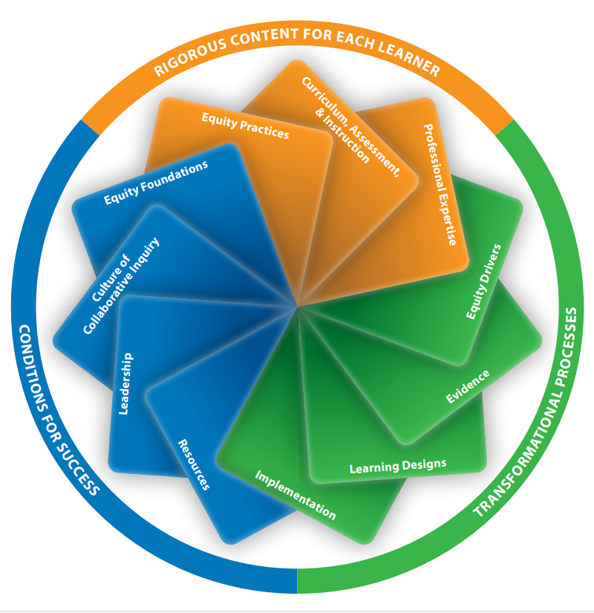
In breakout rooms
Is your district already using these standards to guide professional learning? If so, how?
Which of the “improved outcomes” listed on the right do you see happening in your district?
Scanning the challenges on the left, which have you observed in your district?
Notes:
The standards are a lot. We are not going to have an in-depth discussion of the standards, but I have dropped in the chat a document created by Learning Forward that offers the opportunity for discussion.
We’ll meet in breakout rooms for 10 minutes to look through the document and talk through these questions.
Create rooms by region

Slide 16

Share out

Slide 17
Planning for Success

Slide 18

Analyzing Data
Analyze data to make decisions about what professional learning is needed
Use multiple data sources
  Student data
  Perception data
  Systems data
Resource: Multiple Measures of Data
Notes:
You must know your needs in order to plan how to meet them. For professional development to improve student learning, professional learning needs must be based upon student learning needs (or factors that affect learning).
A good needs assessment should:
• Include input from a variety of data sources.
• Provide specific details about student learning needs.
• Help you prioritize needs allowing you to focus on a few most strategic areas.
In the Title IIA application districts are asked to include information on their needs assessment and tie all activities to prioritized needs. This does not have to be a special process for IIA—whatever process the districts uses for determining needs is fine, as long as student data is at the heart of that process.
Other important information to study includes student, parent, community satisfaction/ perception surveys, discipline referrals, absenteeism, special education referrals, graduation and dropout rates as well as post- graduation activities.
TELL survey, evaluation system data, PLC data

Slide 19

Identifying Goals and Evaluating Impact
Be clear about goals and how you will know they have been achieved
  Desired outcomes: What will educators know and be able to do as the result of professional learning?
  Measures of effectiveness: Was the professional learning successful?
Resource: Increasing the Effectiveness of PL
Notes:
Be clear about goals and how you will know they have been achieved. Goals should be based on needs identified during data analysis.
• Desired outcomes of professional learning should be stated in terms of what the educators will know and be able to do as a result of professional learning and should be very specific in order to close the gaps between the required teacher knowledge, skills, and beliefs and their current practice. Desired outcomes are evaluated at the end of the professional learning to determine to what extent the new knowledge and skills have been fully integrated into routine practice.
This a direct connection with Title IIA. In the application districts are asked to describe what knowledge and skills participants will receive as a result of participating in the activity.
• Measures of effectiveness are used to help determine if the professional development was successful. Measures of effectiveness should include benchmarks to be checked regularly (formative evaluation) to determine if the professional learning is succeeding or needs any changes. An evaluation plan should include a description of how and when progress monitoring will occur and who will be involved.
A common teacher complaint about professional development is that it is a “one-size-fits-all activity.” Therefore, it is important to differentiate which teachers need which professional development to avoid frustration. Data gathered as part of the district evaluation and support system can be valuable information that can help ensure all teachers receive professional learning that meets their needs.

Slide 20

Purposeful Planning
Less is more
  Focus on a few areas
Attend to learning design
  Who is participating?
  What do they already know?
  What is the goal?
Determine roles and responsibilities
Establish implementation expectations
  Need support of leadership
Notes:
Focus on a few areas of professional learning to ensure deep implementation to achieve results. Superficial implementation of professional learning will not improve student results.
When designing and presenting lessons teachers take into consideration the learning styles of their students, as well as the nature of the content they are delivering. Planners of professional learning for educators should keep in mind these same considerations. A number of factors should be considered when determining learning design including the goals of the learning, characteristics of the learners, and their familiarity with the content.
Identifying who is responsible for what in the professional learning plan, and ensuring everyone knows their role, is a key factor in whether the professional learning and follow up take place.
Expectations for implementation need to be made clear at the outset of a professional learning experience. The support of leadership is essential to encourage teachers to implement new practices and to provide teachers time to observe each other’s classes and meet to discuss their practice.

Slide 21

Future Topics
November 26 – Evaluating Professional Learning
December 24 – Winter Break, no session
January 28 – TBD

Slide 22

Resources
Effective Teacher Professional Development
Learning Forward Standards for Professional Learning
Title II-A Non-Regulatory Guidance
Title II-A Professional Learning webpage
Effective Practices - Research Briefs and Evidence Ratings

Slide 23

Please reach out!
Jen Engberg
Jennifer.Engberg@ode.oregon.gov
Sarah Martin
Sarah.Martin@ode.oregon.gov
Lisa Plumb
Lisa.Plumb@ode.oregon.gov
Amy Tidwell
Amy.Tidwell@ode.oregon.gov
Notes:
Jen Engberg
Clackamas, Columbia Gorge, Multnomah and Northwest Regional
Sarah Martin
Douglas, Lake, Malheur, South Coast and Southern Oregon
Lisa Plumb
Lane, Linn Benton Lincoln and Willamette
Amy Tidwell
Grant, Harney, High Desert, InterMountain, Jefferson, North Central and Region 18

