Slide 1
Paraprofessionals and Title I-A
April 2, 2024

Slide 2

Agenda for Today’s Session
Defining “Paraprofessional”
Requirements and Qualifications under Title I-A
Methods for Meeting Qualifications
Resources

Slide 3

Defining Paraprofessional
OAR 581-037-0006
  All Educational Assistants
  Educational Assistants providing translation services
  Title I-A Educational Assistants
Requirements under Every Student Succeeds Act (ESEA)
  An individual with instructional duties*
  Assists in the classroom
  Must work within close and frequent proximity to a licensed teacher
*Paraprofessionals who serve solely in non-instructional roles, including those who serve only as translators or who only conduct family engagement activities, are not included in ESEA’s definition
Notes:
Translators - demonstrated proficiency and fluency, knowledge of and the ability to provide accurate translations from a language other than English into English and from English into a language other than English.
ESSA defines a paraprofessional as an individual with instructional duties who does not hold the position of teacher, but assists in the classroom under the guidance of an appropriately licensed teacher. This includes those who:
provide instructional support services under the direct supervision of a certified teacher,
assist with classroom management, such as by organizing instructional materials,
provide instructional assistance in a computer laboratory, or
provide instructional support in a library or media center.
Individuals who work solely in non-instructional roles, such as food service, cafeteria or playground supervision, personal care services, and non-instructional computer assistance are not considered to be instructional paraprofessionals under ESSA and are not required to meet the Title I-A requirement. In Oregon, the terms “paraprofessional”, “educational assistant” and “instructional assistant” have the same meaning.
It is important to note that paraprofessionals must work under the supervision of and within close and frequent proximity to a licensed teacher.

Slide 4

What are the requirements?
18 years old and hold a high school diploma or its equivalent,
and
Two years of study at an institution of higher education;
or
An Associate’s degree (or higher) ;
or
Meet a rigorous standard of quality, demonstrated through a formal state or local academic assessment
OAR 581-037-0006
Notes:
Districts must follow Oregon Administrative Rules, which describe the requirements for all paraprofessionals in Oregon, including those employed in Title I-A programs. OAR 581-037-0006
Two years of study at an institution of higher education; or
An Associate’s (or higher) degree; or
Meeting a rigorous standard of quality and demonstrate through a formal state, or local academic assessment or para-educator certificate program, knowledge of and the ability to assist in instructing:
Reading, writing, and mathematics; or
Reading readiness, writing readiness, and mathematics readiness, as appropriate.
Two years of higher ed - - “Two years of study” at an institution is defined by the institution of higher education rather than the State educational agency. The credits do not have to be specific to education, and a particular course of study is not required.
Associates degree - An Associate’s Degree is a degree granted after a two-year course of study, generally by a community college. The law specifically states that a higher-level degree (i.e.; Bachelor’s Degree) also meets the requirements.

Slide 5
State or Local Assessment
Districts have flexibility in determining the content and format of a local assessment
Does not have to be a paper and pencil test
Content of the assessment should reflect
  academic standards and skills expected of the students being served, and
  ability of the individual to effectively provide instructional support to assist students in mastering the content
Notes:
Passing a State or Local Assessment – Districts have flexibility in determining the content and format of a local assessment of paraprofessionals. The law does not require a paper and pencil test, so while an appropriate assessment might be entirely a written test, it could be a combination of a written test on content (reading, writing, and math) and a demonstration of competence in instruction (assessed through observations via a series of rubrics).
The content of the assessment should reflect both the academic standards and skills expected of a student at a given school level (preschool, elementary, middle, or high school), and the ability of the individual to effectively provide instructional support to assist students in mastering the content. The assessment must be valid and reliable, and a record should be kept of an individual’s performance on that assessment.

Slide 6
Who has to meet these requirements?
Paraprofessionals employed (even if only for a portion of the day) in Title I-A programs
  All paraprofessionals providing instructional support in a School Wide Program (SWP), whether or not the position is funded with Federal, State, or Local funds
  All paraprofessionals providing instructional support in a Targeted Assistance School (TAS) program who are paid with Title I-A funds
Requirements must be met at the time staff are hired

Slide 7

Resources
Title I-A Paraprofessional Non-Regulatory Guidance
Title I-A Equitable Services Non-Regulatory Guidance
Oregon Administrative Rules for Educational Assistants
TransAct
ESSA Quick Reference Brief: Paraprofessional Requirements under Title I-A

Slide 8
Key Takeaways
Paraprofessionals play a critical role in supporting students and educators
Only paraprofessionals in Title I-A buildings with instructional duties must meet the requirements under ESEA
Districts have flexibility in determining the content and format of a local assessment

Slide 9
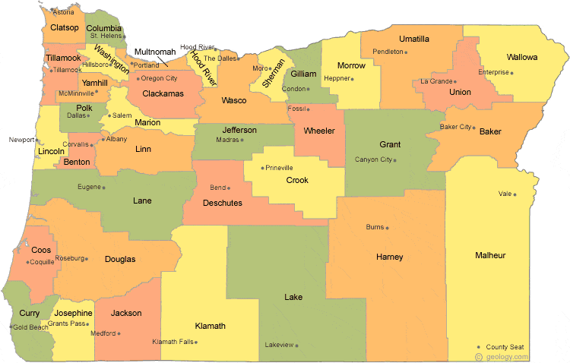
Regional Contacts by ESD
Amy Tidwell
Grant, Harney, High Desert, InterMountain, Jefferson, North Central, and Region 18
Jen Engberg
Clackamas, Columbia Gorge, Multnomah, and Northwest Regional
Lisa Plumb
Lane, Linn Benton Lincoln, and Willamette
Sarah Martin
Douglas, Lake, Malheur, South Coast, and Southern Oregon
Notes:
We have divided up the state into four sections. Each of us serves as the primary contact for the districts in these ESDs

Slide 10

Please reach out!
Amy Tidwell
amy.tidwell@ode.oregon.gov
Jen Engberg
jennifer.engberg@ode.oregon.gov
Lisa Plumb
lisa.plumb@ode.oregon.gov
Sarah Martin
sarah.martin@ode.oregon.gov

