Slide 1
Supplement not Supplant
Titles I-A, II-A & Title IV-A

Slide 2

Outcomes
Defining Supplement not Supplant (SNS)
Title II-A and Title IV-A
Title I-A
Resources

Slide 3

Defining SNS
Supplement – to add to; to enhance; to expand; to increase; to extend; to create something new
Supplant – to take the place of; to replace by something else
Notes:
Most Every Student Succeeds Act (ESSA) programs require districts to supplement, and not supplant, the state and local funds they would otherwise spend on education. Generally, this means, ESSA funds should add to (supplement) and not replace (supplant) state and local funds. A few programs also require districts to use federal program funds to add to and not replace other federal funds. The tests for compliance with supplement not supplant requirements vary depending on the federal program being implemented.

Slide 4
What does it mean?
Federal grant funds may be used only to supplement the educational programs generally offered with state and local funds and to provide supplemental services that would not have been provided had the federal grant funds not been available.
So how do you determine whether something is supplemental?
It depends on the program.
ESSA Quick Reference Brief: Supplement Not Supplant
Notes:
An LEA must be able to operate its schools and its core foundation programs without any federal funds.
Our team has created a brief on this topic that outlines SNS rules by program. In this presentation we will be addressing Titles IA, IIA and IVA only. Keep in mind that Perkins and IDEA also have their own SNS rules.

Slide 5
Title II-A and Title IV-A
  Test I: Are the services that the district wants to fund with ESEA funds required under state, local, or another federal law?
    If they are, there could be a presumption of supplanting.
  Test II: Were state or local funds used in the last year to pay for these services?
    If they were, there could be a presumption of supplanting.
Notes:
Titles IIA and IVA follow the same SNS rules.
To determine whether a fiscal expenditure supplements and does not supplant, school districts must run the following tests:
Test I: Are the services that the district wants to fund with ESEA funds required under state, local, or another federal law? If they are, there could be a presumption of supplanting.
Test II: Were state or local funds used in the past to pay for these services? If they were, there could be a presumption of supplanting.

Slide 6
Overcoming the Presumption of Supplanting
If it is clear that no State or local funds remain available to fund certain activities that previously were funded with State or local resources, then the district may be able to use ESEA funds for those activities.
Maintain documentation including but not limited to:
    fiscal or programmatic documentation to confirm that, in the absence of the federal funds, the LEA would have eliminated services in question.
    state or local legislative action.
    budget histories.
Notes:
It is possible for districts to overcome the presumption of supplanting. Overcoming the presumption of supplanting requires that districts keep documentation (e.g., budget information, planning documents, or other materials). In general, a district must determine what educational activities it would support if no ESEA funds were available. If it is clear that no State or local funds remain available to fund certain activities that previously were funded with State or local resources, then the district may be able to use ESEA funds for those activities.

Slide 7
Title I, Part A

Slide 8
SNS under Title I-A
There are three fiscal tests for Title I-A through
which districts demonstrate that the use of
Title I-A funds is supplemental to state and local funds
Methodology (SNS)
Comparability
Maintenance of Effort
Title I-A Fiscal Requirements
Supplement not Supplant
Comparability
Maintenance of Effort
Notes:
There are three fiscal tests for Title I-A:
Maintenance of Effort (MOE) – LEAs must maintain a consistent floor of state and local funding for free public education from year-to-year.
Supplement, not Supplant – LEAs must distribute state and local funds to schools without taking into account a school’s participation in the Title I program. (Methodology)
Comparability – state and local funds are used to provide services that, taken as a whole, are comparable between Title I and non-Title schools.

Slide 9

Methodology Basics
What: Description of the method used to allocate state and local funds to ALL schools regardless of I-A status
Why: To ensure each Title I-A school is provided with all of the money it would receive if it did not participate in the Title I program
When: Annually, in CIP Budget Narrative (Overview)
Oregon Department of Education
Notes:
Before ESSA, Title I-A’s ‘supplement, not supplant’ requirement was tested through three presumptions that looked at each activity supported with Title I-A funds to determine if it was something an LEA or school would have paid for with state and/or local funds if Title I-A funds were not available. This is similar to the method still used by Title IIA and IVA.
The reauthorization of ESEA under the Every Student Succeeds Act (ESSA) changed the way supplement, not supplant (SNS) compliance is tested for districts and schools that receive Title I-A funds. ESSA’s revised SNS test does not look at how districts and schools spend Title I-A funds as a specific cost test, but instead looks at how districts distribute State and local funds to Title I-A schools. This is also know as the district’s “methodology”.
A district’s methodology must be “Title I neutral” in that it allocates State and local funds to schools without regard for Title I-A status.

Slide 10

Comparability Basics
What: A comparison of the use of funds in Title I-A funded and non-Title I-A funded schools
Why: To determine whether the distribution of state and local funds and resources to schools are comparable regardless of Title I-A status
When:
  June 30: CIP Budget Narrative Assurances
  December 1: Comparability Report
Oregon Department of Education
Notes:
Comparability is a school-level calculation that measures the level of State and local funds and resources provided to a district's Title I-A and non-Title I-A schools. The goal is to determine whether the distribution of State and local funds and resources to schools are comparable regardless of Title I-A status.
Districts must annually demonstrate that they have met comparability requirements through two actions:
Submission of the CIP Budget Narrative Assurances for ESEA programs. Assurances form a binding agreement between the local district, the Oregon Department of Education (ODE), and the U.S. Department of Education (ED) that assures all legal requirements are met in accordance with state and federal laws, regulations, and rules. District superintendents must annually sign and submit these assurances by June 30 for the upcoming year. In the assurances the district attests that it has implemented:
an LEA wide salary schedule;
a policy to ensure equivalence among schools in teachers, administrators, and other staff; and
a policy to ensure equivalence among schools in the provision of curriculum materials and instructional supplies.
Submission of the Comparability Report. The Comparability Report demonstrates that the district’s policies described in the assurance result in comparable distribution of funds between Title I-A funded and non-Title I-A funded schools. ODE provides an Excel document that automates many of the comparability calculations. Districts complete and return the template to ODE no later than December 1 each year, along with the signature of the district superintendent.

Slide 11
Maintenance of Effort (MOE) Basics
What: Demonstration that spending of state and local funds remains at 90% or above what was spent in the preceding year
Why: To ensure a consistent base of state and local funding from year to year regardless of Title I-A funding
When: Annually, based on district submission of
fiscal data (ODE does the calculation)
Oregon Department of Education
Notes:
Maintenance of Effort focuses on spending at the LEA level and requires districts to have a consistent base of state and local funding for public education from year to year. Each year, LEAs receiving funds under ESEA must ensure that district or per-pupil spending of state and local funds remains at 90 percent or above what was spent in the preceding year. ESSA states that funding will be reduced if an LEA fails to meet the 90 percent threshold twice in a five year span. This reduction is made by ODE in the LEA’s Title I-A allocation.
Districts must annually demonstrate that they have met maintenance of effort. Compliance with MOE is based upon data submitted by districts through the Actual Expenditures, Actual Revenue and Average Daily Membership data collections.

Slide 12
Key Takeaways
Federal funds are intended to provide supplemental services that would not have been provided had the federal grant funds not been available
SNS rules vary by title program
Keep good fiscal records from year to year

Slide 13

Resources
Supplement not Supplant and Methodology Guidance (Title I-A)
ESSA Quick Reference Briefs
  Supplement not Supplant
  Comparability under Title I-A
  Methodology under Title I-A
  Maintenance of Effort

Slide 14

Please reach out!
Jen Engberg
Jennifer.Engberg@ode.oregon.gov
Sarah Martin
Sarah.Martin@ode.oregon.gov
Lisa Plumb
Lisa.Plumb@ode.oregon.gov
Amy Tidwell
Amy.Tidwell@ode.oregon.gov
Kyle Walker
Kyle.Walker@ode.oregon.gov

Slide 15
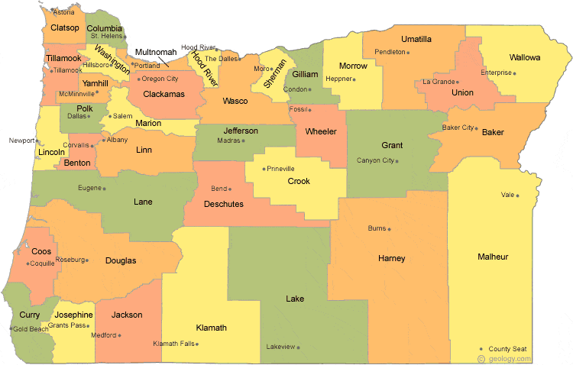
Regional Contacts by ESD
Lisa Plumb
Lane
Linn Benton Lincoln and
Willamette
Amy Tidwell
Grant
Harney
High Desert
InterMountain
Jefferson
North Central and
Region 18
Jen Engberg
Clackamas
Columbia Gorge
Multnomah and
Northwest Regional
Sarah Martin
Douglas
Lake
Malheur
South Coast and
Southern Oregon

