Slide 1
Welcome Families! Annual Title I-A Meeting
Enter your school name here
DATE

Slide 2
Customizing this template
Schools/districts should customize this template to meet their needs. Feel free to rearrange and add slides
Regardless of customization, all annual meeting presentations should include, at minimum, the topics outlined on the slides of this template
Any text in red represents places where information specific to your school should be entered

Slide 3
Purpose of Today’s Meeting/Agenda
Provide information about our school’s Title I-A program
Explanation of Title I-A
Rights of Parents and Guardians
Sharing Our School’s Program
Annual Review and Evaluation
Parent and Family Engagement

Slide 4
Title I-A Program
What is “Title I-A”?
A component of ESEA, our nation’s largest education assistance program for schools
Provides additional support to students with the greatest need
Can support behavioral and social emotional needs as well as academic needs
All ESEA programs, including Title I-A, are about ensuring the right supports get to the right students
Notes:
ESEA = Elementary and Secondary Education Act
Funding can support
Academic, behavioral and social emotional supports
Professional development
Supplementary materials and supplies
Family engagement activities

Slide 5
Each Title I-A school must…
Complete an annual needs assessment
Create and annually update a school-level plan and compact
Develop and implement a Family Engagement Plan
Engage families as partners in their child’s learning
Maintain documentation of staff qualifications
Notes:
Each school must have it’s own version of a comprehensive needs assessment that is specific to the school needs.
District is responsible for monitoring school plans
The district should collect school plans and have conversations with schools to ensure connection and coordination between school plans and the overall district plan and priorities

Slide 6
Parent/Guardian Rights Under ESSA
Right to request educator qualifications
Request opportunities to meet with staff
Participate in decisions affecting your child
Review school’s Title I program and make suggestions
Participate in school activities

Slide 7
Title I-A Program Components
Curriculum
Monitoring Student Progress
Family Involvement
Program Design

Slide 8
Our School’s Program
Our school’s model
Indicate whether your school program Schoolwide (all students) or Targeted (students identified for the program based on multiple criteria)
If Targeted, include description of the school’s targeting criteria
What does our program look like?
In this section articulate what and how services are delivered. What is it like to be a student and a teacher in your program?
Notes:
Customize this slide to describe your school’s program. Is it targeted or schoolwide? What does it look like from a student perspective

Slide 9
Our Goals
Include your school’s specific, measurable goals for improving student outcomes
In our school, families are involved in the process of establishing the goals by (describe your process here)
Notes:
What are the goals of your school plan?

Slide 10
Our School’s Curriculum
Include information about the core and intervention materials used in your school

Slide 11
How We Monitor Student Progress
Assessments our school uses
Enter your description here
Progress monitoring process
Enter your description here
Communication of your child’s progress
Enter your description here

Slide 12
Our Data/How are we doing?
Customize this slide to include data about progress toward goals, student outcomes, etc.

Slide 13
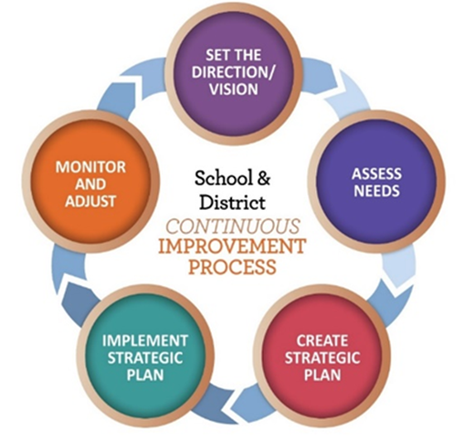
Annual Review & Evaluation
Describe how and when the school plan and compact are reviewed and how families are engaged in the process

Slide 14
Family Engagement
Annual Meeting
Building Family Capacity
Compact
Family Engagement Plan
Notes:
There are four requirements under family engagement that each Title I-A school must complete annually. These requirements are the annual meeting, engagement plan, compact, and providing opportunities to build family capacity.

Slide 15
Families as Partners
Family Engagement Plan
Describe how your school engages families in shared decision making
Compact
When will parents get it, how do they provide input
Building Family Capacity
List opportunities available for the current school year for families to engage in their child’s learning
Notes:
The Every Student Succeeds Act (ESSA) requires that districts and schools that receive Title I-A funds communicate, collaborate and work as partners with parents and families with the goal of improving student achievement and promoting academic success. These provisions reflect good practice in engaging parents/guardians and families in helping to educate their children, because students do better when parents are actively involved in the education process, both at home and at school.
Families must be engaged in the development and annual review of the school-level Family Engagement and Title I-A plans, as well as have opportunities to share suggestions and feedback. The district must establish policies that ensure all interested families are prepared to participate in planning, decision-making and oversight groups such as boards, councils, committees or working groups.
Each school that receives Title I-A funds must develop, with their families, a compact that outlines how families, students and school staff will build and develop a partnership to ensure student success. This includes describing the school's efforts to provide high-quality curriculum and instruction as well as the activities and actions that families can take to support their child's learning.
Each school must provide opportunities for families to be engaged in their child’s learning. This includes sharing information with families on how their child is performing, including their child’s strengths, as well as strategies for how families can promote student progress.

Slide 16
We’re In This Together!
Include contact information for Title I-A Coordinator
Link to website where families can find information about Title I-A, including this PPT and school plan

