Slide 1
Title I, Part A: School-Level Planning
Schoolwide Plans

Slide 2

Today’s Agenda
Targeted Assistance vs. Schoolwide Programs
Digging Deeper into Schoolwide Plans
  Assessing Needs
  Identifying Goals, Activities and Measures
  Evaluating and Adjusting
  Engaging Families

Slide 3

Purpose of
Title I-A
The purpose of Title I, Part A is a to “provide all children significant opportunity to receive a fair, equitable, and high-quality education, and to close educational achievement gaps.”
  Academic Intervention & Enrichment (all subjects)
  Social Emotional Learning and Support
  Professional Development
  Instructional Staff and Supports
  Behavioral Supports
Oregon Department of Education
Notes:
As outlined in the Every Student Succeeds Act (ESSA) Title I-A funded schools may implement one of two approaches: 1) a School-wide Program or 2) a Targeted Assistance Program.

Slide 4
Targeted Assistance vs. Schoolwide Programs
Category | Targeted Assistance | Schoolwide
School Eligibility | Any school with a poverty level of 35% or the district’s poverty average (whichever is lower). | Any school with a poverty level of at least 40%.* *A school with less than 40% poverty may request to conduct a schoolwide program.
Student Participation | Resources are directed to student meeting the establish targeting criteria. | All student in the school have access to activities under a schoolwide plan.
Professional Development | Professional development with Title I funds focuses on staff that provide direct support to Title I students. | Title I funds can be used to provide professional development for all staff.
Planning & Evaluation | Plan includes a general description of targeted assistance program activities to support students identified as eligible for services. | The schoolwide plan must be developed for reforming the total instructional program in the school.
Notes:
Schoolwide programs funded under Title I, Part A offer the opportunity to invest in strategies that help all students, because all students in a schoolwide program can be served . While many schools target services to the most in-need students, a schoolwide program allows for the implementation of tiered supports addressing student needs at every level.
School Wide Programs focus on being INCLUSIVE

Slide 5
Common Ground: TAS and SWP
Both Targeted Assistance (TAS) and Schoolwide (SWP) plans must:
  be based on identified needs,
  include specific goals and strategies, and
  be developed and reviewed annually with the input of families.
Schoolwide Program Brief
Targeted Assistance Program Brief
Notes:
Per ESSA Sections 1114 and 1115
TAS plans are needs inform targeting criteria, SWP needs are based on a comprehensive needs assessment

Slide 6
Schoolwide Programs
Schoolwide plans allow for a broad array of initiatives throughout the school
  Push-in
  Flexible grouping
  Activities that build skills and assess progress
More than reading and math interventions
  Social-Emotional Supports
  Multi Tiered Systems of Support
  Enrichment
All students and teachers can benefit
Notes:
Schoolwide programs funded under Title I, Part A offer the opportunity to invest in strategies that help all students, because all students in a schoolwide program can be served . While many schools target services to the most in-need students, a schoolwide program allows for the implementation of tiered supports addressing student needs at every level.
Hopefully you are all aware by now that with the reauthorization under ESSA, schools are not restricted to specific content areas or delivery models wuch as the “Title I-A Room” model
Whatever needs assessment reveals the school needs is what you focus on. And in a schoolwide model, everyone in the school can benefit.

Slide 7
Schoolwide Plan Criteria

Slide 8
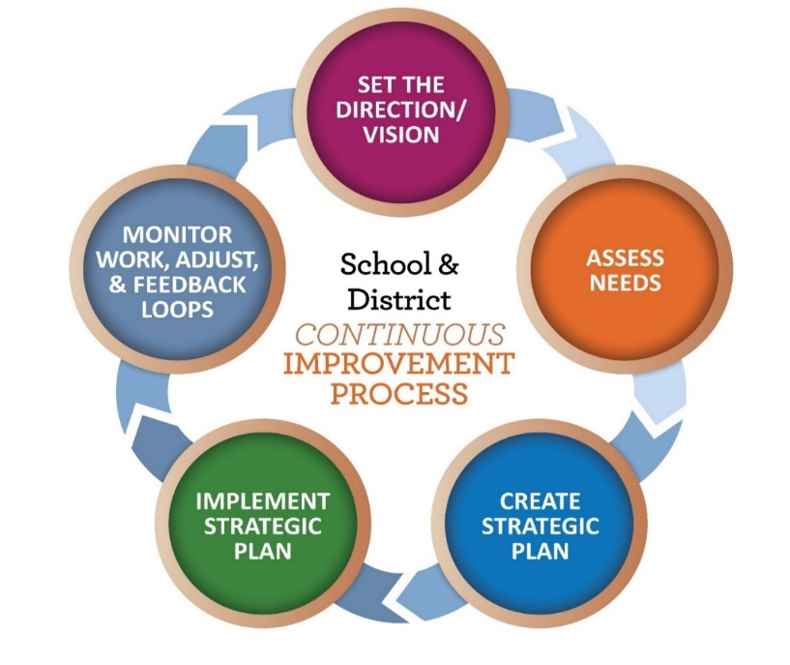
Criteria & Continuous Improvement
Criteria are organized under four categories
  Comprehensive Needs Assessment
  Goals, Activities and Measures
  Family Engagement
  Evaluation and Review
  Criteria for Title I-A Schoolwide Plans
Notes:
Title IA plans are an area that our team gets a lot of questions about. We have spent the last year reviewing both the law and best practice to identify the criteria that should be included in the plan.
The continuous improvement process lends itself well to school-level planning, and districts have a great deal of autonomy in determining the format of their schoolwide plans. ODE has created an optional template that schools can use, or they can design their own. Regardless of the format used, the following components must be included in all schoolwide plans: Needs Assessment Summary, Goals, Activities & Measures, Family Engagement, and Evaluation & Review.

Slide 9
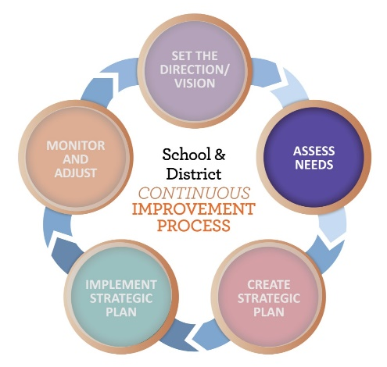
Assess School Needs
Who are our students?
What data did we look at?
What is the story our data is telling?
Who was at the table?
  Community Engagement Toolkit
Notes:
Completing a needs assessment helps schools identify the goals and strategies that they will take to address the underlying inequities and challenges facing their students. A comprehensive needs assessment should include review of multiple sources of data from at least three categories - Student Data, Perception Data, and Systems Data - and should be informed by robust community engagement.
Who are our students - Describe the students you serve. How have your student demographics changed over time? What trends are you seeing? How is your school serving students who have been historically underserved by the system?
What data did we look at - Articulate the multiple measures of data reviewed during the needs assessments. This can include student outcome data (academic, behavioral, programmatic), systems data (e.g. ORIS inidcators) and perception data. Did this provide a comprehensive view of the school and community as well as the opportunities and challenges that should be addressed in a school wide plan?
What is the story our data is telling? Describe the results of the comprehensive needs assessment. What are the strengths and needs of the students the school serves? How has this changed over time? What are the barriers, and root causes, that students in the building face? What opportunities and strengths exist that can be utilized to support the school's academic, social, and other goals?
Who was at the table - Following the results of the needs assessment, describe who was engaged in the development of the schoolwide plan. Which community members (e.g.; students, staff, families, tribal leaders, and tribal organizations) were included?

Slide 10
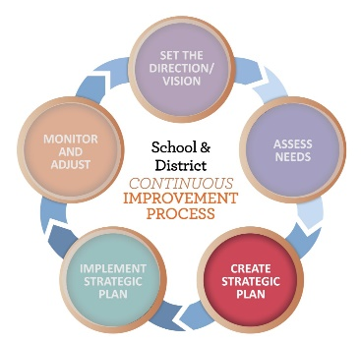
Identify Goals, Activities and Measures
Goals/Outcomes - What change are we hoping for?
Activities/Strategies – What are we going to do?
Measures – How will we know if what we are doing is working?
Professional Learning – How will we support staff?
Notes:
Goals/Outcomes are the changes in health, behavior, actions, attitudes, or policies that affect students, educators, and families.
Activities are the actions the school will take to address the goals identified in the plan.
Measures describe how the effectiveness of activities will be measured.

Slide 11
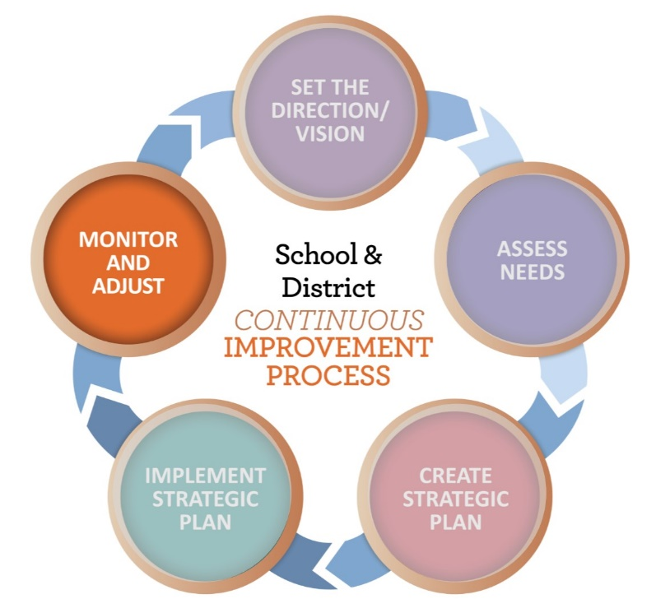
Evaluate and Adjust
Process to annually evaluate
  What did we say we were going to do?
  How are we doing? How do we know?
  What are we going to do next?
Include voice of students, families and staff
Revise as necessary
  Usually spring or summer
Notes:
Evaluation is the final step and it sometimes gets overlooked. We often have a clear plan for implementation, but not necessarily for evaluation. ESSA does require that plans are annually reviewed. This means looking at student outcomes to determine whether adjustments need to be made to goals or strategies.
Again, remembering to include families in this process is critical. WHEN the review happens is not as important as THAT it happens.

Slide 12

Family Engagement
How are families involved in developing the plan and providing feedback?
What steps do we take to remove barriers to participation by ALL families?
How do we communicate about opportunities for family involvement in school activities?
What are the strategies we use to help families support their student's learning?
Notes:
Family Engagement is a powerful strategy that has significant impacts on students and teachers and is a key practice in helping schools build trusting relationships with families as co-creators in their children’s learning. Family Engagement is any way that a child’s adult caretaker (biological parents, foster parents, siblings, grandparents, etc.) at home, at school and in the community, effectively support learning and healthy development. It is a full, equal, and equitable partnership among families, educators, and community partners to promote children’s learning and development from birth through college and career. Intentionality in methods of engagement supports families’ involvement in the school and ensures they are welcomed.
Title I, Part A provides for substantive parental involvement at every level of the program. In order to receive funds, a district must conduct outreach with parents and families, develop policies and procedures for the involvement of parents and family members and plan and implement programs and activities with meaningful consultation with parents of participating children. Each Title I-A funded school within the district must collaborate with parents and families to develop and implement:
a plan to engage parents and families;
structures for parents and families to provide input and feedback on school plan and processes; and
compacts of shared responsibility for student achievement between students, families and teachers.

Slide 13

Resources
Schoolwide Plan Criteria
Schoolwide Planning Template
ESSA Quick Reference Brief: Developing Schoolwide Plans
ORIS Needs Assessment Tool for Schools
Community Engagement Toolkit
Tribal Consultation Toolkit

Slide 14

Please reach out!
Jen Engberg
Jennifer.Engberg@ode.oregon.gov
Sarah Martin
Sarah.Martin@ode.oregon.gov
Lisa Plumb
Lisa.Plumb@ode.oregon.gov
Amy Tidwell
Amy.Tidwell@ode.oregon.gov
Notes:
Our team has moved from a programmatic model to a regional support model. Each of us has taken a section of the state to support across Titles IA, IIA, IVA and VB.

Slide 15
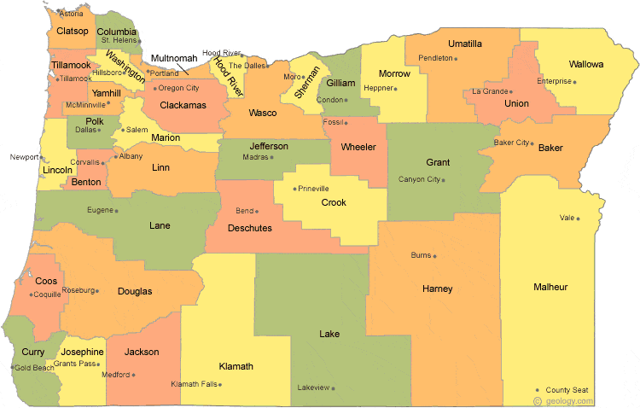
Regional Contacts by ESD
Amy Tidwell
  Grant, Harney, High Desert, InterMountain, Jefferson, North Central and Region 18
Jen Engberg
  Clackamas, Columbia Gorge, Multnomah and Northwest Regional
Lisa Plumb
  Lane, Linn Benton Lincoln and Willamette
Sarah Martin
  Douglas, Lake, Malheur, South Coast and Southern Oregon
Notes:
We have divided up the state into four sections. Each of us serves as the primary contact for the districts in these ESDs

