Slide 1
Welcome to Title II-A Tuesdays!
CIP Budget Narrative Workshop
September 2024
Please put your district name next to your username

Slide 2

Our Time Together Today
Title II-A CIP Budget Narrative Overview
Resources
Work Time
Notes:
WHY? Chance to dive deeper into topics specific to Title II-A
WHEN? 4th Tuesday of each month from 10-11

Slide 3
Accessing the CIP Budget Narrative
Login to the District Secure website
Choose CIP Budget Narrative from the “Applications” list
If you do not have access to the CIP Budget Narratives, reach out to your district Security Administrator
Notes:
We talked in the last session about how the CIP Budget Narrative is the application for Title II-A funds. You will need to have permissions to access the application. These permissions are granted by the district security administrator, not ODE.

Slide 4
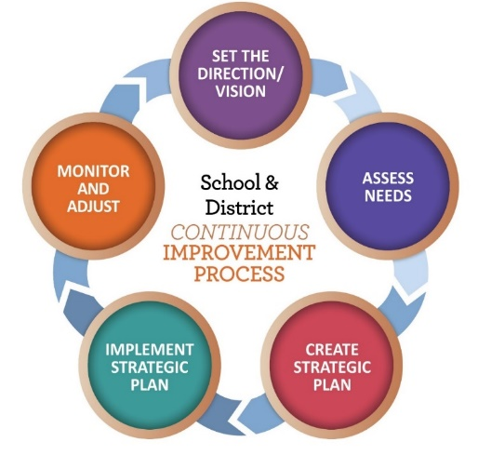
Title II-A CIP Budget Narrative Components
Needs Assessment
What does the data tell us?
Budget Narrative
What will we do to meet our needs?
Equitable Services Worksheet
Only for districts with participating schools
Notes:
Ideally, the district’s application for Title IIA reflects the larger district plan for improvement. Focusing the Title IIA narrative around district priorities established as part of the overall continuous improvement process will help ensure that the district is using its Title IIA funds “more strategically and for greater impact” as the non-regulatory guidance recommends.
Once you get into the CIP Budget Narrative there are 5 tabs on the Title IIA application. The two main parts are the needs assessment and the budget narrative. If a district has participating private schools then an Equitable Services tab will also appear. The Overview and Spending pages are auto-populated and do not require work from the district.
4

Slide 5
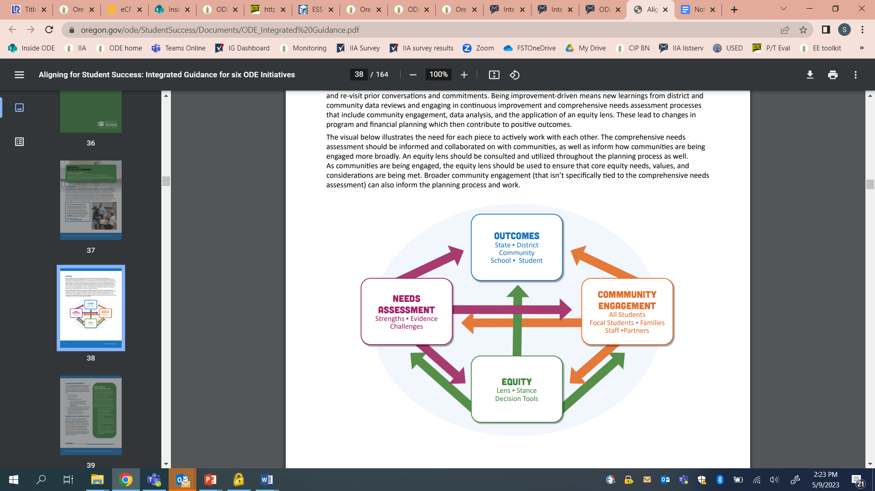
Consultation & Engagement
Districts must meaningfully consult with a wide array of partners when determining the use of Title II-A funds
Administrators
Teachers
Paraprofessionals
Instructional support personnel
Families
Community members and partners
Tribes and tribal organizations
Consultation as part of IG work can count as long as Title II-A is part of the discussion
Notes:
ESEA requires that districts consult with a wide variety of groups as part of the decision making process for how II-A funds will be spent. However, engagement does not have to be a process that is specific to Title II-A. Whatever comprehensive needs assessment and engagement process the district uses can meet the needs assessment and consultation requirement for Title II-A with 2 caveats:
It must include the individuals listed on this slide and
Engagement must include discussion of how the district is proposing to use Title II-A funds.
The work done in engaging staff, students, families and communities as part of IG can be used for this purpose.
An important caveat is around ensuring that activities meet the intent of the program and that they do not represent a supplanting situation.

Slide 6
Step 1: Needs Assessment Summary
Data Sources
List data sources analyzed to determine need
Data Analysis
Summarize trends or gaps in performance
Prioritized Needs
Identify support educators need
Plan Development
Describe process for developing plan
Notes:
In the Needs Assessment section of the Title IIA application, districts respond to four prompts to summarize their comprehensive needs assessment process. The district is asked to list the data that was analyzed, what was learned from that data, what priorities were identified as a result and who was involved. Ideally the data used will include a variety of student data as well as systems and perception data. This does not mean districts needs to conduct a special needs assessment process for IIA. It is simply a summary of the larger process the district uses to determine needs.
DATA SOURCES – This is a list of what data you looked at, both statewide and local data. Remember, achievement data is only one source. Any data that tells you about the students can be used (behavior, attendance, surveys, etc.)
ANALYSIS - In this section you are creating a clear connection between the activities/strategies you plan to undertake and how they relate to what the data show about needs. If you conducted the ORIS Needs Assessment, you can identify what was elevated as a result of that process in the Data Analysis section.
PRIORITIZED NEEDS - Trying to address every identified need may result in no need being addressed well, so “prioritized” is the operative word. All strategies/activities that are included in the budget narrative must be tied back to a prioritized need. Needs should be numbered to make reference to them in the narrative easier. Keep in mind that needs are not the activities the district is undertaking, they are the areas of focus that activities are designed to address.
PROCESS - Districts are asked to describe their process for developing the plan and including the necessary stakeholders (How parents and other relevant school personnel, including paraprofessionals where appropriate, were engaged in this process). Many districts already include this as part of their description of the data analysis in section 2. If this is the case, you can reference that information or repeat it.

Slide 7

Possible Data Sources*
Student data
e.g.; Achievement, growth, graduation, discipline
Perception data
e.g.; Surveys, interviews, focus groups, TELL survey, SEED survey
System health data
e.g.; Retention data, evaluation data, MTSS and data analysis structure
*Not an exhaustive list
Notes:
Multiple sources of data are key to a comprehensive needs assessment. Surveys, while providing valuable information, are not what is meant by “needs assessment” in the context of IIA.
Student learning data is only one source of data about students. In addition to statewide and local assessment data, demographic data, perception data and process data are all valuable sources of data that provide a more complete picture of student needs.
Student level data encompasses more than just academic information - • PreK/early learning experiences children have had before arriving in kindergarten • Academic outcomes (state level data and local assessment data) • Discipline rates • Attendance and mobility • Rates of participation in academic, social-emotional supports • Graduation rates • 9 th Grade on track • Course grades Oregon Department of Education, Fall 2018 • Credits earned • Rates of participation and success in college level courses • Rates of participation
Perception data is a valuable source, but should not be the only source. Think about who your stakeholders are (including parents and students) and how you are collecting data from them. The TELL survey is one source that many districts tap in addition to district-created surveys for students, staff and parents.
System health – This is data gathered about the systems within the district. This includes your educator evaluation data, retention data

Slide 8
Reminder about Charter Schools
District-sponsored charters are district schools
Charter school data must be considered as part of needs assessment
Consider ways to meet their unique needs
Creating a line item for each charter
District line item specifically calling out charter school participation
Notes:
It is important to keep in mind that district-sponsored charter schools are a part of the district. The needs of their teachers and students must be included as part of the data that is analyzed when determining prioritized needs.
Once priority needs are determined it is always possible that the strategies identified will not directly impact all teachers (.e.g., focus on K-3 reading and HS teachers).
While charter schools do not get an “allocation” like private schools, they do have unique needs that should be considered. There are several different approaches to supporting charter schools that districts have taken. Ultimately it comes down to good communication between districts and charters.

Slide 9
2. Budget Narrative
WHAT is the intended objective?
List the prioritized need the activity addresses (WHY)
Briefly describe the activity including the knowledge and skills staff will receive
Indicate how the strategy meets the USED definition of professional learning
WHO will participate?
List the type and number of staff participating (e.g., 10 teachers, 1 principal)
HOW will you measure impact?
Identify what measures will be used to determine whether the strategy is generating the results you expect
Notes:
The Budget narrative section is where districts describe what they will do to meet their identified needs. Based on the needs identified (the WHY), strategies in the Budget Narrative should describe WHAT, WHO and HOW.
FOR THE WHAT
All strategies must tie back to a prioritized need listed in the Needs Assessment. The description needs to provide a picture of what knowledge and skills participants will walk away with.
THE WHO SHOULD
List the type and number of participants. Individual names are not necessary.
The HOW is about identifying the measure(s)/process the district plans to use to determine whether the strategy is generating the expected results. It is important to note that impact is not restricted to student achievement and can include impact on educator practice. Evidence of impact could include surveys, educator evaluation data, attendance, behavior, graduation rate, course participation, etc.

Slide 10
ESSA’s Professional Learning Definition
ESSA defines professional learning as:
“… high quality, sustained, intensive, and classroom-focused in order to have a positive and lasting impact on classroom instruction and the teacher’s performance in the classroom and not 1-day or short-term workshops or conferences.” [ESEA Section 8101(42)]
Notes:
Whatever you choose to do, professional learning must meet the definition in ESSA, meaning it is ongoing, job-embedded, and differentiated. This definition is intended to remind states and districts that one-day conferences and workshops, when done in isolation, do not meet this requirement. Districts that would like to fund workshops or conferences should include a description of how it is part of a sustained, job-embedded plan for professional learning in its CIP Budget Narrative application.
If you include conference attendance as an activity and do not articulate how it will be part of a larger strategy (what will the follow up be?) your reviewer will ask you.

Slide 11
Example
NEED #1: Improve student achievement in reading.
WHAT: Hire 2.0 FTE instructional coaches to provide weekly in-classroom coaching support on the science of reading
WHO: 40 K-3 teachers
HOW: Impact on teacher practice will be measured through instructional coaching logs, principal observations/walkthroughs, and review of lesson plans. Impact on student outcomes will be measured through iReady and Easy CBM results.
Notes:
Here is an example of a Title II-A line item. All activities in the CIP Budget narrative must connect back to the needs assessment section. This provides the “WHY”.
The description does not need to be long, as long as it includes all the components you see listed. For the HOW, while it is often hard to draw a direct throughline from PL to student performance, the goal of Title IIA is to improve outcomes for students. The leading measures are those related to adult behaviors, but there is a place for lagging measures as well.
The pink highlight shows how to demonstrate that the activity meets the USED definition of PL.

Slide 12
Consider a Theory of Action
If we (evidence-based practice - the work we will do)
then (direct short term impact – what change adults will make)
and (the longer term impact - for students)
If we…
Then…
And (So that)
Notes:
Sometimes districts have the most difficulty with the HOW (measuring impact). A Theory of Action model works really well for helping to articulate what impact you are looking for.
If we… The “If” part of the statement describes or is aligned to the evidence-based practice that will be implemented
Then… what changes we will see in adult behavior/practice
And…outcomes we are seeking for students.
Using a TOA model can help you succinctly describe what you are doing, why, and how you will know it is working.

Slide 13
Example of Theory of Action
IF we provide weekly coaching support (2.0 FTE) on the science of reading to 40 K-3 teachers,
THEN teachers will implement science-based reading instruction with efficacy,
AND student achievement in reading and writing will increase.
MEASURES OF IMPACT:
Impact on teacher practice will be measured through instructional coaching logs, principal observations/walkthroughs, and review of lesson plans
Impact on student outcomes will be measured through iReady, Easy CBM and SBAC results
Notes:
Here is the same activity we looked at earlier, in a TOA model that gets at the required components of WHAT, WHO, HOW and the definition of PD
YELLOW = WHAT
GREEN = WHO
PINK = USED PL definition
BLUE = HOW

Slide 14
3. Equitable Services Worksheet
Worksheet will only show if there are schools participating in II-A
The amount a district must reserve for equitable services is based on the total Title II-A allocation less administrative costs
Administrative costs cannot exceed the district’s negotiated indirect rate
All students in the private school are included in enrollment
Notes:
The third section of the CIP Budget Narrative that may need to be completed is the Equitable Services Worksheet. This worksheet appears as a tab in the district’s application once the district has entered the names of the participating private schools through the Private Schools section on the CIP Budget Narrative dashboard. The yellow boxes in the worksheet indicate fields that must be completed by the district. The remaining boxes will be auto-calculated.
Student Enrollment: For District Enrollment enter the total student enrollment in the district; for Participating Private School Enrollment enter the total enrollment of the participating private school(s). The worksheet will automatically add these two numbers to calculate the Total Enrollment. NOTE: All students enrolled in the private school are included in the calculation, regardless of whether they live within the district boundaries.
Title II, Part A Allocation: For District Title II, Part A Entitlement enter the district allocation for Title II-A for the current year. For Allocations for Administration, include the costs that are incurred in operating the grant which can include conducting meetings, negotiating contracts, processing purchase orders, accounting activities, file maintenance, conference registration, etc. This amount cannot exceed the district’s negotiated indirect rate. The worksheet will subtract these costs from the district entitlement to calculate the District’s Remaining Allocation.
Once the remaining district allocation has been determined, the spreadsheet will calculate the Per Pupil Allocation and the resulting Equitable Services Amount. This represents the funds that must be made available to the participating private school(s).

Slide 15

Helpful Resources
Title II-A CIP Budget Narrative Instructions
Title II-A CIP BN Checklist
Title II-A CIP Budget Narrative PPT
Federal Non-Regulatory Guidance
Oregon Federal Funds Guide
CIP Budget Narrative User Guide
ESSA Quick Reference Briefs
Equitable Services
Supplement Not Supplant
Time and Effort
Notes:
There are a wide variety of resources available to support districts with Title IIA. The CIP Budget Narrative instructions and Checklists are particularly helpful tools when submitting the narrative application.

Slide 16

Future Topics
October 22 – Planning for Professional Learning
November 26 – Evaluating Professional Learning
December 24 – Winter Break, no session
January 28 – TBD based on input

Slide 17

Please reach out!
Jen Engberg Jennifer.Engberg@ode.oregon.gov
Sarah Martin Sarah.Martin@ode.oregon.gov
Lisa Plumb Lisa.Plumb@ode.oregon.gov
Amy Tidwell Amy.Tidwell@ode.oregon.gov
Notes:
Jen Engberg
Clackamas, Columbia Gorge, Multnomah and Northwest Regional
Sarah Martin
Douglas, Lake, Malheur, South Coast and Southern Oregon
Lisa Plumb
Lane, Linn Benton Lincoln and Willamette
Amy Tidwell
Grant, Harney, High Desert, InterMountain, Jefferson, North Central and Region 18

