Slide 1
Exploring Student Incentives
Part I
April 18, 2023

Slide 2

Agenda for Today’s Session
What do we know for sure?
What don’t we know about student incentives?
What other guidance is out there?
GOAL: Build Oregon’s incentive guidance together

Slide 3

What we know for sure
Student Incentives…
  can improve student achievement, behavioral outcomes, and engagement
  should include student input
  should be used strategically
  are allowable under Title programs, with some restrictions
Notes:
Student incentives can be effective in improving outcomes and can be allowable under certain federal programs.

Slide 4
Student Incentives: What the Feds Say
Necessary, Reasonable & Allocable
Well documented
Supplemental
Conform to EDGAR
Consistent with state and local laws/policies

Slide 5
Allowable =
Necessary:
Is the cost needed for the operation of the program?
What does your needs assessment and plan say?
Reasonable:
Does the purchase exceed the cost of what a “prudent person” would incur?
Headline test and Cost/Benefit Analysis
Allocable:
Does it serve the purpose of the program?
Is the cost permissible under federal, district, state, and local policies?
Necessary
+
Reasonable
+
Allocable
Notes:
Necessary:
Is the cost included and identifiable in your agency’s plan and allowable under the program?
In the district or school level plan?
If something is not in the plan, it is not necessary. To be necessary it should be connected to the needs assessment.
Reasonable: “ordinary”. How does the amount of money being spent compare to the number of people who will benefit? Was the item purchases consistent with your agency’s procurement or purchasing procedures? Would you be able to defend the cost if it was in the paper?
Allocable: This is the clearest of the three. Does the purchase serve the purpose of the program? Will the item benefit Title I, Part A in proportion to the percentage that Title I, Part A pays for the item?
Will any use by another program be allocated out if that use is not deemed an incidental benefit?

Slide 6

Student Incentives: What the Feds Say
Letter to Anderson (January 2008)
Question: What are the rules governing the use of Title I funds for rewards and incentives? How can a district judge whether a particular initiative is allowable?
USDE’s Response:
May reward for effort and achievement, not participation
Must be nominal and non-monetary
May not be “entertainment”
May not be used to pay students stipends or provide an award for attendance
Notes:
The Letter to Anderson was a response to an inquiry from the state of Wisconsin. According to the letter to Anderson, “Title I-A funds may be used for non-monetary reward of nominal value (e.g. a plaque, gift certificate for a pizza, or a book) to recognize Title I-A students for good performance unless prohibited under state or local law. Title I-A funds may not be used to pay students a stipend or provide some other type of award as an incentive for participation as that is tantamount to paying students to attend class.”

Slide 7

What we don’t know
  How much is reasonable?
  How would we determine what is reasonable?
  How do we know the incentive program is helping us achieve our goals?
  How is the incentive program be equitably implemented?
Notes:
Some states have exact amounts listed, others don’t.
Is it a percentage of Title I-A budget?
What kinds of incentives are appropriate?

Slide 8

Questions that come up for ODE…
Headline test
High value items
Systems where not all students get to participate
High percentage of allocation going to incentives
Notes:
If your CIP BN includes incentives as a strategy, we may reach out with questions to get more context.

Slide 9
Next Steps
Districts:
  Describe incentives in budget narrative
ODE:
  Draft a document for district review
  Continue to review other states
Notes:
Please be sure to include a description of the incentives being purchased and how they connect to the goals in the school plan. You do not have to list every item, but we need to get a sense of what you are buying and how it connects to your goals in order to determine whether it meets the “reasonable, necessary and allocable” requirement
Your input will be invaluable as we work to craft this guidance together!

Slide 10
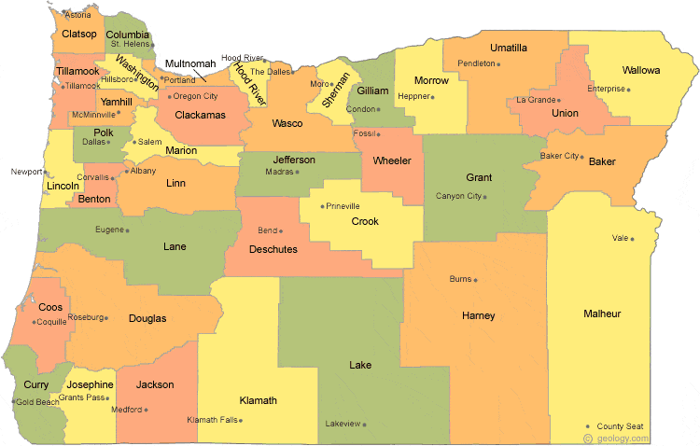
Regional Contacts by ESD
Amy Tidwell
  Grant, Harney, High Desert, InterMountain, Jefferson, North Central and Region 18
Jen Engberg
  Clackamas, Columbia Gorge, Multnomah and Northwest Regional
Lisa Plumb
  Lane, Linn Benton Lincoln and Willamette
Sarah Martin
  Douglas, Lake, Malheur, South Coast and Southern Oregon
Notes:
We have divided up the state into four sections. Each of us serves as the primary contact for the districts in these ESDs

Slide 11

Please reach out!
Amy Tidwell
amy.tidwell@ode.oregon.gov
Jen Engberg
jennifer.engberg@ode.oregon.gov
Lisa Plumb
lisa.plumb@ode.oregon.gov
Sarah Martin
sarah.martin@ode.oregon.gov

