Slide 2
Title I-A Basics
Notes:
Hello!
Thank you for joining our Title I-A Basics webinar today. My name is Jen Engberg and I am one of three education specialists here at ODE with Title I-A. I’m joined with some colleagues who I will let introduce themselves….
Today’s webinar is really a general overview of what Title I-A is all about. I’d like to take a poll- Who here is in their first or second year as a Title I-A program director or similar?
Welcome. This webinar will hopefully give you a high-level overview to get you started. It is also a good resource to look at if you’ve been doing this for awhile and need a refresher. In the past, we included this information in the regional training, but decided to approach things differently this year because of the amount of new information we needed to share at those trainings. Please, send us your feedback and let us know if this is something we should continue.
Today’s goals:
We will discuss what this grant is for, what districts and schools receiving this funding are required to do, and tools we have at ODE to help along the way.
We will cover targeted assistance and school wide planning, things to consider when spending money, and we will also touch briefly on monitoring. Questions before we get started? Please speak up or type in the comments and we can answer things along the way.

Slide 3
Purpose of Title I-A
Purpose of Title I-A
Provide supplemental service to students at risk of failing academic standards
Title I, Part A is a state-administered program
Process
USED grants funds to state based on statutory formulas
State grants funds to LEAs based on statutory formula
LEA allocates funds to schools based on ranking and serving
Notes:
The purpose of Title I-A is to provide supplemental supports and services to students who are at risk of failing academic standards. For this grant, the measurement for “at-risk” is poverty. The U.S. Department of Education uses poverty census data to grant funds to states and then the state in turn allocates the money to districts. The districts then determine which schools they allocate funds to based on “rank and serve.” (We will talk more about this momentarily). District can allocate money as they see fit, within a few parameters set by federal statute.

Slide 4
Overview of Title I-A
Planning
Needs Assessment
Fiscal
Spending/Expenditures
Necessary/Reasonable/Allowable
Rank & Serve rules
Monitoring
Monitoring Components
Methodology
CIP Budget Narrative
Transferability
Risk Factors
2018-2019 Monitoring Schedule
Determines priorities and goals
School-level Models
Targeted Assistance (TAS)
School-wide Program (SWP)
Planning Tools
Stakeholder Engagement
Notes:
Planning, Fiscal Considerations, and Monitoring. These are the three main areas we will cover today. (Read slide)

Slide 5
Title IA Planning
Comprehensive Needs Assessment
Required for all SWP & TAS schools
School-level models (SWP & TAS)
Indistar tool/resources
Updated supplemental questions
Indicators modified/revised
Family Engagement
Annual Meeting
ORIS Needs Assessment Framework required for all CSI & TSI schools
District Annual Review (still required)
Submitted at the start of the year
Notes:
Every school that receives Title I-A funds needs to do a comprehensive needs assessment, make a plan, and engage families. This process will look differently based on the size of the school and district, but the important thing is to make sure a variety of stakeholders are involved a long the way.

Slide 6
Comprehensive Needs Assessment
A needs assessment is the first step in developing a continuous improvement plan
It’s a systemic process used to:
Determine strengths and weaknesses of a school and/or LEA
Understand the context and constraints of the school and/or LEA
Perform a root-cause analysis, and
Develop an improvement plan outlining changes considered most likely to bolster or build on strengths and to remediate weaknesses

Slide 7
Oregon Integrated Systems (ORIS) Framework
Notes:
ORIS is:
A result of cross-office work intended to streamline processes that effect districts and schools.
Conceptual framework, based on multiple points of research to look at the systems health of a school system.
Developed with SWIFT Center at the University of Kansas. (formatted like FIT and FIA).

Slide 8
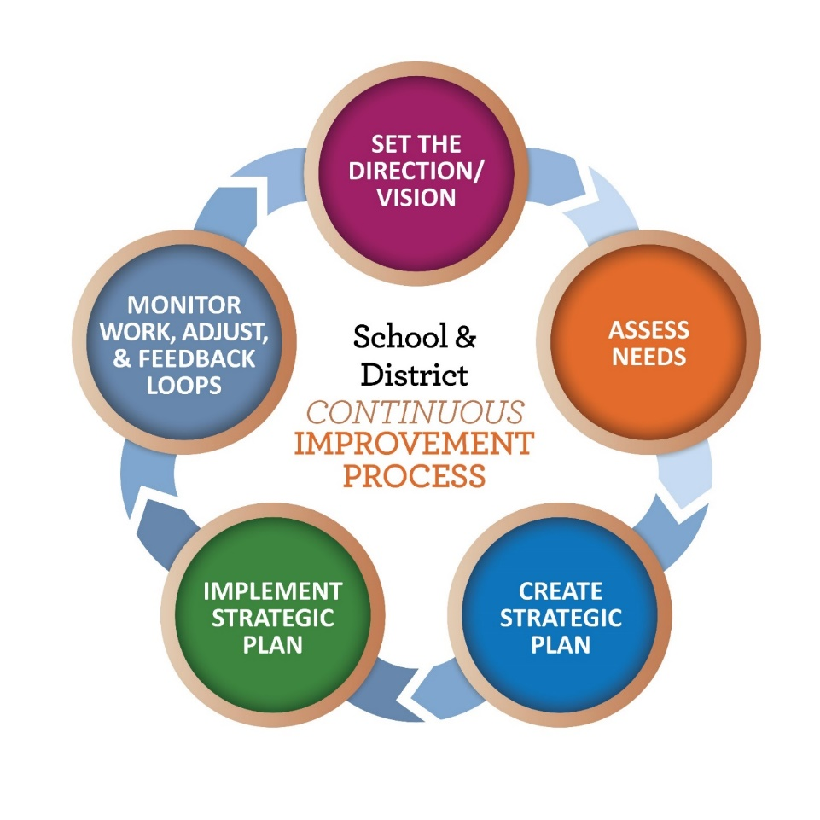

ODE New Planning Models
ORIS Needs Assessment Framework
School & District Improvement Process

Slide 9
What is included in a comprehensive needs assessment process?
What is included in a comprehensive needs assessment process?
Multiple sources of data (student, observation, perception)
Transition lens
Systems Health
Stakeholder engagement
ORIS Framework Needs Assessment Tool
Notes:
Shawna

Slide 10

ORIS Highlights
Let’s shift gears for just a few minutes to introduce
ORIS Highlights:
A conceptual framework to guide improvement
Collaboratively designed
Constructed through research & evidence
Our commitment to equity serves as the foundation and lens with which we approach the ORIS Domains:
Leadership
Talent Development
Well-Rounded, Coordinated Learning
Stakeholder Engagement & Partnerships
Inclusive Policy & Practice
Notes:
Although we are discussing needs assessment processes and tools in this block, we would like to take a few minutes to introduce you to a new ODE Conceptual Framework.
Include ORIS one pager in their packet.

Slide 11

ORIS notes
A few notes about the new ORIS Framework Needs Assessment
ORIS is the name of our conceptual framework
The needs assessment is a tool. It’s aligned to ORIS but it isn’t ORIS all by itself.
It’s meant to be a helpful resource for teams who can use it
It’s use is not required
It helps fulfill the comprehensive needs assessment process requirements for many state leveraged programs

Slide 12
Title I-A: TAS and SWP Components
Targeted Assistance School
Schoolwide Program
Comprehensive needs assessment
Targeting criteria
Progress monitoring
Program design
Professional development
Coordination and integration
Parental engagement
Evaluation & review plan
Comprehensive needs assessment
Plan description
Stakeholder engagement
Coordination & integration with other federal, state & local services
Annual evaluation
Notes:
Once you’ve determined your needs, you’ll need to determine what type of plan to create. There are two options under Title I-A.
We will go through the elements of both. The biggest difference is that a Schoolwide program is just that. All students at the school can participate. A targeted assistance program is smaller and requires entering and exiting criteria. These are a little more restrictive, but some argue more impactful.

Slide 13
Components of a TAS Plan
Coordination & Integration
Program Design
Certified Teachers & Highly Qualified Paras
Professional Development
Parental involvement
Evaluation & Review of Plan
May include any teachers that serve Title I-A students at some point during the day.
Integrate with other federal, state and local services and programs
Targeting Criteria
Progress Monitoring
Process to identify students that are at risk of not meeting achievement standards
Plan for ongoing monitoring of targeted Title I-A students during the year
Effective instructional strategies based on research
Extended learning time
Accelerated, high-quality curriculum
Minimal pull from class
Process to annually review the effectiveness of the plan to be sure progress is being made
Assist the transition of students from and to other programs
Strategies to increase Title I-A parent involvement in support of their student’s academic achievement
Teachers paid with Title I-A funds need to be certified in the area they are teaching and paras HQ.
Notes:
Read slide

Slide 14
SWP Plan Components
Comprehensive needs assessment
Plan Descriptions
Describe how school will improve academic achievement
How strategies implemented will provide opportunities of support for the learning needs of all students
How the methods & strategies will strengthen the academic program of the school
Stakeholder engagement
Coordination w/federal, state, & local services
Annual evaluation
Review data, conduct surveys, interviews, etc
Plan developed with the involvement of key stakeholders
Other title programs, Head start, CTE, schools in improvement
School must annually revise their plan

Slide 15
Title IA Plans
2018-2019 School Year
This will be a transition year to explore the ORIS framework and needs assessment process, and the planning templates at both the district and school levels.
Title IA school plans with the 34 Indicators, supplemental questions and document uploads will still be articulated within Indistar.
Notes:
Tim

Slide 16
Title IA Plans
2018-2019 School Year
If a district and school that receives Title IA funds chooses to move forward in the 2018-2019 school year with implementing the ORIS framework and planning templates, they can.
Supplemental documents relevant to Title IA will also be part of this process.
Notes:
Tim

Slide 17
Components of a Plan
Planning Template
Vision
Goals
Priorities
Statement of Assurances
Checklist of assurances that school leadership has agreed to
Supplemental Requirements
Questions regarding compliance related items

Slide 18
Family / Stakeholder Engagement How does your district involve stakeholders?

Slide 19
Family Engagement Policies/Plans
District Level Parent Involvement Policy
School Level Parent Engagement Plan
Title I School/Parent Compacts
Notes:
District Parent Involvement Policy states what the district is committed to providing to parents. This is typically OSBA policy “IGBC Title I/Parental Involvement”
School Parent Involvement Plan states how the school will be implementing the district policy at the building level. (Basically what does it look like here)
School/Parent Compacts shows the roles of each party in order to make the School Parent Involvement Plan successful. (Basically what does everyone agree to, in order to make this plan work.)

Slide 20
Parent’s Rights under ESEA
Right to request teacher qualifications
Request opportunities to meet regularly with staff for parent involvement
Participate in decisions affecting your child
Review and help develop school’s Title I-A plan
Participate in school activities
Notes:
Within the district policy and school plan, parents have the following rights:

Slide 21
Parent Involvement Requirements
Conduct an annual meeting
Provide opportunities for review and input.
Notify & inform
Increase knowledge
Build capacity
Notes:
These are important because come monitoring time, we ask for specific pieces of evidence.

Slide 22
Title I-A Annual Meeting

Slide 23
Pre-Meeting Prep & Documentation
Compliance Documentation
Agenda
Sign-Ins
Meeting Announcement
Notes:
3 things to always remember when you are putting together a Title IA meeting:
Announcement? Have you announced that you are having a meeting? How did you and do you have a copy of that announcement? Does it state that it is the Title IA annual meeting? (As the East coast folks say, how do folks know to come to something, unless you announce it?)
Agenda? What information are you sharing? Do you have an agenda or are you using a powerpoint? Basically, what’s your documentation on what is discussed at the annual meeting? (Again as the East coach folks say, how do we know what you are going to talk about or did talk about, unless we see either an agenda or a powerpoint?)
Sign-Ins? How do we know who came to the meeting, if any one? And how was this documented?

Slide 24
Agenda Content
Information to be covered in the Annual Meeting:
Inform parents of the school’s participation in Title I
Explain the Title I, Part A requirements
Explain the rights of parents to be involved in the Title I program
Review district policy, school plan, & student-parent compact
Review parent notifications
Provide a description and explanation of the school’s curriculum
Provide information on the proficiency levels students are expected to meet.
Notes:
Information to be covered in the Annual Mtg
Inform parents of the school’s participation in Title I
Explain the Title I, Part A requirements
Explain the right of parents to be involved in the Title I program
A description and explanation of the school’s curriculum
Information on the proficiency levels students are expected to meet.

Slide 25
Overview of Title I-A
Planning
Needs Assessment
Fiscal
Spending/Expenditures
Necessary/Reasonable/Allowable
Rank & Serve rules
Monitoring
Monitoring Components
Methodology
CIP Budget Narrative
Transferability
Risk Factors
2018-2019 Monitoring Schedule
Determines priorities and goals
School-level Models
Targeted Assistance (TAS)
School-wide Program (SWP)
Planning Tools
Stakeholder Engagement

Slide 26
Title I-A Fiscal Considerations

Slide 27
Four things to ask before you spend:
Questions to ask
With which fund source is this being paid?
Is it allowable and noted in the needs assessment?
Has it been approved in the budget narrative?
Is it supplemental or a supplant?

Slide 28
Expenditures
Spending / Expenditures:
Activities based on needs assessment
Reasonable and necessary to carry out the school-level plan
Distribution of funds:
District level set-asides
Building level
Rank & Serve for funding
Rank by Poverty
Rank by Grade Span then Poverty
75% and higher then

Slide 29
Supplement not Supplant Rules for Title IA
Supplemental
Using Title funds for:
Approved in LEA application (budget narrative)
Core
What “methodology” did the district use to determine how much GENERAL FUNDS each school will receive
Necessary & Allowable
New way of looking at supplanting

Slide 30
Transferring Funds
Districts May Transfer All or Some Funds From: | Districts May Transfer Funds Into:
Title II-A, Supporting Effective Instruction Title IV-A, Student Support and Academic Enrichment | Title I-A, Improving Basic Programs Title I-C, Migrant Programs Title I-D, Prevention and Intervention Programs for Children and Youth who are Neglected, Delinquent, or At-Risk Title II-A, Supporting Effective Instruction Title III-A, English Language Acquisition, Language Enhancement, and Academic Achievement Title IV-A, Student Support and Academic Enrichment Title V-B, Rural Education Initiative
Notes:
Updated 7/29/2018 – Added Migrant

Slide 31
Transferability
LEAs can transfer up to 100% of either their Title II-A or Title IV-A into Title I-C, Migrant Education in addition to the other titles already identified.
Starting in 2017-18, LEAs were already able to transfer up to 100% of either their Title II-A or Title IV-A into Title I-A, I-D, II-A, III, IV-A, and V (REAP).

Slide 32
Title I-A: Funding to LEA/Schools
Districts reserve some funds for mandatory set-asides
Districts also have the option to reserve some funds for centrally-run Title I initiatives
The rest flows to schools to operate either a:
School-wide Program (SWP) or
Targeted Assistance School (TAS)

Slide 33
Overview of Title I-A
Planning
Needs Assessment
Fiscal
Spending/Expenditures
Necessary/Reasonable/Allowable
Rank & Serve rules
Monitoring
Monitoring Components
Methodology
CIP Budget Narrative
Transferability
Risk Factors
2018-2019 Monitoring Schedule
Determines priorities and goals
School-level Models
Targeted Assistance (TAS)
School-wide Program (SWP)
Planning Tools
Stakeholder Engagement

Slide 34
Monitoring Overview

Slide 35
Monitoring Process
What is it?
ODE monitors requirements/compliance of ESEA
ODE provides technical assistance
ODE works with districts to support programs
When is it?
Every 3-6 years for Title I-A, II-A, V-B, and X
How is it done?
ODE reviews evidence previously collected, assurances and district submitted materials
Visit districts
Resources?
Monitoring Checklist
http://www.oregon.gov/ode/schools-and-districts/grants/ESEA/Pages/ESEA-Monitoring.aspx

Slide 36
Components of Monitoring
Planning
Review of school-level plans
School documentations
Compacts, principal attestations, meetings, etc
Fiscal
Review CIP budget narrative submission
Time & Effort documentation
Staffing
Paraprofessional requirements
Teacher licensure per TSPC
Additional?
Inventory list & labels
Comparability
Other requirements from Title II-A, IV-A, Private Schools & McKinney-Vento

Slide 37
Which programs are included?
Title I-A Improving Basic Programs
Title II-A Supporting Effective Instruction
Title IV-A Student Support and Academic Enrichment
Title V-B Rural and Low Income Schools (RLIS)
McKinney-Vento Homeless Student Education
Equitable Services to Private Schools

Slide 38
Winter Desk Monitoring 2018-19
Arlington SD 3
Beaverton SD 48J
Canby SD 86
Condon SD 25J
Crook County SD
Fossil SD 21J
Lake Oswego SD 7J
Mitchell SD 55
Oregon City SD 62
Oregon Trail SD 46
Redmond SD 2J
Sherman County SD
Sisters SD 6
Spray SD 1
Tigard-Tualatin SD 23J
West Linn-Wilsonville SD 3J

Slide 39
Spring Desk Monitoring 2018-19
Ashland SD 5
Baker SD 5J
Burnt River SD 30J
Dayville SD 16J
Echo SD
Enterprise SD 21
Huntington SD 16J
Ione SD R2
John Day SD 3
Joseph SD 6
Long Creek SD 17
Monument SD 8
Morrow SD 1
Pine Eagle SD 61
Prairie City SD 4
Troy SD 54
Wallowa SD 12

Slide 41

Questions and Discussion

Slide 42
Contacts
Northern Tier of the State
Melinda Bessner email: Melinda.bessner@ode.state.or.us
Central Tier of the State
Lisa Plumb email: Lisa.plumb@ode.state.or.us
Southern Tier of the State
Jen Engberg email: Jennifer.engberg@ode.state.or.us
503-947-5626
503-947-5749
503-947-0339
Northwest Regional, Multnomah, Clackamas, InterMountain, Grant & Region 18 ESDs
Willamette, Linn Benton Lincoln, Lane, High Desert, Jefferson, Columbia Gorge & North Central ESDs
South Coast, Douglas, Southern Oregon, Lake, Harney & Malheur ESDs

Slide 43
Websites
Informational Materials
ODE website (www.oregon.gov/ode)
Budgets & Data Collections
ODE District website (www.district.ode.state.or.us)
School & District-Level Planning
Indistar (www.indistar.org)
ODE Federal Programs Website
http://www.oregon.gov/ode/schools-and-districts/grants/ESEA/Pages/default.aspx

