Slide 1
Title I, Part A: Basics
Improving Basic Programs

Slide 2

Oregon Department of Education – Our “Why”
Equity and Excellence for Every Learner
The Oregon Department of Education works in partnership with school districts, education service districts and community partners;
Together, we serve over 580,000 K-12 students;
We believe every student should have access to a high-quality, well-rounded learning experience;
We work to achieve the Governor’s vision that every Oregon student graduates with a plan for their future.

Slide 3

Outcomes for Today
Overview of Title I, Part A
Eligibility and Funding
Application Requirements
Resources
Oregon Department of Education

Slide 4
Overview

Slide 5

Purpose of Title I-A
The purpose of Title I, Part A is a to “provide all children significant opportunity to receive a fair, equitable, and high-quality education, and to close educational achievement gaps.”
The goal is to address opportunity gaps that some students experience by providing resources to districts and schools who serve a larger population of children from families experiencing poverty.
Oregon Department of Education
Notes:
As outlined in the Every Student Succeeds Act (ESSA) Title I-A funded schools may implement one of two approaches: 1) a School-wide Program or 2) a Targeted Assistance Program.

Slide 6
Targeted Assistance vs. Schoolwide Programs
Category | Targeted Assistance (TAS) | Schoolwide (SWP)
School Eligibility | Any school with a poverty level of 35% or the district’s poverty average (whichever is lower). | Any school with a poverty level of at least 40%.* *A school with less than 40% poverty may request to conduct a schoolwide program.
Student Participation | Students who meet targeting criteria | All students in the school
Professional Development | Focused on staff that provide direct support to identified students. | Can provide professional development for all staff.
Planning & Evaluation | Plan includes description of TAS program activities to support students identified as eligible for services. | The SWP plan must be developed for reforming the total instructional program in the school.
Notes:
Schoolwide programs funded under Title I, Part A offer the opportunity to invest in strategies that help all students, because all students in a schoolwide program can be served . While many schools target services to the most in-need students, a schoolwide program allows for the implementation of tiered supports addressing student needs at every level.

Slide 7



Each Title I-A Building must …
Complete an annual needs assessment
Create and annually update school-level plan and compact
Develop and implement a Family Engagement Plan
Engage families as partners in their child’s learning
Maintain documentation of teacher and paraprofessional qualifications
Notes:
Each school must have its own version of a comprehensive needs assessment that is specific to the school needs.
District is responsible for monitoring school plans
The district should collect school plans and have conversations with schools to ensure connection and coordination between school plans and the overall district plan and priorities

Slide 8

Family Engagement
Annual Meeting
Building Family Capacity
Compact
Family Engagement Plan
Notes:
There are four requirements under family engagement that each Title I-A school must complete annually. These requirements are the annual meeting, engagement plan, compact, and providing opportunities to build family capacity.

Slide 9
Families as Partners
Annual Meeting
  Program design, family rights, opportunities for partnership
Family Engagement Plans
  Shared planning and decision-making
Compacts
  Shared responsibility for student learning
Building Family Capacity
  Opportunities to be engaged in their child’s learning
Notes:
There are several requirements within the family engagement provision of ESEA, designed to ensure all families feel welcome and able to participate as partners. These requirements apply in both Targeted Assistance and Schoolwide Title I-A programs.
Engage families in decision-making – Families must be engaged in the development and annual review of the school-level Family Engagement and Title I-A plans, as well as have opportunities to share suggestions and feedback. The district must establish policies that ensure all interested families are prepared to participate in planning, decision-making and oversight groups such as boards, councils, committees or working groups.
Include family voice – Schools must have an annual meeting to share details of the school’s program and build family capacity as partners with the school in their child’s education. Family voice can be gathered through input and review of the school plan, participation in surveys, as well as other opportunities for feedback.
Remove barriers to communication – In order to assure that families are able to participate; information must be shared in a language and format accessible to all families. This includes information shared as part of the annual meeting, as well as information specific to their child.
Promote shared partnership for student learning – Each school that receives Title I-A funds must develop, with their families, a compact that outlines how families, students and school staff will build and develop a partnership to ensure student success. This includes describing the school's efforts to provide high-quality curriculum and instruction as well as the activities and actions that families can take to support their child's learning.
Build family capacity – Each school must provide opportunities for families to be engaged in their child’s learning. This includes supporting families with understanding the school’s program. Consider modeling strategies for families to support the academic achievement of their students.

Slide 10

Equitable Services
Timely, meaningful, annual consultation
Equitable share is generated by children experiencing poverty who by age and address would have attended a public Title I-A school (poverty and residence)
Services are provided to eligible students identified as having the greatest need (need and residence)
ESSA Quick Reference Brief: Equitable Services
Oregon Department of Education
Notes:
It is important to note that private schools are eligible for equitable services under Title IA. Districts must engage in consultation with private schools within district boundaries annually to determine if they wish to participate.
All students who would have attended a Title IA school in the district are eligible for Title IA services in the private school regardless of socio-economic status
Title IA provides supplemental instruction by appropriately licensed teachers
LEA maintains responsibility for Title IA services and resources
Services are secular, neutral, and non-ideological and address the needs of the eligible private school students

Slide 11
Eligibility and Funding

Slide 12
Allocations
Component Funding Formulas & Qualifications
  Basic
    (10 formula students, more than 2% of population)
  Concentration
    (District must meet basic grant and a population of over 6500 formula students OR 15% poverty)
  Education Finance Incentive Grant & Targeted Grants
    (10 formula students, more than 5% of population)
District allocations based on census poverty of children aged 5-17 in the district.
Notes:
First: Federal funds originate in Congress
Second: The U.S. Department of Education calculates state level allocations
Third: ODE calculates each district’s allocation
Title I-A is comprised of four separate formulas. Some districts are eligible to receive funding in all four areas, while others are eligible in only a few. There are different criteria for each formula, though all are based on census poverty.

Slide 13



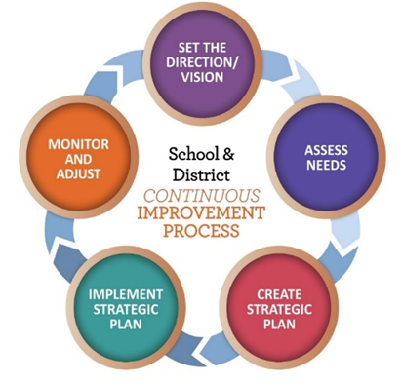


Funding Process
U.S. Census Bureau calculates annual poverty estimates for all public school districts
The U.S. Department of Education allocates program funding to states based on poverty percentages
Congress passes appropriations to federal education programs
The Oregon Department of Education finalizes allocations for all Oregon School Districts
Notes:
First: Federal funds originate in Congress
Second: The U.S. Department of Education calculates state level allocations
Third: ODE calculates each district’s allocation
Title I-A is comprised of four separate formulas. Some districts are eligible to receive funding in all four areas, while others are eligible in only a few. There are different criteria for each formula, though all are based on census poverty.

Slide 14
Transferability
Funds can be transferred into I-A, but not out
Funds transferred into I-A become Title I-A funds
Must consult with private schools if additional funds are transferred in
ESSA Quick Reference Brief: Transferability
Oregon Department of Education
Notes:
Under ESEA districts have the ability to transfer funds it receives by formula under certain programs to other programs to better address local needs. It is important to keep in mind that once funds are transferred, they take on the identity of the Title to which they were transferred and must be spent under rules applicable to that Title.
Before an LEA may transfer funds from a program subject to equitable services requirements, it must engage in timely and meaningful consultation ​
with appropriate private school officials. (ESEA section 5103(e)(2).) With respect to the transferred funds, the LEA must provide private school students and teachers equitable services under the program(s) to which, and from which, the funds are transferred, based on the total amount of funds available to each program after the transfer. A district may not reserve Title II-A or IV-A funds solely to provide equitable services.
There is no limit on the amount of funds that can be transferred from one grant to another, but transfers of funds cannot cross years.​
​

Slide 15
Supplement Not Supplant
Federal funds cannot be used to supplant, or take the place of, state and local funds that would have been spent if Title I-A funds were not available
There are three fiscal tests for Title I-A through
which districts demonstrate that the use of
Title I-A funds is supplemental
ESSA Quick Reference Brief: Methodology
ESSA Quick Reference Brief: Comparability
ESSA Quick Reference Brief: Supplement not Supplant
Title I-A Fiscal Requirements
Supplement not Supplant
Comparability
Maintenance of Effort
Oregon Department of Education
Notes:
There are three fiscal tests for Title I-A:
Maintenance of Effort (MOE) – LEAs must maintain a consistent floor of state and local funding for free public education from year-to-year.
Supplement, not Supplant – LEAs must distribute state and local funds to schools without taking into account a school’s participation in the Title I program. (Methodology)
Comparability – state and local funds are used to provide services that, taken as a whole, are comparable between Title I and non-Title schools.
Title I-A funds are required to supplement, and not supplant existing state and local funding. In plain language, this means that federal funds should add to, and not replace, state and local funds. Before ESSA, Title I-A’s ‘supplement, not supplant’ requirement was tested through three presumptions that looked at each activity supported with Title I-A funds to determine if it was something an LEA or school would have paid for with state and/or local funds if Title I-A funds were not available.

Slide 16
2022-23 FEDERAL FUNDS TIMELINE
JULY
2022
AUG 2022
NOV 2022
BEGINNING OF 2022-23 GRANT PERIOD
2022-23 BUDGET NARRATIVE APPLICATION OPENS
2022-23 BUDGET NARRATIVES DUE
NOV 2023
SEPT 2023
FINAL DATE FOR ALL 2022-23 CLAIMS FOR *INITIAL GRANT PERIOD
FINAL DATE FOR OBLIGATION OF 2022-23 FUNDS FOR *INTIAL GRANT PERIOD
NOV 2023
UNCLAIMED FUNDS BECOME “CARRYOVER”
NOV 2023
SEPT 2024
NOV 2024
*INITIAL GRANT PERIOD: 7/1/22 – 9/30/23 (15 MONTHS)
CARRYOVER APPLICATIONS FOR 2022-23 FUNDS OPEN
FINAL DATE FOR OBLIGATION OF 2022-23 FUNDS
FINAL DATE FOR ALL 2022-23 GRANT CLAIMS
Oregon Department of Education
16
Notes:
Title IA funds are made available on July 1 of the fiscal year and remain available for obligation for a period of 27 months. This 27-month period includes an initial 15-month period of availability and an automatic 12-month extension permitted under the “Tydings Amendment”. While districts are encouraged to obligate funds in the initial grant year, it is not uncommon for districts to have funds available from two different grant years.
This slide shows the 2022-23 grant year timeline.

Slide 17
Application Requirements
CIP Budget Narrative

Slide 18
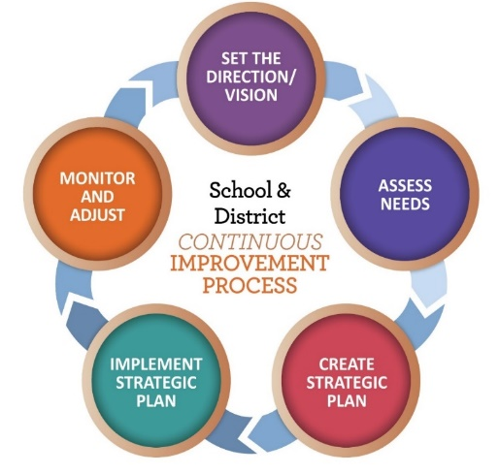
Application Requirements
Overview
What is our methodology?
Targeting Page
How do we rank and serve schools?
Set-Asides
What funds are being spent at the district level?
Budget Narrative
How are schools using their funds in alignment with their plans?
Oregon Department of Education
Notes:
There are four primary sections in the Title IA CIP Budget narrative:
Overview
Targeting (Rank and Serve)
Set-Asides
School Budget Narratives
18

Slide 19
Overview (Methodology)
Include a description of how the district allocates state and local funds to all schools
  Single school districts, or districts with one school per grade span, do not need to provide a methodology statement and can enter NA
Methodology statement considerations:
  Public charter schools
  Different grade spans
  ESSA Quick Reference Brief: Methodology
Oregon Department of Education
Notes:
An LEA must show that its methodology to allocate State and local funds to schools results in each Title I-A school receiving all of the State and local funds it would otherwise receive if it were not receiving Title I-A funds.
In other words, an LEA’s methodology must be “Title I neutral” in that it allocates State and local funds to schools without regard for Title I-A status.
The methodology may be different for charter schools, depending on what is included in the school’s charter.
It is possible to have different methodologies for different grade spans (e.g.; elementary vs. middle) depending on the district’s needs.
19

Slide 20
Targeting Page
Identify which schools are receiving Title I-A funds
Determine per child amount for each school
Ensure that rank and serve requirements outlined in ESSA are followed
PLEASE NOTE: The allocation for each school on the Targeting Page must equal each school’s allocation on the Budget Narrative Page
ESSA Quick Reference Brief: Rank and Serve under Title I-A
Oregon Department of Education
Notes:
On the Targeting page the task is to rank and serve schools by poverty. “Rank and Serve” is the process used to determine which schools should be served with Title I-A funds. The intent of the law is to concentrate the funds in schools with the highest percentages of children from families experiencing poverty and to provide sufficient funds to make a difference in the academic performance of these students. In order to determine which schools will receive Title I-A funds, each district must put its schools in rank order from highest to lowest concentrations of children from families experiencing poverty

Slide 21
Set-Asides, Part I
Required for ALL districts
  Services for students experiencing houselessness
Required for SOME districts
  Parent and family engagement
  Equitable services for private school students
  Services for students without parental supervision*
  *Only 4 districts in Oregon are required to use this set-aside
Oregon Department of Education
Notes:
Set-asides are funds that are reserved for district-wide activities that support Title I-A schools. These funds are reserved at the district level before funds are allocated to schools. Some set-asides are required; others are optional. The are required set-asides are as follows:
The first required set-aside is for students experiencing homelessness.
The second is for parent engagement, but only if the district’s allocation exceeds $500,000.
The third is the equitable share for participating private schools.
Districts that have within their boundaries a local (not state run) residential facility for students without parental supervision and report this facility in the October caseload count are required to set-aside Title I-A funds to provide services to children in those facilities. 5 The amount of Title I-A dollars reserved for serving children and youth in this category is a per-child amount.
21

Slide 22
Set-Asides, Part II
Optional
  District administration costs
  Salary equalization
  Extended time
  Professional Development
  Other
ESSA Quick Reference Brief: Set-Asides under Title I-A
Oregon Department of Education
Notes:
There are other optional set asides that a district can choose to fund. In addition to the ones listed on the slide, districts can use Set Aside funds to support preschool as well as supports for students experiencing Foster Care.
22

Slide 23
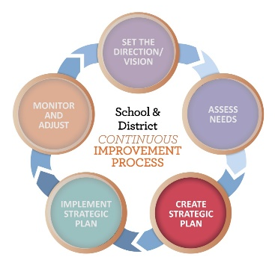
Budget Narrative
Line item for each funded school
Describe how funds are being spent in alignment with identified needs
Amounts listed for each school on budget narrative page must match the amount listed for that school on targeting page
Oregon Department of Education
Notes:
The purpose of the budget narrative page is to provide building-level budget details. This is where schools describe how funds are being in spent in alignment with identified needs.

Slide 24
Allowable Costs Under Title I-A
Strategies/activities that align to the school’s plan
  Academic Intervention & Enrichment (all subjects)
  Social Emotional Learning and Support
  Professional Development
  Instructional Staff and Supports
  Behavioral Supports
Schoolwide vs. Targeted Assistance
  ALL students vs. identified students
Oregon Department of Education
Notes:
Historically, many LEAs and schools have used Title I-A funds narrowly for discrete instructional supports primarily focused on reading and math. This was a result of misunderstandings about how Title I-A funds can be used. Title I, Part A funds can support a wide range of activities to help Title I-A students meet state academic standards. This includes:
Providing eligible students with a well-rounded education.
Instructional supports.
Non-instructional supports like behavior and mentoring supports, and social and emotional learning.
Improving school quality.
Activities addressed within the school’s comprehensive needs assessment.

Slide 25

Resources
Title I-A web page
Title I-A Coordinator’s Calendar
ESSA Quick Reference Briefs
Oregon Federal Funds Guide
Within District Allocations under I-A
CIP Budget Narrative Resources
Notes:
There are a wide variety of resources available to support districts with Title IA. The CIP Budget Narrative User Guide and Checklists are particularly helpful tools when submitting the narrative application.

Slide 26
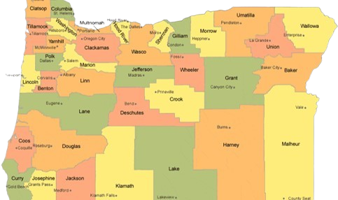
Regional Contacts by ESD
Amy Tidwell
Grant, Harney, High Desert, InterMountain, Jefferson, North Central and Region 18
Jen Engberg
Clackamas, Columbia Gorge, Multnomah and Northwest Regional
Lisa Plumb
Lane, Linn Benton Lincoln and Willamette
Sarah Martin
Douglas, Lake, Malheur, South Coast and Southern Oregon
Notes:
We have divided up the state into four sections. Each of us serves as the primary contact for the districts in these ESDs

Slide 27

Please reach out!
Amy Tidwell
amy.tidwell@ode.oregon.gov
Jen Engberg
jennifer.engberg@ode.oregon.gov
Lisa Plumb
lisa.plumb@ode.oregon.gov
Sarah Martin
sarah.martin@ode.oregon.gov
Notes:
Our team has moved from a programmatic model to a regional support model. Each of us has taken a section of the state to support across Titles IA, IIA, IVA and VB.

