Slide 1
Title I, Part A
CIP Budget Narrative Walkthrough
Notes:
JEN

Slide 2

Outcomes for today
Overview of Title I, Part A
Walkthrough of CIP Budget Narrative components
Resources & Contacts
Oregon Department of Education
Notes:
JEN

Slide 3

Purpose of
Title I-A
The purpose of Title I, Part A is a to “provide all children significant opportunity to receive a fair, equitable, and high-quality education, and to close educational achievement gaps.”
The goal is to address opportunity gaps that some students experience by providing resources to districts and schools who serve a larger population of children from families experiencing poverty.
Oregon Department of Education
Notes:
JEN

Slide 4
Supplement Not Supplant
Federal funds cannot be used to supplant, or take the place of, state and local funds that would have been spent if Title I-A funds were not available
There are three fiscal tests for Title I-A through
which districts demonstrate that the use of
Title I-A funds is supplemental
ESSA Quick Reference Brief: Methodology
ESSA Quick Reference Brief: Comparability
ESSA Quick Reference Brief: Supplement not Supplant
Title IA Fiscal Requirements
Supplement not Supplant
Comparability
Maintenance of Effort
Oregon Department of Education
Notes:
There are three fiscal tests for Title I-A:
Maintenance of Effort (MOE) – LEAs must maintain a consistent floor of state and local funding for free public education from year-to-year.
Supplement, not Supplant – LEAs must distribute state and local funds to schools without taking into account a school’s participation in the Title I program. (Methodology)
Comparability – state and local funds are used to provide services that, taken as a whole, are comparable between Title I and non-Title schools.
Title I-A funds are required to supplement, and not supplant existing state and local funding. In plain language, this means that federal funds should add to, and not replace, state and local funds.

Slide 5
2024-25 FEDERAL FUNDS TIMELINE
JULY
2024
AUG 2024
NOV 2024
BEGINNING OF 2024-25 GRANT PERIOD
2024-25 BUDGET NARRATIVE APPLICATION OPENS
2024-25 BUDGET NARRATIVES DUE
NOV 2025
SEPT 2025
FINAL DATE FOR ALL 2024-25 CLAIMS FOR *INITIAL GRANT PERIOD
FINAL DATE FOR OBLIGATION OF 2024-25 FUNDS FOR *INTIAL GRANT PERIOD
NOV 2025
UNCLAIMED FUNDS BECOME “CARRYOVER”
NOV 2025
SEPT 2026
NOV 2026
*INITIAL GRANT PERIOD: 7/1/24 – 9/30/25 (15 MONTHS)
CARRYOVER APPLICATIONS FOR 2024-25 FUNDS OPEN
FINAL DATE FOR OBLIGATION OF 2024-25 FUNDS
FINAL DATE FOR ALL 2024-25 GRANT CLAIMS
Oregon Department of Education
5
Notes:
Title I-A funds are made available on July 1 of the fiscal year and remain available for obligation for a period of 27 months. This 27-month period includes an initial 15-month period of availability and an automatic 12-month extension permitted under the “Tydings Amendment”. While districts are encouraged to obligate funds in the initial grant year, it is not uncommon for districts to have funds available from two different grant years.
This slide shows the 2022-23 grant year timeline.

Slide 6

Equitable Services
Timely, meaningful, annual consultation
Equitable share is generated by children experiencing poverty who by age and address would have attended a public Title I-A school (poverty and residence)
Services are provided to eligible students identified as having the greatest need (need and residence)
ESSA Quick Reference Brief: Equitable Services
Oregon Department of Education
Notes:
It is important to note that private schools are eligible for equitable services under Title IA. Districts must engage in consultation with private schools within district boundaries annually to determine if they wish to participate.
All students who would have attended a Title IA school in the district are eligible for Title IA services in the private school regardless of socio-economic status
Title IA provides supplemental instruction by appropriately licensed teachers
LEA maintains responsibility for Title IA services and resources
Services are secular, neutral, and non-ideological and address the needs of the eligible private school students

Slide 7
Application Requirements
Title I-A CIP Budget Narrative

Slide 8
Accessing the CIP Budget Narrative
Login to the District Secure website
Choose CIP Budget Narrative from the “Applications” list
If you do not have access to the CIP Budget Narratives, reach out to your district Security Administrator

Slide 9
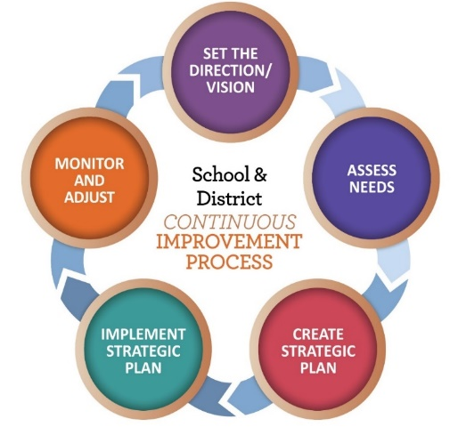
Title I-A Application Requirements
Overview
  What is our methodology?
Targeting Page
  How do we rank and serve schools?
Set-Asides
  What funds are being spent at the district level?
Budget Narrative
  How are schools using their funds in alignment with their plans?
Oregon Department of Education
Notes:
Districts login to their CIP Budget Narrative applications through the district secure site. If you do not have access to the dashboard contact your district Security Administrator for access.
There are four primary sections in the Title IA CIP Budget narrative:
Overview
Targeting (Rank and Serve)
Set-Asides
School Budget Narratives
9

Slide 10
Overview (Methodology)
Description of how the district allocates state and local funds to all schools
  Single school districts, or districts with one school per grade span, do not need to provide a methodology statement and can enter NA
Methodology statement considerations:
  Public charter schools
  Different grade spans
  ESSA Quick Reference Brief: Methodology
Oregon Department of Education
Notes:
An LEA must show that its methodology to allocate State and local funds to schools results in each Title I-A school receiving all of the State and local funds it would otherwise receive if it were not receiving Title I-A funds. In other words, an LEA’s methodology must be “Title I neutral” in that it allocates State and local funds to schools without regard for Title I-A status.
The methodology may be different for charter schools, depending on what is included in the school’s charter.
It is possible to have different methodologies for different grade spans (e.g.; elementary vs. middle) depending on the district’s needs.
10

Slide 11
Targeting Page
Identify which schools are receiving Title I-A funds
Determine per child amount for each school
Ensure that rank and serve requirements outlined in ESSA are followed
*PLEASE NOTE: The allocation for each school on the Targeting Page must equal each school’s allocation on the Budget Narrative Page
ESSA Quick Reference Brief: Rank and Serve under Title I-A
Oregon Department of Education
Notes:
On the Targeting page the task is to rank and serve schools by poverty. “Rank and Serve” is the process used to determine which schools should be served with Title I-A funds. The intent of the law is to concentrate the funds in schools with the highest percentages of children from families experiencing poverty and to provide sufficient funds to make a difference in the academic performance of these students. In order to determine which schools will receive Title I-A funds, each district must put its schools in rank order from highest to lowest concentrations of children from families experiencing poverty

Slide 12
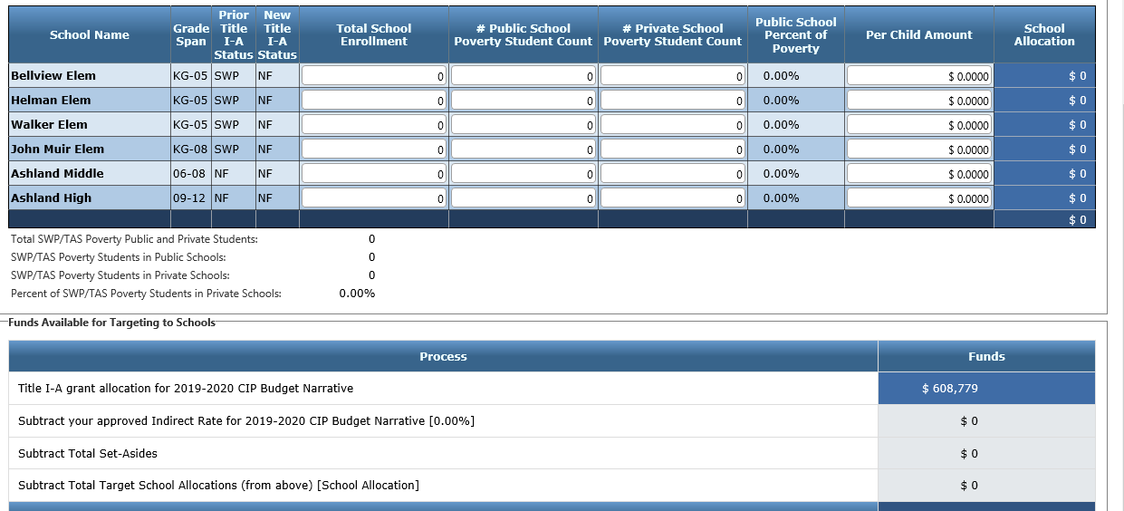
Targeting Page – A Closer Look
Notes:
On the targeting page the total school enrollment and student poverty count are entered. These counts should be from the same point in time, i.e.; the last official count in the spring from the previous year, or the first official count in fall from the current year.
The private school poverty count is also entered. This generates a percentage that is taken from the district’s total Title I-A allocation and the amount is entered on the set-aside page for equitable services to private schools.
Schools are then ranked, with those having the highest poverty count (typically over 40%) being served with Title I-A. Any school with 75% poverty count must be served with Title I-A.
A Per Child Amount is then entered in for each school. The school with the highest poverty count within a grade span must have the same or greater than Per Child Amount than the schools with lower poverty count in that same grade span.

Slide 13
Selecting Measures of Poverty
Free and reduced-price lunch count or Community Eligibility Provision (CEP) data
Count of students receiving assistance under Temporary Assistance for Needy Families (TANF)
Count of student eligible for Medicaid (Oregon Health Plan)
Census counts of children from families below the poverty level (SAIPE)
A combination of two or more of these data sources
Notes:
Before the rank and serve process can begin, districts receiving Title I-A funds must determine the level of poverty at all schools in the district. As outlined in ESSA, districts must select one of five measures to determine relative percentages of children from economically disadvantaged families residing in their attendance areas. CEP data is one method the district could use for this purpose.

Slide 14
Community Eligibility Provision
The Community Eligibility Provision (CEP) gives eligible Local Education Agencies (LEAs) and schools with high percentages of low-income children the option to offer meals without cost to all children in those schools without collecting free and reduced lunch applications.
CEP is coordinated through the ODE’s Office of Child Nutrition.
Notes:
CEP is a universal meal service option that permits eligible schools to provide meal service to all students at no charge, regardless of economic status. CEP schools only use eligibility data that are not obtained through the use of an application, such as data from the Supplemental Nutrition Assistance Program (SNAP) or Temporary Assistance for Needy Families (TANF) program, to determine the Federal cash reimbursement for school meals provided by USDA. They do not rely on annual household applications that are generally used to determine eligibility for free and reduced-price meals.
To be eligible, LEAs and/or schools must meet a minimum level of “identified students” for free meals in the year prior to implementing CEP; agree to serve free breakfasts and lunches to all students; and agree to cover with non-Federal funds any costs of providing free meals to students above the amounts provided by Federal assistance. Districts participating in CEP are approved for 4-year cycles. Districts can find out more about CEP from the Special Provisions webpage of the Office of Child Nutrition and the CEP- Title IA guidance put out by USED. https://www.oregon.gov/ode/schools-and-districts/grants/ESEA/IA/Documents/cep-title-i-guidance-from-used-3-2015.docx

Slide 15

When all schools in the district are CEP…
Option 1: Use the number of identified eligible students in each school
Option 2: Use the number of identified eligible students in each school times the multiplier (1.6)
Notes:
AMY
If all schools in the district participate in CEP, there are two options:
Option 1: All school poverty numbers are determined based on the number of “identified students” in that school. The count of identified students is divided by the site's total enrollment to calculate the percentage of poverty.
Option 2: In this method, all schools use the same process as in Option 1, but apply the 1.6 multiplier. NOTE: The use of the multiplier will increase the poverty percentage in all schools. When using this option keep in mind the requirement that schools with a poverty level of 75% or above must be served in rank order, regardless of grade span.

Slide 16
When only some schools in the district are CEP…
CEP Schools
Option 1: Use the number of eligible students in both CEP and non-CEP schools
Option 2: Apply the 1.6 multiplier to the number of identified eligible students in both CEP and non-CEP schools
Option 3: Use the number of identified eligible students times the multiplier (1.6) and use the free and reduced-price meal data for non-CEP schools
Non-CEP Schools
Notes:
When a district has a combination of CEP and non-CEP schools, there are three options for using CEP data:
Option 3: In this method different data is used for CEP and non-CEP schools. To account for the difference in poverty rates when using free and reduced-price meals data for non-CEP schools and eligible student data for CEP schools, the multiplier of 1.6 is intended to approximate the free and reduced-price meals count for a CEP school. With this option, CEP schools may rank higher as compared to non-CEP schools.

Slide 17
Required Set-Asides
Required for ALL districts
  Services for students experiencing houselessness, regardless of whether they attend a Title I-A funded school
Required for SOME districts
  Parent and family engagement
  Equitable services for private school students
  Services for students without parental supervision*
  *Only 2 districts in Oregon are required to use this set-aside
Oregon Department of Education
Notes:
Set-asides are funds that are reserved for district-wide activities that support Title I-A schools. These funds are reserved at the district level before funds are allocated to schools. It is important to note that set asides can be used to support any student experiencing houselessness and Foster Care regardless of whether the school they attend is Title IA funded or not.
The first required set-aside is for students experiencing houselessness.
The second is for parent engagement, but only if the district’s allocation exceeds $500,000.
The third is the equitable share for participating private schools.
Districts that have within their boundaries a local (not state run) residential facility for students without parental supervision and report this facility in the October caseload count are required to set-aside Title I-A funds to provide services to children in those facilities. 5 The amount of Title I-A dollars reserved for serving children and youth in this category is a per-child amount.
17

Slide 18
Required Set-Aside (Houselessness)
Services for students experiencing houselessness
  Support eligible students in ALL schools, not just Title I-A funded schools
  Consider the number of students identified experiencing houselessness when calculating set-aside
  Primary goal of the set-aside is to remove barriers to student engagement and participation in education (e.g.; transportation for school of origin, fees for extracurricular activities/athletics, extended day programs)
Notes:
Services for children experiencing houselessness. Districts must reserve funds to provide services to students experiencing houselessness in all schools within the district. ESSA does not specify an amount, but the amount should be based on a needs assessment and could include costs for a liaison, transportation for eligible students, and other activities eligible under the McKinney-Vento Homeless Education Act. District Title I Coordinators should work in collaboration with the Homeless Liaison to complete the needs assessment as a way to determine the appropriate amount of Title I set-asides required to meet homeless student needs.
Use the number of students experiencing houselessness identified in the previous school year to project count for upcoming year. A best practice would be increasing the amount allocated by 5% or as your budget allows to account for potential increases in enrollment.
The primary goal of the set-aside is to remove barriers to student engagement and participation in education. This means there is no “right way” to spend the funds, but your description should clearly articulate how the activities the district is undertaking with this set aside will remove barriers for students. ESEA Section 1113(c)(3)(C)

Slide 19
Required Set-Asides (for some districts)
Equitable Services for private school students
  Equitable services are based on the proportionate share of the district’s total Title I-A allocation
  Calculated before any other set-asides are taken
Calculation of Equitable Share = % of private school students experiencing poverty from Targeting Page X total allocation
Per Pupil Allocation (PPA) = Equitable share / # of private school students experiencing poverty
Notes:
Equitable Services for eligible private school students. This only applies to districts with participating schools. Districts must reserve a proportional amount to serve students who attend private schools (either inside or outside the district’s boundaries) who would otherwise attend a Title I-A funded school within the district. Funds used for costs associated with the school’s Targeted Assistance Program.

Slide 20
Required Set-Asides (for some districts), Part II
Parent and family engagement
  Only required for districts with allocations of $500K+
    Required to set-aside 1% of the total district allocation; 90% of the 1% must go to Title I-A schools
    Districts with participating private schools must reserve 1% of the proportional share allocated for equitable services
Notes:
Parent and Family Engagement. Districts with Title I-A allocations greater than $500,000 must reserve an amount equal to 1% of the total district allocation and distribute 90% of the reserved 1% to schools receiving Title I-A funds for parent and family engagement activities. The remaining 10% (or less) may remain at the district level. Some examples of allowable costs include parent/family liaisons/coordinators, supplies and materials for Title IA meetings or activities (including food for families), and childcare to support attendance.
ESEA Section 1116(a)(3)(A)
JANETTE
Districts with participating private schools that receive more than $500,000 must reserve 1% of the proportional share allocated for equitable services to carry out mandatory Title I-A parent and family engagement activities.
ESEA Section 1116(a)(3)(A)
The district is responsible for engaging private school parents because the district runs the TAS program. The district and the school should partner in this engagement, it is not simply the responsibility of the school. Could involve holding separate engagement activities at each school or holding one engagement opportunity for all the private schools in the district. However it is designed, the district and school should work together to ensure that the parents/guardians and families of eligible students understand the services and supports their student are receiving and their rights under Title IA.

Slide 21

Optional Set-Asides
District Administration
  Costs to administer in district and equitable services to private schools
Salary Equalization
  Establishes equity in funding between Title I-A funded schools
Extended Time
  Before/after/summer school
Notes:
Administering the Title I program. Administrative costs may include staffing to administer Title I-A programs and other expenses required to carry out the administration of Title I-A services throughout the district for public and private school children. Funds reserved for this purpose should meet the necessary and reasonable guidelines. This is not the cost of teachers in buildings, but staffing costs associated with district-level implementation of IA.
Salary Equalization. Salary Equalization is designed to take into account school-by-school variations in personnel costs, such as seniority-pay differentials or fringe benefit differentials. It is intended to address situations where similar per-child amounts would result in different levels of service because the salary and benefit costs of Title I-A staff at one school are higher for the equivalent staff at another Title I-A school. Salary Equalization is allowable for paraprofessionals as well as teachers.
Extended Time. This set-aside can be used for summer school and/or before and after school programs for students who attend Title I-A schools.
34 CFR Part 200

Slide 22

Optional Set-Asides, Part II
Professional Development
  Title I-A schools ONLY
Additional Set-Asides
  Early Learning activities in Title I-A schools
  Supports for students experiencing Foster Care
  Supplement services to students in locally run facilities or community day programs
  ESSA Quick Reference Brief: Set-Asides under Title I-A
Notes:
Professional Development. This set-aside can be used to provide professional learning to teachers in Title I-A schools. In schools implementing a schoolwide program this includes all instructors/staff in the school. In schools implementing a targeted program, this includes instructors/staff working with targeted students.
Additional Set-Asides. There are number of purposes for which this set-aside can be used:
Early Learning – Early learning activities for children from birth to the age at which the LEA provides a free public elementary education, including full day kindergarten and preschool.
Foster Care – Assist in the provision of services for students experiencing foster care which may include additional costs to transport children to their school of origin.
Students in Secure Care– Districts that receive Title I-D, Subpart II funds can choose to supplement services to students in locally run facilities or community day programs with this set-aside.

Slide 23
Budget Narrative
Create a line item for each funded school
Describe how funds are being spent in alignment with identified needs and school plan
Amounts listed for each school on budget narrative page must match the amount listed for that school on Targeting Page
Oregon Department of Education
Notes:
The purpose of the budget narrative page is to provide building-level budget details. This is where schools describe how funds are being in spent in alignment with identified needs articulated in the school’s plan.

Slide 24

Resources
Title I-A web page
Title I-A Coordinator’s Calendar
ESSA Quick Reference Briefs
Oregon Federal Funds Guide
Within District Allocations under I-A
CEP and Requirements under I-A
CIP Budget Narrative Resources
Notes:
There are a wide variety of resources available to support districts with Title IA. The CIP Budget Narrative User Guide and Checklists are particularly helpful tools when submitting the narrative application.

Slide 25
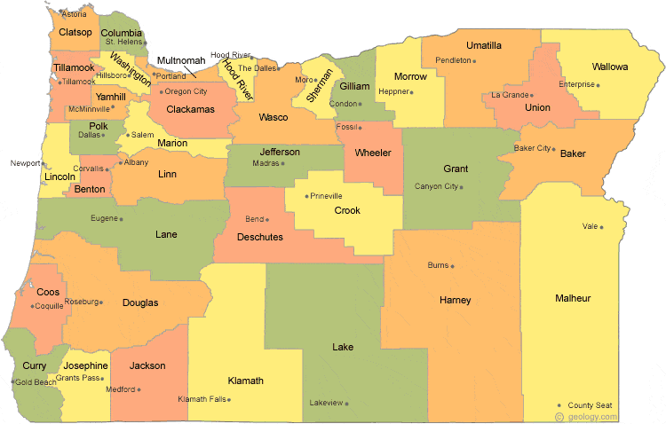
Regional Contacts by ESD
Jen Engberg
  Clackamas, Columbia Gorge, Multnomah and Northwest Regional
Sarah Martin
  Douglas, Lake, Malheur, South Coast and Southern Oregon
Lisa Plumb
  Lane, Linn Benton Lincoln and Willamette
Amy Tidwell
  Grant, Harney, High Desert, InterMountain, Jefferson, North Central and Region 18

Slide 26

Please reach out!
Jen Engberg
Jennifer.Engberg@ode.oregon.gov
Sarah Martin
Sarah.Martin@ode.oregon.gov
Lisa Plumb
Lisa.Plumb@ode.oregon.gov
Amy Tidwell
Amy.Tidwell@ode.oregon.gov
Lexi Neeman - McKinney-Vento Program
Lexi.Neeman@ode.oregon.gov
Janette Newton - Private Schools
Janette.Newton@ode.oregon.gov
Marlie Magill - Foster Care
Marlie.Magill@ode.oregon.gov
Jon Mabale - CEP
Jon.Mabale@ode.oregon.gov

