Slide 1
Title I-A “101” Session 1: August 21, 2024
Please put your district name next to your username.
In the chat: What is the best road trip you ever took?
Notes:
SARAH

Slide 2

Planning our journey
Quarterly webinars
August
November
February
May
Formula Grants Calendar is our map
Our goal is to travel to our destination in a way that will enable you to have a smooth trip this year!

Slide 3

Today’s Itinerary – Day 1
Meet our tour group (Getting to know you)
Study the map (Orienting to the calendar)
Visit “Scheduled Stops” (Key tasks for August – October)
Choose your own adventure (What do you want to learn about?)
Oregon Department of Education

Slide 4
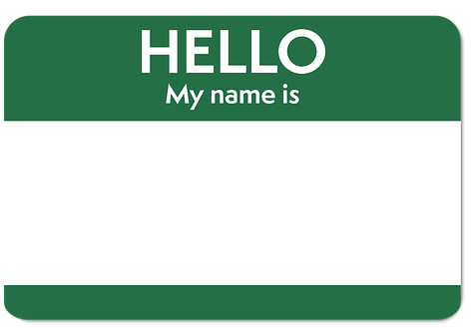
Who is on this trip?
Please tell the group:
Name
District
Role
Favorite road trip snack!

Slide 5
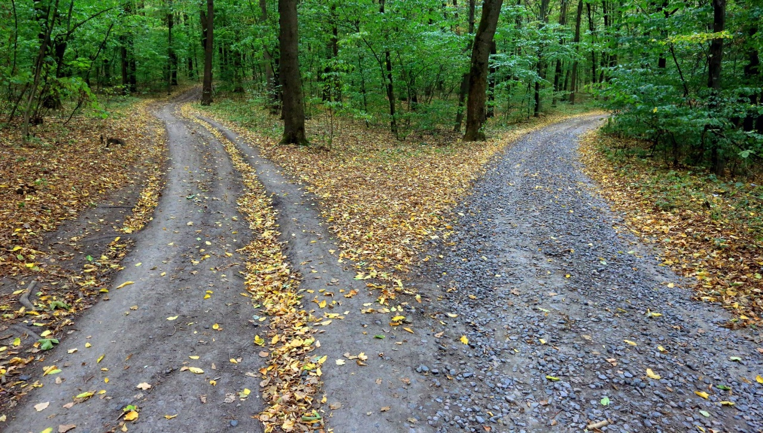
Finding our Way – Formula Grants Calendar
At-a-Glance
Freeway view
Key tasks and highlights
Chunks of time
Expanded Version
Scenic view
Programmatic vs. fiscal tasks
Laid out by month
Notes:
JEN Purpose: We are going to talk about the freeway view today

Slide 6

Stop #1: CIP Budget Narrative
Opens in August, due November 1
Prerequisites due October 1
Requires collaboration and communication
Nutrition and fiscal staff
McKinney-Vento & Foster Care liaisons
Private School staff
Principals
Highlights from this stop
Get access from district security administrator
Spending must align with school plans
Watch for allowability and supplanting
Use available CIP Budget Narrative resources
Notes:
CIP Budget narrative is the district application describing how Title I-A funds will be spent.
Nutrition staff – determining poverty
Fiscal staff – ensuring allowability (necessary, reasonable and allocable)
McKinney-Vento liaison – set aside for students experiencing housing instability
Private School staff – set aside for equitable share and services provided
Principals – school plans and budgets

Slide 7

Stop #2: Consolidated District Performance Report
Opens in August, closes September 27th
Reporting on the demographics and academic achievement of students in Title I-A schools from the previous year
Validation worksheet lets you fix errors before submission
Slide deck training from last week posted
Highlights from this stop
Get access from district security administrator
Annual training and resources available
Contact Kyle Walker with questions
Notes:
SARAH
CDPR is an annual collection of data required by USDE districts that received Title I-A funds in the previous school year. The data collections report on the demographics of students in the district served with Title I-A funds at School Wide Program and Targeted Assistance Program schools.

Slide 8

Stop #3: School Plans
Two types of programs and plans
Targeted Assistance (TAS) and Schoolwide (SWP)
Annual process
Plan should be in place at the start of the year
Reviewed and revised based on data
Families must be partners in planning
Highlights from this stop
Title I-A is not just about reading and math
Spending described in CIP Budget Narrative must align with needs identified in plan
Explore the criteria and templates for school plans
Notes:
AMY
School plans are tools for communicating and evaluating school priorities, goals, and strategies to improve outcomes for students.

Slide 9

Stop #4: Providing Equitable Services
The allocation is based on the private school student’s physical address and their family’s income
Service eligibility is based on the private school student’s physical address and their academic needs
Highlights from this stop
Equitable services should start at the beginning of the school year
Evidence of Consultation must be uploaded for each private school located in your district
Helpful resources and tools: Private School Participation Under ESEA
Notes:
Janette Title I-A programs are supported by tax dollars, so ALL children are eligible to access the program

Slide 10
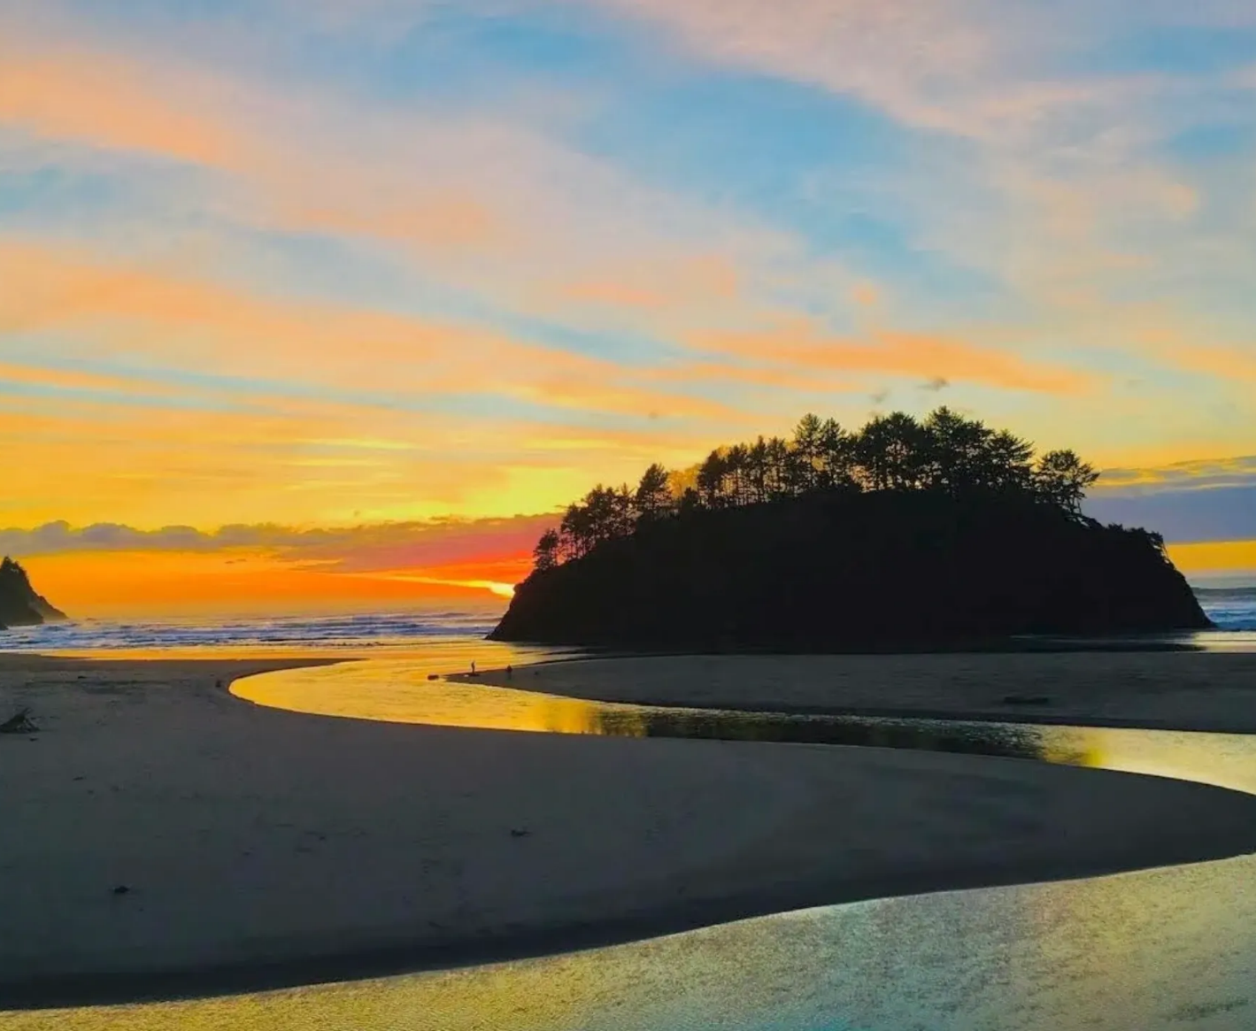
Stop #5: Annual Title I-A Meeting
Should occur by October 1
Communicate with families
Design of school program
Family rights under Title I-A
How families are engaged as partners
Highlights from this stop
Excellent opportunity to get family input on revisions to school plan and compact
Coordinate with other events, but be explicit in sharing Title I-A information
PPT template and Quick Reference Brief available
Notes:
LISA
The annual meeting is a requirement of ESEA under Title I-A, Section 1116.
Annual meeting content should include:
Explanation of Title I-A
Rights of Parents and Guardians
Sharing Our School’s Program, including goals, curriculum and assessments used
Annual Review and Evaluation and how student progress is tracked
Parent and Family Engagement including how families are included in review of the school plan and how the school offers support to families to help them help their students meet academic standards and other programmatic goals

Slide 11

Where would you like to go next?
Notes:
This is where we ask what topics they would like to talk about today, and in upcoming sessions.

Slide 12

Resources
Title I-A web page
Oregon Federal Funds Guide
ESSA Quick Reference Briefs
CIP Budget Narrative Checklists
Title I-A Data Collections (CDPR)
10 Tips for Federal Program Directors
Formula Grants Calendar
Equitable Services Resources

Slide 13

Please reach out!
Jen Engberg Jennifer.Engberg@ode.oregon.gov
Sarah Martin Sarah.Martin@ode.oregon.gov
Lisa Plumb Lisa.Plumb@ode.oregon.gov
Amy Tidwell Amy.Tidwell@ode.oregon.gov
Janette Newton Janette.Newton@ode.oregon.gov

