Slide 1
Title I-A “101” Session 4: May 8, 2025
Please put your district name next to your username.
In the chat: What is something you are looking forward to?

Slide 2

Planning our journey
Quarterly webinars
August
November
February
May
Formula Grants Calendar is our map
Our goal is to travel to our destination in a way that will enable you to have a smooth trip this year!

Slide 3

The Final Leg – Day 4
Locate our place on the map (Understanding the calendar)
Visit “Scheduled Stops” (Key tasks for March - June)
Reconciling Budget Narratives
Evaluating School-level Plans
Family Engagement
Dive deeper on a guided tour (Family Engagement)
Presentation by Yoncalla SD
Oregon Department of Education

Slide 4
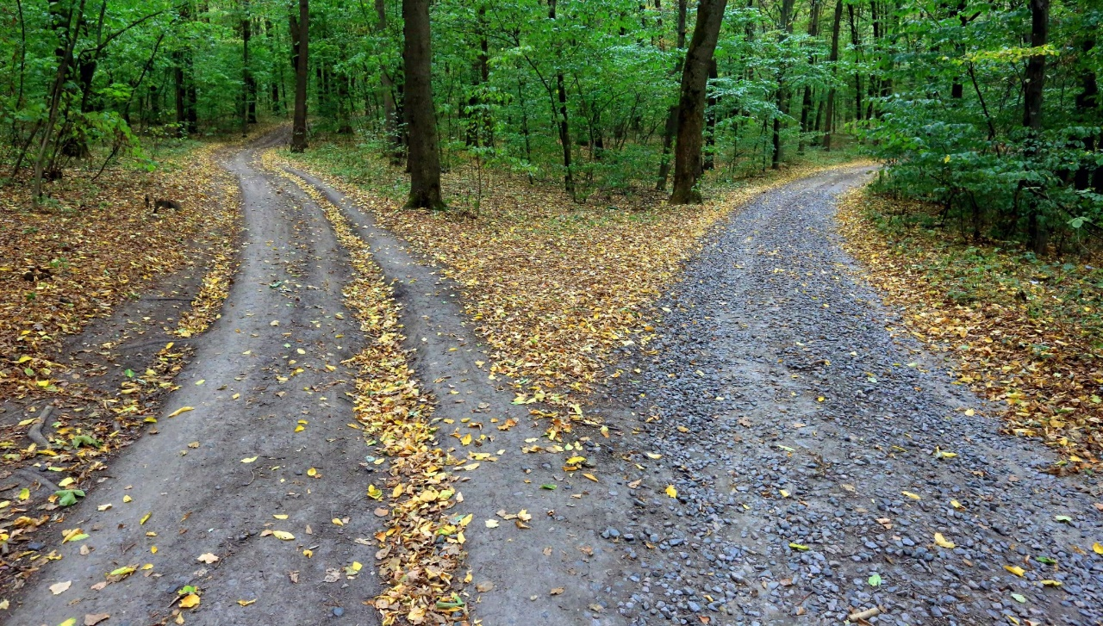
Finding our Way – Formula Grants Calendar
At-a-Glance
Freeway view
Key tasks and highlights
Chunks of time
Expanded Version
Scenic view
Programmatic vs. fiscal tasks
Laid out by month
Notes:
Reminder of the two views of the views of the calendar

Slide 5

Stop #1: Reconcile Budget Narratives
Districts must ensure funds are spent in alignment with the approved plan
Identify transaction errors
Ensure that award expenditures are complete
Plan for remaining funds as carryover
Should happen at least annually
Mind the cap: 15% limit on carryover*
Highlights from this stop
CIP Budget Narrative Quick Start Guide
ESSA Quick Reference Brief: Carrying over Federal Funds
*Can be waived once every three years
Notes:
What: Ensuring actual spending aligns to narrative
Why: Demonstrate that each award is used as intended
Identify transaction errors
Ensure that award expenditures are complete
Plan for remaining funds as carryover
When: At least annually (quarterly is better)
Anytime a new activity is added
If the change is 10% or more
Although carryover for Title I-A funds is capped at 15% of the total award, there is a provision within ESSA which allows ODE to waive that limitation once every three years. For example, a district that carried over more than 15% of its FY 2022-23 Title I-A funds would next be eligible for the waiver of the carryover limitation for its FY 2025-26 funds. Districts request this waiver through the carryover application in the CIP Budget Narrative.
ODE is NOT requesting another waiver from USED. We sent a letter to superintendents in mid-April to notify districts that will not be eligible to carryover more than 15% of 2024-25 funds.

Slide 6

Stop #2: Program and Plan Evaluation
Using data, districts must annually evaluate schoolwide plans
What did we say we were going to do?
How are we doing? How do we know?
Includes evaluation of private school program services
Families must be partners in this process
Highlights from this stop
Developing Schoolwide Plans Quick Reference Brief
Criteria for Schoolwide Plans
Schoolwide planning documents
Annual Evaluation of Equitable Services Programs
Notes:
AMY
Schools should have a process in place to annually evaluate the schoolwide plan to determine if the school is on track to meet their goals. Data to include in the evaluation process can include student outcome data, perception data, behavioral data, and any other metrics that the school feels necessary to provide a comprehensive evaluation of the enacted strategies.
Remembering to include families in this process is critical. WHEN the review happens is not as important as THAT it happens.

Slide 7

All Title I-A School Level Plans Articulate…
What students need
How the school will meet those needs
What success looks like
How families are involved
Notes:
Just a quick overview of the key components of the school plan

Slide 8
The WHY of School Level Plans
School level plans give the school community a voice
Opportunity for the school community to co-develop a plan
Strategically utilize Title I-A Funds to meet the needs of the specific school community
It is a requirement of any school receiving Title I-A Funds
Notes:
Opportunity for the school community comes together to discuss the needs of the students and how they might be addressed.
Plan is codeveloped and informed by families and school staff
Strategically leverage Title I-A funds to meet the needs of a specific school community.

Slide 9

Needs Assessment
Who are our students?
What data are we using to determine student needs and strengths?
If Targeted Assistance Plan:
What is our criteria for targeting interventions to the students who need them?
Must include:
Staff, families, students
Multiple data sources
**Needs assessments are generally completed every 3 years

Slide 10

Goals and Activities
What are the goals we have for our students?
What activities will be implemented to reach the goals?
Are these goals and activities reflective of how Title I-A funds are being spent in the building?
Include:
Staff, students, and families in developing the plan
Professional development needs

Slide 11

Annual Plan Review
Use data to review the effectiveness of the school level plan
Are there particular student groups who need of more support?
For next year, what should we:
Continue doing?
Stop doing?
Add to our plan?

Slide 12
Equitable Services
Title I-A
District must annually evaluate services to determine the progress being made in meeting participate students’ academic needs
The results are used to improve services
Evaluate
Spring/Summer 2025
Evaluate Services
Discuss Carryover
Notes:
JANETTE

Slide 13

Stop #3: Building Family Capacity
Districts and schools who receive Title I-A funds must work as partners with families
Families are an invaluable resource
Two-way communication is key
Trust is the foundation
Develop engagement infrastructure
Highlights from this stop
ESSA Quick Reference Brief on Family Engagement
Family Engagement Resources
Notes:
SARAH “Family Engagement is a full, equal, and equitable partnership among families, educators, and community partners to promote children’s learning and development from birth through college and career.” - Karen Mapp
Each school must provide opportunities for families to be engaged in their child’s learning. This includes supporting families with understanding the school’s program.
Trust is the secret to engagement
Invest in building systems and structures that enable this work. Teachers need time to make positive calls home, connect with families. WE need to find ways to building to their schedules opportunities to communicate well with families.

Slide 14

Required Family Engagement Activities
Annual Meeting
Required Elements (see the ODE Annual Meeting PPT Template)
Student Compact
How is this distributed?
When is this reviewed, including family input?
Parent/Family Involvement Plan
How can families be involved?
Family Support Activities
What activities are we doing as a school to support families in supporting their students’ learning?

Slide 15
Less Impact More Impact
Fundraisers
PTAs/PTOs
Potlucks
Family Volunteering
Student Performances
Family Resource Rooms
Family Website Portal
Regular Personalized Communication
Positive Phone Calls Home
Student Goal Setting Talks
Adapted from TNTP
School Newsletters
Back to School Night
Family Training Events
Tips/Tools for Home Learning
Teacher Conferences
Classroom Observations or Mini-Lessons
Home Visits
Weekly Data Sharing Folders
Notes:
The most impactful engagement strategies are those that center on student learning and provide parents with data and support for their student.
Anytime you bring families into buildings it should be linked to learning – what students are doing and where they need support. Start by sharing data and showing where kids are and why you need their help to get to the next level. Whatever activity you do should be closely aligned with meeting that goal. Make sure parents are actively engaged and the information is relevant to all parents. Activities tailored to the needs of each grade will be more effective than whole group activities where everyone is doing the same thing.
Interactive homework, tips, and tools for home learning
Regular personalized communication
Positive phone calls home
Goal Setting Talks
Classroom observations or mini-lessons
Home Visits
Weekly data-sharing folders

Slide 16

A Guided Tour of Family Engagement – Yoncalla SD
Notes:
Back in 2011, Jerry Fauci, then-principal of the elementary school in Yoncalla, Oregon — a rural community of about 1,000 residents in southern Oregon — had a backyard conversation with his new neighbor, a program officer for The Ford Family Foundation. The conversation centered on education and how to support the school’s youngest students to make sure they’re ready to be successful entering kindergarten. Eventually a partnership formed between the Foundation, the Children’s Institute and Yoncalla School District.
“Initially this was an opportunity to make sure that the school district could see families and children clearly,” explains Erin Helgren, current principal of Yoncalla Elementary School. “Not only some of the barriers they may have had engaging with the school, but some of their infinite strength and potential.”
Early conversations were held in the community library. Then there was Dr. Seuss night at the school. It grew into a parent drop-in room. Then a preschool classroom. Then an Early Head Start class. Ten years later, the elementary school, the school district and community of Yoncalla have been completely transformed.

Slide 17


Responsive Family Engagement

Slide 18

Why We’re Here
Notes:
Remember why we’re here – for Yoncalla and North Douglas County children, families and community, to promote school readiness and school success – Ready Families, Ready Schools, and Ready Community.

Slide 19
Elements of an Effective Prenatal-Grade 3 System
Committed Leadership
Effective Governance
Shared, Leveraged Resources
Data-Driven
Decision Making
Supports for learning
Aligned, Seamless
Pathways
Outcome Children Ready for School & Meeting Benchmarks
Health and community resources
Family engagement at home and school

Slide 20
Guiding Principles
Effective system & services for children
Universally available
A smart investment
Community-based and school-connected
Integrated & Aligned Around Common Goals
Outcome Focused & Data Driven
Fueled by Engaged & Empowered Families
Led by Committed, Supportive Local Leaders
Notes:
So, now imagine that those triangles are sitting on a base.
That base is the foundation of Early Works, and those are these Guiding Principles.
These flow through all the work and decisions of Early Works to guide activities and supports.
These 8 principles are woven into Early Works at all levels, from building on ways to strengthen parent-teacher relationships and communication, to decision-making of the Leadership Team, to designing summer learning activities.
And they all point to building and strengthening an effective system of supports and services for children birth to 8.
And this is all to be successful in high school.
This is the foundation for success!
P-20
It’s good enough for all – PK through HS
Districtwide approach

Slide 21
How P3 Work develops over time

Slide 22
Entering Yoncalla kinders know many more lowercase letter names over time.
Entering Yoncalla kinders also know many more uppercase letter names over time.
Orange line is State average
Notes:
2016 - Out of 26 possible instead of 100.
Prior years - Students have 1 minute to name as many letters as possible, e.g., from a 10x10 grid with both upper and lower case letters.
In two sections, starting in F16, upper and lower case letters separately.
These are averages for YEW students whose families consented to share individual-level data.

Slide 23
Entering Yoncalla kinders know many more letter sounds over time on average, and show an upward trend.
Orange line is State average
Source: Oregon Kindergarten Assessment – CBM Letter Sounds – Fall – Kindergarten
Notes:
F13 through F15: Students have 1 minute to name as many letter sounds as possible, e.g., from a 10x10 grid with both capital and lower case letters and blends, similar to KPALS letter sound section
F16 measure is different from prior years and is on scale from 0-26 rather than 0-100
Letter name recognition was also up in F16, just above state average as well

Slide 24
More kindergartners were in the expected range for behaviors compared to the most recent prior years.
% Borderline Range
% Concerning Range
Source: Portland State University Assessment: Strengths & Difficulties Questionnaire, completed by teacher
Notes:
Emotional problems – similar to Interpersonal of CBRS
Headaches
Worries
Unhappy, downhearted
Nervous, clingy
Many fears, easily scared
Conduct problems – similar to Emo Reg of CBRS
Temper tantrums
Obedient, do as told
Fights with others
Lies, cheats
Steals, takes things
Hyperactivity – similar to Emo Reg of CBRS
Restless, overactive
Fidgeting, squirming
Easily distracted, difficulties concentrating
Thinks before acting
Peer problems – similar to Interpersonal of CBRS (Not included here)
Solitary, plays alone
Has at least one good friend
Generally liked by others
Picked on or bullied
Gets along better with adults than children
TOTAL
Prosocial – similar to Interpersonal of CBRS
Considerate of others’ feelings
Shares readily
Helpful if someone is hurt
Kind to younger children
Often volunteers to help others

Slide 25
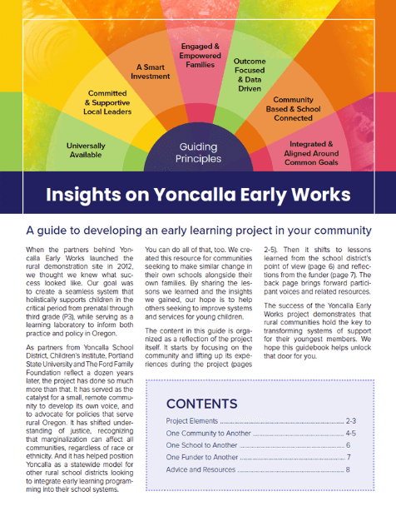
Insights on Yoncalla Early Works

Slide 26

Resources
Formula Grants Calendar
Title I-A School Planning web page
Oregon Federal Funds Guide
ESSA Quick Reference Briefs
CIP Budget Narrative Resources web page
Equitable Services Resources
Dual Capacity Framework
Yoncalla Early Works

Slide 27

Please reach out!
Jen Engberg Jennifer.Engberg@ode.oregon.gov
Sarah Martin Sarah.Martin@ode.oregon.gov
Lisa Plumb Lisa.Plumb@ode.oregon.gov
Amy Tidwell Amy.Tidwell@ode.oregon.gov
Janette Newton Janette.Newton@ode.oregon.gov

