Slide 1
Title I-A “101”
Session 2: November 13, 2024
Please put your district name next to your username.
In the chat: What is top of mind for you right now?

Slide 2

Planning our journey
Quarterly webinars
  August
  November
  February
  May
Formula Grants Calendar is our map
Our goal is to travel to our destination in a way that will enable you to have a smooth trip this year!

Slide 3

Today’s Itinerary – Day 2
Locate our place on the map (Understanding the calendar)
Visit “Scheduled Stops” (Key tasks for November - January)
Dive deeper on a guided tour (Presentation by Medford SD!)
Oregon Department of Education

Slide 4

Finding our Way – Formula Grants Calendar
At-a-Glance
  Freeway view
  Key tasks and highlights
  Chunks of time
Expanded Version
  Scenic view
  Programmatic vs. fiscal tasks
  Laid out by month
Notes:
Reminder of the two views of the views of the calendar

Slide 5

Stop #1: Carryover
Funds that were not spent as originally obligated by the district
  Percentage allowed for carryover depends on the program
Keep in mind carryover applies to:
  required set-asides under Title I-A
  equitable services
Transferred funds that are unclaimed will generate a carryover application under the original grant
Application opens November 22nd
Highlights from this stop
  ESSA Quick Reference Brief on Carryover
  Federal Funds Timeline graphic
  Carryover CIP Budget Narrative Checklist
  Carryover Revision Form
Notes:
Federal formula funds are made available on July 1 of the fiscal year and remain available for obligation by districts for a period of 27 months. This 27-month period includes an initial 15-month period of availability and an automatic 12-month extension permitted under the Tydings Amendment. “Carryover” is the term often used to refer to those funds that have not been spent as originally obligated by the district.
Each year districts submit their plan for spending federal funds. However, plans can change and there are many reasons why a district may not expend all allocated funds within the initial grant year. Consequently, any funds not spent by a district in the first year of the grant are “carried over”. Districts complete a carryover application in CIP Budget Narrative and have an additional 12 months to spend the remaining funds.
When completing the carryover application the district provides: 1. an explanation for why funds were not spent as originally intended; 2. which approved activities did not take place; and 3. a description of the allowable activities that the district would like to undertake in place of those originally planned.
If funds were transferred in the initial grant year, they must be claimed from the original grant in EGMS. Any unclaimed funds will generate a carryover application, so it is recommended that transferred funds be claimed first.

Slide 6

Stop #2: Comparability
Demonstrates the distribution of State and local funds/resources to schools are comparable, regardless of Title I-A status
Student-Instructional Staff ratio is most common method
Some districts and schools are exempt
Due December 1st
Highlights from this stop
  ESSA Quick Reference Brief on Comparability
  NEW! Comparability Checklist
  Title I-A Data Collections web page
  Sample timeline
Notes:
Comparability is a school-level calculation that measures the level of State and local funds and resources provided to a district's Title I-A and non-Title I-A schools. The goal is to determine whether the distribution of State and local funds and resources to schools, including charter schools, are comparable regardless of Title I-A status. Comparability’s focus is educational materials and resources specifically. While comparability and methodology requirements both examine how the district distributes state and local funds and resources to schools, they are separate tests that measure different aspects of the supplemental nature of Title I-A funds.
LEAs are exempt from demonstrating comparability when there is only one school per grade span. Additionally, schools with fewer than 100 students need not be included in the calculation. LEAs may exclude the following State/local funds for the purposes of determining comparability: • Language instruction for emergent bilingual students • Excess costs of providing services to students experiencing disability • Staff salary differentials for years of employment • Supplemental programs that meet the intent and purpose of Title I

Slide 7

Stop #3: Self-Assessment
Designed to help districts reflect on their practices around federal programs
Required for districts being monitored, optional for all other districts
Good way to establish a baseline understanding of district practices
Highlights from this stop
  ESEA Self-Assessment
  Federal Monitoring web page
  ESEA Monitoring Organizational Tool
Notes:
The self-assessment is aligned to programmatic requirements laid out in ESEA and is designed to help districts examine their practices around federal programs. Districts being monitored are required to complete the self-assessment to develop shared understanding of the district's current practices relative to ESSA requirements, noting strengths and identifying where technical assistance/support may be needed from the Oregon Department of Education (ODE). However, the self-assessment is available for use by any district at any time for the process of program reflection. Each district will decide the appropriate staff to involve, but participants should include those who have the most knowledge of/responsibility for the topics included.
The ESEA Monitoring Organizational Tool includes information on all the requirements within ESEA for which districts are responsible. This tool serves as a reference for districts regarding what documentation should be maintained at the local level.

Slide 8

Stop #4: Time and Effort
Employees paid with federal funds must track and formally document their time
Includes full time and part-time certificated and classified staff
Based on work done (cost objective)
District systems must meet requirements outlined in 200.430(i) of UGG
Highlights from this stop
  ESSA Quick Reference Brief on Time & Effort
  Uniform Grants Guidance
  Sample Time and Effort form
Notes:
Districts must have a system for documenting and reporting the time of staff paid out of federal funds which includes: • Full time and part time employees; • Stipends paid from federal funds that are considered salary expenses; and • Substitute teachers.
Time and effort reports should be prepared by all certificated and classified staff with salary and benefits that are charged: • to a single federal award; • to multiple federal awards; or • to any combination of a federal award and other federal, state or local fund sources.
Time and effort is not based on how you are paid (funding source), but on the work that you do (cost objectives). A cost objective is a set of work activities allowable under a particular funding source or sources.
Regardless of whether an employee works on a single cost objective or multiple cost objectives, time and effort documentation should: • reflect an after-the-fact documentation of the activity of the employee; • account for the total activity for which each employee is compensated; and • be affirmed by the employee and/or supervisory official having firsthand knowledge of the work performed by the employee.

Slide 9

A Guided Tour of Time & Effort – Medford SD
Notes:
\Medford will share their process for documenting time and effort.

Slide 10
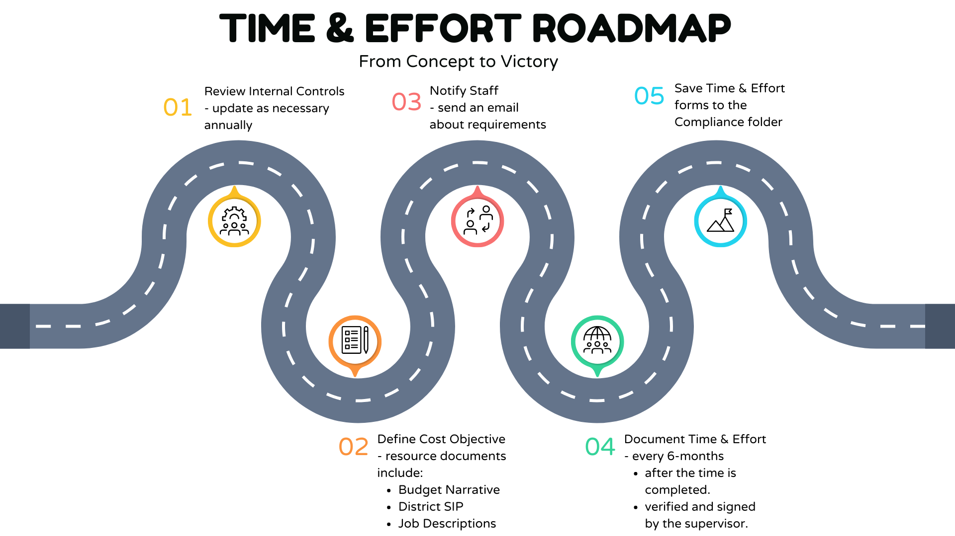
Time & Effort Road Map
Notes:
\

Slide 11

Resources
Title I-A Data Collections web page
Oregon Federal Funds Guide
ESSA Quick Reference Briefs
Equitable Services Learning Module 3: Allocations, Transferability & Carryover
Formula Grants Calendar
Uniform Grants Guidance
Federal Monitoring web page

Slide 12

Please reach out!
Jen Engberg
Jennifer.Engberg@ode.oregon.gov
Sarah Martin
Sarah.Martin@ode.oregon.gov
Lisa Plumb
Lisa.Plumb@ode.oregon.gov
Amy Tidwell
Amy.Tidwell@ode.oregon.gov
Janette Newton
Janette.Newton@ode.oregon.gov

