Slide 1
Title II-A & Title IV-A
Completing the CIP Budget Narrative

Slide 2

Outcomes
Overview of Title II-A & IV-A
Review CIP Budget Narrative components
Walkthrough of applications
Resources
Oregon Department of Education
Notes:
Title IIA and IVA are unique programs with their own distinct focus. However, they have a lot in common, both in the requirements wi

Slide 3

Title II – A Purpose
The purpose of Title II-A is to improve teacher and leader quality and focuses on preparing, training, and recruiting high-quality teachers and principals.
Notes:
The purpose of Title II-A is to improve teacher and leader quality and focuses on preparing, training, and recruiting high-quality teachers and principals.
The Title II-A program is intended to provide historically underserved students, particularly students of color and students experiencing poverty with greater access to effective educators. While the goal of Title IIA is to improve outcomes for students, the
The purpose of the SSAE grant program is to improve students’ academic achievement by increasing the capacity of states, LEAs, schools, and local communities to:
Provide all students with access to a well-rounded education;
Improve school conditions for student learning; and
Improve the use of technology in order to improve the academic achievement and digital literacy of all students.
focus is on supporting educators to become more effective practitioners.

Slide 4
Title IV- A Purpose
The purpose of Title IV-A is to improve student academic achievement through:
  Access to a well-rounded education;
  Improve school conditions for student learning; and
  Improved use of technology in order to improve the digital literacy of all students.
Notes:
The purpose of Title II-A is to improve teacher and leader quality and focuses on preparing, training, and recruiting high-quality teachers and principals.
The Title II-A program is intended to provide historically underserved students, particularly students of color and students experiencing poverty with greater access to effective educators. While the goal of Title IIA is to improve outcomes for students, the
The purpose of the SSAE grant program is to improve students’ academic achievement by increasing the capacity of states, LEAs, schools, and local communities to:
Provide all students with access to a well-rounded education;
Improve school conditions for student learning; and
Improve the use of technology in order to improve the academic achievement and digital literacy of all students.
focus is on supporting educators to become more effective practitioners.

Slide 5

Common Ground: II-A and IV-A
Supplement not Supplant
Equitable services
Consultation
Needs assessment
Prioritizing high needs schools
IMPORTANT: Allowable uses are different! Title II-A cannot be spent on direct services to students
Notes:
There are a lot of commonalities between Title IIA and IVA

Slide 6
Supplement Not Supplant
Federal funds cannot be used to supplant, or take the place of, state and local funds that would have been spent if Title II-A or IV-A funds were not available
  Test I: Are the services that the district wants to fund with ESEA funds required under state, local, or another federal law? If they are, there could be the presumption of supplanting.
  Test II: Were state or local funds used in the last year to pay for these services? If they were, there could be a presumption of supplanting.
ESSA Quick Reference Brief: Supplement Not Supplant
Notes:
There is a federal provision of supplement, not supplant in Title IIA and IVA: Funds received under this subpart shall be used to supplement, and not supplant, non-Federal funds that would otherwise be used for activities authorized under this subpart.
To determine whether a fiscal expenditure supplements and does not supplant, school districts must run the following tests:
Test I: Are the services that the district wants to fund with ESEA funds required under state, local, or another federal law? If they are, there could be a presumption of supplanting.
Test II: Were state or local funds used in the past to pay for these services? If they were, there could be a presumption of supplanting.
It is possible for districts to overcome the presumption of supplanting. Overcoming the presumption of supplanting requires that districts keep documentation (e.g., budget information, planning documents, or other materials). In general, a district must determine what educational activities it would support if no ESEA funds were available. If it is clear that no State or local funds remain available to fund certain activities that previously were funded with State or local resources, then the district may be able to use ESEA funds for those activities.

Slide 7

Equitable Services
Timely, meaningful, annual consultation
LEAs can deduct administrative costs prior to calculation of Equitable Share
Calculation is based on total enrollment
  All district students + all PS students
ESSA Quick Reference Brief: Equitable Services
Oregon Department of Education
Notes:
It is important to note that private schools are eligible for equitable services under both Title IIA and Title IVA. Districts must engage in consultation with private schools within district boundaries annually to determine if they wish to participate. As a result of completing the Private School information linked in the district’s CIP Budget narrative dashboard an equitable services worksheet will automatically be generated. When calculating total enrollment on the ES worksheet – all students in the district and PS are included which is different from the Title IA calculation.
The Equitable services Tab is where the district determines the share of Title IVA funds that will be available to private schools.
The amount an LEA must reserve to provide equitable services for private school teachers and other educational personnel for Title IV, Part A services is based on the LEA’s total Title IV, Part A allocation less administrative costs.
It is important to keep in mind that when calculating total enrollment on the ES worksheet – all students in the district and PS are included which is different from Title IA.
Services are secular, neutral, and non-ideological and address the needs of the eligible private school students

Slide 8
Prioritizing High Needs Schools
LEAs must prioritize funds to schools that:
  Have the greatest need as determined by the LEA
  Have the highest percentages or numbers of low-income children
  Are identified for CSI or TSI support
  Are identified as a persistently dangerous school under Section 8532 (Title IV-A)

Slide 9
CIP Budget Narrative

Slide 10

Consultation
Districts must meaningfully consult with a wide array of stakeholders when designing their Title II-A and Title IV-A programs
  Administrators
  Teachers
  Paraprofessionals
  Instructional support personnel
  Parents
  Community members and partners
  Tribes and tribal organizations

Slide 11
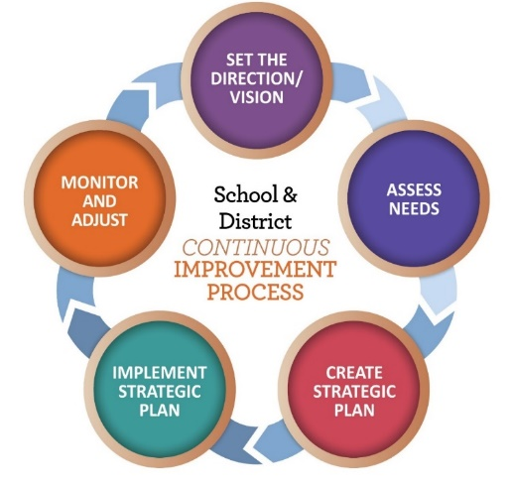
Application Requirements
Needs Assessment
  What does the data tell us?
  Which schools have the highest need?
Budget Narrative
  What will we do to meet our needs?
Equitable Services Worksheet
  Only for districts with participating schools
Notes:
The district applies for Title IIA and IVA funds through the CIP Budget narrative on the secure district site. Ideally, the district’s application for these funds reflects the larger district plan for improvement.
The two main parts are the needs assessment and the budget narrative. If a district has participating private schools then an Equitable Services tab will also appear.
11

Slide 12
Needs Assessment
Title II-A
Data Sources
Data Analysis
Prioritized Needs
Plan Development
Prioritizing Schools (2023-24)
Title IV-A
Identified Needs & Priorities
Program Objectives & Intended Outcomes
Only required for districts that receive $30K or more
Prioritizing Schools (2023-24)
Notes:
In the Needs Assessment section of the Title IIA application, districts respond to four prompts to summarize their comprehensive needs assessment process. The district is asked to list the data that was analyzed, what was learned from that data, what priorities were identified as a result and who was involved. Ideally the data used will include a variety of student data as well as systems and perception data. This does not mean districts needs to conduct a special needs assessment process for IIA. It is simply a summary of the larger process the district uses to determine needs.
For Title IVA, districts will see two prompts. First, districts are asked to list their identified needs and priorities. Second, they should articulate the objectives and intended outcomes of the activities they plan to undertake with IVA funds. It is important to note that only districts that receive $30,000 or more are required to complete the needs assessment for IVA.
Currently the CIP BN does not ask districts to articulate how they prioritize the use of IIA and IVA funds toward high need schools. We are going to make adjustments to the narrative application for 2023-24 which will require districts to share this information.

Slide 13
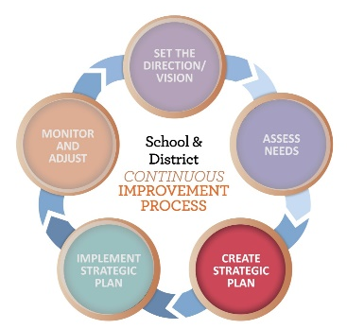
Completing the Budget Narrative
WHY was the strategy/activity selected?
  List the prioritized need the activity addresses
WHAT is the intended objective?
  Briefly describe the activity
WHO is participating?
  List the audience for the activity (e.g.; staff, students)
HOW will you measure impact?
  Identify what measures will be used to determine whether
  the strategy is generating the results you expect
Notes:
The Budget narrative section is where districts describe what they will do to meet their identified needs. Based on the needs identified (the WHY), strategies in the Budget Narrative should describe WHAT, WHO and HOW.
The HOW is about identifying the measure(s)/process you are planning to use to determine whether the strategy is generating the results you expect. It is important to note that impact is not restricted to student achievement, and can include impact on educator practice. Evidence of impact could include surveys, educator evaluation data, attendance, behavior, graduation rate, course participation, etc.

Slide 14
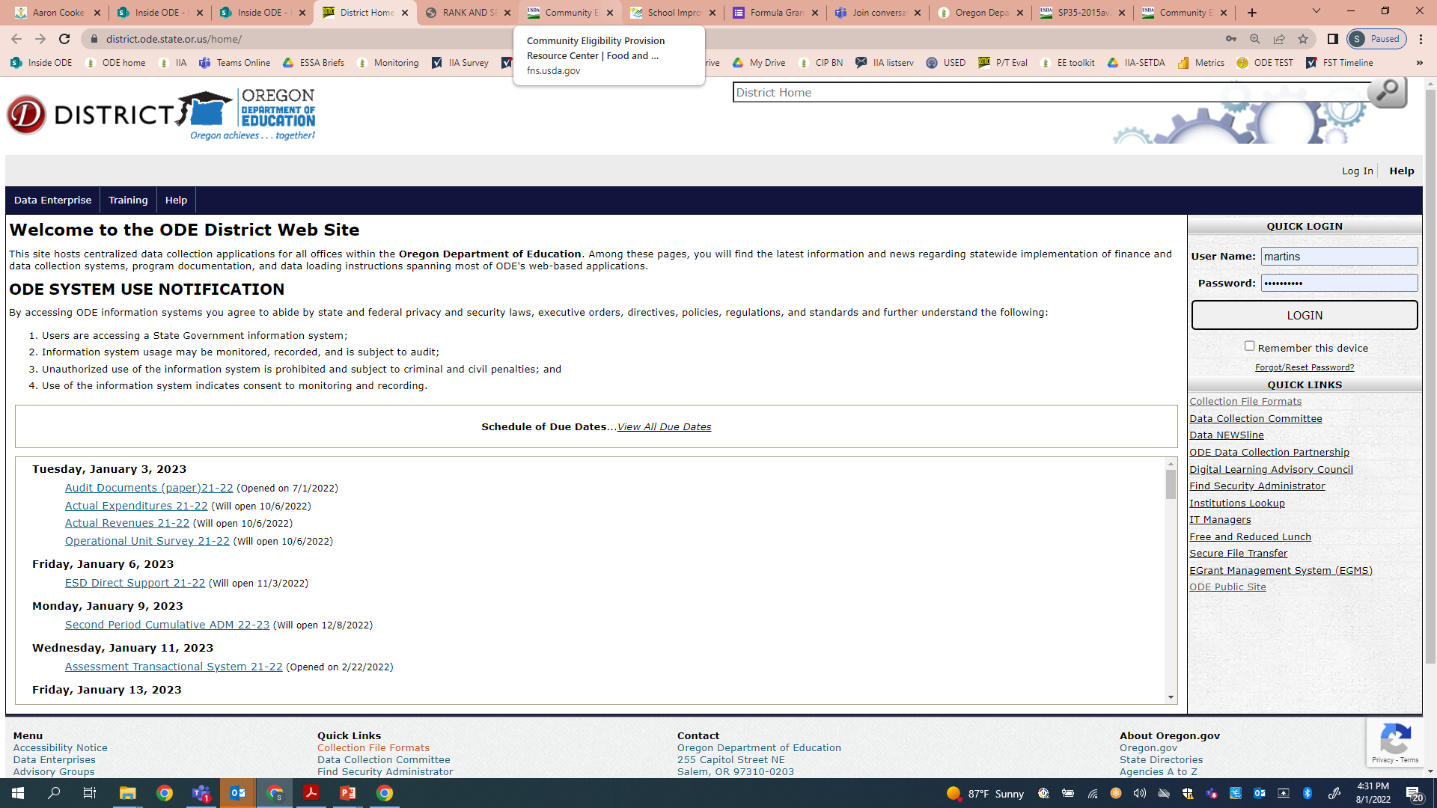

Take a Look!
District Secure Site
Notes:
You can log onto the district’s CIP BN dashboard through the district secure site to find the application.

Slide 15

Resources
Oregon Federal Funds Guide
CIP Budget Narrative User Guide
CIP Budget Narrative Checklists
Non-Regulatory Guidance (II-A)
Non-Regulatory Guidance (IV-A)
Notes:
There are a wide variety of resources available to support districts with Title IIA and IVA. The CIP Budget Narrative User Guide and Checklists are particularly helpful tools when submitting the narrative application.

Slide 16
Questions?

