Slide 1
Supporting our Emerging Bilingual Students Title III Start of Year Webinar
2021-22
September 2021
Notes:
Liz – Greetings

Slide 2
Welcome and Introductions
Welcome
and
ODE Introductions
Notes:
Liz

Slide 3
Land Acknowledgment
To implement the Land Acknowledgement is to respect those whose relationship to the land precedes ours and to collectively engage in fundamental measures that advance justice for the Indigenous peoples of the region, past, present, and future.
Al implementar la presencia a la tierra damos honor y respeto a todos los que vinieron antes que tenían una comunicación/amistad con la tierra y que todos juntos entremos en pasos fundamentales para avanzar justicia para las personas indígenas esta región en el pasado, presente, y futuro.
Notes:
Susy

Slide 4
ODE Education Equity Stance
Education equity is the equitable implementation of policy, practices, procedures, and legislation that translates into resource allocation, education rigor, and opportunities for historically and currently marginalized youth, students, and families including civil rights protected classes. This means the restructuring and dismantling of systems and institutions that create the dichotomy of beneficiaries and the oppressed and marginalized.
Equidad en educación es la implantación équida en póliza, practicas, procesos, y legislación que se transfiere en fondos monetarios, rigor en educación, y oportunidades para todos los niños, estudiantes, familias, y clases protegidas por derechos civiles que históricamente y en el presente has sido marginalizados. Esto quiere decir es reestructura y desmantelizacion de sistemas e instituciones que han creado la dicotomía de beneficiarios y los que son oprimidos y marginalizados.
Notes:
Susy

Slide 5
Honoring Your Work
Thank you for all that you are doing to support our students during this time
Thank you for your flexibility as you navigate each day
Thank you for your grace and care as you develop systems in your district/school to further support our EL students

Slide 6
Agenda
Foster discussion with district leaders on Title III strategies regarding upcoming updates
Review CIP-Budget Narrative submission process
Review timelines for the Title III grants and activities;
Participate in breakout session ELPA and OTELP to provide more time for questions ☺
Notes:
Susy

Slide 7
Care and Connect How Are You?
Survival: “We are feeling the burn, but getting things done.”
Performance: “Things are very busy, but we are prepared and working well as a team.”
Burnout: “Things are day to day and I’m tired.”
Recovery: “Things are calm and we are preparing for the next challenge.”
Notes:
Susy
Responding and acknowledging where we all are…
Transition---what is giving you hope, what is sustaining you? (aloud or in the chat)

Slide 8
Connection Time
Breakout rooms – 7 minutes
Time to talk with colleagues
Check in time
What’s going well ?
What are you grappling with?
What supports could ODE give to assist you?
Google Link to share your thoughts
Notes:
Host will send to breakout rooms
Kim on Monday and Susy on Friday

Slide 9
LUS and EL Plan- Updates
We hold deep respect for all the challenges, hard pivot changes, and multiple areas of work that districts continuously face.
LUS: Due to the pandemic, we had to update the timeline for developing and implementing the Oregon LUS. The Oregon LUS will be developed with input and partnership from our districts and partners.
EL Plans: We have started the process of research and engagement regarding updates to the EL Plan. We will keep you informed on this process and how you can provide input. We will provide a comfortable “runway” when EL Plans need to be submitted.
Notes:
Susy

Slide 10
Important Timelines
August 9: CIP Budget Narrative application opened for Title III Regular School Year
October 1:– CIP Budget Narrative Prerequisites Due
November 1: Title III Regular School Year Budget Narrative Due
November 15: CIP Budget Narrative – Title III Carryover opens (this is the application for the prior year’s funds that were not spent)
Early January: CIP Budget Narrative – Title III Immigrant opens
January 30: Title III Immigrant CIP Budget Narrative Application Due
January 30: Title III Carryover CIP Budget Narrative Application Due
February 1: Any Title III Regular School Year applications not submitted will have the Title III funds frozen
Notes:
Kim

Slide 11
Funding Timeline Chart
Grant Name | Grant Dissemination Year: | Spend Funds by: | Claim Funds by: | Notes
Title III Regular SY | 2018-19 | 9/30/2021 | 11/2021 | Tydings waiver approved to extend these funds
Title III Regular SY | 2019-20 | 9/30/2022 | 11/2022 | Tydings waiver approved to extend these funds
Title III Regular SY | 2020-21 | 9/30/2022 | 11/2022 | Normal timeline including Carry-over
Title III Regular SY | 2021-22 | 9/30/2023* | 11/2023 | Districts will have access to 20% of these funds when prerequisites are received – normal timeline including Carry-Over
The same timeline applies to the Title III Immigrant subgrants
* Unclaimed funds will be available in Title III Carryover beginning November 2022
Notes:
Kim

Slide 12
CIP Budget Narrative Application
Title III
2021-22
September 2021
Notes:
Kim

Slide 13
Title III Purpose
There are five purposes of Title III under the ESEA:
1. “To help ensure that English learners (ELs), including immigrant children and youth, attain English language proficiency (ELP) and develop high levels of academic achievement in English;
2. To assist all ELs, including immigrant children and youth, to achieve at high levels in academic subjects so that all ELs can meet the same challenging State academic standards that all children are expected to meet;
3. To assist teachers (including preschool teachers), principals and other school leaders, State educational agencies (SEAs), local educational agencies (LEAs), and schools in establishing, implementing, and sustaining effective language instruction educational programs designed to assist in teaching ELs, including immigrant children and youth;
4. To assist teachers (including preschool teachers), principals and other school leaders, State educational agencies (SEAs), and local educational agencies (LEAs) to develop and enhance their capacity to provide effective instructional programs designed to prepare ELs, including immigrant children and youth, to enter all-English instructional settings; and
5. To promote parental, family, and community participation in language instruction educational programs for the parents, families, and communities of ELs.”
(ESEA § 3102)
Notes:
Kim

Slide 14
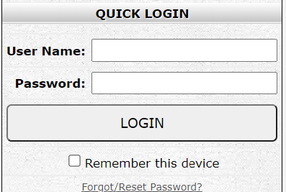
Here’s how to access your CIP Budget Narrative
Here are the steps to access your CIP Budget Narrative Application.
Make sure your district security administrator has granted permission to read, write, edit, and submit the application.
Sign in to your ODE District secure applications on the ODE district secure web page.
Select the CIP Budget Narrative Application
Notes:
Kim

Slide 15
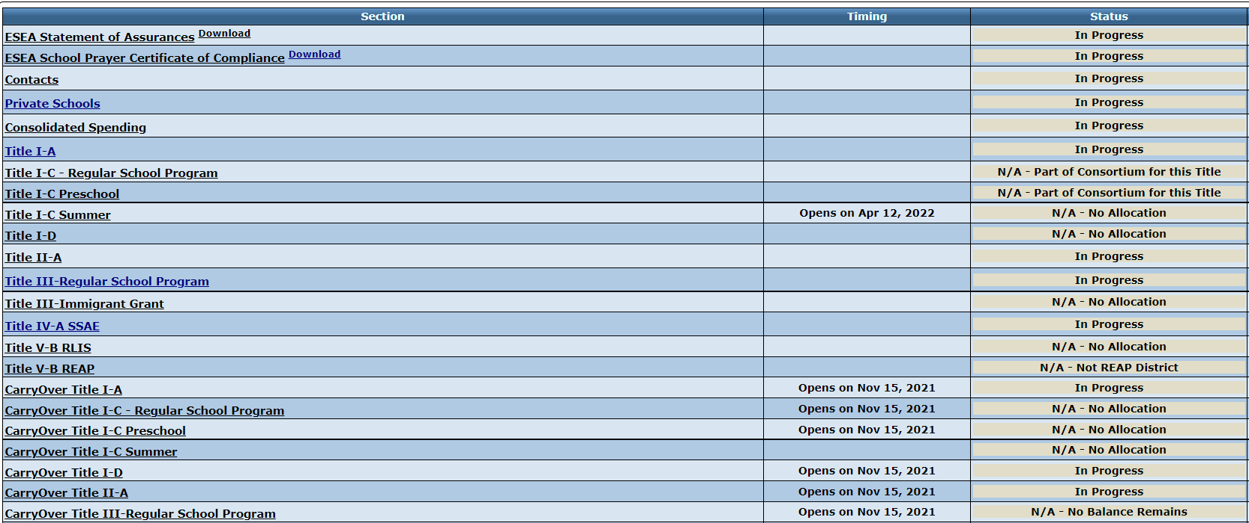
BUDGET NARRATIVE OVERVIEW
Click on the Section on the Overview page to open the specific Budget Narrative page.
Notes:
Susy - This is a snapshot of the worksheet in the budget narrative application. Each title is hot linked for you to enter into that specific title. Dates are provided so you can see when a particular budget narrative Title is open.
If the status reads – in progress this is in the district hands, ODE staff can’t review.
If it reads under review – the budget narrative has been submitted to ODE staff for review.
Response required means this is returned to the district for more information from ODE.
Approved – means the proposed budget is approved, if you make changes to your activities (funding, or actual activity) you will need to edit and resubmit this application. (for Regular school year – there is no editing of carryover budget narratives once approved – contact ODE staff for assistance editing a carryover budget.).
For consortium members all prerequisites must be submitted and approved prior to budget narrative submission.
You will need to return to this page to actually submit the budget narrative to ODE for review.

Slide 16
BUDGET NARRATIVE - Requirements
There are a few prerequisites that each district must complete prior to the Title III application being able to be submitted. For Title III Consortia, each member district must have these prerequisites completed.
Notes:
Susy - Each of these elements must be completed prior to any budget narrative being submitted.
Statement of Assurances and School Prayer are downloadable forms signed by the District Superintendent or designee and emailed to the ODE staff person identified on the form.
The contacts requirement is reported directly on the contact page in the budget narrative application.
The private school requirement is is reported directly on the private school page in the budget narrative application.
Any indirect for Title III is included on the Consolidated spending page, this indirect for the Regular school year and Immigrant grant is handled thus. For carryover this item becomes a line item in the carryover budget section.

Slide 17
Indirect/Administrative Rate
Title III has a maximum indirect of 2% in ESSA.
This amount is coded on the Consolidated Spending page for Budget Narrative.
Districts may apply the 2% Title III indirect amount off the per student allocation when calculating private school equitable share.
Notes:
Susy - The indirect rate for Title III is the direct administrative amount to be used for the grant - Some sub-grantees do not opt to take the indirect rate.

Slide 18
Title III Components
Overview
Detailed Narrative: Describes fund usage, required data & collaboration.
Budget Narrative: Specific activity funding explained.
Spending Page: A spreadsheet that is organized by function and object code based on the codes inserted on the Budget Narrative page. Tool to support budget planning.
Notes:
Susy - Each federal Title has different tabs in its budget narrative application. Title III has 5 tabs including the overview.
The spending page takes the function and object codes included in the budget narrative page to enter the codes on an Excel spreadsheet. Sub-grantees do not submit data directly on the spending page but can use this page to assist with tracking expenditures appropriately.

Slide 19
Detailed Narrative
Section 1: Grantee affirms the EL instructional program and EL instructional materials are the same as are explained in the approved EL plans. Or the grantee provides a brief description of the changes to the instructional program or material.
Section 2: Describe how grantees will use Title III funds to enhance their EL program.
Section 3: Provide data required by ESSA Title III
Data elements (i.e. OTELP, Obtaining Proficiency, Math outcomes, etc.)
Please use the most recent data available and include the data year.
Sections 4-6: Pertain to consultation and collaboration on the Title III grant
Notes:
Kim

Slide 20
Required Title III Funded Activities
Strategies to support the English language development for ML/EBs (this includes PD).
Strategies to support ML/EBs access to core content (ELA, Math, and Science) (this includes PD).
Strategies for district outreach for parents, families, and communities.
For Title III Consortia, all of the three above required activities must be funded but not all member districts need to participate in all three activities.
U.S. Department of Education Title III Guidance is located here,
Notes:
Kim

Slide 21
Private Schools
Grantees with private schools participating in Title III should include the consulted activities in the budget section of the CIP Budget Narrative application.
List activities for local private schools participating in Title III; make sure to include funding for all private schools accordingly.
There is a specific function/index code for private schools.
Notes:
Kim - This section is required as part of the private school consultation – please use the specific private school function and object codes so that ODE staff can ensure equitable share for private schools participating in Title III funds.
Remember private school identified ELs must participate in the ELPA summative assessment annually and be identified with the ELPA screener.

Slide 22
Contact
Please contact your Title III Point of Contact for assistance with your Title III budget narratives.
Kim Miller
Kim.a.miller@state.or.us
971-239-9681
Susy Mekarski
Susan.merkarski@ode.state.or.us
971-720-3444
Notes:
Susy

Slide 23
2021-22 ELPA Testing Update
Title III Coordinators
20 Sept 2021
Notes:
Ben

Slide 24
“Post” Pandemic
The pandemic has evolved, but it has not ended.
The information on these slides is current, but ODE continues to monitor the situation and some policies may need shifting
Ready Schools, Safe Learners (requirements and best practices) has been replaced with Ready Schools, Safe Learners Resiliency Framework (best practices with few requirements).
Administering the ELPA Screener and Summative in 2020-21​​ is phasing out.
If new guidance is needed for 2021-22, it will be issued separately to minimize confusion.
We have returned to in-person instruction, and in-person testing.
Notes:
Ben

Slide 25
Standard Screening
Scores retrieved through new Centralized Reporting System
Parent permission is preferred, but not necessary
In-person only (no remote option)
Do not enter students without a Screener score into EL status at this time
Remote identification phased out on July 31; however…
Health and safety are paramount
We are monitoring the evolution of the pandemic to see if any of last year’s tools may be needed in 2021-22
Notes:
Ben

Slide 26
Unique Screening
Described in Administering the ELPA Screener and Summative in 2020-21​
For students who were eligible to participate in spring 2021 ELPA Summative, but did not
Parent permission is preferred, but not necessary
Window closes 17 December 2021
Requirement: test as “feasible”, not “all students”
Students who do not test retain EL status and will participate in next ELPA Summative
Notes:
Ben

Slide 27
Health and Safety
Ready Schools, Safe Learners Resiliency Framework contains no ELPA-specific requirements
Administering the ELPA Screener and Summative in 2020-21​ contained health and safety recommendations, not requirements
Mask mandate applies to ELPA testing
Scoring vendor confirms that “mask muffling” has no effect on ELPA scores
USDE health and safety flexibilities from 2020-21 were not extended to 2021-22; ODE is requesting updates as pandemic impacts shift
Notes:
Ben

Slide 28
ELPA Summative
Test window: 11 Jan – 15 April 2022
In-person testing (no remote option)
Will include some field test items; otherwise no changes to test from previous years
For students with “presumptive” EL status (remotely identified ELs), ELPA Summative score will determine EL status going forward
Notes:
Ben

Slide 29
Questions and Answers
Ben will host a breakout room for
Q & A

Slide 30
Thank You!
Ben Wolcott
ELPA Specialist
ben.wolcott@state.or.us
503-947-5835
Notes:
Ben

Slide 31
Break
10 Minute Break

Slide 32
OTELP
On Track to English Language Proficiency
Notes:
Josh

Slide 33
What is OTELP?
OTELP is an acronym for On Track to English Language Proficiency. It is a school and district accountability measure required by the Every Student Succeeds Act (ESSA). Oregon began calculating OTELP in the 2017-18 school year.
OTELP measures the extent to which current English learners (ELs) are on track to attain English language proficiency given (1) their initial domain proficiency, (2) their years identified as an EL, and (3) whether they have a disability and/or an interrupted formal education.
OTELP applies trajectory expectations to each tested ELPA domain (i.e., reading, writing, listening, and speaking) to determine whether the current ELs are on track.
Notes:
Josh

Slide 34
OTELP Includes Which ELs?
Is the student a current EL, enrolled on the first school day in May, and enrolled for a full academic year?
If no, the EL is not included in OTELP calculations.
If yes and the EL has an EL exit date and/or English proficiency via ELPA, the EL is included in OTELP calculations.
If yes and the EL does not have EL exit date and/or English proficiency via ELPA, the EL is only included if all of the following are met:
EL’s initial ELPA test must occur before the current year
EL must be identified as an EL for 1.50 or more years
EL must be enrolled during the current ELPA test window
Notes:
Josh

Slide 35
OTELP Trajectory Expectations?
Years Identified as an EL (No Disability and/or Interrupted Formal Education)
Initial Domain Proficiency | <1.5 | 1.5 to <2 | 2 to <3 | 3 to <4 | 4 to <5 | 5 to <6 | 6 to <7 | 7 or more
1 | Not Included | 1 | 2 | 2 | 3 | 3 | 3 | 4 or 5
2 | Not Included | 2 | 3 | 3 | 3 | 4 or 5
3 | Not Included | 3 | 3 | 3 | 4 or 5
4 or 5 | 4 or 5
Years Identified as an EL (Disability and/or Interrupted Formal Education)
Initial Domain Proficiency | <1.5 | 1.5 to <2 | 2 to <3 | 3 to <4 | 4 to <5 | 5 to <6 | 6 to <7 | 7 to <8 | 8 or more
1 | Not Included | 1 | 2 | 2 | 2 | 3 | 3 | 3 | 4 or 5
2 | Not Included | 2 | 2 | 3 | 3 | 3 | 4 or 5
3 | Not Included | 3 | 3 | 3 | 4 or 5
4 or 5 | 4 or 5
Notes:
Josh

Slide 36
How to Calculate OTELP?
Use trajectory expectations for each tested domain to determine on track to domain proficiency.
Compare the student’s domain performance level with expectation (given initial ELPA21 domain performance level, years identified as an EL, and disability and/or interrupted formal education status).
On Track to Domain Proficiency | Performance Level vs. Expectation
Yes | ≥ Expectation
No | < Expectation
Use on track to domain proficiency to determine OTELP.
OTELP | No Domain Exemptions | Domain Exemptions
Yes | ≥ 3 Domains On Track | All Tested Domains On Track
No | < 3 Domains On Track | < All Tested Domains On Track
Notes:
Josh

Slide 37
Example
Initial Domain Proficiency | <1.5 | 1.5 to <2 | 2 to <3 | 3 to <4 | 4 to <5 | 5 to <6 | 6 to <7 | 7 or more
1 | Not Included | 1 | 2 | 2 | 3 | 3 | 3 | 4 or 5
2 | Not Included | 2 | 3 | 3 | 3 | 4 or 5
3 | Not Included | 3 | 3 | 3 | 4 or 5
4 or 5 | 4 or 5
A student has been identified as an EL for 2.25 years and doesn’t have a disability or an interrupted formal education. The student’s initial and current performance levels are in the following table:
Domains | Initial | Current
Reading | 1 | 2
Writing | 1 | 2
Listening | 2 | 2
Speaking | 2 | 3
Is the student OTELP?
Notes:
Josh

Slide 38
Another Example
Initial Domain Proficiency | <1.5 | 1.5 to <2 | 2 to <3 | 3 to <4 | 4 to <5 | 5 to <6 | 6 to <7 | 7 to <8 | 8 or more
1 | Not Included | 1 | 2 | 2 | 2 | 3 | 3 | 3 | 4 or 5
2 | Not Included | 2 | 2 | 3 | 3 | 3 | 4 or 5
3 | Not Included | 3 | 3 | 3 | 4 or 5
4 or 5 | 4 or 5
A student has been identified as an EL for 4.75 years and has a disability. The student’s initial and current performance levels are in the following table:
Domains | Initial | Current
Reading | 2 | 3
Writing | 1 | 3
Listening | Exempt | Exempt
Speaking | 3 | 3
Is the student OTELP?
Notes:
Josh

Slide 39
Where to Access OTELP Data?
Aggregate Public Data:
English Learners on the Accountability Measures page:
School Year 2016-17
School Year 2017-18
School Year 2018-19
School Year 2019-20 – Not Available
School Year 2020-21 – Coming October
Student and Aggregate Secure Data:
On Track to English Language Proficiency validation within the Achievement Data Insight (ADI)
Request permission from your district security administrator
Validation Instructions
2018-19 and 2020-21 data are available
Notes:
Josh

Slide 40
OTELP in 2021-22 and Beyond
Rating level cuts on Accountability Details
Create specific cuts for middle and high schools
Trajectory expectations
Expand or contract trajectory expectations for specific student groups (e.g., EL SWD, EL SIFE)
Add student groups (and unique trajectory expectations)
Adolescent newcomers (i.e., recently arrived ELs in middle or high school)
Number of on track domains for OTELP
Increase or decrease for specific school types (e.g., elementary schools)
Notes:
Josh

Slide 41
Virtual OTELP Working Group
When: One meeting in late October or early November
Where: Virtual
Who: District Title III directors, staff, and/or educators with experience using OTELP or similar accountability data
What: Discuss enhancements, review impact data, and provide a nonbinding recommendation
Why: We have a unique opportunity to enhance an important accountability indicator
Please email me if you would like to participate.
(josh.rew@state.or.us)
Notes:
Josh

Slide 42
Thank You!
W. Joshua Rew
OTELP Data Owner
josh.rew@state.or.us
Notes:
Josh

Slide 43
Title I-C
Title I-C
Migrant Education Updates
Notes:
Yuliana

Slide 44
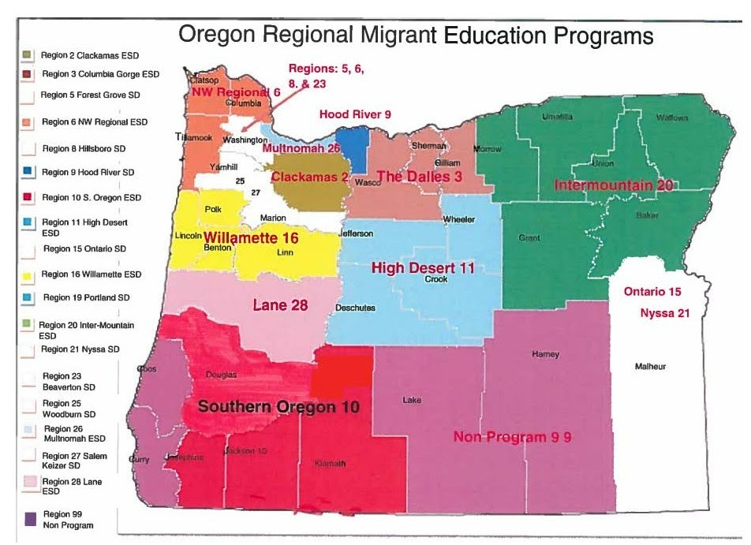
Migrant Education Title I-C
Yuliana Kenfield
Title I-C Migrant Education Specialist
Yuliana.kenfield@state.or.us

Slide 45
Charter Schools
Charter Schools Updates
Notes:
Kate

Slide 46
Public Charter Schools
132 public charter schools in Oregon
87 non-virtual charter schools sponsored by school districts
21 Single school district charter schools
20 state-wide virtual public charter schools
4 State Board of Education sponsored charter schools
Public charter schools may not limit enrollment based on proficiency in the English language
Are required to comply with state testing, including ELPA
May claim ADMw for qualifying emergent bilingual students
May participate in Title III funded activities through district or consortium

Slide 47
Public Charter Schools
Questions and Support:
Kate Pattison
Charter School Specialist
kate.pattison@state.or.us
503-580-5749 (text preferred to schedule call)

Slide 48
Private Schools
Private Schools Updates
Notes:
Joni

Slide 49
TITLE III: EQUITABLE SERVICES
Included in Consultation Process (Affirmations of Consultation to ODE)
Timely, meaningful and ongoing
LEAs may serve eligible private school students and educational personnel either directly or through third party contract
District is responsible for initial identification (LUS and ELPA)
Carry-over for 2019-2021 and 2020-2021
The district maintains title to materials, equipment, and property purchased with Title III funds. Include in inventory.
Notes:
Joni

Slide 50
TITLE III: SERVICES
Examples of Title III services include:
Administration of English language proficiency (ELP) assessments for identification and/or for the purpose of evaluating continued eligibility and the effectiveness of services (test booklets, teacher training, stipends to teachers to administer assessments)
Participation in district‐sponsored professional development, or PD organized specifically to meet the needs of the private school teachers for the purposes of improving services to English language learners
Tutoring for students before, during, or after school hours
Participation of private school ELL students in summer school
Participation of students in a weekend language development program
Purchase of supplemental instructional materials and supplies to support language development
Notes:
Joni

Slide 51
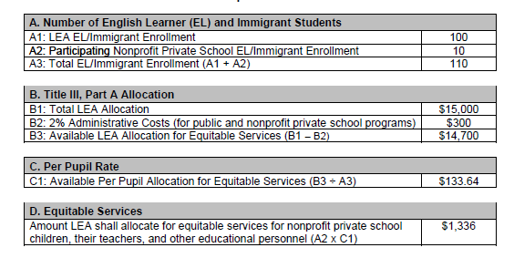
TITLE III: ALLOCATION
Examples of Title III services include:
Administration of English language proficiency (ELP) assessments for identification and/or for the purpose of evaluating continued eligibility and the effectiveness of services (test booklets, teacher training, stipends to teachers to administer assessments)
Participation in district‐sponsored professional development (PD), or PD organized specifically to meet the needs of the private school teachers for the purposes of improving services to English language learners
Tutoring for students before, during, or after school hours
Participation of private school ELL students in summer school
Participation of students in a weekend language development program
Purchase of supplemental instructional materials and supplies to support language development
Notes:
Joni

Slide 52
TITLE III: Resources
Non-Regulatory Guidance: English Learners and Title III of the ESEA, as amended by ESSA (September, 2016)
ODE Equitable Services FAQs
Joni Gilles joni.gilles@state.or.us
Notes:
Joni

Slide 53
Breakout Sessions
Breakout Sessions OTELP & ELPA

Slide 54
Thank you

