Slide 1
Using CEP to Rank & Serve Schools
August 20, 2024

Slide 2

Outcomes for Today
Learn how to navigate Rank and Serve for Title I-A using Community Eligibility Provision (CEP) data
Dispel Common Myths
Provide Resources
Oregon Department of Education
Notes:
Today we will be talking about using Community Eligibility Provision with Title I-A. We have received many questions about this over the past few months so we hope this will be helpful as you complete your budget narratives. If you aren’t aware, the requirements around CEP have changed, making free meals a reality for more Oregon students. It also means the data that districts have been using (free and reduced lunch applications) is no longer collected. So will talk about how to rank and serve accurately using different data, dispel some common myths, and share some resources to help.

Slide 3

New CEP Rules: What’s on the menu?
Lower eligibility threshold (25%) means more schools qualify
All students in a school receive free meals
Less stigma
Eligibility is good for four years
Free and Reduced Lunch Applications are out
Notes:
In October 2023, CEP eligibility rules changed, for the better! The eligibility threshold is now 25% through direct certification, which means more students are receiving free lunch at school. Eligibility is good for four years and there is less paperwork for districts. No free and reduced lunch applications means less stigma and burden for schools and families.

Slide 4

What does CEP have to do with Rank and Serve?
“Rank and Serve” is the process used to determine which schools should be served with Title I-A funds
Free and Reduced Lunch Applications were the main source data used
Districts must identify a consistent measure across schools to determine the number of students experiencing poverty
CEP can be used as a metric for this purpose
Notes:
The intent of Title I-A is to concentrate the funds in schools with the highest percentages of children from families experiencing poverty and to provide sufficient funds to make a difference in the academic performance of these students. In order to determine which schools will receive Title I-A funds, each district must put its schools in rank order from highest to lowest concentrations of children from families experiencing poverty.
Until recently, most districts were using free and reduced lunch applications to measure how many students were experiencing poverty in a given school. This worked fine, but there was a heavy paperwork burden and there is a stigma attached.
Title I-A provides several options for allowable data sources to measure poverty. Districts can use several different options, as long as they are consistent across schools in the district. Our goal today is to dive into how to use CEP or direct certification data for ranking and serving Title I-A schools.

Slide 5
Measures of Poverty outlined in ESEA
Free and reduced-price lunch count or Community Eligibility Provision (CEP) data
Count of students receiving assistance under Temporary Assistance for Needy Families (TANF)
Count of student eligible for Medicaid (Oregon Health Plan)
Census counts of children from families below the poverty level (SAIPE)
A combination of two or more of these data sources
Notes:
Before the rank and serve process can begin, districts receiving Title I-A funds must determine the level of poverty at all schools in the district. As outlined in ESSA, districts must select one of five measures to determine relative percentages of children from economically disadvantaged families residing in their attendance areas. CEP data is one method the district could use for this purpose.
If you look at these 5 options, CEP data is largely the most accessible data districts have. You can certainly use any of the ones listed here. However, the CEP data already does the work for you.

Slide 6
How do I find CEP data?
Visit the Special Provisions webpage
Select “Current Program Operation Information”
Download the most current school year’s spreadsheet
Select the “Site Notification Report” tab
Filter for your district
Notes:
Where do you find the CEP data for your district and how do you use it. Let’s walk through it together.
Visit the Special Provisions webpage
Select “Current Program Operation Information”
Download the most current school year’s spreadsheet
Select the “Site Notification Report” tab
Filter for your district

Slide 7
Which data do we use?
Look for your Identified Student Percentage (ISP)
The ISP is a low estimate of how many students in each school are experiencing poverty
By applying the ISP to the school’s current enrollment, you will get the number of students experiencing poverty to plug into the budget narrative
Notes:
Once you have filtered for your district, look for the column that says “Identified Student Percentage.” This is a low estimate of how many students are experiencing poverty in each school.

Slide 8
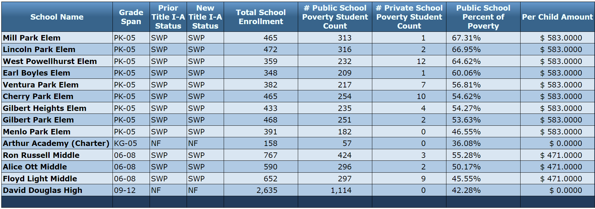
Entering data into the Budget Narrative
Budget Narrative will only let you enter enrollment and poverty counts.
Notes:
The budget narrative only allows for districts to enter in the “poverty student count” columns. So, we have to do a little math to figure out what number to enter.

Slide 9
How to Calculate
XYZ Elementary
ISP = 50%
Current Enrollment = 400
400*.5= 200 students experiencing poverty
Private school data is collected through consultation
School | Enrollment | Student Poverty Count | Private School Poverty Count | Percentage
XYZ Elementary | 400 | 200 | 4 | 50.00%
Notes:
Here is how you calculate the student poverty count. Let’s say the ISP for XYZ Elementary is 50%. You will take the current enrollment for that school and enter it in. We will use 400 for this case, because it’s a nice round number.
Calculate what 50% of 400 is and enter that in the student poverty count.
Private school poverty count is determined as you typically have in the past, through consultation.
Let’s pause for a moment and see what questions you have.

Slide 10

Some of our schools are CEP and some are not – how do we Rank and Serve schools?
CEP Schools
Option 1: Use the number of eligible students in both CEP and non-CEP schools
Option 2: Apply the 1.6 multiplier to the number of identified eligible students in both CEP and non-CEP schools
Option 3: Use the number of identified eligible students times the multiplier (1.6) and use the free and reduced-price meal data for non-CEP schools
Non-CEP Schools
Notes:
Jen talked to us about how we can reverse engineer the data from the CEP spreadsheet to determine the number of students experiencing poverty to enter in the Targeting page. However, in some districts, not all schools are CEP eligible. In that case there are several options:
Option 1: For non-CEP Schools: Check with your child nutrition person for the number of eligible students. The same direct certification information is available for all students, regardless of whether they attend a CEP eligible school or not. Those numbers can be entered into the Students Experiencing Poverty column.
Option 2: You can use the 1.6 multiplier across all schools. The multiplier will increase the number, and therefor the percentage of students experiencing poverty. The multiplier is a way of acknowledging that not all students experiencing poverty are captured in the direct certification data. Because using the multiplier will increase the poverty percentage, watch out for the 75% or above rule. Under ESEA, any school that has 75% or more of its students experiencing poverty must be served under Title I-A.

Slide 11
Calculating Using the Multiplier
XYZ Elementary
ISP = 50%
Current Enrollment = 400
400 X .5= 200 students experiencing poverty
200 X 1.6 multiplier = 320 students experiencing poverty
School | Enrollment | Students Experiencing Poverty | Percentage
XYZ Elementary | 400 | 320 | 80.00%
Notes:
We can see in this example that using the multiplier puts XYZ above 75% which means that this school is required to be served with Title I-A funds.

Slide 12
Dispelling Myths
Participation in CEP does not impact a school district’s Title I-A funding.
I-A allocations are based on census poverty (SAIPE) data and come directly from USED
Participation in CEP does not mean that 100% of students are experiencing poverty.
Under CEP all students receive free meals, but the ISP represents the school’s poverty percentage
Districts must update enrollment numbers each year.
CEP percentages are good for 4 years, AND districts must apply that percentage to current enrollment
Notes:
Each year, the Census Bureau determines the number of children in each public school district that are experiencing poverty. Information about this data can be found at the Small Area Income and Poverty Estimates (SAIPE) website. The measure used to determine poverty for SAIPE is separate from the Free and Reduced Lunch Program. SAIPE data uses census information, in combination with other federal program data, such as Temporary Assistance to Needy Families (TANF).
When completing the Targeting page of the Title I-A CIP Budget Narrative districts are asked to enter the number of students experiencing poverty. While it is true that 100% of children are receiving free meals, not all of those children are experiencing poverty. The number of students experiencing poverty is related to the school’s ISP and is the number that should be used.

Slide 13
Key Takeaways
With more schools qualifying for CEP, the data source for Rank and Serve is shifting away from Free and Reduced Lunch data
Use data from Child Nutrition to determine the number of students experiencing poverty
Direct certification data is available for all students

Slide 14

Resources
Within District Allocations under Title I-A
Special Provisions web page
ESSA Quick Reference Briefs and PPTs:
Rank and Serve under Title I-A
CEP and Title I-A
Notes:
There are a wide variety of resources available to support districts with this topic.

Slide 15

Please reach out!
Federal Systems Team
Jen Engberg Jennifer.Engberg@ode.oregon.gov
Sarah Martin Sarah.Martin@ode.oregon.gov
Lisa Plumb Lisa.Plumb@ode.oregon.gov
Amy Tidwell Amy.Tidwell@ode.oregon.gov
Child Nutrition
Jon Mabale jon.mabale@ode.oregon.gov
Michelle Fleener michelle.fleener@ode.oregon.gov

