Slide 1
EL/ML Coordinators Winter Webinar
January 11, 2024
Kim Miller
Education Specialist
kim.a.miller@ode.oregon.gov
Tiffany Palaniuk
Education Specialist
tiffany.palaniuk@ode.oregon.gov

Slide 2
Presentation Outline
Welcome and Introductions
ODE: Who We Serve and ODE Equity Statement
Today’s Objective
Updates
Lau v. Nichols: Grounding our focus
Video: “Freedom to Talk”
Small group activity
Reporting back on small group activity
Closing

Slide 3
Who We Serve
553,012 Students
“My vision is to make sure every child in Oregon is successful and has a safe place to receive a high-quality public education. I’ve seen firsthand how a positive student-teacher relationship can set a child on a successful path for the rest of their life. When we collaborate and build partnerships with students, educators and families we can advance equity and lead all students toward success.”
- Dr. Charlene Williams
More than 300 languages spoken
81,826 Educators
Staff of Color
12.2% of Teachers
12.8% of Administrators
17.5% of Counselors
22.3% of Educational Assistants
197 Districts
1,270 Schools
131 Charter Schools
19 Education Service Districts

Slide 4
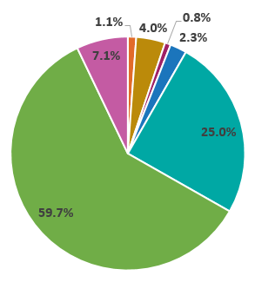
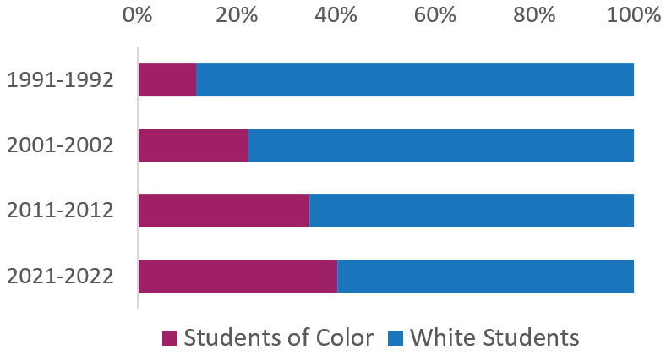
Who We Serve
Race and Ethnicity†
American Indian/ Alaska Native: 1.1%
Asian: 4.0%
Native Hawaiian/ Pacific Islander: 0.8%
Black/African American: 2.3%
Hispanic/Latino: 25.0%
White: 59.7%
Multi-Racial: 7.1%
Student Demographics
Economically Disadvantaged: 74%
Ever English Learners: 18%
Unhoused/homeless: 3%
Mobile Students: 13.9%
Students with Disabilities: 15%
Lesbian, gay, bisexual, something else, or questioning*: 31.5%
Transgender, gender expansive, or questioning*: 8%
Oregon's Increasing Diversity
Notes:
Please note:
* Sexual Orientation and Gender Identity demographic data comes from the 2020 Oregon Student Health Survey, voluntarily taken by 6th, 8th, and 11th grade students in Oregon.
† “Student demographic data reported using the federally defined race/ethnicity groups. Federal reporting guidelines require states to report students who identify as Hispanic or Latino/a/x as such, even if the student also holds other racial identities. Similarly, if a student does not identify as Hispanic or Latino/a/x and holds more than one racial identity, under federal reporting guidelines, that student is categorized as Multiracial.” (ODE Report Card 2021-22, pg. 17)

Slide 5
Equity
Education equity is the equitable implementation of policy, practices, procedures, and legislation that translates into resource allocation, education rigor, opportunities for historically and currently marginalized youth, students, and families including civil rights protected classes
This means the restructuring and dismantling of systems and institutions that create the dichotomy of beneficiaries and the oppressed and marginalized

Slide 6
Presentation Outline
Welcome and Introductions
ODE: Who We Serve and ODE Equity Statement
Today’s Objectives
Updates
Lau v. Nichols: Grounding our focus
Video: “Freedom to Talk”
Small group activity
Reporting back on small group activity
Closing

Slide 7
Today’s Objectives
Outline the evolution of ed policy over the decades as relevant to the integration of language development and academic content for English learner students
Make a connection between civil rights for English learners to civil rights for Black Americans obtained during the Civil Rights Movement of the 1960’s

Slide 8
Presentation Outline
Welcome and Introductions
ODE: Who We Serve and ODE Equity Statement
Today’s Objective
Updates
Lau v. Nichols: Grounding our focus
Video: “Freedom to Talk”
Small group activity
Reporting back on small group activity
Closing

Slide 9
Update: The Raise the Bar Initiative
- a new era in education - has three focus areas
Focus Area | Description
Achieving Academic Excellence | Recovery of lost instructional time; emphasis on literacy and math concepts; rigorous learning standards; well-rounded learning opportunities (including early childhood education); STEM; the arts.
Boldy Improving Learning Conditions | Ensuring every child has access to proactive mental health supports in an inclusive and supportive environment that nurtures the student’s and family’s well-being. It also means that every student is taught by a certified teacher, who is provided professional development opportunities and competitive salary. Eliminate the educator shortage and increase educator diversity.
Creating Pathways for Global Engagement | Evolving our P-12 systems, in coordination with higher education institutions and workforce partners, to establish multiple pathways to college and the careers of today and tomorrow. Preparing for global competitiveness also includes more and better opportunities for our students to be bilingual.

Slide 10
Providing every student with a pathway to multilingualism posits multilingualism as a superpower
Creating a pathway to bilingualism will be achieved by:
Award more than $890 million in Title III state grants to improve the education of ELs
Provide toolkits and technical assistance to states and districts so they can better meet their obligations to robustly serve English learners in public schools
Propose a new $25 million competitive grant for states and districts to scale up dual language immersion opportunities in schools
Elevate the need for a diverse and multilingual educator workforce through $18 million in first-time funding for August F. Hawkins Centers of Excellence Grants to increase high-quality teacher preparation programs for teachers of color at Historically Black Colleges and Universities, Tribal Colleges and Universities, Hispanic-Serving Institutions, and Minority-Serving Institutions
Highlight states and districts that are implementing evidence-based dual language programs and seals of biliteracy

Slide 11
Update:
Title III Returns to the Office of English Language Acquisition
“We need to be more thoughtful, more purposeful in the way that we’re going to support state formula programs,” said Montserrat Garibay, Assistant Deputy Secretary and the Director of OELA.
OELA received feedback from administrators and superintendents that sometimes they are the last to know about English learner research and pedagogy. For this reason, OELA is looking into providing training and webinars for specifically for administrators and superintendents on these topics.
OELA will continue to review how Title III dollars are used for effectiveness, meaning whether the language programs that are funded through these grants match research on what works best for English learners—including looking into bilingual and dual-language programs.
Article: $890 Million in English-Learner Aid Is Under New Management. Why Researchers Are Hopeful (Education Week)

Slide 12
Update:
The ED released the English Learner Family Toolkit
Available in English, Spanish, Chinese, and Arabic
Topics include:
enrolling a child in school
programs and services
extracurricular activities
supporting children in school

Slide 13
Presentation Outline
Welcome and Introductions
ODE: Who We Serve and ODE Equity Statement
Today’s Objective
Updates
Lau v. Nichols: Grounding our Focus
Video: “Freedom to Talk”
Small group activity
Reporting back on small group activity
Closing

Slide 14
Photograph of school-age children in the San Francisco Unified School District
(date: unknown)
Source: Historical Photograph Collection of San Francisco Public Library’s History Center

Slide 15
Photograph of school-age children in the San Francisco Unified School District
(date: unknown)
What are some words or phrases that come to your mind in response to this photograph?
Share your words or phrases in the chat

Slide 16
What is important to these kids? What matters to them?

Slide 17
Presentation Outline
Welcome and Introductions
ODE: Who We Serve and ODE Equity Statement
Today’s Objective
Updates
Lau v. Nichols: Grounding our focus
Video: “Freedom to Talk”
Small group activity
Reporting back on small group activity
Closing

Slide 18
Plan/Activity
Watch the video Freedom to Talk
Focus on the connections between the following terms/ideas as you watch the video:
English Learner students
Federal Policy
Lau v. Nichols
Elementary & Secondary Education Act (1965)
Standards-based movement
No Child Left Behind (2001)
Title I
Title III
Common Core State Standards
Themes/factors/concepts:
Civil rights
Equal Opportunity
Foreclose
Access
Regulation
Accountability
Shared responsibility
English language proficiency

Slide 19
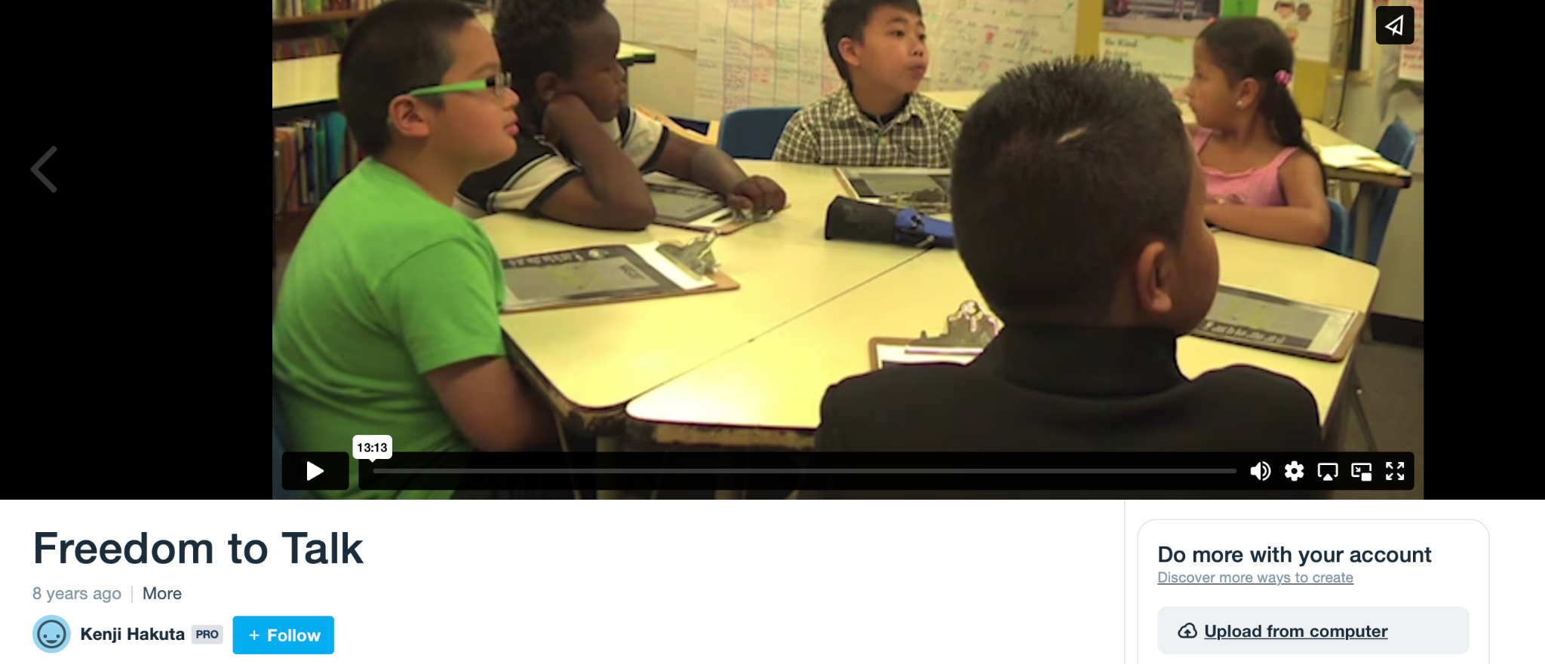
Freedom to Talk by Kenji Hakuta (13:13)

Slide 20
Presentation Outline
Welcome and Introductions
ODE: Who We Serve and ODE Equity Statement
Today’s Objective
Updates
Lau v. Nichols: Grounding our focus
Video: “Freedom to Talk”
Small group activity
Reporting back on small group activity
Closing

Slide 21
Small Group Activity
Create a “map” of the ideas/terms using the Jamboard link
Use sticky notes, circles, or the pen feature (or all the features) to show the relationships between the ideas/terms

Slide 22
Jamboard Features
-Pen (fine tip, highlighter, thick tip, brush)
-Eraser
-Sticky note
-Image
-Shapes
-Text box

Slide 23
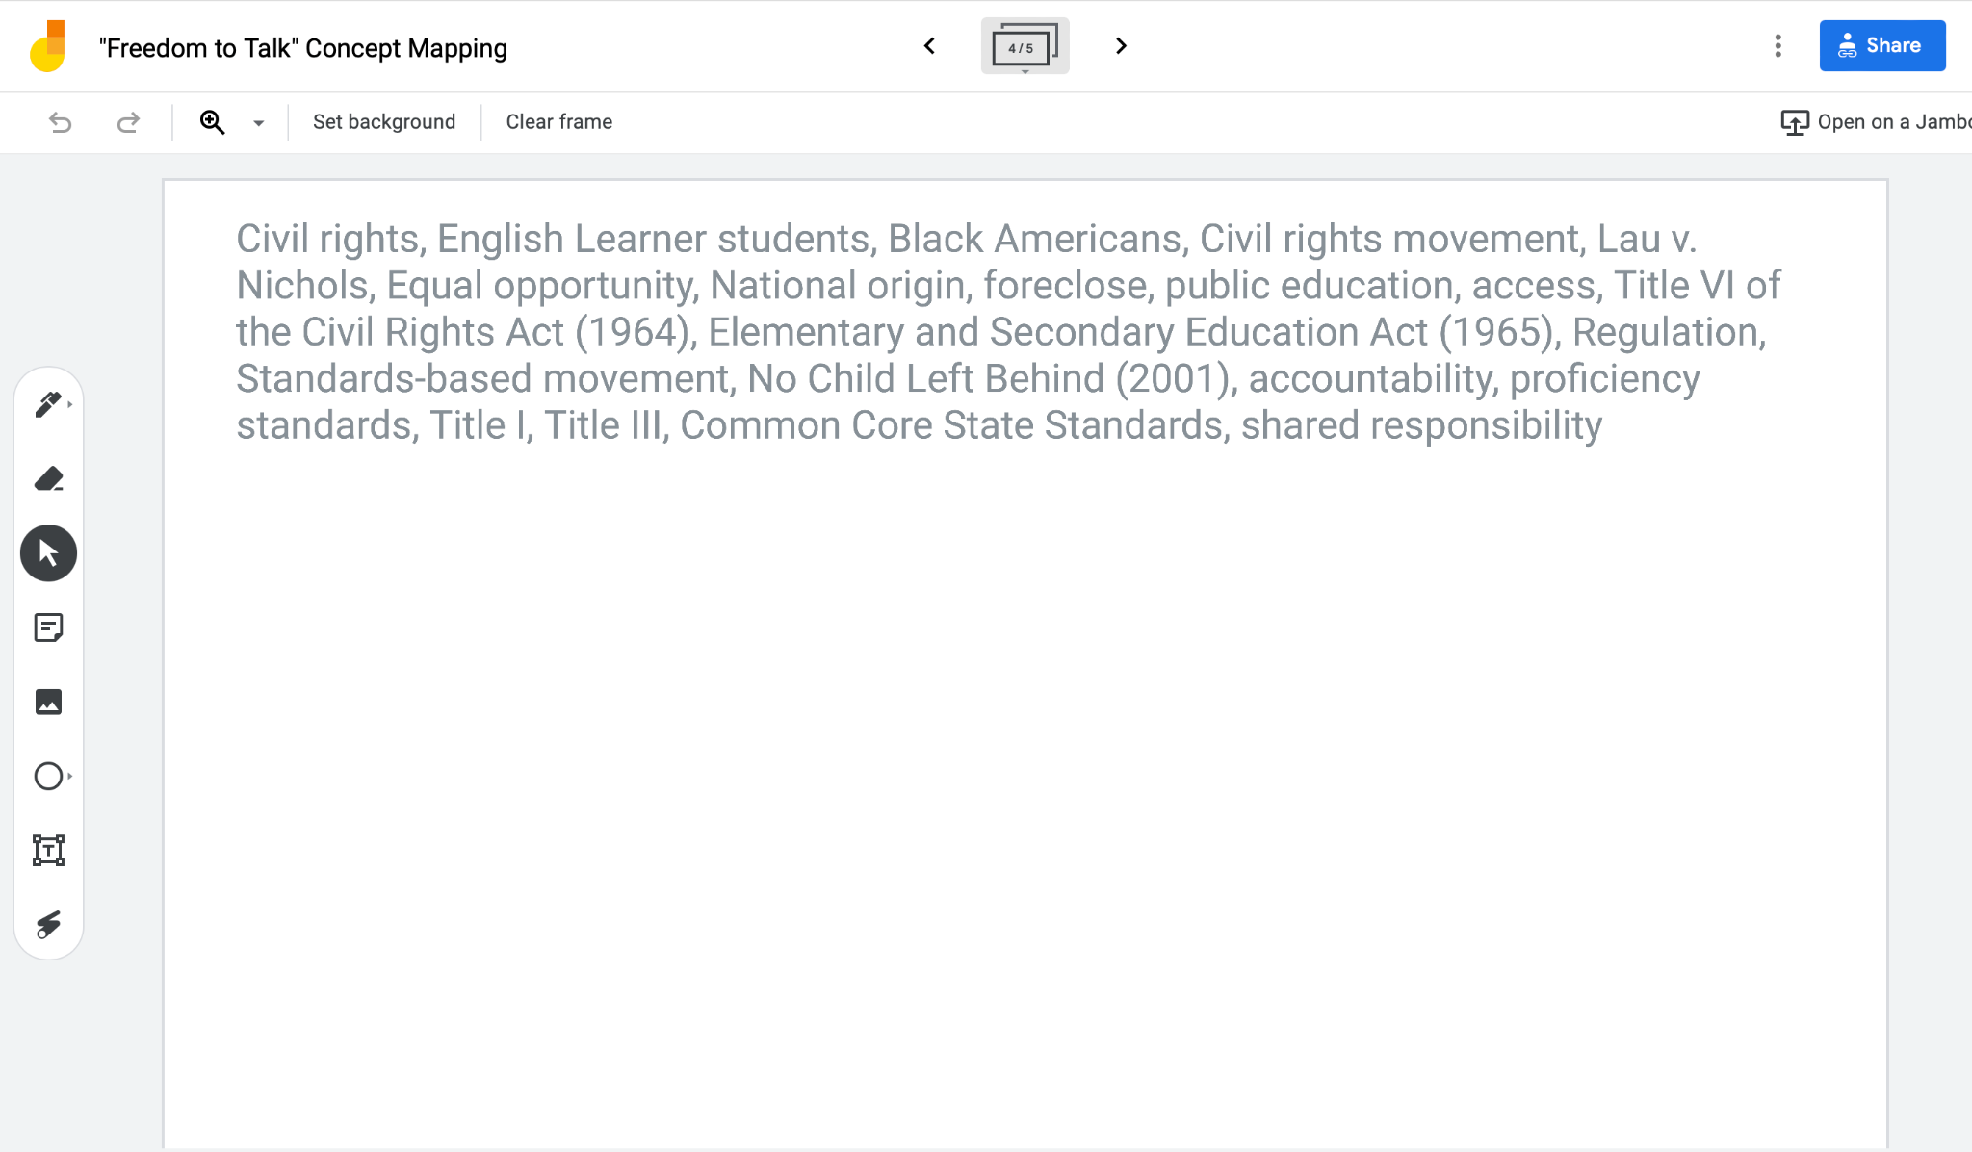
Small Group Activity:
Organize the concepts visually based on associations, relationships, connections, effects, positionality, centrality, etc.

Slide 24
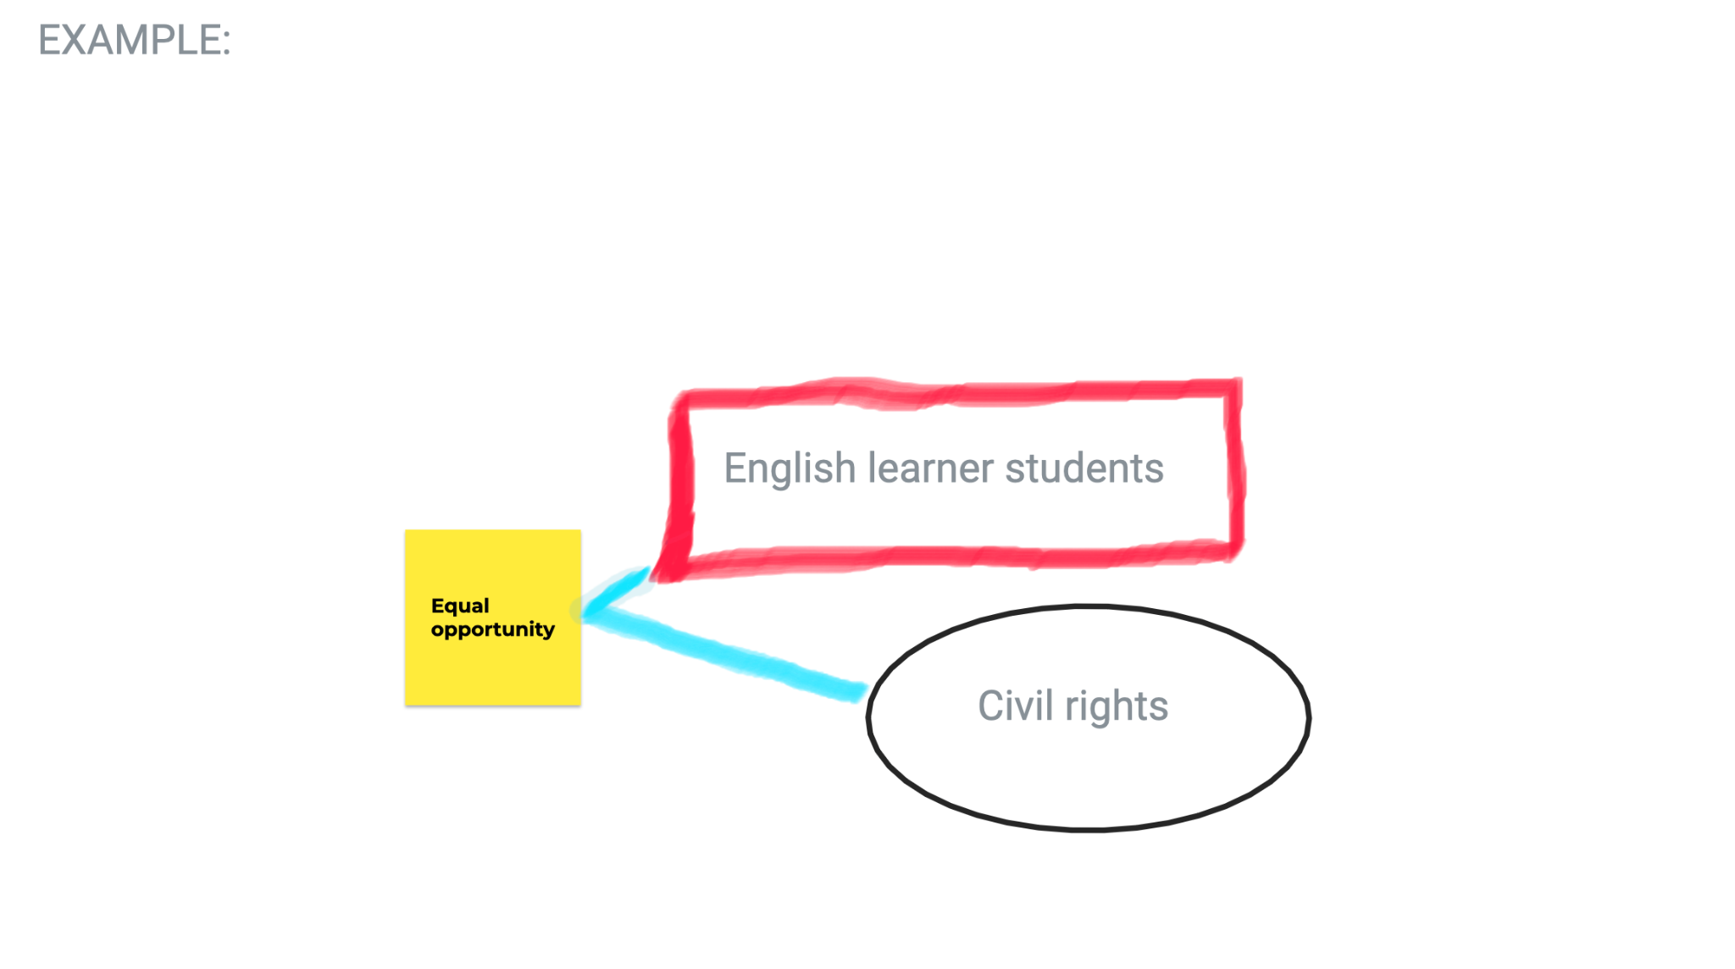
24

Slide 25
Presentation Outline
Welcome and Introductions
ODE: Who We Serve and ODE Equity Statement
Today’s Objective
Updates
Lau v. Nichols: Grounding our focus
Video: “Freedom to Talk”
Small group activity
Reporting back on small group activity
Closing

Slide 26
Closing: Share one “takeaway” from today’s discussion in the chat box

Slide 27
References
From Developing Educator Expertise to Work with Adolescent English Learners, Module 6: Equitable
Policy and Practice for English Learners: What Should Teachers and School Leaders Know and Do? by
George Bunch. WestEd. All rights reserved.
Lau v. Nichols, 414 U.S. 563 (U.S. Supreme Court 1974).
Thompson, K. D. (2013). Is separate always unequal? A philosophical examination of ideas of equality in key cases regarding racial and linguistic minorities in education. American Educational Research Journal, 50(6), 1249–1278 doi:10.3102/0002831213502519

