Slide 1
Data Collection Window
ESEA Title III Recent Arrivers 22-23
Opens: Sept 22, 2022
Closes: October 28, 2022
Notes:
Transitioning data collections to Holly Tucker.

Slide 2
Support Materials
2022-23 Recent Arrivers PPT
Recent Arrivers FAQ
File Format
File Format User Guide
Consolidated Collections Student Collections User Guide
Common Student Collection Errors
Link to resource Materials

Slide 3
What is a “Recent Arriver”?
Aged 3-21;
NOT born in any US state or US Territory; and
Has NOT been attending one or more schools in any one or more states for more than three full (cumulative) academic years.

Slide 4
Who should be reported?
All students, age 3-21, who were not born in the US or U.S. Territories
AND
Have been educated in the US for less than three (3) cumulative years (or 540 days).

Slide 5
Required Data to report a Recent Arriver student
SSID#
Language of Origin
English Learner (EL) - Yes/No (cannot be blank)
Students with Interrupted Formal Education (SIFE) - Yes/No (cannot be blank)
Foreign Exchange Student - Yes/No (cannot be blank)

Slide 6
Student with Interrupted Formal Education (SIFE)
SIFE students meet at least one of the following 2 categories:
Come from a home where a language other than English is spoken and enter a school in the US after grade 2
Are immigrant students who enter a school in the United States after grade 2
AND meet the following conditions
Have had at least 2 years less schooling than their peers
Function at least 2 years below expected grade level in reading and in math
(May be pre-literate in their native language)

Slide 7
Should Foreign Exchange students be reported?
YES – if they meet the criteria of a “Recent Arriver”

Slide 8
Collecting the Data
It is recommended that the information be requested after student enrollment
If this information is not provided by the student/parent, it can in NO WAY hinder the enrollment of the student
Notes:
In other words, it cannot be required for enrollment.

Slide 9
Optional vs Additional Information Needed
Optional: Not Required from the student/parent upon enrollment. May be requested as optional at the time of or after (preferably) enrollment
Additional: Not Required from the student/parent upon enrollment.
  May be requested at the time of enrollment, but may not hinder in any way the enrollment of the student.
  Information will be required at some point (from student, parent, and/or school personnel determination)
Notes:
In order to determine whether a student qualifies as a Recent Arriver

Slide 10
Optional Information Needed
Whether the student was born outside the U.S. or U.S. Territories
Date of U.S. school enrollment
  Should only be requested once the following is known:
    Student is between the ages of 3-21
    Student was born outside the U.S./U.S. Territories
Notes:
Date of enrollment is to determine if the student has had 3 cumulative years of schooling within the US.

Slide 11
When requesting the “optional” information, you must:
Request the information of ALL students (Civil Rights)
State the information is optional (in writing/on form)
State why the information is being requested
State what the information will be used for
State how the information may help the student(s)

Slide 12
Why the information is being requested:
To determine whether or not a student meets the Title III definition of an immigrant child and youth

Slide 13
What the information will be used for:
To calculate and disperse additional funds to qualifying LEAs
To meet annual reporting requirements

Slide 14
How the information may help the student:
This information may provide additional funds to the district for aiding the education of newly arrived/Immigrant students .

Slide 15
What if the needed “optional” information is not provided?
Then the district does not report the student in the Recent Arrivers data collection.
The only consequence of not reporting a potential Recent Arriver is that it lessens the district’s possibility of receiving an Immigrant subgrant.
Submitting the Data Collection is required, having the data is not.
Notes:
If the district does not know the status of the student, the district cannot report the student as a recent arriver.
The district cannot report what it does not have.
In other words, if you didn’t receive the information, and no students meet the definition of a Recent Arriver in the information you did receive, then your district just needs to verify the data collection, indicating to me your district has “zero” Recent Arrivers to report.

Slide 16
Additional Information Needed
Date of Birth (to determine age)
Language of Origin
Whether the student is EL/ML
Whether the student is a Foreign Exchange student
Whether the student has Interrupted Formal Education (SIFE)
Notes:
This information is needed for many reasons, including this data collection, but cannot be required to enroll a student.
Keep in mind: Any student born outside the US/US Territories, regardless of language of origin, may be a Recent Arriver based on the federal definition.

Slide 17
“Chilling Effect”
Please make sure that the registrar understands the possible “chilling effect” questions like these could create for families.
Again, the optional information MUST be labelled as “Optional” and none of the information requested may hinder a student being enrolled if not provided.
Students, parents, guardians, etc. should NEVER be asked about their immigration status or date of entry into the United States.
Consider how the district will handle the situation if this information is requested during enrollment and it causes any discomfort to the enrolling party.

Slide 18
Where to submit the data
Login to the ODE District webpage:
  https://district.ode.state.or.us/home/
Choose “Consolidated Collections” from the Applications list
Hover over the “Student Collections” tab
Hover over “ESEA Title III Recent Arrivers 22-23”
Hover over “Data Submission”
Choose “File Upload” or “Web Submission”

Slide 19
Two Ways to Submit the Data
Web Submission (Manual)
  Suggested if you have 1-149 students to report
File Upload (File Template)
  Suggested if you have 150+ students to report

Slide 20
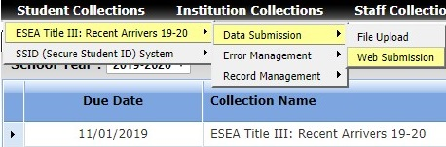
Submitting by Web Submission
-Student Collections
-ESEA Title III: Recent Arrivers 22-23
-Data Submission
-Web Submission

Slide 21
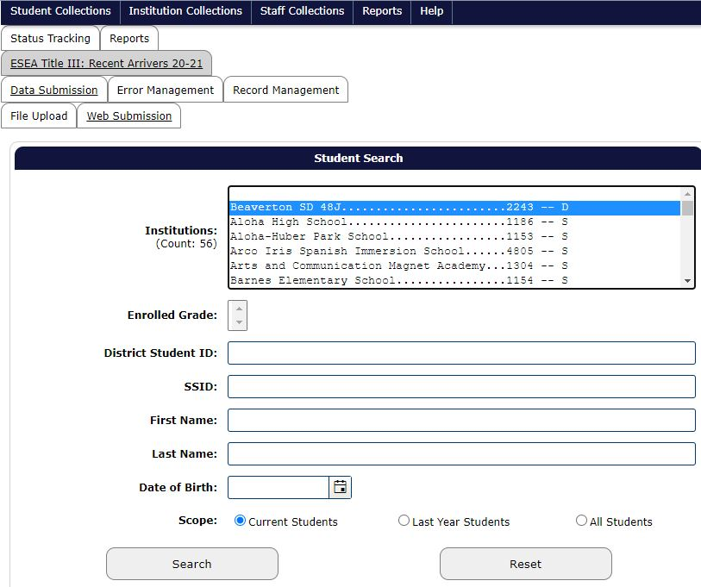
Web Submission Search Screen

Slide 22
Searching by Web Submission
  Select your School District
  Type in student’s SSID#
  Click “Search”
  The Student’s record will show

Slide 23
Web Submission Search Example

Slide 24
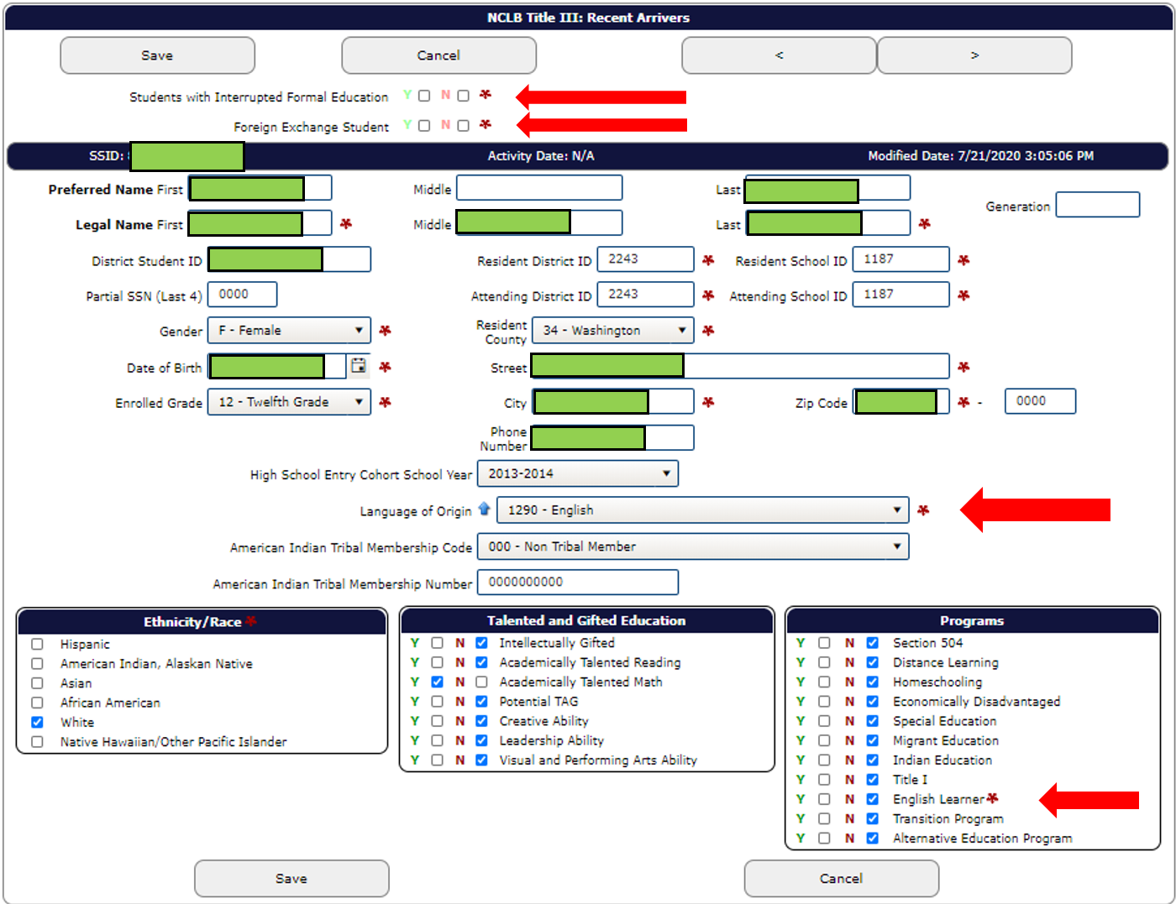
Web Submission Student Screen

Slide 25
Data Elements to Submit Record
Mark “Yes” or “No” (can’t leave blank) for the following:
  Students with Interrupted Formal Education (SIFE)
  Foreign Exchange Student
  English Learner (whether the Student is considered EL or not)
Select the student’s Language of Origin
Click “Save”
Continue the process for every Recent Arriver student

Slide 26
Submitting by File Upload
Download the File Format
Populate the template as the file format indicates
    Use the Codes Table tab for the Language of Origin Code

Slide 27
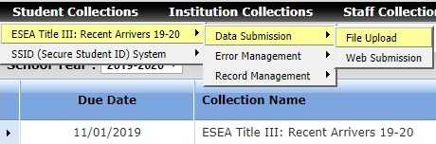
File Upload Process
-Student Collections
-ESEA Title III: Recent Arrivers 22-23
-Data Submission
-File Upload

Slide 28
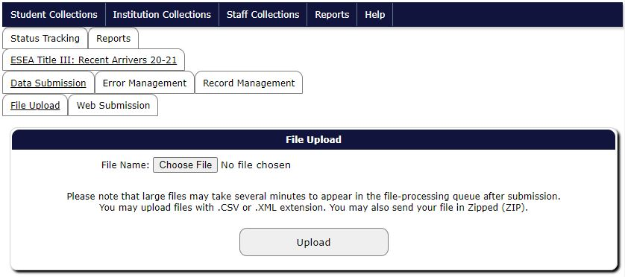
File Upload Screen
Select “Choose File”
Navigate and select where the file was saved
Click “Upload”

Slide 29
What causes Errors?
If Yes or No is not answered for the following:
  Students with Interrupted Formal Education (SIFE)
  Foreign Exchange Student
  English Learners(EL Flag)
A Language of Origin was not selected

Slide 30
Clearing Errors
Web Submission
  You will not be able to save a record if there are errors. Follow the error prompt to correct the error then save
File Upload
  Error Management / Review Errors
  Either:
    “Fix Errors”: Review each record, fix and save
    “Download Errors”: Fix records, re-upload

Slide 31
Production Download
Be sure to do a Production Download Report
Use this to verify that the records ODE accepted for your submission match your report(s).
If a student’s record isn’t listed:
  There was an error with that record; this means it was not accepted by the ODE server system or
  The record wasn’t submitted

Slide 32
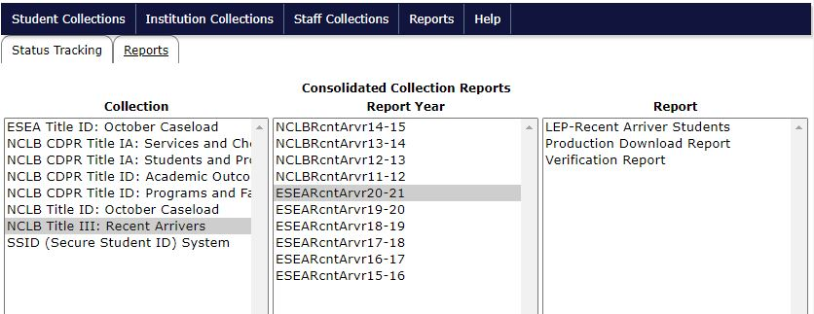
Production Download Example

Slide 33
District has no Recent Arrivers to report
  The district must verify the data collection, does not need to submit records.
  This verification will notify ODE staff that the district has no students to report.
  ODE staff may contact the district to confirm this information at a later date.

Slide 34
How to Verify the Data Collection
On the Consolidated Collections home page
Click on “Status Tracking” tab (default)
Click the drop-down arrow to the left of “ESEA Title III: Recent Arrivers 22-23”
Once the collection drops down
Click on the “Verify Submission” button

Slide 35
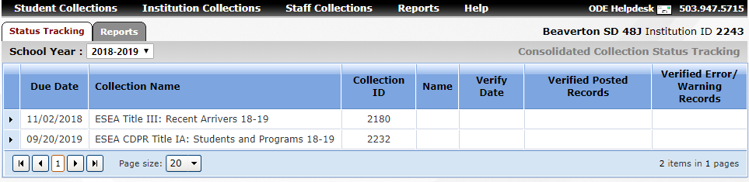
Status Tracking and “drop-down arrow”

Slide 36
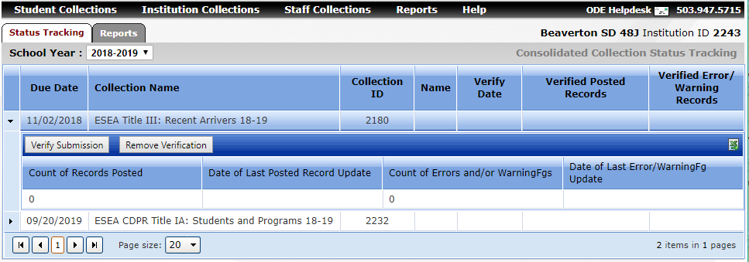
“Verify Submission”

Slide 37
Data Use Timeline
September 22, 2022
First week of November
Qualification during November, districts notified to “opt-in”
End of February 2023
Collection Opens
ODE Data Review
Title III Immigrant Calculations
Immigrant Budget Narrative Due
Collection Closes
District Data Clean-up
Immigrant Grant disseminated
October 28, 2022
First week of November
During December 2022

Slide 38
Contact Information
Recent Arrivers Data Collection questions:
  Kim Miller (Kim.a.Miller@ode.Oregon.gov (971)-239-9681)
Assistance with uploading or general collection questions:
  ODE HelpDesk (ode.helpdesk@state.or.us, (503)947-5715)

