Slide 1
EL Coordinators’ Webinar April 9, 2020
Ensuring Care, Connection, and Continuity of Learning

Slide 2
Recognition of Context
We are in unprecedented times. Staying calm provides our communities with a sense of calm.
Shifts happen daily; rapid change is part of our leadership landscape. We continue to keep students at the center and we are models of care and respect for one another.
Connection with students and communication with families eases uncertainty.
Remember to preserve your own mental health as you extend so much energy for your students, staff, family and community.

Slide 3
Honoring your work in these trying and challenging times
Thank you for all that you are doing to support our students during this time
Thank you for your flexibility as you navigate each day
Thank you for your grace and care as you develop systems in your district/school to further support our EL students

Slide 4
Cross Agency Collaboration and Supports
Office of the Director
Office of Enhancing Student Opportunities- OESO
Title III
Students Who Experience Disability
Office of Teaching, Learning, and Assessment - OTLA
Civil Rights
Assessment
Oregon Educator Resource- OER
Office of Equity, Diversity, and Inclusion - EDI
HB3499
Office of Research and Data Analysis
Accountability

Slide 5
Agenda
ELPA Testing
On Track to English Language Proficiency - OTELP
Monitoring- its on pause for 2019-20-
Funding- Carryover and 2019-20 Budget
General Overview/Civil Rights - ELD services
SPED – Overview and Resources
Addressing Student’s EL Proficiency Needs
Immediate Considerations for Supporting EL with Distance Learning
Communication with families that may not speak English as a primary language
Research based practices to support EL achievement
Title III and HB3499 Collaboration and Supports
New ODE distance learning supports- Oregon Open Learning (OER)
EL Legislative Report - your voice and input requested

Slide 6
Questions?
Google Form for you to send us your questions☺
http://ode.news/ELquestions
The PPT will be made available☺

Slide 7
IMPORTANT INPUT REQUESTED
In an effort toward continuous improvement and best supporting our students/parents/and schools, we would like to request your input around critical needs that you anticipate regarding:
Distance Learning for All – what additional guidance do you see is needed?
Impact on our graduating seniors -what additional guidance do you see is needed?
Impact due to schools closing- what additional guidance do you see is needed?
Please provide your comments in http://ode.news/ELquestions under the “Critical Needs” section.

Slide 8
Assessment
English Language Proficiency Assessment
ELPA
Ben Wolcott

Slide 9
Extended school closure
Given April 8 confirmation on-site schooling will not reconvene after April 28, and given continuing social distancing measures:
ELPA Summative testing will not resume
Already completed tests used in exiting
Guidance will be issued about exiting for untested students, partially completed tests*
ELPA Screener will not reopen
Guidance will be issued about identifying students in a distance learning environment*
*United States Department of Education still vetting guidance on ELP testing, screening and identification, and other Title III issues

Slide 10
When will additional guidance be provided?
United States Department of Education to issue guidance soon
Waivers granted to states so far do not touch on ELP testing or Title III requirements
ELPA21 to release recommendations soon
Distance Learning for All to begin April 13
ODE issuing a number of priority communications in a short amount of time
ODE’s priorities in extraordinary times
Health and safety first
Student-centered solutions

Slide 11
Accountability
On-Track to English Language Proficiency
OTELP
Josh Rew

Slide 12
On Track to ELP (OTELP) – Update (Part 1)
What do we know
What else do we know
Oregon received a waiver to suspend assessment, accountability, and reporting for the 2019-20 school year.
What does the waiver mean?
No ELA, math, and science testing
No school identifications
i.e., comprehensive and targeted identifications
No accountability details
Waiver may impact other accountability data
The waiver doesn’t apply to ELPA and Title III reporting.
OTELP depends on ELPA and two other collections¹.
The public reporting of OTELP falls under Title III, Subpart 2, Sec. 3121(a)(2) (see p. 201).
¹ESEA Title III English Learner (Spring) collection and 1st school in May 3rd Period Cumulative ADM snapshot (i.e., Spring Membership).

Slide 13
On Track to ELP (OTELP) – Update (Part 2)
What we don’t know
What does this mean?
If schools and districts will be able to administer the ELPA.
If we’ll be able to calculate and publicly report OTELP.
If or when Oregon will receive a waiver to suspend ELPA and Title III reporting.
Stay tuned!
Don’t touch
that dial!
(We’ll keep you posted.)

Slide 14
Questions?
Google Form for you to send us your questions☺
http://ode.news/ELquestions
The PPT will be made available☺

Slide 15
Monitoring for Title III
Monitoring for Title III
is on pause for 2019-20

Slide 16
Funding – Title III
We are in the process of applying for a waiver. More news on this as we learn more information.
If you wish to update your 2018-19 carryover or 2019-20 budget, please send an email to both Kim and Susy.
Supplement and supplant rules for Title III still apply.
If you have questions about consumable expenditures that you incurred from March 12th to April 12th, please send an email to both Susy and Kim.

Slide 17
General Overview/Civil Rights
General Overview/Civil Rights
Civil Rights
Karin Moscon

Slide 18
Meaningful Communication with Families
Ensure meaningful communication with limited English proficient (LEP) parents by notifying them of information about any program, service, or activity called to the attention of English-speaking parents.

Slide 19
Communicating with Families
The Distance Learning For All Plan instructs us to reach out and make contact with the families that we serve.
It is vital that this connection happens in the language of the family
Please let ODE know if you do not have access to resources to meet these language needs.

Slide 20
Your schools should already know the following:
Your school should already know (1) if parents and guardians have additional language needs,
(2) what their primary language is;
(3) And in what format should it be provided.
In many cases, this information and any records are maintained by the ELD teacher. It is imperative that schools and districts are consulting with language specialists in order to determine the needs for effective communication with parents.

Slide 21
General Overview/Civil Rights
1. Supports for meeting the needs of your students and families can be found in the 2015 Dear Colleague Letter and the accompanying toolkit. https://www2.ed.gov/about/offices/list/oela/english-learner-toolkit/eltoolkit.pdf
Chapter 10 of the toolkit focuses on providing Meaningful Communication with Parents
2. Students who are identified to receive English Language Development services (Title III) must be provided with language assistance services and supports that allow the students to access the academic content. A brief overview of the legal requirements for English language development services, can be found in the 2016 Guidance for English Learners.
Notes:
Karin to present
Susy to provide support in following slides

Slide 22
Providing ELD Services
The district must make every effort to provide services to EL students.
This will require collaboration between the English language teacher and the academic content area certified classroom teacher.
Keep in mind the delivery of academic content, assessments, appropriate scaffolds, and supports align with the English language proficiency of the student.
The same should be aligned with identified special needs of the student.

Slide 23
SPED Services - Overview
Please see Oregon’s Extended School Closure Special Education Guidance, as well as the toolkit for Students with Complex Learning Needs which is aligned with the guidance issued from the United States Department of Education on March 21, 2020.
For students who experience a disability and are protected under ADA with a 504 plan, the district/school must:
Review the student’s current 504 plan;
Determine if adjustments are necessary for the student to access materials and instruction;
If deemed necessary, the school team meets with the parent/guardian to develop or revise the 504 plan.

Slide 24
Resources
1) Technical Assistance for Districts
Extended School Closure Special Education Guidance​
2) A Toolkit of information to share
Resource Toolkit to support Students with Complex Needs

Slide 25
Key Links: Distance Learning for All
Distance Learning for All – ODE webpage
Oregon’s Extended School Closure Guidance
DISTANCE LEARNING FOR ALL: ENSURING CARE, CONNECTION AND CONTINUITY OF LEARNING

Slide 26
Students’ English Language Proficiency Needs
What should teachers keep in mind when developing distance learning lessons for EL students? This section will explain how to implement the specific civil rights requirements that Karin mentioned.
As teachers engage in planning for the student’s English language learning needs to meet the educational requirements, it is important to know the student’s English language proficiency level. The English Language Proficiency Assessment (ELPA), Oregon’s statewide English language proficiency assessment can tell us this. The ELPA assessment has four domains that the student is tested on: reading, writing, speaking, and listening.
Notes:
Linking to what Karin talked about

Slide 27
Students’ English Language Proficiency Needs (cont.)
The ELPA assessment has four domains that the student is tested on: reading, writing, speaking, and listening.
These domains have a set of 10 ELP standards that highlight what students do with language to accomplish content-specific tasks as well as vocabulary, grammar, and discourse specific to a particular content area or discipline which are needed by ELLs as they develop competence in the practices associated with English language arts (ELA) & literacy, mathematics, and science.
Supporting the 10 ELP standards and providing a description of the skills that a student obtaining a given performance level on the ELPA Summative would be expected to demonstrate by the end of the year, are the achievement level descriptors.
To access student’s ELPA scores, please visit the On-Track to English Language Proficiency page.

Slide 28
Students’ English Language Proficiency Needs (cont.)
By following steps one through six (on next slide☺), teachers can:
Do a needs assessment for each student
Identify goals to be reached (i.e. what is ELPA level of the student)
Identify what standards and/or achievement level descriptors should be targeted to support the student to increase their English language proficiency
Reflect how to best support continuous improvement in EL student learning

Slide 29
Students’ English Language Proficiency Needs (cont.)
What grade level is the student?
What is the English proficiency level (ELP) of the student? (this can be found through the ELPA scores, which can be found in On-Track to English Language Proficiency page)
What ELPA domains did the student do well in and what ELPA domains need support?
What are the ELP standards in these domains that teachers can target as they plan lessons?
What are the achievement level descriptors that teachers can target as they plan lessons?
What media platforms can help you target specific ELPA domains? For example, as a teacher looks to target either the speaking, listening, reading, and/or writing domains what are some platforms that can help to support?
Notes:
(Ben to talk about World Language)

Slide 30
Scaffolding methods to support ELs in a distance learning environment
Teachers should consider the various learning options available as they provide access to content for ELs.
For example, learning resources such as multi-media platforms (Zoom, Google Hangout), social media, email, YouTube, phone connections, and online learning are resources that could support specific ELPA domains.
Google Translate is another potential resource, but keep in mind that using online resources for translation may not always be accurate. Check the translation before sharing.
The student’s home language is a great asset to tap into. Multilingual families could be encouraged to support their children’s learning in the home language. This might include reading books, magazines, or newspapers in the family’s home language, and discussing as a family. It could include watching or listening to news or educational programs in the home language as well.

Slide 31
Communication with families that may not speak English as a primary language
Connect families with interpretation services and/or specific personnel within the district who can provide interpretation services.
Reach out to parent/guardian to discuss important facts and school structures for the remainder of the year including supplemental learning resources, how to access meals, and what community groups/contacts/supports are available for the families.
The school may wish to designate a liaison with whom each family can communicate over the phone as many families may prefer to communicate via phone and text. Utilize school autodialer system to broadcast messages in a variety of languages.

Slide 32
Communication with families that may not speak English as a primary language (cont.)
Following appropriate health guidelines, districts should consider a variety of ways to reach out to families that do not use English as a primary language.
Multi-media platforms (Zoom, Google Hangout), social media, email, phone connections, and online learning are resources that can be leveraged.
Multilingual staff with linguistic resources and cultural capital, can be key in this support. Additionally, there may be resources in the community such as organizations and/or religious institutions that could be leveraged.

Slide 33
Communication with families that may not speak English as a primary language (cont.)
Based on their own experiences and perspectives, families may have a wide range of questions and concerns related to this crisis. Ask cultural/family liaisons/family members active in the school community to focus on cultural considerations schools or districts should be aware of and share suggestions and ideas.
Colorin Colorado: School Responses to COVID - ELL/Immigrant Considerations , Talking Points, and Immigrant Connections: English Learner Family Engagement During Coronavirus have resources for connecting with families.

Slide 34
Research Based Practices To Support EB/EL Achievement
Best practice evidence based resources to support ELs include the following:
From the USED What Works Clearinghouse (you can also do a search under WWCH, practice guides):
Teaching Academic Content and Literacy to English Learners in Elementary and Middle School
Improving Adolescent Literacy: Effective Classroom and Intervention Practices
Meeting the Unique Needs of Long Term English Language Learners from the National Education Association
And from Colorin Colorado
Essential Actions: 15 Research-based Practices to Increase ELL Student Achievement

Slide 35
HB3499
Title III and HB3499 Collaboration
HB3499- Focus on Specialist Supports
Kelly.kalkofen@state.or.us

Slide 36
Title III & HB 3499 Collaboration
There are 7 EL Specialists housed at 5 ESDs across the state, and funded by HB 3499:
Malheur ESD 1.0 FTE (1 Specialist)
InterMountain ESD 1.0 FTE (1 Specialist)
Willamette ESD 1.85 FTE (2 Specialists)
Clackamas ESD 1.0 FTE (1 Specialist)
South Coast ESD 0.6 FTE (2 Specialists share this work, along with other responsibilities)

Slide 37
Title III & HB 3499 Collaboration
The primary goal of the Specialists is to support districts with less than 20 English learners/emergent bilingual students.
These are districts who may not have available resources that larger, urban districts sometimes benefit from. The support that districts receive is different for every district and is dependent on each district’s specific needs.

Slide 38
Title III & HB 3499 Collaboration
Additionally, as time and capacity allows, districts with 20 or more EL/EB students may also benefit from this support.

Slide 39
Title III & HB 3499 Collaboration
As you are navigating the newness of distance learning, Specialists may be available to help in the following areas:
Providing resources to ELD and content-area teachers for EL/EB students
Virtual coaching
Tips for online teaching
Support for administrators
Other supports at district’s request

Slide 40
Oregon Open Learning
Oregon Open Learning
oercommons.org/hubs/oregon
Andrew.byerley@state.or.us

Slide 41
Distance Learning for All: Oregon Open Learning
Open Educational Resources (OER) hub
OER are free and open
Equitable & accessible
Key-makers!
Professional learning
Collaboration
Localization
oercommons.org/hubs/oregon
Notes:
Talk briefly about creative commons licenses that allow for remixing and redistribution.

Slide 42
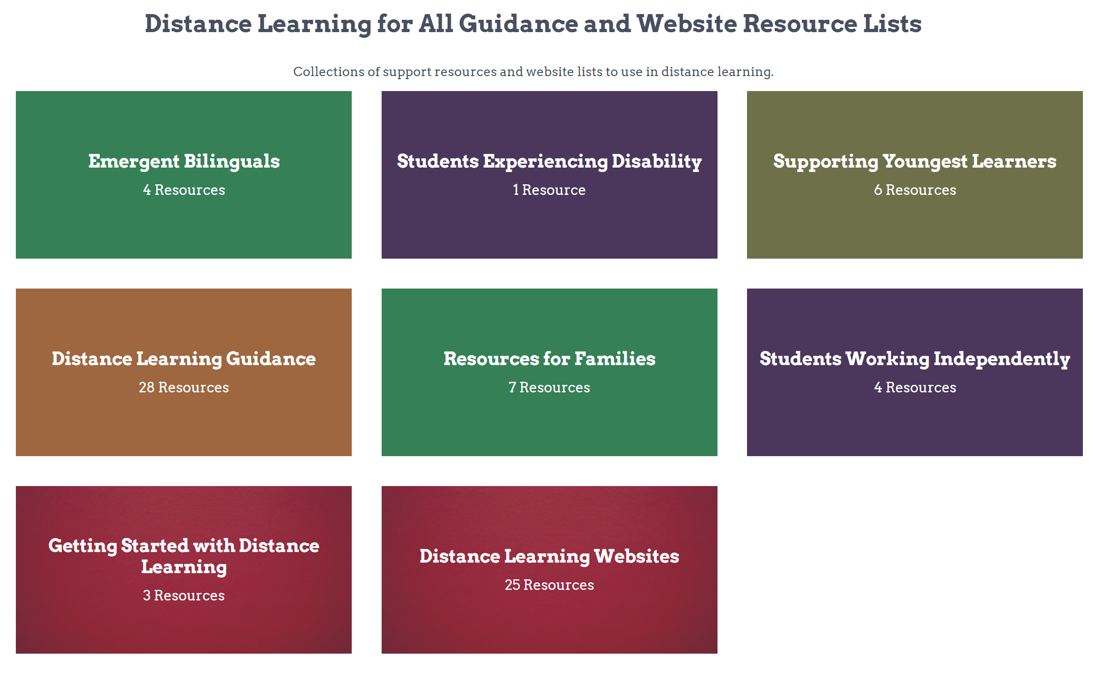
Oregon Open Learning: What’s Currently Live?
Collections of resources curated by OER providers
Collections of resources curated by ODE
Notes:
Prioritized range of content areas and grade bands in the “Curricular Resources”

Slide 43
Oregon Open Learning: ELs & Emergent Bilinguals
Guidance & Support
Curated learning resources
Filter for quick search

Slide 44
Oregon Open Learning: What’s Coming Soon?
Our students need the voices, resources, and expertise of Oregon’s caring educational communities!
“CARE, CONNECTION, and CONTINUITY”
Groups will allow for resource curation and creation by Oregon educators and partners
Notes:
Prioritized range of content areas and grade bands in the “Curricular Resources”

Slide 45
EL Legislative Report
Office of the Director
EL Legislative Report
mary.martinez-wenzl@state.or.us

Slide 46
Office of the Director - Annual EL Legislative Report - Update
Each year ODE prepares an annual report to the legislature concerning English learners in Oregon (per ORS 327.016).
ODE is currently gathering feedback from stakeholders (via survey) concerning the content of the report (e.g., demographics, EL funding, outcomes, participation in special programs, etc.).
ODE sent the survey to several stakeholder groups (e.g., Title III directors) on Monday, April 6, 2020.
Please complete survey by Monday, April 13, 2020 COB.
Please send questions to Mary Martinez-Wenzl (mary.martinez-wenzl@state.or.us).
ODE intends to use the stakeholder feedback to guide the planning and development of this year’s report (and future reports as well).

Slide 47
Questions?
Google Form for you to send us your questions☺
http://ode.news/ELquestions
The PPT will be made available☺

Slide 48
ODE Contacts
Candace Pelt – Assistant Superintendent
Candace.Pelt@ode.state.or.us
Deb Lange- Director Federal Systems Team
Deb.lange@state.or.us
Sara Green- Interim Director, Federal Systems Team
Sara.e.green@ode.state.or.us
Susy Mekarski – Title III Susan.mekarski@ode.state.or.us
Kim Miller – Title III
Kim.a.miller@ode.state.or.us
Leslie Casebeer –Support Leslie.casebeer@ode.state.or.us
Ben Wolcott – Assessment
Ben.wolcott@ode.state.or.us
Josh Rew – Accountability
Josh.rew@ode.state.or.us
Karin Moscon- Civil Rights
Karin.moscon@state.or.us
Kelly Kalkofen- HB3499
Kelly.kalkofen@state.or.us
Mary Martinez-Wenzel – Office of the Deputy Director
Mary.Martinez-Wenzl@ode.state.or.us
Andrew Byerley - Assessment
Andrew.Byerley@ode.state.or.us

