Slide 1
Data Collections in 2019-20
EL Coordinators – April 16, 2020

Slide 2
Dates for the Calendar
2019-20 Spring EL Data Collection
  Opens 4/16/2020
  Closes 5/29/2020
  Review window 6/11/20 – 6/22/2020
  Critical Validation data will be sent to districts

Slide 3
Where do I go?
ODE District Secure web page
Sign in to your applications
  Choose Consolidated Collections
    ESEA – Title III English Learners – Spring
What if I don’t see this application?
  Contact your district security administrator for permission
  You can find your district security administrator on the ODE District web page – link to list is located on the right hand side of the page

Slide 4
Web Submission
Districts have the option of uploading the data directly to ODE using the CSV template, or submitting via web submission.
If you are new to submitting this data, please gather the necessary information for the collection and contact Kim Miller (kim.a.miller@ode.state.or.us ) to arrange a time for her to provide assistance.

Slide 5
Required EL Collection Fields
EL Record Type
Program Model 1
Program Model 2
Program Model 3 (not required)
Proficiency Test Name Code –
  06 ELPA summative – if you intend to administer this assessment to the student this school year – choose this test code
  01, 02, 03, 04, or 07 for students not eligible to receive services (3-H) or identified as an EL in the 2019-20 school year
  05 – for Potential EL (2-J)
Composite Scale Proficiency Level -
    00 for ELPA summative –ODE will load the ELPA proficiency levels directly from Student Centered Staging.
    3-H records and identified in 18-19SY, scale is available based on selected Proficiency Test reported.
    Blank for 2-J
Proficiency Test Administration Date
  Blank for students who will participate in ELPA and Potential ELs
  Required for students not eligible to receive services EL Record Type 3-H
  Required for identified as an EL in the 2019-20 school year
EL Start Date (required for all record types except 3H and 2J)
EL Exit Date (all students the district has deemed as proficient)

Slide 6
Key Reminders

Slide 7
Identified as EL in 2019-20
For all students identified as an EL in 2019-20, regardless of service:
Report the identification assessment given.
Report the date the assessment was given.
Report the score(s) the student received.
  ELPA Screener – all four language domains are reported
  Other screeners (administered prior to 8/15/19) – report the composite score

Slide 8
Exited in 2019-20
Record the student as exited in 2019-20 on both the Fall and Spring EL Collections.
  The Spring EL Collection is used for Title III allocations and federal reports.
  Changing the code from exited on the Fall Collection to monitored year 1 on the Spring Collection will result in an error code.

Slide 9
Waived Students
4-N waived services and the district administered the ELPA summative
4-O waived services and not enrolled during the ELPA summative testing window.
Exiting students with waivers is easy:
  Enter an EL Exit Date in the exit date field

Slide 10
Not Eligible Students
Students found ineligible for ELD services on the district’s initial language assessment are coded as a 3-H.
These students are entered into the EL Data Collection the year they are assessed for identification.
Entering these students assists in tracking student language proficiency and mobility.
ODE tracks this information, and will contact districts who may not have submitted this data.

Slide 11
Things to Check

Slide 12
Check Before Uploading to ODE
Language of Origin
  To fix this error, please check English and ethnic codes – English is only permissible when the ethnic code is American Indian/Alaska Native
  Note this error does not apply for the Additional Language field
EL Start Date
  In the error code narrative, the ODE data system will provide the start date from the ODE data system
  Contact Kim Miller for assistance

Slide 13
Verify Submission
Production Download
  ODE will send you a secure file of all submitted records.
  Production Downloads are located under the Reports section of the Consolidated Collections
ODE staff strongly recommends getting a Production Download and comparing the data accepted by the ODE data system and the district EL data.
  Records with errors are not included in the Production Download

Slide 14
EL Historical Data

Slide 15
EL Student History
The EL Student History Report includes:
EL start date
EL exit date
Last language of origin
Last EL collection submission
Last EL program models
SIFE flag
Last district submitting to EL data collection
Most recent ELP score(s) and test date
Enhancement – The Wavier Effective Date field has been added to this report.

Slide 16
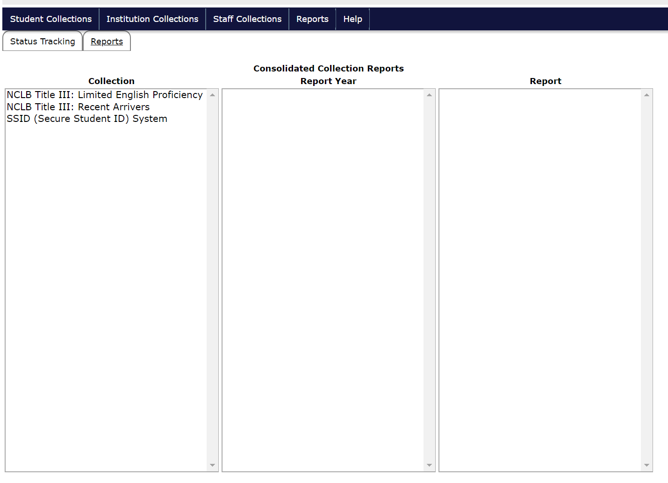
EL History Report Steps

Slide 17
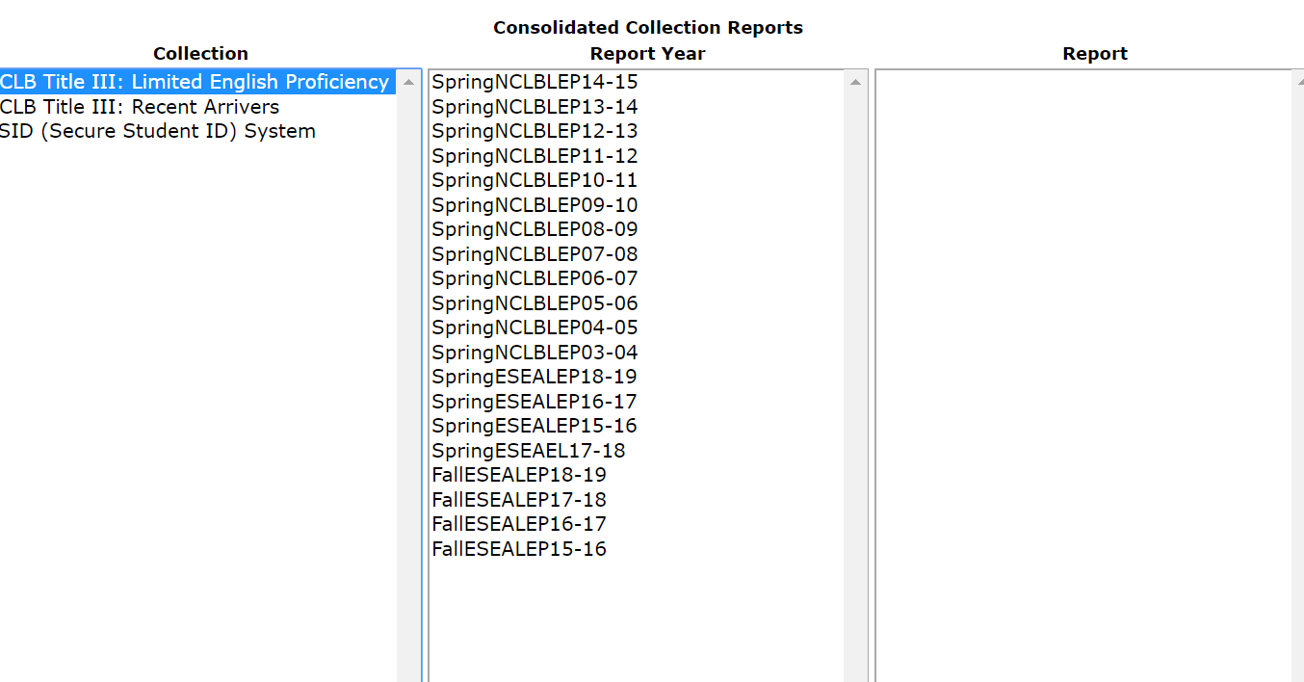
Reports Tab

Slide 18
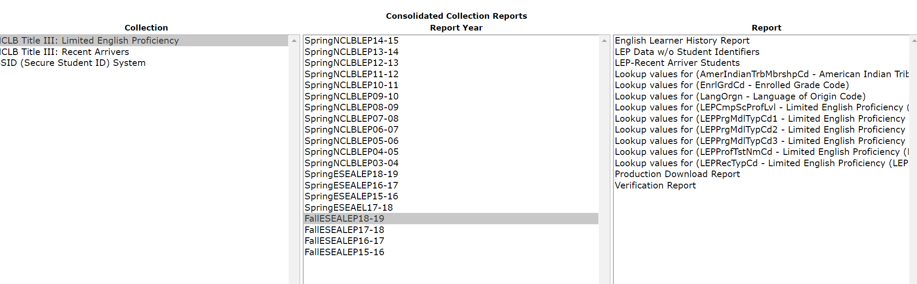
Reports
Scroll across from the Collection, to the Report Year, to the Report.

Slide 19
What’s in the Report?
You can search by:
SSID
Last name
First name
Middle name
Date of birth
You will find:
EL start date
EL exit date
Last EL collection
Last ELP date
Last ELP score
Last language of origin
Last district submitting to EL data collection

Slide 20
Support Resources

Slide 21
Documents to Help You
EL file layout
  This document lays out all required fields for each student.
CSV Template
  This template is available on the EL collection documents for districts who are submitting a data file to ODE.
EL FAQ
  This document answers many of the daily questions ODE receives while the collection is open.

Slide 22
Who do I call for help?
I can’t see the collection in my applications – contact your District Security Administrator
How do I upload a CSV file – contact the ODE Helpdesk
How do I know what field to choose in the data collection – contact Kim Miller – data owner

Slide 23
How is this data used?
Title III allocations
Federal EL data reporting
Reviewing EL programs
  Comparing numbers of ELs (current, monitor, former)
  Comparing ELSWD numbers

Slide 24
2020-21 Title III Allocation Preparations

Slide 25
Title III Grant Intent
Each year, ODE asks districts to provide a Title III Grant Intent as part of the Title III Allocation process
The form includes:
  Summer contact information
  Name of participating private schools
  Count of ELs and Recent Arrivers enrolled in participating private schools
  Confirmation that the district is participating in T-III in 2020-21
    Independent Grant (at least $10,000)
    Consortium membership
    Not participating

Slide 26
Grant Intent
Web link
Will be emailed to EL Contacts with the presentation and video link
Please send completed form to Kim Miller
Due June 1, 2020

Slide 27

Questions?

