Slide 1
Data Collections in 2022-23
September 2022

Slide 2
Goals and Purpose
The purpose for the EL Data Collection is to collect data on Oregon’s English Learners for:
Federal Title III allocation determinations
Federal required EL data submissions
Review by ODE state fiscal (ADM) staff to ensure the appropriate dissemination of state weighted EL funding
The goals for today’s EL data collection presentation are:
Assist districts with learning how to submit the EL collection data
Provide support on frequently asked EL data collection questions

Slide 3
Dates for the Calendar
Name of Collection | Open Date | Close Date | Review Window (Y/N) | Data validation (Y/N
Fall EL Data Collection | 10/13/22 | 12/02/22 | N | Yes, Informal – in Feb/Mar to assist with Spring data submission (Fall Critical Validation)
Spring EL Data Collection | 4/13/23 | 5/26/23 | Y | 6/8/23 - 6/23/23

Slide 4
Where do I go?
ODE District Secure web page
Sign in to your applications
Choose Consolidated Collections
ESEA – Title III English Learners – Fall
What if I don’t see this application?
Contact your District Security Administrator for permission
You can find your district security administrator on the ODE District web page – link

Slide 5
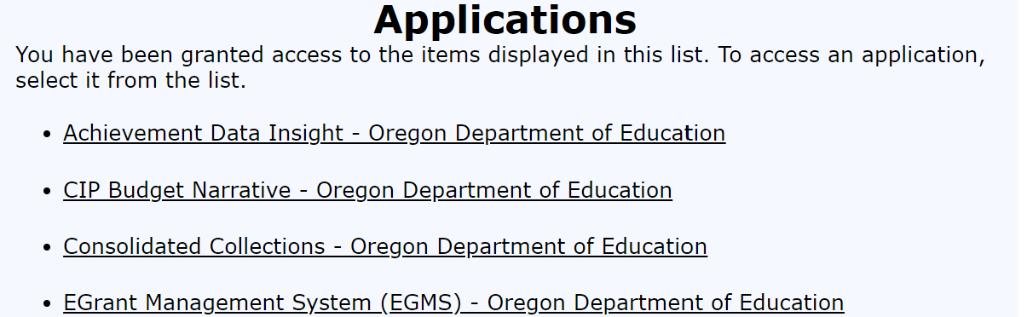
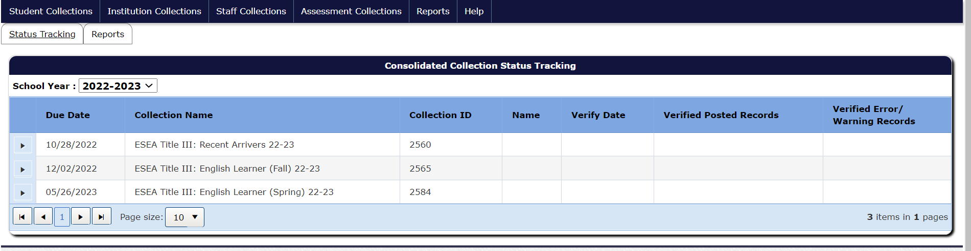
How to Access the Collection

Slide 6
What do I need to report?

Slide 7
Required EL Collection Fields
ELRecTypCd – Code that describes the student’s EL status
ELFlg – Flag that shows the student is an EL or not
ELPrgMdlTyp (1, 2, and 3) – Description of the EL instructional program and access to core support
ELStrtDt – Date the student was first identified as an EL
ELExitDt – Date the student exited the EL program as proficient
ELProfTstNmCd – Code for the EL proficiency test
EL Domain scores – Score for each language domain for ELPA screener
SIFEFg – Flag showing the student is a student with interrupted formal education

Slide 8
Any changes to the requirements for 2022-23?

Slide 9
New for 2022-23 – ELProfTstCd - 10
There is new fields for the 2022-23 school year and the definitions of several codes have updated language.
ELProfTstCd 10 - Alt-ELPA– added for 2022-23 EL Data Collection - NEW
This proficiency test code is for a new English language proficiency assessment for Oregon’s English learners with the most significant cognitive disabilities. Students participating in this assessment are English learners who either (a) participate in Oregon’s Alternate Content Assessment or (b) are anticipated to participate in Oregon’s Alternate Content Assessment.

Slide 10
Removed in 2022-23
The following codes have been removed from the EL data collection beginning in 22-23.
EL Record Type Code – CS
Covid Screener Participant
The ELPA Unique Screener opportunity is not available in 2022-23, thus this record type code is no longer included in the collection
Proficiency Test Code – 08 Identified by Language Use Survey
This code was used when students were unable to be administered the ELPA screener due to Covid health/safety protocols.
The US Dept. of Education has lifted this optional identification process for the 22-23 school year, therefore this proficiency test code is no longer included in the collection.

Slide 11
How do I determine what code to use for my student’s record?

Slide 12
Student scored proficient in 2021-22 but did not have an exit date reported in 2021-22, how do I code the student?
Students who scored proficient in 2021-22, but were inadvertently missed as exited are coded as a 1-E with an exit date or 4-O with an exit date. The code depends on if the student had a waiver(4-O) or received service in the prior school year (1-E)
Record the student as exited in 2022-23 on the Fall EL Collections
The Fall EL Collection is used to report the number of students are enrolled in Oregon as of October 1st.
The Spring EL Collection is used for accountability reports.
Changing the code from Exited on the Fall Collection to Monitored Year 1 on the Spring Collection will result in an error.
Please contact the EL data owner for assistance if needed.

Slide 13
Student was given the ELPA screener this year, how do I code the student?
Students identified as ELs for the first time in the US are coded as either
1-A – Identified and provided EL instructional services or
4-N – Identified and parent/guardian has waived EL instructional services
With either coding (1-A or 4-N) the following information must be include:
Proficiency test code 07 – ELPA screener
Proficiency test administration date – within the current school year
Beginning August 15th
For kindergarteners administered the ELPA screener during Kindergartner Round-up please use the first day of school
ELPA screener domain scores
Please see ELPA screener administration guidance

Slide 14
Student was given ELPA screener and scored proficient, how do I code the student?
Students found ineligible for ELD services on the district’s initial language assessment are coded as a 3-H.
These students are entered into the EL Data Collection the year they are assessed for identification.
Entering these students assists in tracking student language proficiency and mobility.
These records must include the ELPA screener assessment test administration date and the domain scores received.
ODE tracks this information and will contact districts who may not have submitted this data.

Slide 15
Parent/guardian has waived EL instructional services, how do I code the student?
4-N waived services and the district administered the ELPA summative (in-person, remote, or Alt)
4-O waived services and did not participate in ELPA summative (in-person, remote, or Alt)
How do I code the student if the student has scored proficient on the ELPA summative (in-person, remote, or Alt)?
Enter an EL Exit Date in the exit date field.
These students are included in all accountability reports as ELs

Slide 16
Student scored proficient under Unique Screening(code CS) in 2021-22, how do I code the student?
Students scoring proficient in the 2021-22 school year on any of the following:
Unique Screening (During the Fall of 2021)
ELPA summative (in-person)
ELPA summative (remote)
AND
The student has had an exit date entered in the Spring 2021-22 EL data collection
Need to be coded as Monitor year 1 in the 2022-23 EL data collections

Slide 17
Student did not score proficient under Unique Screening(code CS) in 2021-22, how do I code the student?
For students who did not score proficient on the unique screener in the 2021-22 school year and did not score proficient on the ELPA summative (in-person or remote) then
Code this student as:
1-B if the student is participating in EL instructional programs or
4-N if the parent/guardian has signed a waiver for EL instructional program participation

Slide 18
How do I submit the data?

Slide 19
How do I submit the data to ODE?
In the data collection. . .
Select Data Submission, then either:
File Upload - Districts have the option of uploading the data directly to ODE using the CSV template
Web Submission - District will upload the students’ records individually

Slide 20
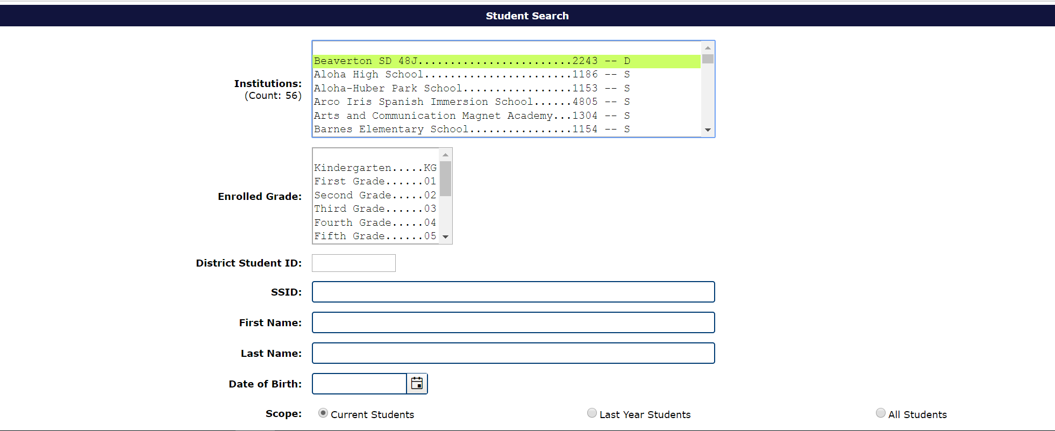
Web Submission Screen
If you are selecting to upload data individually by each student, you will use the search box below to locate the student’s record in the ODE data server.

Slide 21
Student Information System Uploads
Your student information system (i.e. Synergy) may have created a file creation to assist you in uploading to ODE.
Please check with your student information system provide for assistance with a file upload support.

Slide 22
Key Items to Remember

Slide 23
Common Errors in the EL Data Collection
Language of Origin
Each year students are reported with English in their language of origin field without the allowable ethnic code for this language. This results in a data collection error.
To fix this error, please check English and ethnic codes; English is only permissible when the ethnic code is American Indian/Alaska Native.
EL Start Date Error
When a district enters a start date that is more recent than the start date in the ODE system, a data collection error is triggered.
In the error code narrative the ODE data system will provide the start date from the ODE data system.

Slide 24
How can I check that all my records are submitted to ODE?
Production Download:
This download is a copy of all records accepted by the ODE data collection. Any record in error is not included in this report.
Production Downloads are located under the Reports section of the Consolidated Collections.
ODE will send you an email with a link to a secure file download for your records.
ODE staff strongly recommend getting a Production Download and comparing the data accepted by the ODE data system and the district EL data.

Slide 25
Validation Check Box
After you review the production download with your records, please click the verification check box on the EL Collection status tracking page.
Click on the small triangle next to the collection dates
This opens the validation check box
This check box is a way of tracking that a district has reviewed their submitted records
Each year, districts inform ODE staff that the records in their student information system do not match ODE’s records in the EL collection. By comparing the production download to your records, and clicking the verification box, will help alleviate this issue.

Slide 26
Where can I go to get historical EL data for enrolling students?

Slide 27
EL Student History
EL start date
EL exit date
Last language of origin
Last EL Collection submission
Last EL program models
SIFE flag
Last district submitting to EL data collection
Most recent ELP score(s) and test date
The Wavier Effective Date field
SSIDs that have been merged are included
CS students with fall 2021 exits – have exit dates included.
Note: The 22-23 Fall History Report on the list will open with this opening of the Fall EL collection

Slide 28
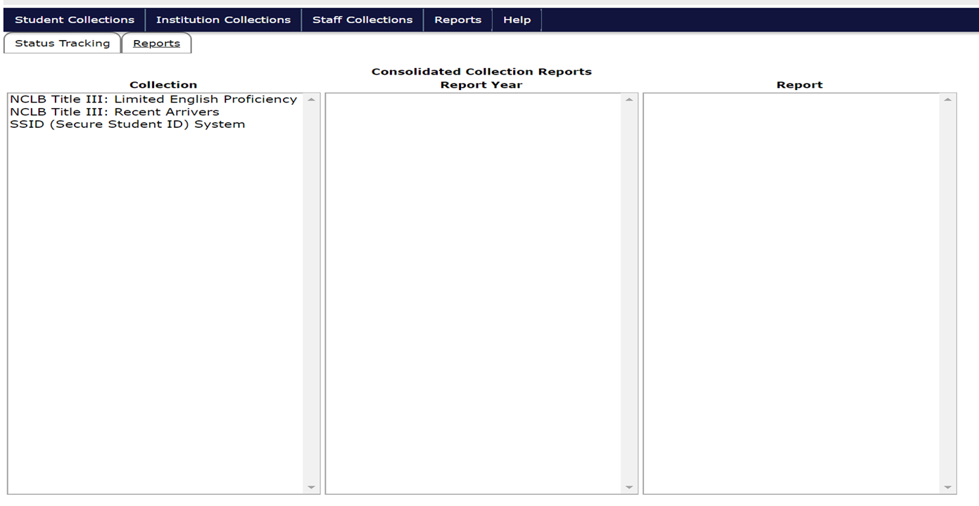
So how do I get there?

Slide 29
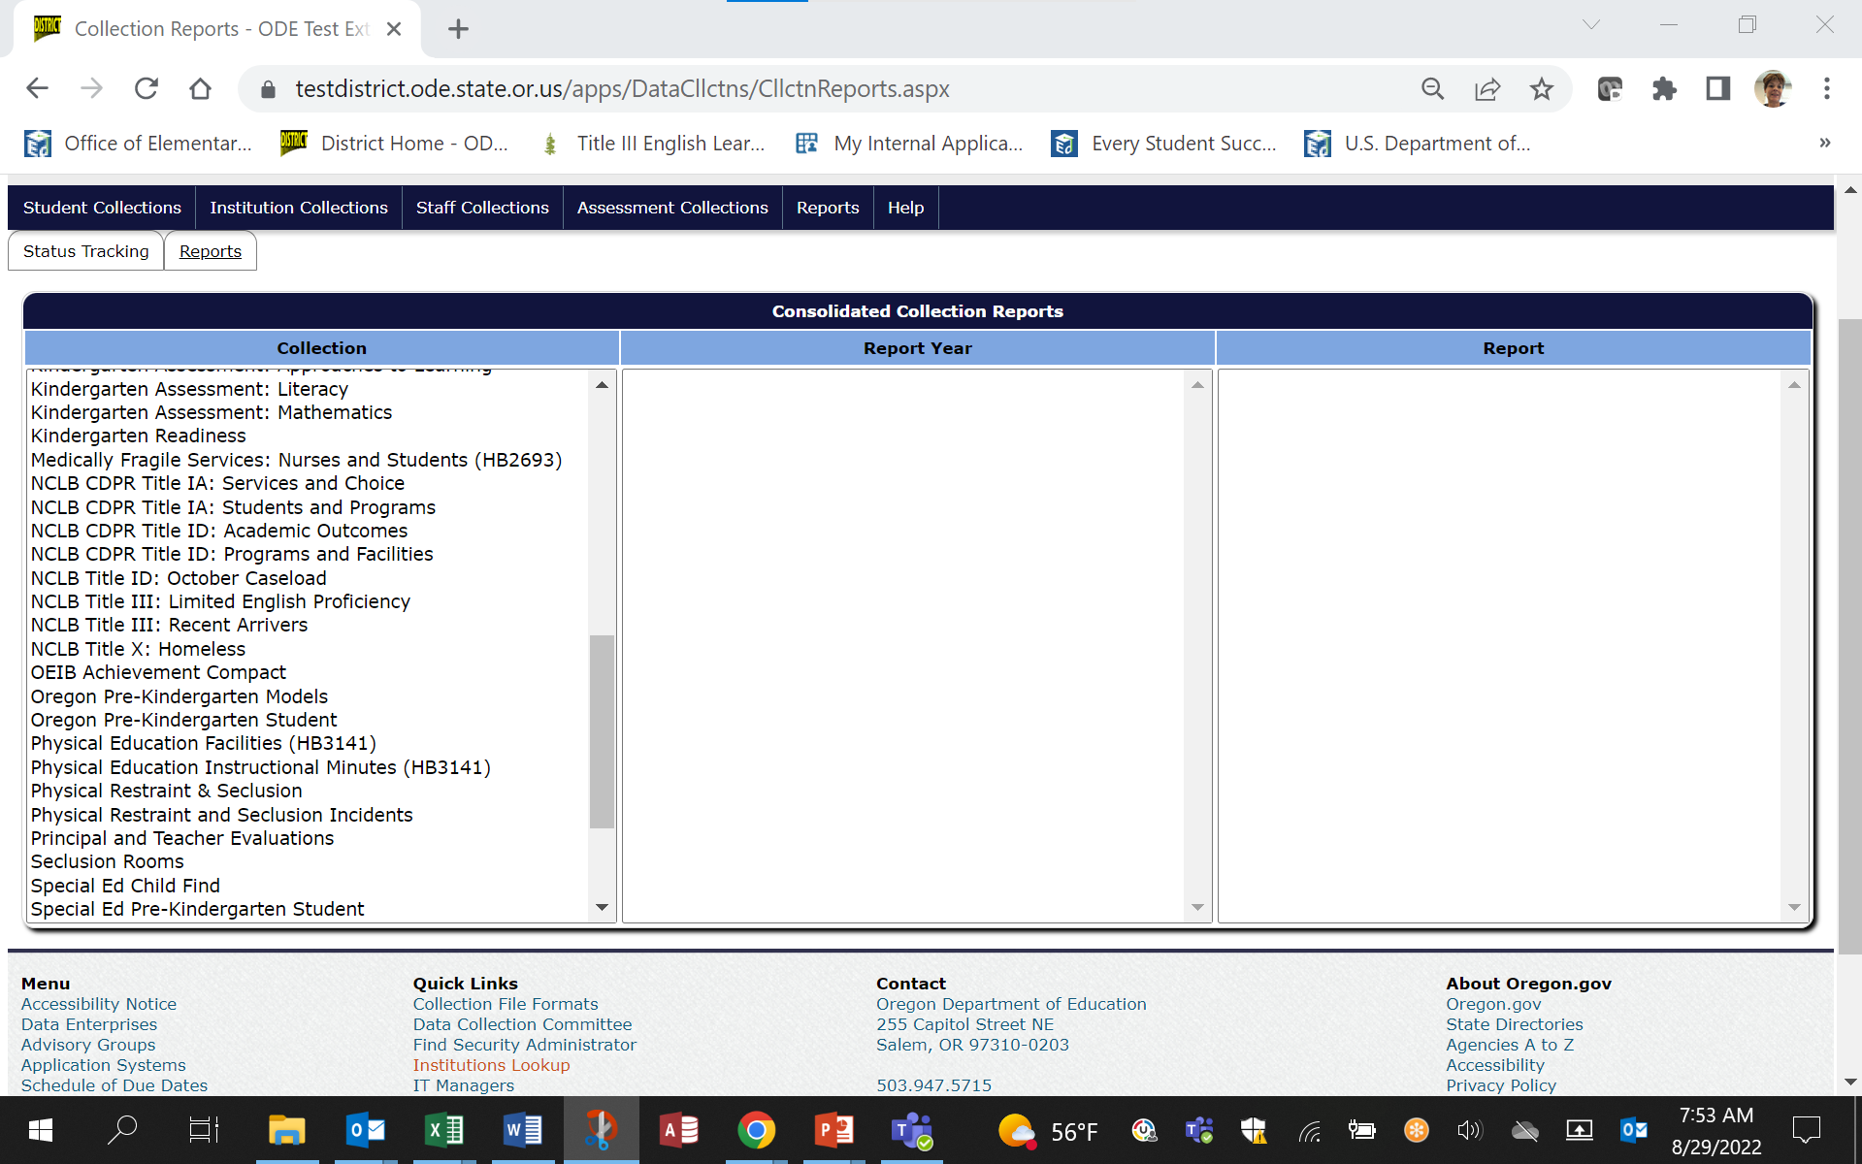
Reports Tab

Slide 30
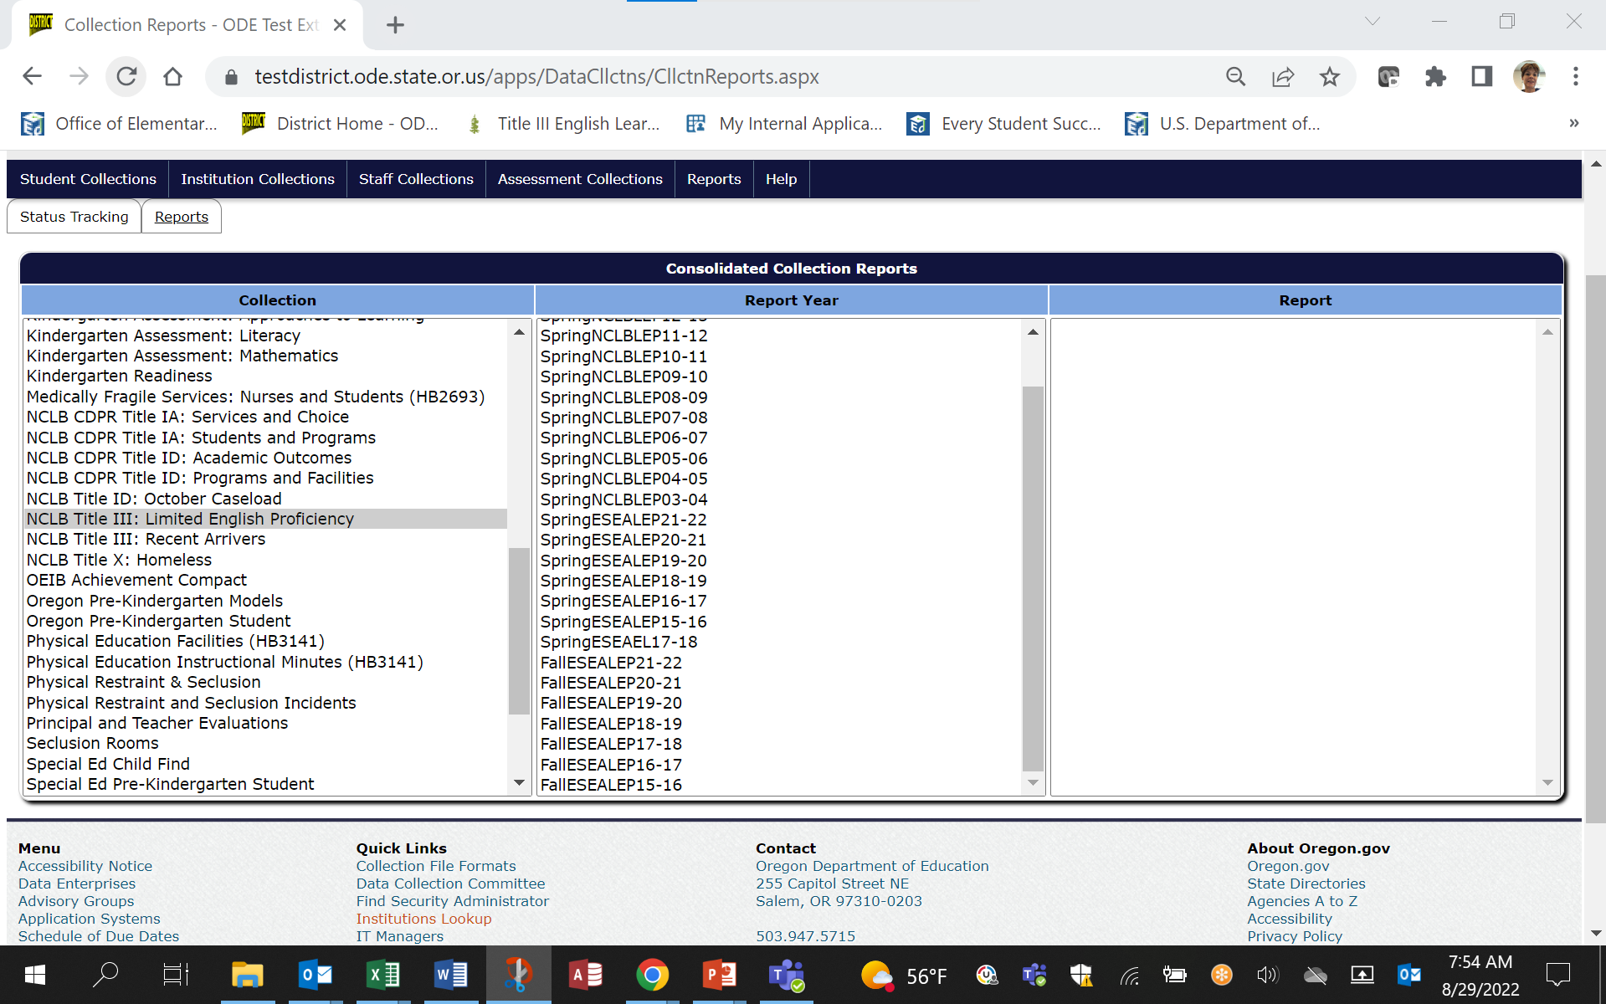
Report Year Selection
Scroll across from the collection to the report year to the report.

Slide 31
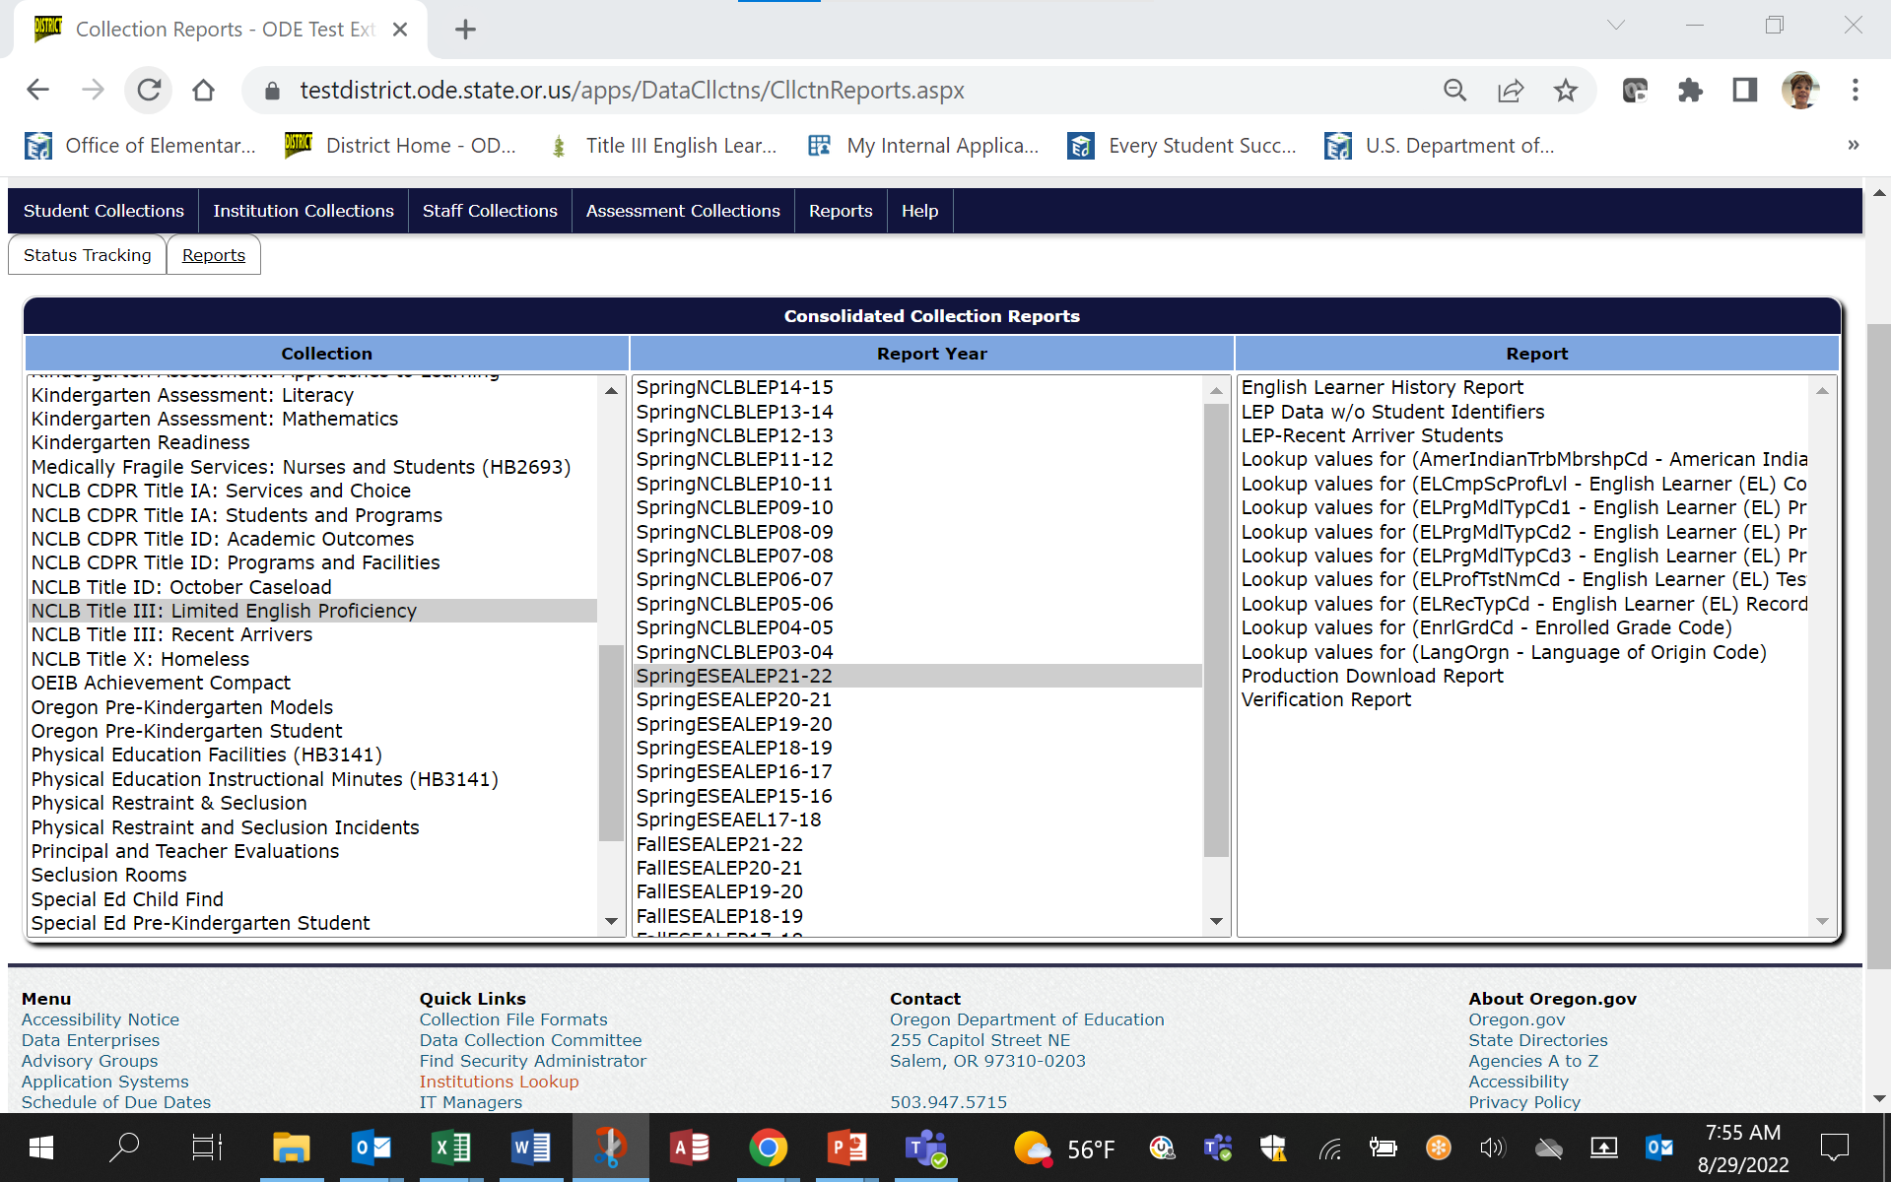
Report Selection

Slide 32

What will I get?
A spreadsheet on the screen with a button.

Slide 33
How do I use it?
You can download a CSV report and see information on your students.
The report links to SSID, Assessment, and EL Collection information (as well as the start/exit date override tables).
NOTE: This report is linked to SSID, if the SSID is not linked to your district, then the student will not be included on this report.

Slide 34
If you export this file . . .
You can search by:
SSID
Last name
First name
Middle name
Date of birth
And you will find:
EL start date
EL exit date
Last EL collection
Last ELP date
Last ELP score
Last language of origin
Last district submitting to EL data collection
Waiver date

Slide 35
Next Steps and Help Documents

Slide 36
Documents to Help You
EL file layout
This document lays out all required fields for each student.
EL FAQ
This document answers many of the daily questions ODE receives while the collection is open.
EL Submission Guide
This spreadsheet is divided by each ELRecTypCd to assist districts in responding to the various programmatic data elements in the collection.
EL Definitions
This is a technical manual for the specific definitions used the EL data collection.

Slide 37
Who do I call?
I can’t see the collection in my applications – contact your District Security Administrator
How do I upload a CSV file – contact the ODE Helpdesk
How need help with the data collection – contact Kim Miller – data owner
I need help with administering the assessment – contact Ben Wolcott – ELPA Assessment Specialist
I need help with EL instructional support – contact your Title III ODE Point of Contact – Susy Mekarski or Kim Miller

