Slide 1
Data Collection in 2020-21 April 2021

Slide 2
Overview
The EL Data Collection is part of the Consolidated Collections, an ODE district secure application used by districts.
District staff upload individual student data information for students who are: current ELs, monitored ELs, former ELs, Potential ELs, Initially Fluent Students, COVID Screener Participants, or Erroneously Identified.
Notes:
There are two annual EL data collections one in the Fall and one in the Spring.
Current ELs – include served and waivered ELs
Monitored EL – include students who exited with English proficiency within the past 4 school years
Former ELs – include students who exited with English proficiency more than 4 school years
Potential ELs – includes students with a disability who were unable to participate in the ELPA screener due to the screener not being accessible for students.
Initially Fluent Students – students who scored proficient on the ELPA screener in the current school year
COVID Screener participants – students who were unable to complete the ELPA summative in the 2019-20 school year and participated in the ELPA screener in the fall of 2020-21 in place of that summative assessment
Erroneous Identified - students who were identified and reported as an EL in a prior school year, who was later determined to be identified in error. This record type is used only for students identified and reported in a prior school year.

Slide 3
Dates for the Calendar
2020-21 Spring EL Data Collection
Opens 4/15/2021
Closes 5/28/2021
Review window 6/10/21 – 6/21/2021
Critical Validation data will be sent to districts
Notes:
Validation is a comparison of the EL data collection with the ADM data collection to ensure that data reported to both collections is accurate.
ODE will also ensure districts have reported all monitored and former ELs that have enrolled within the district.
The ODE data owner can open the Fall collection for editing whenever necessary within the 2020-21 school year.

Slide 4
Where do I go?
ODE District Secure web page
Sign in to your applications
Choose Consolidated Collections
ESEA – Title III English Learners – Spring
What if I don’t see this application?
Contact your District Security Administrator for permission.
You can find your district security administrator on the ODE District web page – link to list is located on the right hand side of the page.
Notes:
Here is how to access the data collection.
District EL staff are encouraged to check with the district data team to determine who will be submitted the EL collection for the district.

Slide 5
Submitting Data
Districts have the option of uploading the data directly to ODE using the CSV template, or submitting each student individually via web submission
Once in the collection – click on the data submission tab – then click
File upload
Web submission
Notes:
This the way the district upload data to the ODE consolidation collections system.

Slide 6
Web Submission Screen
Notes:
This is a picture of the web submission search feature used by districts if they are web submitting an individual student to the EL collection.

Slide 7
Submission File Checks
Prior to uploading a file to ODE – please check:
Language of Origin
To fix this error, please check English and ethnic codes; English is only permissible when the ethnic code is American Indian/Alaska Native.
Review the EL Student History Report
This report includes all students currently enrolled in your district with a previous record in the EL collections.
Confirm all students included on this report (except prior years 3-H coded students) are included in your file upload.

Slide 8
Required EL Collection Fields
ELRecTypCd – Code that describes the student’s EL status
ELFlg – Flag that shows the student is an EL or not
ELPrgMdlTyp (1, 2, and 3) – Description of the EL instructional program and access to core support
ELStrtDt – Date the student was first identified as an EL
ELExitDt – Date the student exited the EL program as proficient
ELProfTstNmCd – Code for the EL proficiency test
EL Domain scores – Score for each language domain for ELPA screener
SIFEFg – Flag showing the student is a student with interrupted formal education
Notes:
There are several required elements in the EL collection – here is a list of them and what their definitions.

Slide 9
New for 2020-21
ELRecTypCd
SE – State of Emergency (added to spring 2019-20) – Code to be used when a student could not be given an ELPA screener due to a State of Emergency. (NOTE: Other options are available for 2020-21 identification. ODE staff do not anticipate this code being used for the 2020-21 school year.)
EI – Erroneously Identified – Code to be used when a student identified as an EL in a prior school year was later determined to be identified in error.
If you have a student who may fit this category – gather relative information
Email information and SSID to Kim Miller or Susy Mekarski
ODE will review the students data and provide next steps.

Slide 10
ELRecTypCd - CS (COVID Screener)
CS – COVID Screener Participant – Code to be used for an EL who was not able to participate (or complete) the ELPA summative in 2019-20, and the student participated in the ELPA screener in the fall of 2020-21 to determine the student’s EL status.
OR
This code is to be used for students participating in unique screening in the spring of 2021, after the close of the ELPA summative.
Unique Screening is an opportunity for those students who did not participate in the ELPA summative in 2020-21.
Students scoring proficient with Unique Screening will have an exit date and enter monitor status.

Slide 11
New Code for Remotely Identified ELs
ELProfTstCd – Code 08 – Identification with Language Use Survey (LUS)
Students are identified as ELs based on the responses to the LUS.
The EL Start Date is the date from the LUS.
The EL Flag is set to yes, and the student receives EL instruction.
Parents can opt out of EL instruction.
EL Record Type codes for this Test code are either 1-A (served by the EL program) or 4-N (waived from EL instruction).
Students identified by LUS, participate in ELPA summative without having to participate in the ELPA screener.

Slide 12
Common Errors
Some common errors that occur in the EL collection:
EL Start Date Error
In the error code narrative the ODE data system will provide the start date from the ODE data system.
Contact Kim Miller for assistance.
EL Monitor Year Record Type is not consistent with the EL Exit Date
The monitor year (ELProgMdl) must match the number of school years since the student’s EL exit date.
To correct this count back from the last school year (2019-20 – monitor year 1) to determine the correct year of monitoring.

Slide 13
More Common Errors
Do not have permission to report – This means another district has reported the student – your district still must report the student if the student was enrolled in the current school year
Change the attending district ID and attending school ID to match your district
Language of origin invalid
Only students with an ethnic flag of American Indian/Alaska Native may have English in the Language of Origin field

Slide 14
Common Questions
How do I exit a student with a waiver for EL instructional service?
4-N waived services and the student has participated in the ELPA summative.
Exiting students with waivers is easy:
Enter an EL Exit Date in the exit date field.
IF this student participated in the Unique Screening and scored proficient – Do NOT use code 4-N – Use Code CS, include the exit and waiver dates

Slide 15
More Common Questions
The student exited as proficient this school year (8/15/2020 or more recent), how do I code this student?
Record the student as exited in 2020-21 on Spring EL Collection
Record the student as 1-C (exited) if the student was served by the program.
Record the student as 4-N with an exit date if the student had a waiver for EL services.
Record this student as CS, if this student participated in the Unique Screening in the fall/spring of 2020-21 and the student scored proficient – enter an exit date in the exit date field.
Students who scored proficient in 2019-20, but were inadvertently missed as exited are coded as a 1-E with an exit date or 4-O with an exit date. The code depends on if the student had a waiver or received service in the prior school year.

Slide 16
What are 3-H Students?
Students found ineligible for ELD services on the district’s initial language assessment are coded as a 3-H
These students are entered into the EL Data Collection the year they are assessed for identification
Entering these students assists in tracking student language proficiency and mobility
ODE tracks this information, and will contact districts who may not have submitted this data

Slide 17
3-H and LUS Identified Students
For students who were identified by the Language Use Survey and demonstrated high levels of English Language Proficiency during instruction, the district could administer the ELPA screener prior to the ELPA summative.
For students participating in the ELPA screener and scoring proficient code the student as a 3H.
Doing so, removes the monitoring requirement.
All ELPA screener data must be reported
Students participating in the ELPA screener and not scoring proficient are expected to participate in the ELPA summative
This option is not available for unique screening after the close of the ELPA summative. Students participating in Spring Unique Screening are coded as a code CS with an exit date if proficient.

Slide 18
How can I check that all my records are submitted to ODE?
To verify that ODE has received all your records, compare a Production Download (reports tab) with your data.
Requesting a Production Download:
You will receive an email from ODE with a link to file of all your accepted records. (any record with an error is not included in this report).
Production Downloads are located under the Reports section of the Consolidated Collections.
ODE staff strongly recommend getting a Production Download and comparing the data accepted by the ODE data system and the district EL data.

Slide 19
Validation Check Box
After you verify ODE’s records with your records, please click the verification check box on the EL Collection.
This check box is a way of tracking that a district has reviewed their submitted records.
By comparing the production download to your records and clicking the verification box will help alleviate this issue.
ODE staff use the EL collection data for federal Title III allocations, accountability and reporting. Confirming all your district records are accurately received by ODE servers assists ODE staff in accurately calculating these reports.

Slide 20
EL Student History
I need to check if I have all my students?
Under the reports tab, you will find the EL Student History Report – this report includes any student currently enrolled in your district who has a prior record in any EL collection. This information is vital to ensuring your have reported all your students.
The EL Student History Report includes:
EL start date
EL exit date
Last language of origin
Last EL Collection submission
Last EL program models
SIFE flag
Last district submitting to EL data collection
Most recent ELP score(s) and test date
The Wavier Effective Date field has been requested to add to this report
Enhancement – merged SSIDs will provide most recent EL data, regardless of the SSID used for that data

Slide 21
How do I use it?
You can download a CSV report and see information on enrolled students.
The report links to SSID, Assessment, and EL Collection information (as well as the start/exit date override tables).
NOTE: Any student found on this report that isn’t in your SIS as a student who was at one time an EL, should be updated in the district SID.
NOTE: This report is linked to SSID, if the SSID is not linked to your district, then the student will not be included on this report.

Slide 22
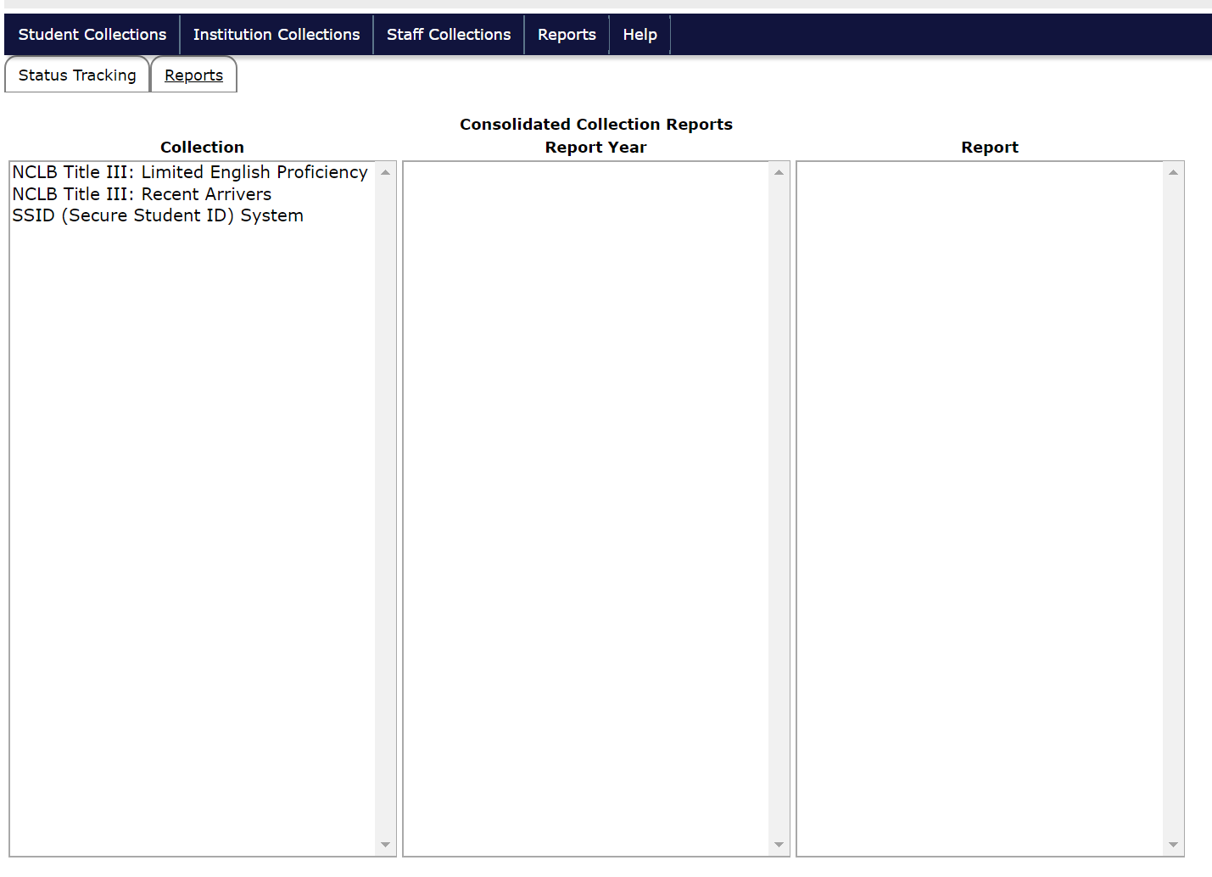
So how do I get there?

Slide 23
Reports Tab

Slide 24
Reports
Scroll across from the collection to the report year to the report.

Slide 25
What will I get?
A spreadsheet on the screen with a button.

Slide 26
Documents to Help You
EL file layout
This document lays out all required fields for each student.
EL FAQ
This document answers many of the daily questions ODE receives while the collection is open.

Slide 27
Who do I call?
I can’t see the collection in my applications – contact your District Security Administrator
How do I upload a CSV file – contact ODE Helpdesk
How do I know what field to choose in the data collection, contact Kim Miller – data owner, or Susy Mekarski

Slide 28
Questions?

