Slide 1
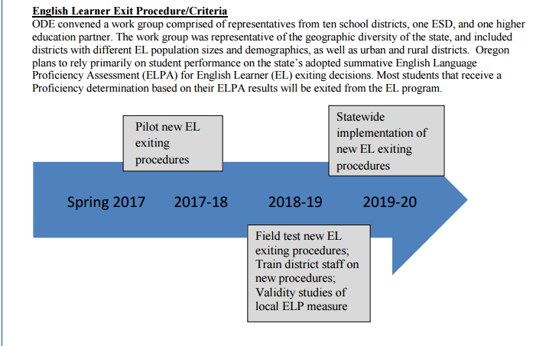
Oregon’s Consolidated State Plan: EL Exit Procedures

