Slide 1
EL Coordinator’s Webinar
January 15, 2020

Slide 2
Agenda
ELPA Testing
Bridge Language Use Survey
On Track to English Language Proficiency - OTELP
Calendar

Slide 3
ELPA Testing

Slide 4
ELPA Screener and Summative
  Measure proficiency in reading, writing, speaking, and listening English based on Oregon’s English Language Proficiency Standards.
  Determines eligibility to enter/exit English Language Development (ELD) services.
  ELP testing is a federal requirement. There are no provisions for four-domain exemptions or opt-out.
    However, OAR 581-021-0009 allows for parent-requested exemptions based on disability or religion. See Test Administration Manual.

Slide 5
ELPA Screener Testing
Total students tested as of 1/2: 9,417
Total K students tested: 5,815
Total Future K students tested: 110
Proficient: 4 or better in all tested domains
Future K scoring window open 1 March to 14 August
  Proficient if R/W 3 or better, L/S 4 or better
Informational webinars in May and August

Slide 6
ELPA Screener Testing
Screener can be reset or reopened just like any other test.
Administered in three steps:
Step 1 Practice—ensure student can navigate technology (participation determined here)
Step 2 Scored—“Early Stop” for students who will not score Proficient
Step 3 Scored—Full test for students who could score Proficient

Slide 7
Non-participation
Non-participation: student does not interact with test in any way (e.g. completely withdrawn, no response in any language, point blank refusal)
550 instances of non-participation
Determined at end of Step 1 (Practice)
Majority reason: “Student does not speak English.” This is inappropriate practice because:
  That’s what the Screener is trying to determine.
  “Don’t know”, “Don’t understand”, or answering in another language is participation.

Slide 8
ELPA Summative Testing
Test window 7 Jan through 10 April
One opportunity
  Expires at 11:59 10 April
Accommodations and supports should mirror classroom instruction
  Same accommodations and supports are available on the ELPA Screener as on the Summative
All domains 4 or above is Proficient

Slide 9
ELPA Domain Exemptions
Decision made by IEP team
Central question: taking into consideration all available supports and accommodations, does a disability prevent the student from showing what they know and can do in a particular domain on the English language proficiency test?
  If yes, exempt that domain.
  If no, test in that domain.

Slide 10
Domain Exemption Examples
Q: What about a student who performs at a level 2 in [domain] year after year?
A: “Performing at a level 2” is not a disability. However, if there is a disability which prevents the student from showing what they know and can do in [domain], taking into consideration all available supports and accommodations, the IEP team may decide to exempt.

Slide 11
Domain Exemption Examples
Q: Student X has severe test anxiety. Can they be exempted from [domain]?
A: It is unclear from this description if the student has a disability. If the IEP team determines there is a disability, and the disability prevents the student from showing what they know and can do in [domain], taking into consideration all available supports and accommodations, the IEP team may decide to exempt [domain].

Slide 12
Proposing New Accommodations
Q: The student has a disability. However, they would be able to show what they know and can do on the test if they only had [accommodation or support].
A: Appendix D of the Oregon Accessibility Manual outlines the process for proposing a new accommodation or support.

Slide 13
ELPA Update
This year ELPA21 will be able to see how the first ELPA21 cohort performed on statewide accountability measures
High identification rates continue to present concern, especially at early grades
New items and task types in development for future years
ELPA21 meeting mid-December, updates to be provided via workgroups

Slide 14
Alternate ELPA Update
For students with the most significant cognitive disabilities
Development has officially begun. Timeline:
  2020-23: design and development; conduct pilot
  2023-24: operational field test
  2024-25: official launch
Updated domain exemption guidance to be added to EL Program Guide.

Slide 15
Useful Links and Contacts
Test Administration page: Test Administration Manual, Oregon Accessibility Manual, and more
Training materials page: ELPA Screener Manual, Module, Speaking Scoring document, and more
Testing contacts:
Your DTC
Regional ESD partners
OSAS Helpdesk
Ben Wolcott at ben.wolcott@state.or.us or 503-947-5835

Slide 16
Questions?

Slide 17
Poll: ELPA Summative TA to student ratio
How many students does a single TA supervise on the ELPA Summative at grade K or grade 1 in your district?

Slide 18
Thank you!
Ben Wolcott
ELPA Specialist
ben.wolcott@state.or.us
503-947-5835

Slide 19
B-LUS
Bridge Language Use Survey
(B-LUS)

Slide 20
Voice and Input
ODE - honoring voice and input from school districts and stakeholders:
School districts and stakeholders shared concerns with ODE
ODE led by Deputy Director Carmen Xiomara Urbina and Assistant Superintendent Candace Pelt called for a cross agency team to review Legacy LUS
LUS survey developed for statewide input
The Bridge LUS was developed and is now in effect

Slide 21
ESEA
Elementary and Secondary Education Act of 1965
[As Amended Through P.L. 115–224, Enacted July 31, 2018], p. 191
(A)Establishing and implementing, with timely and meaningful consultation with local educational agencies representing the geographic diversity of the State, standardized statewide entrance and exit procedures, including a requirement that all students who may be English learners are assessed for such status within 30 days of enrollment in a school in the State.

Slide 22
Language Use Survey Feedback
Sent to
  American Indian/Alaskan Native Advisory Group recommendations, including Title VI contacts
  Referrals
  Title III contacts
  District testing coordinators
Responses
  n = 204 out of 547

Slide 23
Across all comments, themes emerged
Questions are too numerous, wordy, and unclear
Some questions (#1 and #4) are redundant
Decision rules call for screening students who speak “a little of another language”
The importance and purpose of the LUS is not clear to parents/guardians

Slide 24

Legacy- LUS
"We have MANY parents who choose ‘Mostly English and a little of another language’ and almost always it means their child has taken some lessons or uses Rosetta Stone or watches Dora the Explorer....not something that is relevant for this survey.”

Slide 25
Language Use Survey - Terms
Legacy Language Use Survey-
  Executive Numbered Memo 005-2017-18
  Can be used until the Oregon LUS is finalized (targeted date, December 2020)
Bridge Language Use Survey-
Can be used starting January 1, 2020
Can be used until the Oregon LUS is finalized (targeted date, December 2020)
Oregon Language Use Survey-
Under development - targeted date for completion December 2020

Slide 26
Timeline
November 2019
  Feedback survey closed (~204 responses)
  Data analysis
  Multiple LEA feedback
December 2019
  B-LUS edits and review by:
    ODE leadership
    Government to Government Tribal Education Cluster
    American Indian/ Alaskan Native Advisory Committee
    Various external and internal stakeholders
January 2020
  Final edits and review
  B-LUS ,Key, and translations posted on ODE web page

Slide 27
Bridge-LUS, key, and translations: http://ode.news/LUS

Slide 28
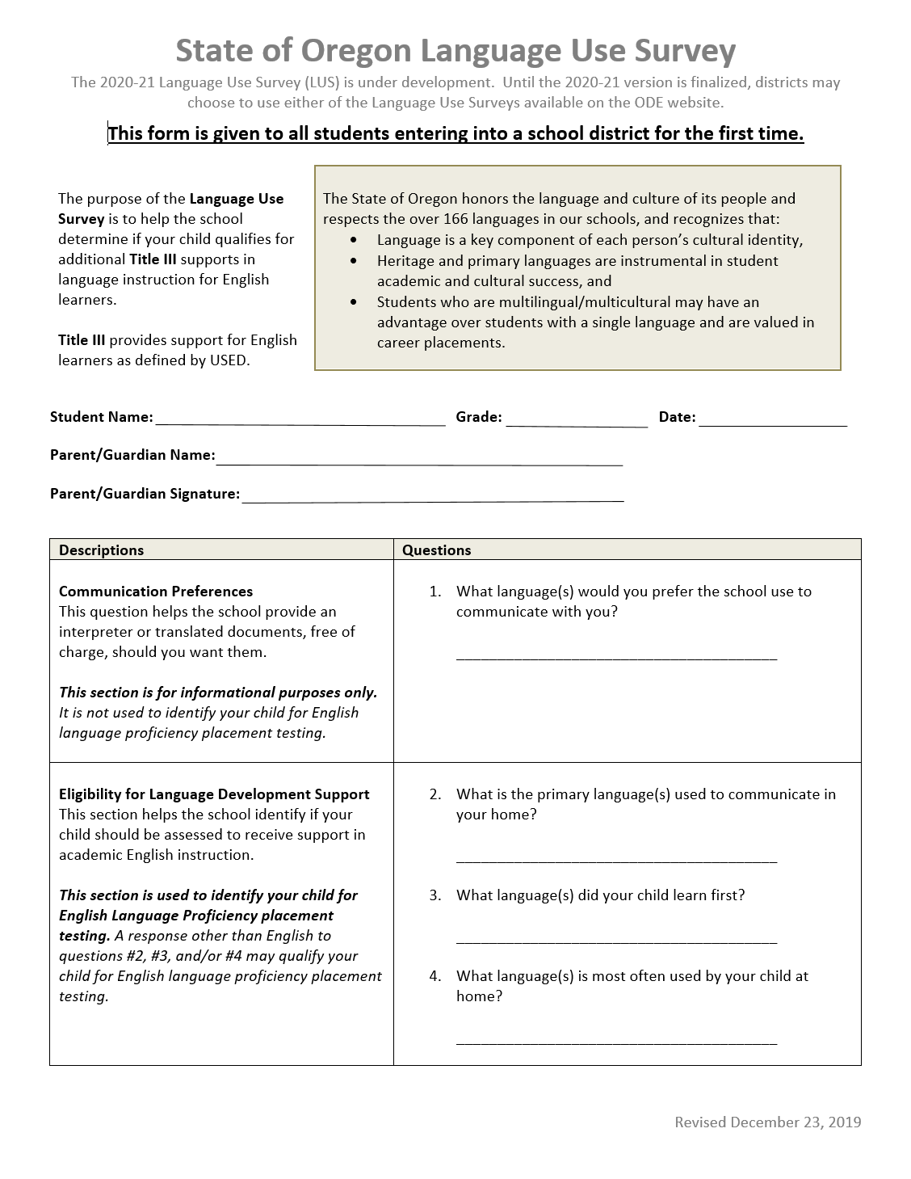
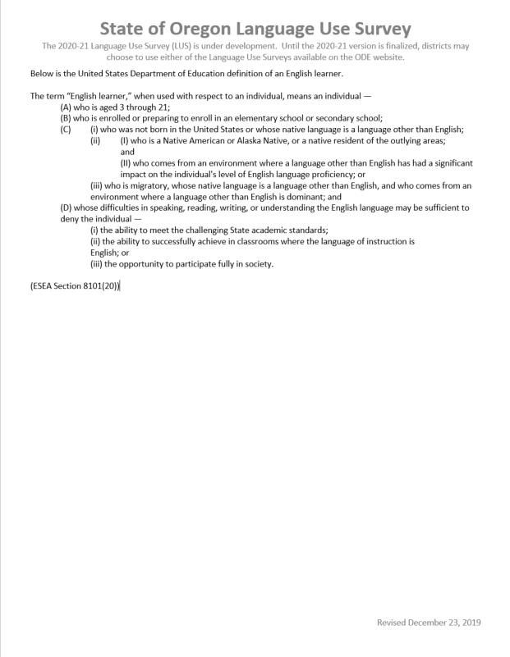
Bridge -LUS

Slide 29
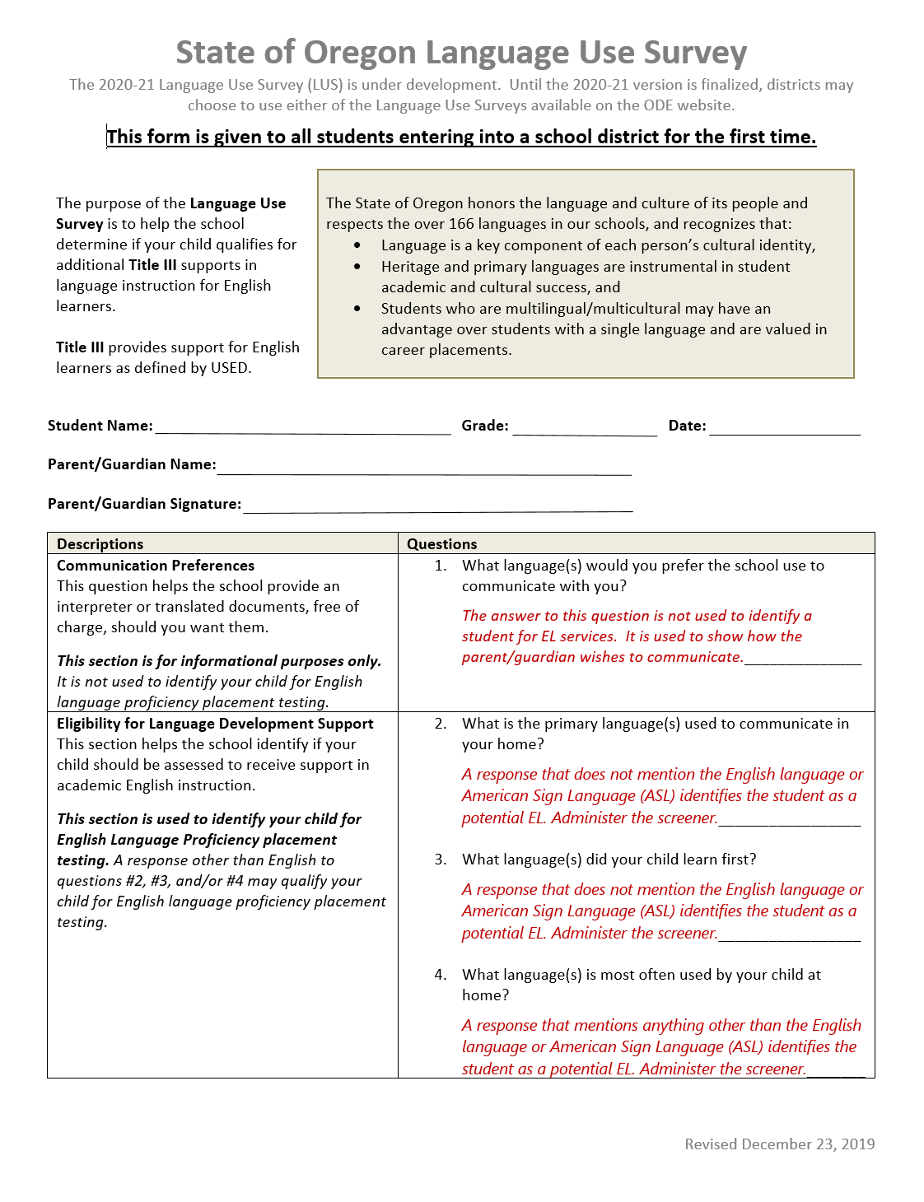
Bridge-LUS Key

Slide 30
LUS Scenario 1
Parent/Guardian responses:
Question 2—English and Spanish
Question 3—Spanish
Question 4—English and Spanish

Slide 31
LUS Scenario 1 Interpretation
Parent/Guardian responses
Interpretation
2—English and Spanish
3—Spanish
4—English and Spanish
Do not screen
Screen
Screen
Overall interpretation: Screen student

Slide 32
LUS Scenario 2
Parent/Guardian responses:
Question 2—English
Question 3—Arabic
Question 4—English

Slide 33
LUS Scenario 2 Interpretation
Parent/Guardian responses
Interpretation
2—English
3—Arabic
4—English
Do not screen
Screen
Do not screen
Overall interpretation: Screen student

Slide 34
LUS Scenario 3
Parent/Guardian responses:
Question 2—English and French
Question 3—English and French
Question 4—English

Slide 35
LUS Scenario 3 Intetrpretation
Parent/Guardian responses
Interpretation
2—English and French
3—English and French
4—English
Do not screen
Do not screen
Do not screen
Overall interpretation: Do not screen student

Slide 36
Guidance
What LUS can districts use?
Districts can choose to use either the Legacy LUS or the Bridge LUS until the Department has finalized the 2020-21 version of the LUS. The Department will provide additional notice once the Oregon LUS has been finalized.
Where can I find the Bridge LUS, Key, and translations?
The LUS, its translations, and its key can be found here
Guidance for the LUS is under development and expected to be posted at this same link by May 2020.

Slide 37
Guidance
When will the Oregon LUS be available?
The Oregon LUS is currently under development. The Department is hopeful that it will be completed no later than December 2020.
For whom must the LUS be completed?
The LUS must be completed for every student who enters a school district for the first time.
Do districts have the flexibility to edit the LUS in any way?
No, per Federal guidelines, districts must use what is developed by their state education agency.

Slide 38
Questions?

Slide 39
On Track to English Language Proficiency
OTELP

Slide 40
What is OTELP?
OTELP is an acronym for On Track to English Language Proficiency. It is a school and district accountability measure required by the Every Student Succeeds Act (ESSA). Oregon began calculating OTELP in the 2017-18 school year.
OTELP measures the extent to which current English learners (ELs) are on track to attain English language proficiency given (1) their initial domain proficiency, (2) their years identified as an EL, and (3) whether they have a disability and/or an interrupted formal education.
OTELP applies trajectory expectations to each tested ELPA domain (i.e., reading, writing, listening, and speaking) to determine whether the current ELs are on track.

Slide 41
OTELP Includes Which ELs?
Is the student a current EL, enrolled on the first school day in May, and enrolled for a full academic year?
If no, the EL is not included in OTELP calculations.
If yes and the EL has an EL exit date and/or English proficiency via ELPA, the EL is included in OTELP calculations.
If yes and the EL does not have EL exit date and/or English proficiency via ELPA, the EL is only included if all of the following are met:
  EL’s initial ELPA test must occur before the current year
  EL must be identified as an EL for 1.50 or more years
  EL must be enrolled during the current ELPA test window

Slide 42
OTELP Trajectory Expectations?
Years Identified as an EL (No Disability and/or Interrupted Formal Education)
Initial Domain Proficiency | <1.5 | 1.5 to <2 | 2 to <3 | 3 to <4 | 4 to <5 | 5 to <6 | 6 to <7 | 7 or more
1 | Not Included | 1 | 2 | 2 | 3 | 3 | 3 | 4 or 5
2 | Not Included | 2 | 3 | 3 | 3 | 4 or 5
3 | Not Included | 3 | 3 | 3 | 4 or 5
4 or 5 | 4 or 5
Years Identified as an EL (Disability and/or Interrupted Formal Education)
Initial Domain Proficiency | <1.5 | 1.5 to <2 | 2 to <3 | 3 to <4 | 4 to <5 | 5 to <6 | 6 to <7 | 7 to <8 | 8 or more
1 | Not Included | 1 | 2 | 2 | 2 | 3 | 3 | 3 | 4 or 5
2 | Not Included | 2 | 2 | 3 | 3 | 3 | 4 or 5
3 | Not Included | 3 | 3 | 3 | 4 or 5
4 or 5 | 4 or 5

Slide 43
How to Calculate OTELP?
Use trajectory expectations for each tested domain to determine on track to domain proficiency.
  Compare the student’s domain performance level with expectation (given initial ELPA21 domain performance level, years identified as an EL, and disability and/or interrupted formal education status).
On Track to Domain Proficiency | Performance Level vs. Expectation
Yes | ≥ Expectation
No | < Expectation
Use on track to domain proficiency to determine OTELP.
OTELP | No Domain Exemptions | Domain Exemptions
Yes | ≥ 3 Domains On Track | All Tested Domains On Track
No | < 3 Domains On Track | < All Tested Domains On Track

Slide 44
Example
Initial Domain Proficiency | <1.5 | 1.5 to <2 | 2 to <3 | 3 to <4 | 4 to <5 | 5 to <6 | 6 to <7 | 7 or more
1 | Not Included | 1 | 2 | 2 | 3 | 3 | 3 | 4 or 5
2 | Not Included | 2 | 3 | 3 | 3 | 4 or 5
3 | Not Included | 3 | 3 | 3 | 4 or 5
4 or 5 | 4 or 5
A student has been identified as an EL for 2.25 years and doesn’t have a disability or an interrupted formal education. The student’s initial and current performance levels are in the following table:
Domains | Initial | Current
Reading | 1 | 2
Writing | 1 | 2
Listening | 2 | 2
Speaking | 2 | 3
Is the student OTELP?

Slide 45
Another Example
Initial Domain Proficiency | <1.5 | 1.5 to <2 | 2 to <3 | 3 to <4 | 4 to <5 | 5 to <6 | 6 to <7 | 7 to <8 | 8 or more
1 | Not Included | 1 | 2 | 2 | 2 | 3 | 3 | 3 | 4 or 5
2 | Not Included | 2 | 2 | 3 | 3 | 3 | 4 or 5
3 | Not Included | 3 | 3 | 3 | 4 or 5
4 or 5 | 4 or 5
A student has been identified as an EL for 4.75 years and has a disability. The student’s initial and current performance levels are in the following table:
Domains | Initial | Current
Reading | 2 | 3
Writing | 1 | 3
Listening | Exempt | Exempt
Speaking | 3 | 3
Is the student OTELP?

Slide 46
Where to Access OTELP Data?
Aggregate Public Data:
  Accountability Details:
    School Year 2018-2019 (see ‘English Learners On Track’ tab)
    At-A-Glance School and District Profiles (see ‘Accountability Details’ .pdf)
  English Learners on the Accountability Measures page:
    School Year 2018-2019 (note that this includes additional OTELP data)
Student and Aggregate Secure Data:
  On Track to English Language Proficiency validation within the Achievement Data Insight (ADI)
  Request permission from your district security administrator
  Validation Instructions

Slide 47
Statewide OTELP (2016-17 to 2018-19)
Grade Levels | 2016-17 | 2017-18 | 2018-19
Elementary (K-5) | 67.0 | 65.8 | 66.0
Middle (6-8) | 43.5 | 35.9 | 38.8
High (9-12) | 40.5 | 36.9 | 36.2
All (K-12) | 60.2 | 56.3 | 55.9
Student Groups | 2016-17 | 2017-18 | 2018-19
ELs with Disabilities | 34.3 | 33.7 | 34.5
ELs with Interrupted Formal Education | 71.7 | 65.3 | 62.8
All ELs | 60.2 | 56.3 | 55.9
The transition from Oregon’s legacy ELPA to ELPA21 in 2015-16 likely inflated the percent OTELP for 2016-17 because districts were unable to reclassify proficient ELs in 2015-16 (and subsequently reclassified them in 2016-17).

Slide 48
Distribution of OTELP
Distributions only include schools with 7 or more current ELs in the OTELP calculation.
Data are from the 2018-19 school year.

Slide 49
OTELP by Total Current ELs
Plots only include institutions with 7 or more current ELs in the OTELP calculation.
Data are from the 2018-19 school year.

Slide 50
ELA, OTELP, and EL Proficiency
These examples are from 3rd grade in 2018-19.

Slide 51
ELA Achievement Gaps
These examples are from 3rd grade in 2018-19.
Notes:
These figures are empirical cumulative distribution functions (ECDFs). The X axis represents 3rd grade ELA scale scores and the Y axis represents the proportion at or below the scale score. The ECDF allows us to examine achievement gaps across all values in the scale score distribution. For instance, 75 percent of ELs with disabilities who are not on track to ELP have an ELA scale score at 2330 or below (as compared to 2396 for 75 percent of ELs with disabilities who are on track to ELP). Note that 2367 is the scale score which corresponds with the level 2 achievement standard.

Slide 52
Questions?

Slide 53
One Question Survey – Input Requested
This one question survey will launch after we close the webinar
The question is: What area(s) would you like for Title III to cover in future webinars?

Slide 54
From the Calendar
This information is shared in the Title III calendar. Please check the calendar periodically for updates.
January 15: EL Coordinators’ webinar, 8:30-11:00 am
March 11-13: ODE/COSA EL Alliance Conference, Eugene
April 8: EL Coordinators’ webinar
April 16: Spring EL Data Collection opens
May 13: EL Coordinators’ webinar
May 29: EL Spring Data Collection closes
June 11: EL Spring Data Collection – Review Window open (critical validation)
June 22: EL Spring Data Collection – Review Window closes

Slide 55
ODE Contacts
Candace Pelt – Assistant Superintendent
Candace.Pelt@ode.state.or.us
Sara Green- Interim Director, Federal Systems Team
Sara.e.green@ode.state.or.us
Kim Miller – Kim.a.miller@ode.state.or.us
Susy Mekarski – Susan.mekarski@ode.state.or.us
Leslie Casebeer – Leslie.casebeer@ode.state.or.us
Ben Wolcott – Ben.wolcott@ode.state.or.us
Josh Rew – Josh.rew@ode.state.or.us

