Slide 1
2024-2025 Consolidated District Performance Report (CDPR)
ESEA CDPR Title I-A: Students and Programs 2024-2025
Notes:
Welcome, and thank you for joining this webinar regarding the completion of the 2024-2025 Consolidated District Performance Report for Title I-A, Students and Programs.
I am Kyle Walker, a program analyst, from the Federal Systems Team in the Office of Teaching, Learning and Assessment. Joining us today are the Title I-A Education Specialists (Amy Tidwell, Jen Engberg, & Sarah Martin). We also have Serena Robinson, our team’s Administrative Specialist, here to provide technical support for the meeting.
Our goal today is to provide you with the support and guidance you need in order to make the Title I-A data collection go as smoothly and efficiently as possible.

Slide 2
Agenda
Data Collection Window
Resource Materials
Data Element Explanations
Data Preparation
Validation Worksheet Entry
Consolidated Collections Entry
Questions and Discussion
Notes:
Today we will be reviewing the:
Data collection window
The resource materials available to you
Give tips on data preparation
Show you step by step how to use the Validations Worksheet
Show you steps on how to submit the data in the Consolidated Collections application
Then give you a chance to ask any questions that have not been answered yet.
There are no data element changes for this year.

Slide 3
Data Collection Window
Opened: August 7, 2025
(approx. 2:00 PM)
Closes: September 26, 2025
(approx. 11:59 PM)
Notes:
The data collection window for the ESEA CDPR Title I-A Data Collection opened around 2:00 PM August 7th, 2025, and closes at 11:59 PM on September 26th, 2025.
Just a note, that this is the only data window for this data collection, and it will be important to enter in the data within the time given as there is a process of review, validation and re-validation that all needs to be accomplished in order to get the data ready to populate for the Consolidated State Report by mid November.
Acknowledging the short data collection window, and knowing this is an incredibly busy time for districts, we want to provide you with the tools you need so you can begin the process in a timely manner.
Thank you ahead of time for your time and effort on this.

Slide 4
Resource Materials
CDPR: Title I-A Data Collection User Guide
Today’s PowerPoint Presentation
CDPR Title I-A Validations Worksheet
CDPR FAQ
Link to Support Materials: http://www.oregon.gov/ode/schools-and-districts/grants/ESEA/IA/Pages/Title-IA-Coordinators.aspx
Notes:
The resource materials available to complete this data collection include the CDPR Title I-A Data Collection User Guide, today’s PPT slides and recording, the CDPR Title I-A Validations Worksheet and the FAQ document. Today’s recording will be made available early next week.
The PowerPoint presentation we are reviewing today, is really meant to be something you can view as you work on the data collection. Please feel free to download this PowerPoint and use as a guide as you work through this data collection process.

Slide 5
CDPR Title I-A Validations Worksheet
The CDPR Title I-A Validations Worksheet provides:
A “savable” place to collect and enter your data
Clarification on the data points
A place to see your data errors and fix them before submission
The Consolidated Collections web application
Does not allow entering partial data, saving, and coming back to finish submission later
All data must be entered all at once
Notes:
The Validations Worksheet can help you gather the data in an efficient and accurate manner prior to entering it into the web-based application. (read slide)
As mentioned in the slide, it is important to note that the web-based application does not allow you to log in, enter some data, log out and enter in more data at a later date. All data fields must be entered in all at once.
Using the Validations Worksheet will allow you to have all the data points needed prior to logging in to the web-based application.

Slide 6
Validations in the Worksheet
Validations within the CDPR Title I-A Validations Worksheet include validations not included within the web-based Consolidated Collections data collection.
By utilizing the Validations Worksheet prior to entering data in the web-based Consolidated Collections application, the chance for errors and being contacted in the future due to those errors will be greatly reduced.
Validations are checks for accuracy in data sets. For example the validations worksheet will check that total Grade Level student counts align with Race/Ethnicity student count totals.
Notes:
There are internal ODE validations that are run months later when we are reporting to the feds. These validations occur across multiple data collections we use to report in the Consolidated State Performance Report.
There are validations are not included in the Consolidated Collections web application, but ARE included in the Validations Worksheet.
Taking care of these errors now while the data is fresh in your mind instead of months down the road is a good thing to do. We will be reviewing the Validations Worksheet together shortly.

Slide 7
CDPR FAQ
The FAQ document includes the following, for all CDPR data collections:
Reporting Students – Who should be reported?
Access to Data – Who can help me?
Consolidated Collections Web Applications – How do I login?
Common Validation Sheet Errors – What does “this” error really mean?

Slide 8
District Security Administrator
Contact your District Security Administrator for:
Help on preparing and entering the data
Permissions to be able to view and submit the data collection
If you select “Save” and nothing happens, you don’t have the needed permissions.
Find your District Security Administrator: https://district.ode.state.or.us/apps/login/searchSA.aspx

Slide 9
Data Needed for the Collection
The cumulative enrollment data from the First to Last day of school of 2024-2025:
Schoolwide Program (SWP) Title I-A Schools (all students)
Targeted Assistance (TAS) Program Title I-A School students who received Title I-A services
Private School students who received Title I-A services
Students within Neglected Programs/Facilities who received Title I-A services
These students would have been reported in last year’s October Caseload count unless the facility is new this year.
Notes:
Double check school designation in your district’s Title I-A CIP budget narrative on the Targeting page, where schools are designated as Schoolwide or Targeted Assist.
If your district reports TAS students but shows no TAS schools in CIP Budget Narrative, I will reach out regarding this discrepancy.
SchoolWide: ALL enrollment data should be reported, as all students are considered Title I-A students in a schoolwide school
Targeted Assistance: ONLY those students receiving Title I-A services should be reported, as only the designated TAS students are considered Title I-A students.
You will also need to make sure the SWP/TAS totals match the Race/Ethnicity totals.

Slide 10
Schoolwide Program (SWP) & Targeted Assistance Program (TAS)
Schoolwide Program (SWP):
Buildings funded with Title I-A funds and operate as a Schoolwide Program
Buildings that use Title I funds to provide services for ALL students within the building, to meet the State’s challenging content and student performance standards.
Targeted Assistance Program (TAS):
Buildings that receive Title I-A funds but are ineligible or have chosen not to operate as a Title I Schoolwide Program (SWP)
Buildings that use Title I funds to provide services to a select group of children – those identified as failing, or most at risk of failing, to meet the State’s challenging content and student performance standards.
Notes:
For more clarification around Schoolwide Programs and Targeted Assistance Programs for your particular district, please reach out to your district’s Title I-A specialist.

Slide 11
SWP & TAS Data Elements
Be sure to report students in the correct Title I-A School type and grade
Example 1
District has 1 SWP School which is grades K-6:
Only report SWP student totals in the SWP K-6 grade data elements.
Example 2
District has 1 TAS School which is grades 6-8:
Only report TAS student totals in the TAS 6-8 grade data elements who are receiving Title I-A services
Notes:
Again, double check school designation in your district’s Title I-A budget narrative on the Targeting page.
As districts submit, I will be checking to make sure they are reporting students in the correct categories.
If the submission doesn’t match, I will be sending you an email asking you to resubmit your data correctly.

Slide 12
ESEA CDPR Title I-A Students & Programs Data
Notes:
As we go through these slides you will see “Validation” notations, these explain the validations that are in the CDPR Title I-A Validations Worksheet

Slide 13
Using the Title I-A Validations Worksheet
Open the CDPR Title I-A Validations Worksheet
Save the worksheet
Read the “Instructions” Tab
Go to the “Title I-A Students & Programs” Tab (default)
Enter data, saving as you go
Note:
Once you have entered all your data, BLACK cells indicate errors.
An explanation of what would make a cell BLACK is next to the data point.
Correct all errors before submitting the data collection online.
Notes:
(go over slide)
Districts will need to be careful not to: delete the conditional formatting or formulas.
However, if something wrong does happen, you can always download a fresh new worksheet from the website.
(Go to the Validations worksheet Instructions Tab, read Instructions)

Slide 14
Items #1 - #4
Total unduplicated count of students in each category who were served in TAS or SWP at any time during the school year.
Title I-A Disability District Student Count
Title I-A Limited English Proficient District Student Count
Title I-A Homeless District Student Count
Title I-A Migrant District Student Count
Validation: If any data element count is greater than the Race/Ethnicity total.
Notes:
Remember, for TAS students, we are only requesting those students who received Title I-A services in the TAS school, NOT ALL students in the TAS school.

Slide 15
Reporting Items #1-#4
Students may be counted in one or all of these categories, depending on the student’s designation.
Each category is the total unduplicated count of students served in TAS or SWP at any time during the school year.
Even if a student leaves and then returns to the building/district, the student is only counted once per category.

Slide 16
What exactly does “Students with Disabilities” mean?
Students with Disabilities includes students who have an:
Individualized Education Program (IEP)
Individualized Family Service Plan (IFSP), or a
Services Plan
Do not include students only covered under Section 504 of the Rehabilitation Act of 1973.

Slide 17
Items #5 - #8: Race/Ethnicity
#5: American Indian/Alaskan Native
Report student if identifies ONLY as American Indian/Alaskan Native
#6: Asian
Report student if identifies ONLY as Asian
#7: Pacific Islander
Report student if identifies ONLY as Pacific Islander
#8: Black
Report student if identifies ONLY as Black/African American
Notes:
Total unduplicated count of students in each category who were served in TAS or SWP at any time during the school year.
A student can only be counted in ONE Race/Ethnicity Category.
Remember, for TAS students, we are only requesting those students who received Title I-A services in the TAS school, NOT ALL students in the TAS school.

Slide 18
Items #9 - #11: Race/Ethnicity
#9: Hispanic Student Count
Report student if identifies as Hispanic/Latino ethnicity regardless of the race they identify.
Report student if identifies as 2+ races/ethnicities if one of them is Hispanic/Latino.
#10: White
Report student if identifies ONLY as White
#11: Multi-Racial
Report student if identifies as two or more races and none of them are Hispanic/Latino.
Validation: The Race/Ethnicity data element (5-11) total must equal the SWP/TAS total.
Notes:
Example:
If a student identifies as Hispanic and Asian, should ONLY be reported as Hispanic.
If a student identifies as Asian and White, should ONLY be reported as “Multi-Racial”
“Multi-Racial” is only for students who identify as 2+ race or ethnicities and NONE of them are Hispanic/Latino.

Slide 19
“Ungraded”: Items 27, 43, 59, 75
UNGRADED = 0
“Ungraded” means the student is not enrolled in a school that designates students by grade.
Example: school operates an ungraded system, there is no “Kindergarten”, “First Grade”, etc.
We have no record of schools who do not designate students by grade, therefore the count should ALWAYS be “0”.
Validation: If there is any count entered other than “0” for “Ungraded” student count data elements.

Slide 20
Items #12 - #27: TAS
Items #12 - #27
These data points are asking an unduplicated count of students by Age and Grade level who were identified and participated in a Targeted Assistance (TAS) Program.
In Targeted Assistance programs this means only those students who were identified and participating (served) in the program, not all the students in the building.
Count each student only once regardless of whether they exited and then re-entered the program or school.

Slide 21
Items #28 - #43: SWP
Items #28 - #43
These data points are asking an unduplicated count of students by Age and Grade level who were in a Title I-A funded building running a Schoolwide Program.
In Schoolwide Programs this means ALL the students in the Schoolwide building
Count each student only once regardless of whether they exited and then re-entered the program or school.
Notes:
Be sure to still gather this information and enter it into the Title I-A Validations Worksheet. You will need to make sure the SWP/TAS total matches the race/ethnicity total.

Slide 22
TAS & SWP Total
The sum of SchoolWide and Targeted Assistance Students
must equal the Race/Ethnicity total
SW Total + TAS Total = Race/Ethnicity Total
Validation: The sum of the Race/Ethnicity student count must equal the sum of the SchoolWide and Targeted Assistance Student count.

Slide 23
Items #44 - #59: Private Schools
Items #44 - #59
These data points are asking an unduplicated count of students by Age and Grade level who were served in Private School Title I-A programs
In Private School Title I-A programs means only private school students who received Title I-A services.
Count each student only once regardless of whether they exited and then re-entered the program or school.
Notes:
I will be referring to the district’s reported Private Schools in CIP_BN who would be receiving Title I-A services and checking that your district reports these students.

Slide 24
Items #60 - #75: Neglected
Items #60 - #75
These data points are asking an unduplicated count of students by Age and Grade level who were served in Title I-A Neglected programs
In Title I-A Neglected programs means only students who received Neglected services through the Title I-A Neglected Set-Aside funds. Do not include students served under Title I-D.
Count each student only once regardless of whether they exited and then re-entered the program or school.
Note: If the student is in a Neglected Facility/Program, the facility/program should be reported in the October Caseload Count data collection.
Notes:
If you report Neglected Students and I do not have record of a neglected facility in your district I will be contacting you.

Slide 25
Districts with Neglected Facilities/Programs
Few districts receive neglected funds under Title I-A in any given year. For 2024-2025, these districts reported having neglected facilities/programs:
Douglas County SD 4 (Roseburg SD 4)
Medford SD 549C
Neglected funds are generated through the October Caseload count. A district must have a facility within its geographic boundaries to submit in October Caseload.

Slide 26
Items #76 - #81: TAS Supplemental Services
Items #76 - #81
The count of students identified and participating in a Title I-A Targeted Assistance (TAS) program who received supplemental services in:
Math
Reading/Language Arts
Science
Social Studies
Vocational/Career Instruction
Other Instructional Program

Slide 27
Items #82 - #84: TAS Misc. Services
Items #82 - #84
The count of students identified and participating in a Title I-A Targeted Assistance (TAS) program who received services in:
Health/Dental/Eye Care
Supporting Guidance/Advocacy
Other Support Services

Slide 28
Validations Check
Check the spreadsheet for BLACK highlighted cells.
BLACK highlighted cells indicate a data error and must be corrected before submission within the Consolidated Collections application.
Resources:
“Validations Explanation & Etc.” column explains the error
“CDPR FAQ” gives more clarification.
Questions? Contact Kyle Walker (kyle.walker@ode.oregon.gov)
Notes:
Once you have made sure that there are no errors in your data, you are ready to submit the data in the web-based Consolidated Collections application.

Slide 29
Submission: Title I-A Students & Programs
Login to the ODE District webpage at https://district.ode.state.or.us/home/
Choose “Consolidated Collections” from the Applications list
Hover over the “Institution Collections” tab
Hover over “ESEA CDPR Title IA: Students and Programs 24-25”
Select “Submission/Maintenance”
Select “Add New Record”

Slide 30
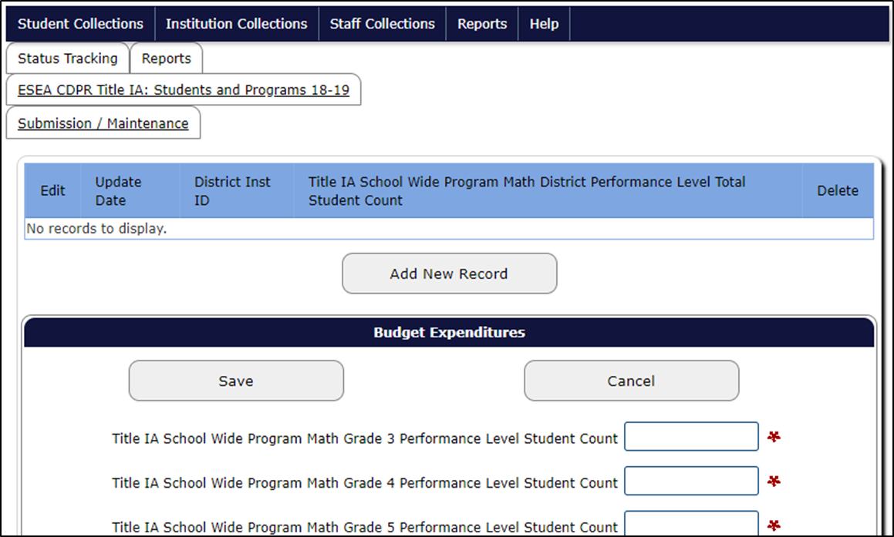
Data Entry Screen
Notes:
This is a snippet of the data entry screen for the data collection.

Slide 31
Entering the Data
Using the CDPR Title I-A Validations Worksheet as reference, enter the data for each data element.
If there is not a count for a data element, you MUST enter “0” or you will be unable to correctly submit the data collection.
Once you have finished entering the data from the CDPR Title I-A Validations Worksheet, select “Save”
If you cleared all data errors within the Validations Worksheet, you should have no errors when you submit the data through the Consolidated Collections.

Slide 32
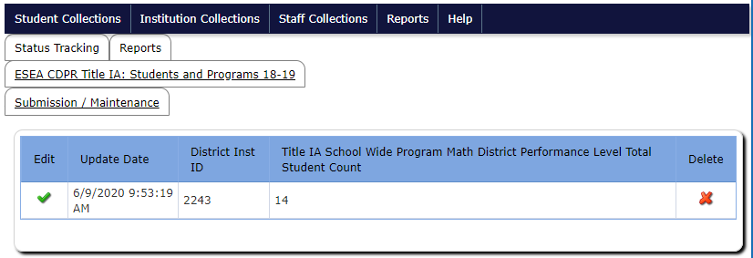
Data Submitted Screen
If you entered the data and there were no errors you should see this screen:

Slide 33
Editing Submitted Data
Select the green check in the “Edit” column, to view the data submitted, make changes, then save again (resubmit).
Select the red “x” in the “Delete” column, to delete the data submission and start over.

Slide 34
Data Errors
If there are data errors, when you select “Save”:
You will not see the data submitted screen
Errors will be listed at the top of the screen
Data Fields associated with the error will be framed in red
What you need to do:
Make the needed corrections to the data error(s)
Select “Save”

Slide 35
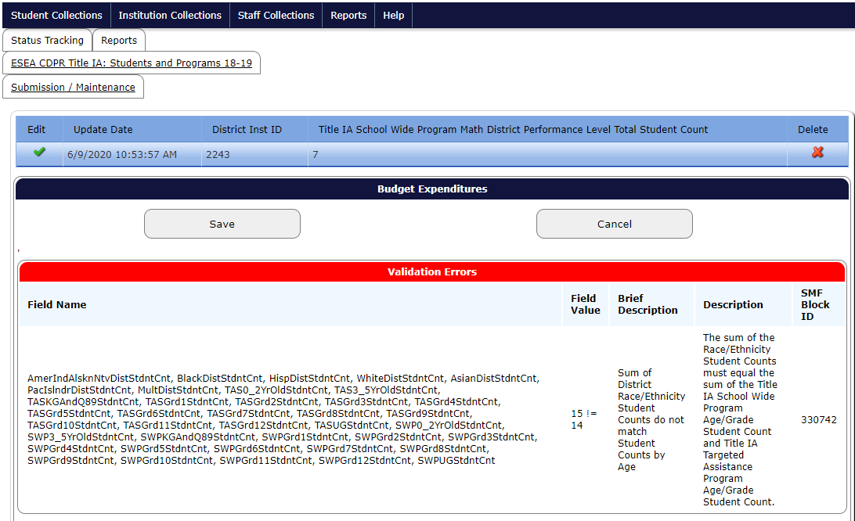
Example Data Error Screen
Notes:
This error shows that the SWP/TAS grade level total count does not match the Race/Ethnicity total count.

Slide 36
Assistance
If you are still having trouble submitting within the Consolidated Collections application after you have:
Cleared all data errors within the Validations Worksheet
Entered the data correctly from the Title I-A Validations Worksheet into the Consolidated Collections
Checked that there are no data elements without a digit
Contact Kyle Walker (kyle.walker@ode.oregon.gov)

Slide 37
Contact Information
For data questions:
Kyle Walker, Program Analyst | kyle.walker@ode.oregon.gov | (503) 689-0479
For questions/problems with the web-based tool:
ODE Helpdesk | ode.helpdesk@ode.oregon.gov | (503) 947-5715
For Title I-A program questions:
Jen Engberg, Education Specialist | jennifer.engberg@ode.oregon.gov | (971) 208-0207
Sarah Martin, Education Specialist | sarah.martin@ode.oregon.gov | (971) 208-0333
Amy Tidwell, Education Specialist | amy.tidwell@ode.oregon.gov | (503) 580-0078

Slide 38
Questions?

