Slide 1
COMMITTEE OF PRACTITIONERS
Thursday
May 12, 2016

Slide 2
Agenda
1:30 PM Welcome & Introductions
1:35 PM Role of Committee of Practitioners relevant to ESEA Reauthorization: Every Student Succeeds Act (ESSA) Review and Implementation
1:40 PM Every Student Succeeds Act (ESSA) Updates
2:40 PM Additional Agenda Items from Committee
3:15 PM Next Steps
2016 Odyssey Conference
2016-17 Future Agenda Items

Slide 3
Committee Members
Lori Cullen Brown, Clackamas ESD
Brian Goldman, Clackamas ESD
Brenda Lewis, Beaverton SD
Alisha McBride, Vale SD
Tricia Mooney, Pendleton SD
Leslie O’Dell, Portland Public SD
Rosalie Sumsion, St Helens SD
Christy Wilkins, Cascade SD
Melissa Wisner, Salem-Keizer SD

Slide 4
ODE Representatives
Theresa Richards, ODE Director of Federal Systems
Russ Sweet, Federal Systems Team Lead
Melinda Bessner, Federal Systems
Lisa Plumb, Federal Systems
Erica Anderson, District and School Effectiveness
Shanda Brown, District and School Effectiveness
Shawna Moran, District and School Effectiveness

Slide 5
Every Student Succeeds Act (ESSA) Updates

Slide 6
Federal ESSA Update
USED seeking comments by May 25 to formulate non-regulatory guidance on ESSA, including:
ways to expand early learning;
the recruitment, development, and retention of teachers and leaders under Title II;
the clarification of fiscal requirements;
student support services under Title IV; and
students in foster care, homeless children and youth, and English learners under Title III.
Negotiated rule-making process  Draft rules & submit to Congress  Public comment

Slide 7
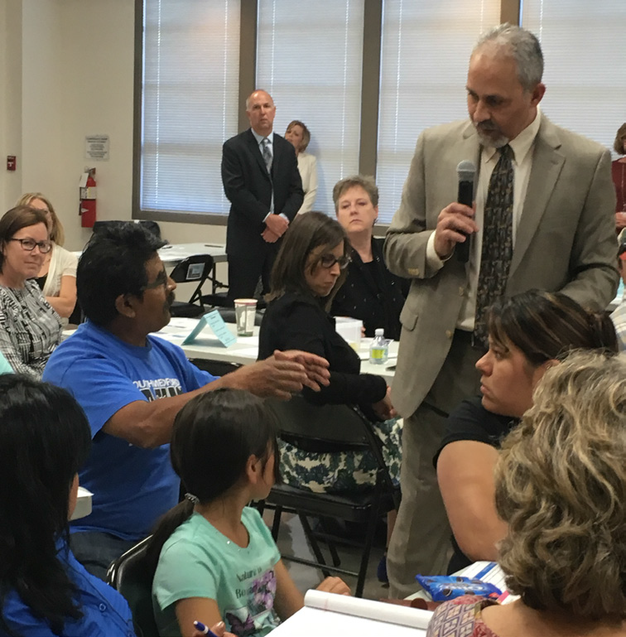
Oregon Stakeholder Engagement
Reimagine Education in Oregon
Community forums around the state to hear directly from Oregonians about their vision, values, and priorities for education. The feedback we are collecting from these discussions will help inform the State Plan.

Slide 8
State Plan Development - ODE and Stakeholder Roles
ODE TEAMS | Work Groups | Stakeholders | ESSA Leadership Group (Internal) | ESSA State Plan Advisory Committee (External) | Dept. Supt, Governor, and State Board
Frame the key issues based on ESSA, Oregon vision, and guiding principles Draft work group reports Synthesize stakeholder feedback Develop state plan drafts | Share ideas, perspectives through collaborative approach Develop considerations on key issues Review drafts and provide feedback | ODE and work group members solicit stakeholder feedback (engaging existing statewide and targeted groups) | Reviews work group considerations/reports to ensure coherence across groups and alignment to the established guiding principles; provides feedback | Reviews work group considerations/reports to ensure state plan represents the state’s values and aspiration for our schools; provides feedback | Deputy Supt. meets with ESSA State Plan Advisory Committee and consults with Governor State Board approves state plan

Slide 9
Oregon Timeline
April-June 2016
Work groups convene
July-Aug 2016
Sept-Dec 2016
Adjust state plan based on USED rules
ODE teams draft state plan
ODE and work group members solicit stakeholder feedback
Public comment
Work groups review and provide feedback
State Board review Preliminary State Plan in Oct and approve in Dec
Advisory groups provide feedback
ODE solicit stakeholder feedback

Slide 10
Oregon Timeline
Winter 2017
Develop policy, guidance, rules, legislative proposals
Spring- Summer 2017
2017-2018 SY
Full implementation begins
Submit Oregon State Plan
USED approval within 120 days⬄
Stakeholder input
ODE guidance and technical assistance

Slide 11
Accountability Work Group
Charged with considering how to design an accountability and reporting system in order to support school improvement efforts and to effectively communicate school quality with Oregon parents and other stakeholders.

Slide 12
Accountability Work Group
Discussion
School Ratings vs. Multiple Measures Dashboard
Qualities of an Accountability Indicator
Indicators of School Quality/Student Success
Additional topics identified:
Designing a dashboard
Additional indicators
Participation rate requirement
Alternative schools

Slide 13
School & District Improvement Work Group
Charged with developing a proposed framework of supports for schools identified for comprehensive and targeted improvement as well as developing a proposed framework for determining how and when schools will exit identification.
To accomplish this, the group established a common understanding of the various stages of Oregon’s current improvement cycle and the impact on schools currently undergoing improvement efforts.

Slide 14
School & District Improvement Work Group
Discussion
Identification: How might schools be identified for improvement supports?
Diagnostic Review and Planning: What role might ODE / LEAs play in the diagnostic review / needs assessment? What are the opportunities and barriers in conducting high-quality, in-depth diagnostic reviews? How might stakeholders be meaningfully and productively engaged in the review process?

Slide 15
School & District Improvement Work Group
Discussion
Monitoring: What (additional) data might be used for in-year/ implementation monitoring? What resources might be developed in order to support improvement efforts? How might plans be evaluated and approved on an annual basis?
Exit Criteria and Progressive Interventions: How might we define improvement? Does exit criteria need to mirror identification criteria? Can schools exit improvement status before the end of the identification period? How might we support sustained improvement? What might progressive interventions include for schools who do not demonstrate improvement?

Slide 16
Standards & Assessment Work Group
Charged with considering how best to support districts in implementing the state’s rigorous content standards and how best to tailor our state’s assessment system to both meet the requirements under ESSA and to meet the needs of students and educators to improve student outcomes throughout students’ PK-20 experience.

Slide 17
Standards & Assessment Work Group
Discussion
Long-term vision for Oregon’s assessment system and shared understanding of the purpose of different types of assessments:
Summative assessments
Interim assessments
Formative assessments

Slide 18
Standards & Assessment Work Group
Discussion
Focused on short-term or near-term action:
Standards implementation resource needs
High school flexibility
Accessibility support needs
Summative assessment administration policies
Formative and interim assessment resource needs

Slide 19
Educator Effectiveness Work Group
Charged with how best to support districts in ensuring every student is taught by a high quality, effective teacher and every school building is led by a high quality, effective educational leader.
This includes:
implications of Senate Bill 290
developing considerations to improve how the state and local districts determine the effectiveness of an educator
how best to infuse elements of the Equitable Access to Educator Plan into Oregon’s State Plan under ESSA

Slide 20
Educator Effectiveness Work Group
Equity Plan -- Ensuring that all students, particularly the most vulnerable students, including those with disabilities, language learners, and historically underserved, are taught by an effective teacher.

Slide 21
Educator Effectiveness Work Group
Discussion
Exploring ways to define an “excellent educator” and “excellent school leader” without the constraints of HQT (Highly Qualified Teacher).
Discussing the root cause of inequitable access to excellent educators and school leaders for traditionally marginalized student populations and the strategies identified in the plan to address them.
How state tests should play a role, if at all, in Student Learning and Growth Goals for evaluations.
Benefits of the Evaluation Matrix, drawbacks of the Matrix, if not the Matrix, then what?

Slide 22
Next Work Group Meetings
May 18th - Salem
June 28th - Portland

Slide 23
Interrelated Components of the State Plan Aligned to Oregon’s Vision and Goals
Title I-A: Standards & Assessment
Fiscal Flexibility
Other Federal Programs
Title II-A: Educator Effectiveness
Title I-A:
School & District Improvement
Title I-A: Accountability
Oregon State Plan
Notes:
ESSA encourages more fiscal flexibility, including the blending of funds to improve the academic program of Title I schools.
New fiscal rules encourage program innovation and investments that can benefit all students, so long as the investment also benefits at-risk students.

Slide 24
Questions? Comments?

Slide 25
Next Steps
2016 Odyssey Conference
August 16th – August 18th
Sheraton Portland Airport Hotel, Portland
August 23rd – August 25th
Riverhouse Hotel, Bend

Slide 26
Resources
ODE ESSA Link
http://www.ode.state.or.us/search/page/?id=5493
ODE Odyssey Conference Link
http://www.ode.state.or.us/search/page/?id=3914

Slide 27
Future Agenda Items?

