Slide 1
Title I-A Committee of Practitioners
Thursday, February 14, 2019

Slide 2
Agenda
2:30 PM Welcome & Introductions
2:35 PM Role of Members
2:40 PM Overview and Discussion re Comprehensive
and Targeted Supports to Districts and Schools
3:15 PM Overview and Discussion re Private Schools and Foster Care
3:45 PM Agenda Items from Committee for Next Meeting

Slide 3
Introductions

Slide 4
Guest Presenters
Shawna Moran,
Education Specialist
District and School Effectiveness Team
Joni Gilles
Ombudsman
Federal Systems Team

Slide 5
Role of Members

Slide 6
CSI and TSI Support and Partnerships

Slide 7


BIG SHIFTS
Where we’ve been and where we’re headed

Slide 8
Federal Education Law
No Child Left Behind (NCLB), 2002
Every Student Succeeds Act (ESSA), December 10, 2015
ESEA Flexibility Waiver, 2012
Expired Aug 1, 2016
Elementary and Secondary Education Act (ESEA), 1965
Notes:
ESEA – Enacted during the Johnson administration as part of the War on Poverty and is our nation’s national education law.
NCLB – Reauthorization of ESEA during the George W. Bush administration. Had us paying attention to outcomes for kids, emphasis on closing opportunity gaps for students. . While well intentioned, it overemphasized reading and math as the measure of school improvement, and created a culture of shame and blame - rating schools and using a one size fits all approach
Waiver – ESEA Flexibility waiver was the opportunity for states to seek relief from some of the provisions of the No Child Left Behind law that weren’t working. Elevated the idea that growth matters too.
ESSA – Replaces NCLB and provides states the flexibility to design models for accountability and support that work for their students. ESSA is deeply rooted in advancing educational equity and truly building systems that eliminate systemic and historical barriers to student success.
PRESENTER NOTE: Refer participants to the one-pager “Oregon Plan: the Every Student Succeeds Act” in their folder

Slide 9
Shifts in Approach & Mindset
NCLB | ESSA
Rating of schools (1-5) | Rating of individual measures
Focusing school improvement supports directly at school level | Focusing school improvement supports on schools as part of a larger district system
Identifying and labeling low-performing schools | Describing and differentiating supports for schools based on need and in concert with district engagement
Promoting top-down, hierarchical accountability | Encouraging mutual, shared accountability
Engaging few stakeholders in improvement planning process | Broadly engaging stakeholders in improvement planning and implementation process

Slide 10
Oregon’s Accountability Model
Oregon’s Accountability Model
Sk th | Elem/ Middle | High Schools
Chronic Absenteeism | X | X
ELA Achievement | X | X
Math Achievement | X | X
ELA Growth | X
Math Growth | X
English Learner Progress | X | X
9th Grade On-Track |  | X
4-year Graduation |  | X
5-year Completion |  | X
Notes:
The federal law requires states to develop an accountability model that meaningfully differentiates schools for support. Oregon’s accountability model represents available state-level data to convey student outcomes and provide a broad picture of school performance over time. This is the initial “knock on the door”.
Oregon’s model expands to include data outside of just reading and math. What’s important for us to know is that we believe that there are other data that are important for determining how schools are doing. Context and local data matter.
NOTE TO PRESENTER: Ask them to turn and talk.
Which data listed here helps drive your decision making?
What other data do you have locally that are of higher value than is what is listed here?

Slide 11

Our Four Commitments
Oregon’s Four Commitments
Advance Equity
Promote a Well-Rounded Education
Strengthen District Systems
Foster Ongoing Engagement
Notes:
Oregon’s approach to developing a plan under ESSA was to engage as many stakeholders as possible. Central to Oregon’s Plan and the work ahead are key commitments generated through this feedback and voices of Oregonians. We believe these commitments serve as the foundational tenets and levers to strengthen and shape our educational system to better serve Oregon’s students.
PRESENTER NOTE: Refer to left column of the one pager for additional description of each commitment.

Slide 12
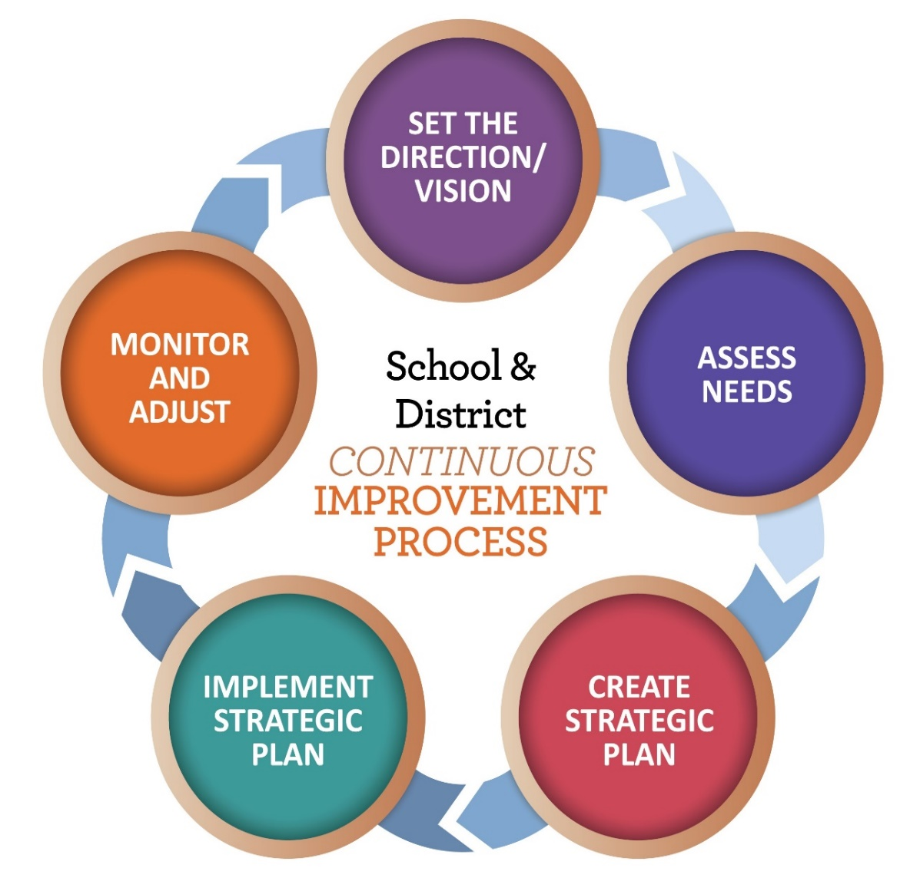
Promoting Continuous Improvement for ALL
Continuous Improvement Process
Notes:
Purpose of each step in the cycle
Direction and Vision – District vision and mission builds the foundation for overall improvement. What is our purpose for improvement?
Assess Needs – Identify and prioritize critical needs based on data.
Strategic Planning – Create a rigorous yet attainable plan with enough detail to guide the work
Implement Plan – Implement the improvement plan effectively and continuously collect progress data
Monitor and Adjust – Install school and district routines and feedback loops designed to self-monitor and adjust plan implementation and outcomes based on evidence.
We are going to focus most heavily on steps 2 and 3 in this cycle, starting with Assessing Needs
NOTE TO PRESENTER: The arrow is animated, so click to add arrow pointing to ASSESS NEEDS

Slide 13
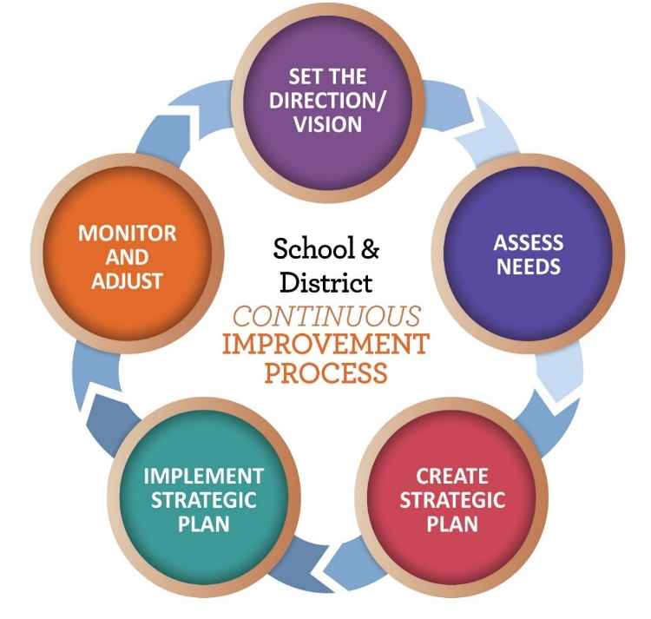

Promoting Continuous Improvement for ALL
Continuous Improvement Process
Essential parts of a Comprehensive Needs Assessment Process:
Student outcome data
Systems health data
Perception data
Notes:
PRESENTER NOTE: Make sure to emphasize the multiple types of data that should be part of a CNA including student outcome data, perception data and systems health data
Key/Essential parts of a Comprehensive Needs Assessment Process:
Student outcome data
Systems health data – ORIS
Perception data
It is in the area of systems health that the ORIS framework comes in. The genesis of ORIS was the conversations that took place as part of the ESSA workgroups. The feedback provided prompted ODE to focus on internal cohesion, common language and develop a structure under which all the work of the agency could fit and be described.

Slide 14

Review – Why, How & What
Why | How | What
Advance Equity Promote a Well-Rounded Education Strengthen District Systems Foster Ongoing Engagement

Slide 15

Oregon Integrated Systems Framework
Oregon Integrated Systems Framework
Notes:
The ORIS Framework includes 5 evidence based domains. These domains represent the evidence based systems that districts need to ensure are strong in order to achieve desired outcomes for students.
ODE has created two tools (district and school) aligned with the domains and indicators of the ORIS framework. These tools are effective in examining system health as part of a CNA.

Slide 16
Promoting Continuous Improvement for ALL
Continuous Improvement Process
Notes:
We’re moving to the next stage in the CI process which focuses on planning. “Failing to plan is planning to fail”. “A goal without a plan is just a wish.”
PRESENTER NOTE: This slide has animation. Click to add arrow for STRATEGIC PLAN

Slide 17
ODE Planning Template
ODE Planning Template
Articulated Vision and Mission
Summary of Comprehensive Needs Assessment process
Specific Priorities and Goals
Evidence-based Strategies and Actions
Measures of Evidence
Feedback Loops and Monitoring Routines
Notes:
SWITCH BACK TO PRESENTER 1
NOTE TO PRESENTER: Review the components of planning that we just walked through with the graduation rate example. Shift focus to monitoring routine (last bullet is in blue to emphasize that this is a component of the process that is not on the template just shared.)

Slide 18
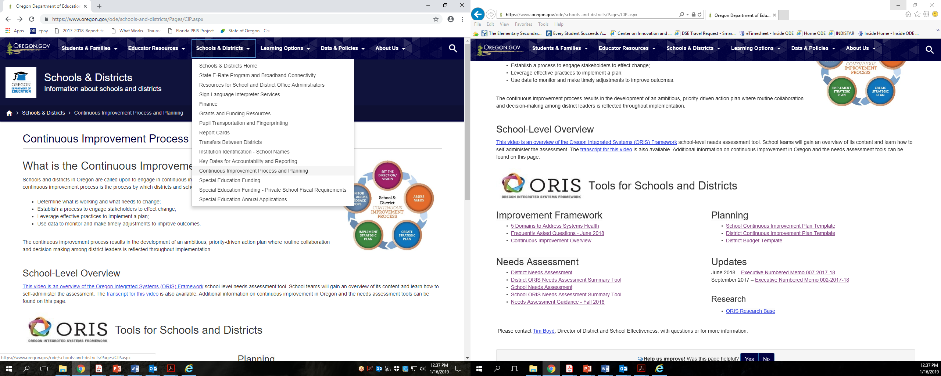
Tools, Templates, Resources
https://www.oregon.gov/ode/schools-and-districts/Pages/CIP.aspx
Notes:
Website where you can find our resources

Slide 19
Next Steps/Timeline
Next Steps/
Timeline
Winter – Review data, conduct needs assessments
Spring – Develop plans
Late Spring/Early Summer – Plans submitted to ODE for review by point person
If you want to go fast, go alone.
If you want to go far, go together.
Notes:
Ideally plans in place for start of 19-20 SY
How to get in touch with your point person?

Slide 20

Thank you
Tim.Boyd@state.or.us
Tanya.Frisendahl@state.or.us
Michael.Linblad@state.or.us
Sarah.Martin@state.or.us
Susan.Mekarski@state.or.us
Jennifer.Molan@state.or.us
Shawna.Moran@state.or.us
Brian.Putnam@state.or.us

Slide 21
Questions and Discussion

Slide 22
Private School and Foster Care Updates

Slide 23
Private Schools: Equitable Services Update
Private School Partnership
Private School List
FAQs: Section One: General Information https://www.oregon.gov/ode/Pages/search-results.aspx?q=private school faqs
Section Two: Equitable Services
What is Working? What Needs Attention?
March 5 Webinar https://www.oregon.gov/ode/schools-and-districts/grants/ESEA/Pages/Private-Schools.aspx

Slide 24
Foster Care
Points of Contact
What is Working? What Needs Attention?
Spring Trainings https://www.oregon.gov/ode/students-and-family/fosteringconnections/Pages/default.aspx

Slide 25
Questions and Discussion

Slide 26
Items for Future Meetings

Slide 27
Thank you!

