Slide 1
Title I-A Committee of Practitioners
Wednesday, May 2, 2018

Slide 2
Agenda
1:30 PM Welcome & Introductions
1:35 PM Approve Revised Bylaws
1:40 PM Title IV-A Student Support and Academic Achievement
2:00 PM Comprehensive Needs Assessment
A Streamlined Approach to Continuous Improvement
2:20 PM Agenda Items from Committee for Next Meeting

Slide 3
Introductions

Slide 4
Guest Presenters
Raquel Gwynn,
Education Specialist for Title IV-A
Federal Systems Team
Shawna Moran,
Education Specialist
District and School Effectiveness Team

Slide 5
BY-LAWS

Slide 6
Title IV-A
Student Support and
Academic Enrichment Grant

Slide 7
Title IV-A
New block grant for:
  well-rounded education;
  improving school conditions for learning; and
  use of technology to improve academic achievement and digital literacy of all students
Formula grant to all districts based on Title I-A formula
Oregon received $3,819,272 (2017-18)
Minimum a district may receive is $10,000

Slide 8
Title IV-A
LEAs that receive $30,000 or more must spend:
  At least 20% to support well-rounded education;
  At least 20% to support safe and healthy students; and
  At least “some funds” to support the effective use of technology.
  May not spend more than 15% on technology infrastructure)
LEAs that receive less than $30,000 must meet at least one of the above requirements.
Notes:
A single activity can satisfy more than one category of required costs.
LEAs that receive less than $30,000 in SSAE funds must meet at least one of the above requirements (that is, spend at least twenty percent on activities to support a well-rounded education or at least twenty percent on activities to support safe and healthy students or at least some funds(?) for activities to support the effective use of technology).
Cap on Technology Infrastructure
Of the SSAE funds spent on technology, LEAs may not spend more than fifteen percent (15%) of those technology funds to purchase technology infrastructure. Specifically, this means that LEAs may not spend more than fifteen percent of its SSAE technology funds on devices, equipment, software applications, platforms, digital instructional resources and/or other one-time IT purchases.

Slide 9
Well-rounded Education
Well-Rounded Education | Safe & Health Students | Use of Technology
College & career guidance Music & Arts STEM Accelerated learning History, civics, economics, geography, government education Foreign language Environmental education Volunteerism & community involvement Integrating multiple disciplines | Drug & violence prevention School-based mental health services Health & safety programs Addressing trauma Addressing sexual abuse Reducing exclusionary discipline practices Positive behavioral interventions Resource coordinator Pay for success | Professional learning Technological capacity & infrastructure Delivering courses through technology Blended learning PD on use of technology in STEM areas Access to digital learning

Slide 10
Title IV-A Application Process
Application and information can be found at:
http://www.oregon.gov/ode/schools-and-districts/grants/ESEA/Pages/SSAE.aspx

Slide 11
Title IV-A: Resources
Non-Regulatory Guidance: ESSA Title IV, Part A Guidance – Student Support And Academic Enrichment Program
Contact: Raquel Gwynn at Raquel.Gwynn@state.or.us
Or Melinda Bessner Melinda.bessner@state.or.us

Slide 12
Questions and Discussion

Slide 13
A Streamlined Approach to
Continuous Improvement
April 2018

Slide 14
Objectives for today
Revisit the continuous improvement process
Review performance indicators
Share timelines
Collect feedback and answer your questions

Slide 15
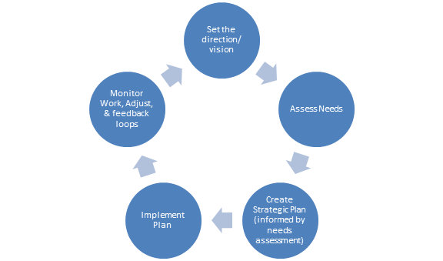
Continuous Improvement Process

Slide 16
Key Principles Driving this Work
Districts, schools, and partners are better supported by:
  Reduced burden and duplication of needs assessments and plans
  Improved cohesion, collaboration, and communication by ODE staff
  Alignment of improvement initiatives and priorities

Slide 17
Where have we been?
Then
Now
Districts completed multiple needs assessments and plans
The needs assessment and CIP process was a compliance exercise for many districts
Districts submitted a CIP every three years to ODE
ODE is in the process of developing a comprehensive needs assessment to be used agency-wide as the basis for all programs and initiatives
The needs assessment is organized around 5 domains that make up the ORISS framework
Districts to submit a CIP by June 2019

Slide 18
What is ORISS?
It starts with Equity.

Slide 19
ORISS Draft Domains
How have we arrived at where we are today?
Extensive Review of Research Based Domains for both Improvement & MTSS
Calibration of Domains
Oregon’s Draft Domains

Slide 20
What are the ORISS domains?
Leadership
Stakeholder Engagement
Talent Development
Coordinated Educational Framework
Inclusive Policy, Structure, and Practice

Slide 21
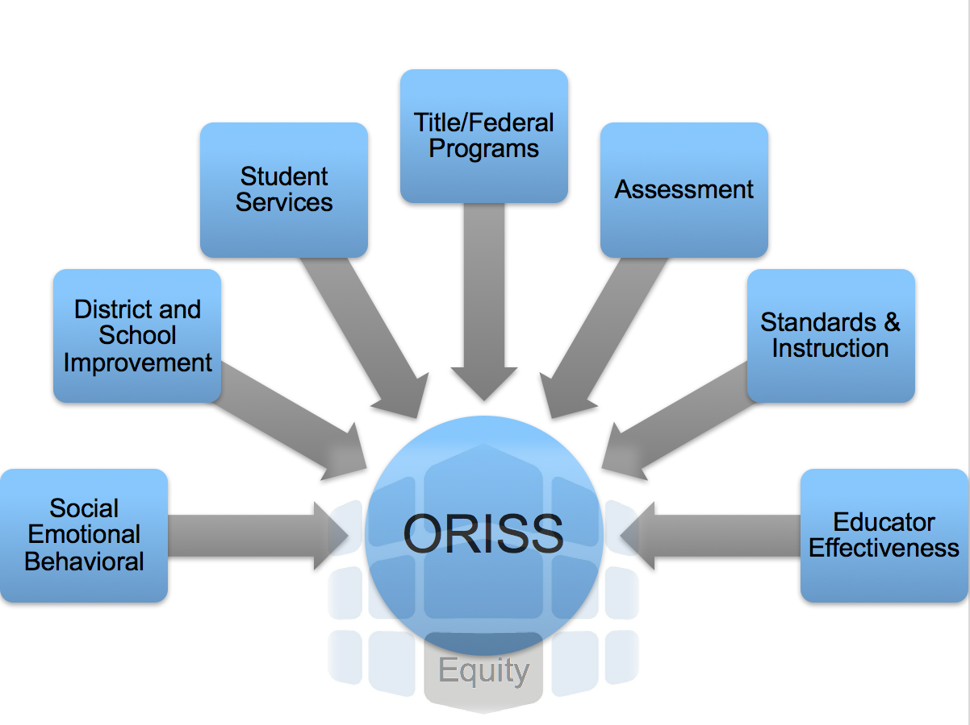
Who Helped Create ORISS?

Slide 22
ORISS Domains – How’d we do?
Leadership
Leadership across levels (community, school board, district, school) has cultivated a shared vision, mission and culture that emphasizes the belief that all students are capable of success
Expectations and priorities are developed collaboratively and based on the needs of the students (as evidenced by data)
Effective systems and structures are installed, supported and monitored to ensure focus remains pointed on the needs and outcomes of students
Leadership is intentionally distributed with a balance between professional empowerment accountability
Notes:
As we share these, check off concepts or terms that you expected to see or hear about from your own note-taking.

Slide 23
ORISS Domains - How’d we do?
Talent Development
An evidence based evaluation model is used to ensure all educators and district personnel receive the support needed to be successful in their position
Quality professional learning offerings are informed and balanced by trends in student outcomes and professional goals or preferences
Effective systems to recruit and retain are cultivated and include opportunities for growth

Slide 24
ORISS Domains -How’d we do?
Stakeholder Engagement
Multiple pathways and feedback loops are intentionally designed and executed to ensure positive engagement with all stakeholders including the school board, families, the community, teachers, staff and especially for groups that have traditionally been marginalized
Stakeholder input is valued and genuine partnerships are established and maintained
Communication systems are effective, transparent and multifaceted to ensure ongoing two-way information sharing
Notes:
As we share these, check off concepts or terms that you expected to see or hear about from your own note-taking.

Slide 25
ORISS Domains -How’d we do?
Inclusive Policy, Structure & Practice
A welcoming, learning centered, inclusive and safe climate is expected and reinforced across all district settings
Barriers to advancement, participation and opportunity are identified and replaced with inclusive and equitable practices in all settings
Notes:
As we share these, check off concepts or terms that you expected to see or hear about from your own note-taking.

Slide 26
ORISS Domains -How’d we do?
Coordinated Educational Framework
Fosters necessary conditions for learning, as established in research on learning theory
Establishes a clear line to the benefit each aspect provides to student learning
Supports collection of evidence of its effectiveness in improving learning outcomes
Contributes to a system with increasing levels of support matched to a student’s needs, goals, and interests
Leverages interconnections among all aspects of the framework

Slide 27
ORISS
High Level Descriptions are not meant to fully flesh out the specific terms and concepts for each domain. | Supporting guidance documents will provide the specific details and concepts.
So…

Slide 28

Why is the ORISS Framework important for you?
  Because processes such as:
  Facilitating needs assessments…
  Developing strong implementation & improvement plans…
  Supporting the effective implementation of plans, and
  Helping schools and districts install data-based routines to monitor their implementation progress and student outcomes are…
  the continuous improvement strategies we plan to use as our road map in helping districts and schools improve and these will soon all align to ORISS.

Slide 29
What’s Next?
ODE will:
  Continue to collaborate to refine our domains and high level descriptions
  Develop a Comprehensive Needs Assessment tied to ORISS domains
  Build our CIP and CAP planning templates and electronic platforms tied to ORISS domains
  Develop supportive guidance documents for districts and providers, such as yourselves, to use to guide teams in their use
  Adapt our district and school progress reporting for improvement and growth based on these domains

Slide 30
Questions and Discussion

Slide 31
Items for
Future Meetings

Slide 32
Thank you!

