Slide 1

Continuous Improvement Process A Team Workshop Session

Slide 2
Who is here with us today?

Slide 3

Our Collective Aim
To leverage the continuous improvement process as a powerful mechanism to:
Strengthen district systems
Meaningfully engage Community Partners
Promote well-rounded learning environments
Elevate equitable learning outcomes

Slide 4
Workshop Objectives
Explore key elements of the continuous improvement process for deeper learning and planning
Begin to connect continuous improvement planning and processes with Student Investment Account applications
Develop a roadmap of next steps

Slide 5
General Agenda
Common Background Building
Continuous Improvement Review - Process & Products
Connections with Federal/State Programs
Federal Programs
ESSA (Accountability) Partnerships
Student Investment Account
Others
Workshop Time
Closing & Next Steps
Assessing Needs | How community members are meaningfully engaged throughout these continuous improvement processes
Goals/Strategies
Identifying Measures
Monitoring Routines

Slide 6
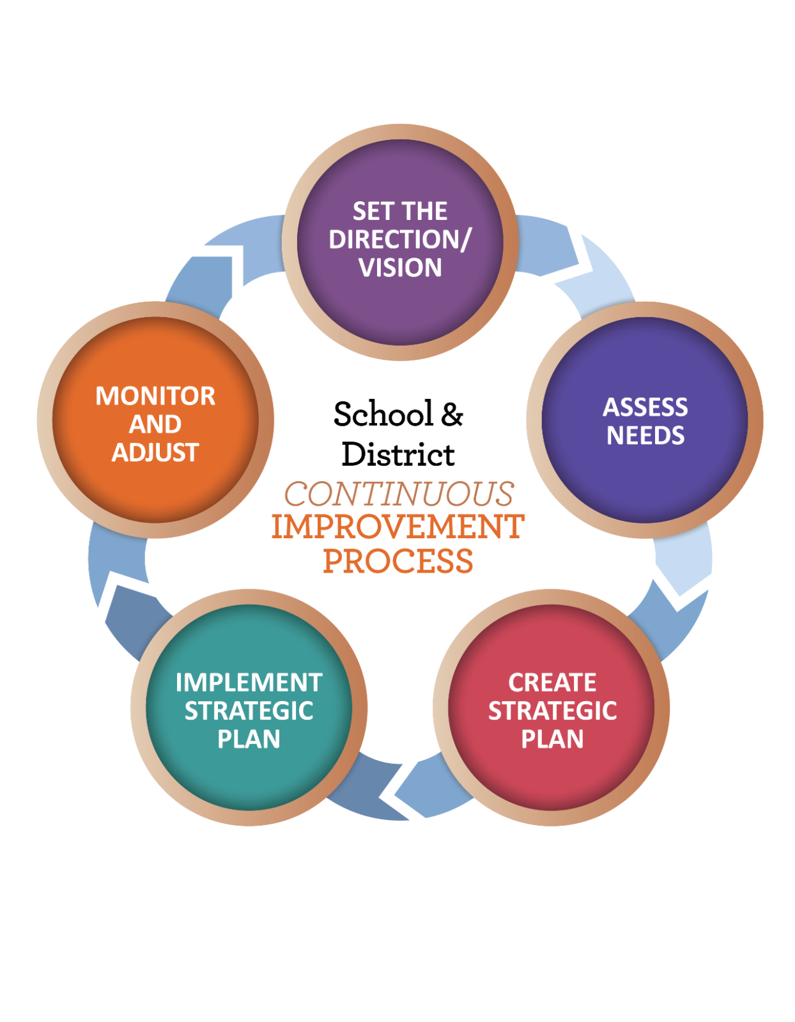
Continuous Improvement Process Best Practices aligned with Requirements

Slide 7
“The CIP”
The CIP | The Big 5 | Implementation Plan Vision Mission Goals/Strategies Action Steps Routine to Monitor/ Adjust | Reviewed for districts with CSI – TSI schools and allocation of federal school improvement funds Opportunity to inform SIA applications
 | The Supplemental 10 | Questions that describe how the districts will address state and federal requirements | Reviewed to ensure compliance with state and federal law Required to submit budget narrative

Slide 8

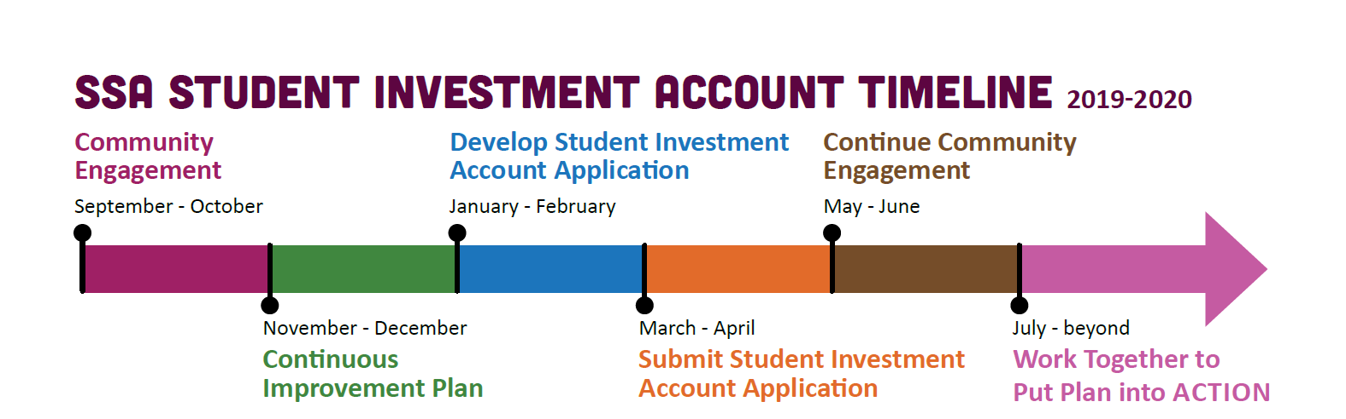
Where are we?

Slide 9
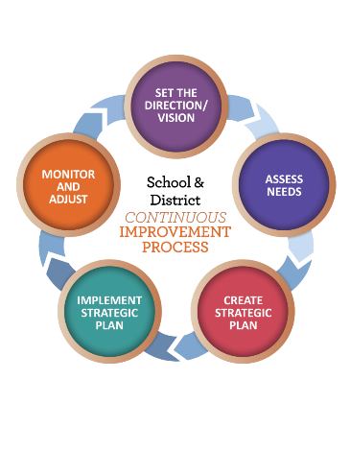
Resources
Needs Assessment Guidance
ORIS Health Assessment Tool
Data Analysis Summary
District Continuous Improvement Plan Template
Tips on writing goals and strategies as theories of action
Routine Guidance
ODE Continuous Improvement Web page
Community Engagement Toolkit

Slide 10
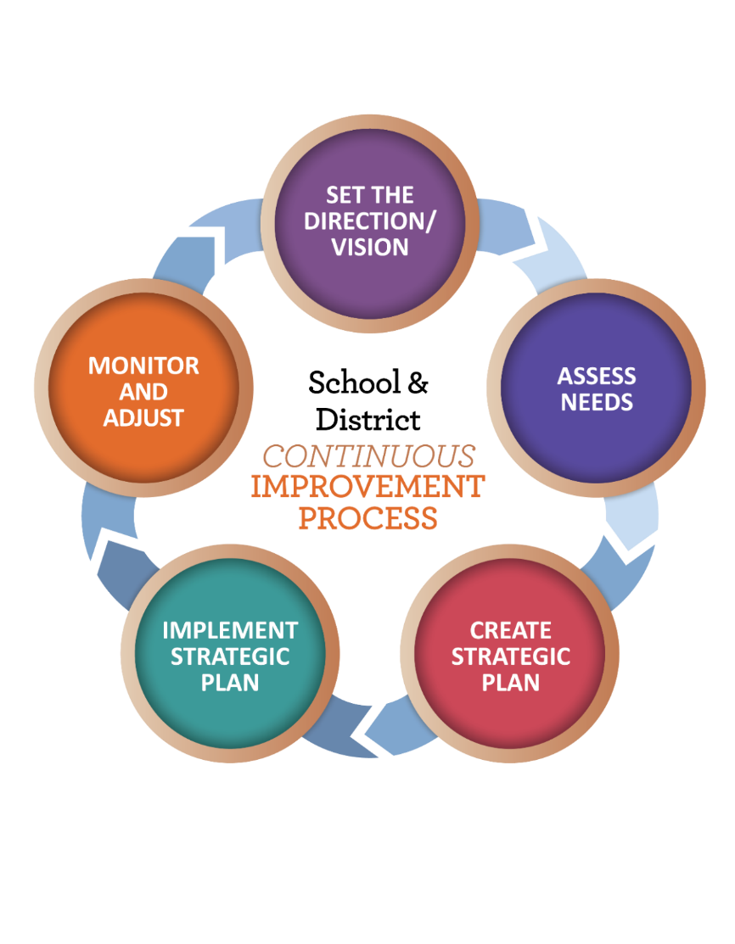
Focus for Today Based on Registration
Needs Assessment
Goals and Strategies
Identifying Measures
Establishing Routines

Slide 11
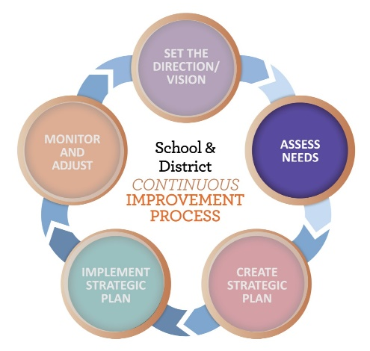
Comprehensive Needs Assessment
WHAT
A systematic process that assists district and school teams in identifying systemic inequities, strengths and opportunities
WHY
To select priorities and goals based on needs and strengths
WHO
All who have a stake in the outcomes for students
HOW
Examination of multiple sources of data

Slide 12

Data Sources
System Health Data |  | Student Data Trends (pay attention to specific student groups’ needs) |  | Engagement Data
ORIS Domains Leadership Talent Development Stakeholder Engagement & Partnership Well Rounded Coordinated Learning Inclusive Policy & Practice |  | Academic Behavioral Social Emotional Attendance Graduation |  | Education Professional Input Community Partners & Partner Input
Strengths | Opportunities | Strengths | Opportunities | Strengths | Opportunities

Slide 13
Activity – You choose
Look at the Needs Assessment sample provided.
What data was analyzed?
Are all three categories represented?
What is the evidence of engagement of staff? Students and families? External community partners?
OR
Get out your own plan. With our discussion in mind:
What data are we collecting across the three categories? Is there any data we are not currently collecting that we might consider adding?
How have we communicated with Community Partners what we learned from our systems health assessment? How have we solicited feedback?
Is our list of Community Partners complete? Is there anyone else we should bring into the conversation?

Slide 14
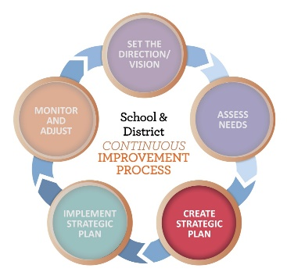
Goals and Strategies
Tips for Writing Goals:
Goals should be ambitious (rigorous) and aspirational (may take several years). For an SEA, LEA, or school, the goals are student focused and apply to all students.
Example Goal with Metric
Goal: Increase percent of all students graduating high school to 85% | Data Source: Annual Graduation Rates (up from 65% ) | Year 1 Increase 5% to 70% | Year 2 Increase 10% to 80% | Year 3 Increase 5% to 85%

Slide 15
Goals and Strategies
About Strategies:
Strategies describe the work the organization will undertake in pursuit of its goals
A strategy may take one or two or more years to implement
Strategies are powerful, high leverage work that build capacity and changes practice, behavior, and belief so students are more successful
One bold strategy can have more impact than a litany of poorly implemented strategies.
Writing a strategy as a theory of action: - Redding & Layland, 2015
If we (the work we will do)
then (direct short term impact – what change adults will make)
and (the longer term impact - for students)
The “If” part of the statement describes or is aligned to the evidence-based practice that will be implemented (for example, practices found in the ORIS Domains).

Slide 16
Strategy as a Theory of Action
The practice we want to implement to address need(s)
If we…
then…
and …
The immediate impact on adult practice
The long-term impact on student learning or behavior
Evidence-Based Practice
Measurable

Slide 17
Practice with Strategies
Read and critique each theory of action (TOA). How can the TOA be clarified or improved? Then, rewrite the statement so it is a stronger theory of action.
Strategy | Critique | Examples of Rewritten Strategy as ToA
1. If the school provides Teachers on Special Assignment, then teachers will get support working with their struggling students in planning and meetings, as well as direct instruction in targeted areas of need. | It is missing what long-term impact will be on the students. Also, what do the teachers do because of the support from TOSAs? | If the Teachers on Special Assignment provide support on planning and direct instruction to selected struggling students, then teacher capacity to plan for and meet individual needs will improve, and struggling students will gain needed skills.
2. If the school provides Intervention/Universal Access, then students will be able to receive targeted instruction in areas of need.
3. Implement college and career standards

Slide 18
Practice with Strategies
Action | Critique | Examples of Rewritten Action as a ToA
1. If the school provides Teachers on Special Assignment, then teachers will get support working with their struggling students in planning and meetings, as well as direct instruction in targeted areas of need. | It is missing what long-term impact will be on the students. Also, what do the teachers do because of the support from TOSAs? | If the Teachers on Special Assignment provide support on planning and direct instruction to selected struggling students, then teachers will plan for individual needs, and struggling students will needed skills.
2. If the school provides Intervention/Universal Access, then students will be able to receive targeted instruction in areas of need. | It is missing what the adults will do as well as the impact on student results. | If the school provides professional learning on Intervention/Universal Access, then teachers will include universal access and intervention strategies in their planning and instruction, and students learning will improve.
3. Implement college and career standards | This is too vague. What is the school doing, what do you want teachers to do, what will be the impact on student learning? | If the school provides professional learning lessons aligned to essential college and career standards, then teachers will create and deliver standards aligned lessons, and students’ achievement scores will improve.

Slide 19
Activity – You choose
Look at the Goals and Strategies sample provided.
How many metrics will be used for the stated goal?
What evidence-based practice(s) are highlighted in the strategy?
What adult actions in the Theory of Action will impact improved student outcomes?
OR
Get out your own plan. With our discussion in mind:
Does your TOA include adult actions (THEN) and student outcomes (AND)?
Can your goal be written for all students and have differentiated metrics for student groups or grade-bands?
How many discrete strategies are needed to address the goal?

Slide 20
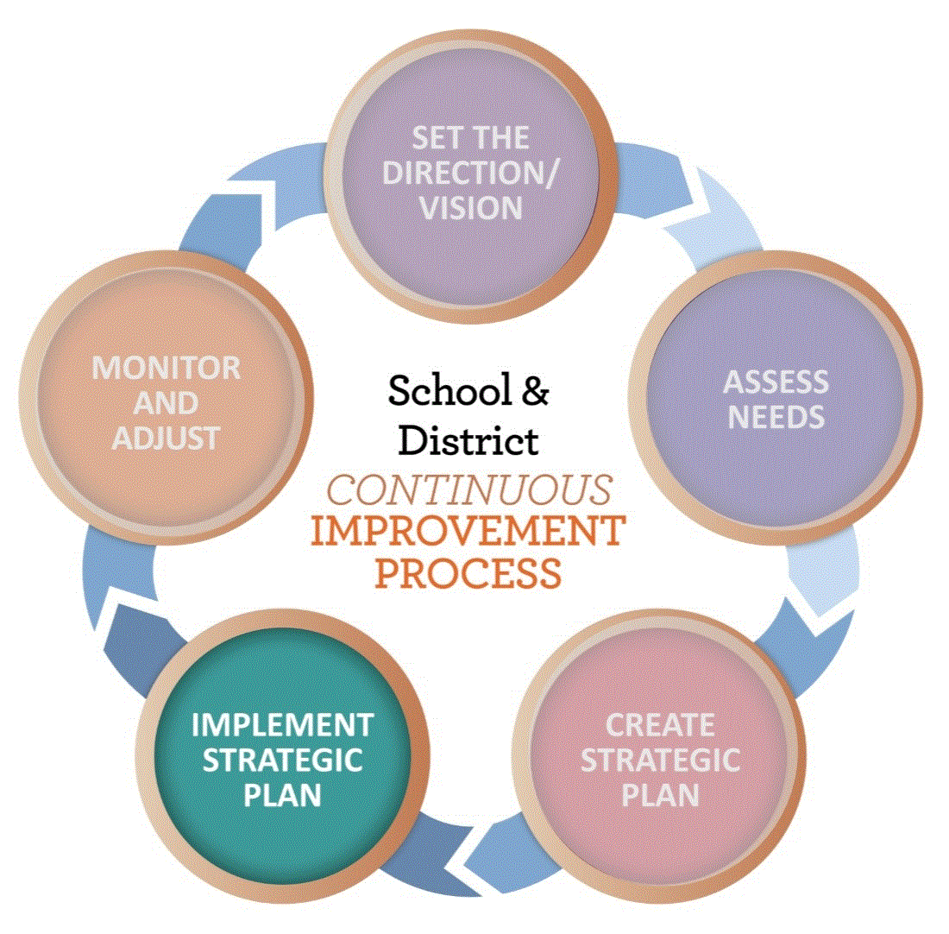
Using Measures of Evidence to Monitor Progress
Lagging Indicators
Diagnose a trend once it has already begun
Focus on the outcome of instruction that has already occurred
Don’t tell us what is happening now
Leading Indicators
Frequent and formative
Predictive in nature
Can provide an early warning

Slide 21
Using Measures of Evidence to Monitor Progress
When monitoring implementation of an initiative, educators most often rely on Student Outcomes—Quantitative Data such as student growth
It is important to examine evidence of Adult Actions—Qualitative Data that gauges changes in adult behaviors that reflects implementation of a goal
The question to answer here is:
Are we doing what we agreed we would do?

Slide 22
Using Measures of Evidence to Monitor Progress
Examples of measures of adult actions:
Collecting data on the timeliness and participation of professional learning
Analyzing PLC minutes to see if new strategies or approaches are part of the planning process
Observing educators to see if implementation is occurring and supporting those having difficulty

Slide 23
Practice with Measures
Read each theory of action. Create the questions to ask. What is the desired impact on adult practice? Then, identify possible measures to get evidence to answer the questions.
Theory of Action | Questions to Ask | Measurement Examples
1. If the Teachers on Special Assignment provide support on planning and direct instruction to selected struggling students, then teachers will plan for individual needs, and struggling students will needed skills. | Did the Teachers on Special Assignment provide support on planning to meet the needs of struggling students to teachers? Did the Teachers on Special Assignment provide direct instruction to selected struggling students? Did teachers plan to address individual student needs? | Teachers on Special Assignment support logs % of students identified as needing direct instruction/those identified % of students who received direct instruction that improved skills % of teacher lesson plans that demonstrate planning for individual student needs
2. If the school provides professional learning on Intervention/Universal Access, then teachers will include universal access and intervention strategies in their planning and instruction, and students learning will improve.
3. If the school provides professional learning lessons aligned to essential college and career standards, then teachers will create and deliver standards aligned lessons, and students’ achievement scores will improve.

Slide 24
Practice with Measures
Theory of Action | Questions to Ask | Measurement Examples
1. If the Teachers on Special Assignment provide support on planning and direct instruction to selected struggling students, then teacher capacity to plan for and meet individual student needs will improve and struggling students will gain needed skills. | Did the Teachers on Special Assignment provide support on planning to meet the needs of struggling students to teachers? Did the Teachers on Special Assignment provide direct instruction to selected struggling students? Did teachers plan to address individual student needs? | Teachers on Special Assignment support logs % of students identified as needing direct instruction/those identified % of students who received direct instruction that improved skills % of teacher lesson plans that demonstrate planning for individual student needs
2. If the school provides professional learning on Intervention/Universal Access, then teachers will include universal access and intervention strategies in their planning and instruction, and students learning will improve. | Was professional learning provided and was it effective? Did teachers plan for and provide universal access and interventions for students? | Number of teachers who participated in the professional learning Scenario assessment after learning session Teacher lesson plans showing universal access or intervention instruction Walkthroughs with look-fors for individualized learning
3. If the school provides professional learning lessons aligned to essential college and career standards, then teachers will create and deliver standards aligned lessons, and students’ achievement scores will improve. | Was professional learning provided and was it effective? Did teachers create and deliver standards aligned lessons? | Number of teachers who participated in the professional learning Scenario assessment after learning session Teacher lesson plans Teacher observations

Slide 25
Activity – You choose
Look at the Measures sample provided or get our your own plan. With our discussion in mind:
What adult actions are in place that can effectively gauge implementation of the strategy?
Are these metrics appropriate to support implementation?

Slide 26
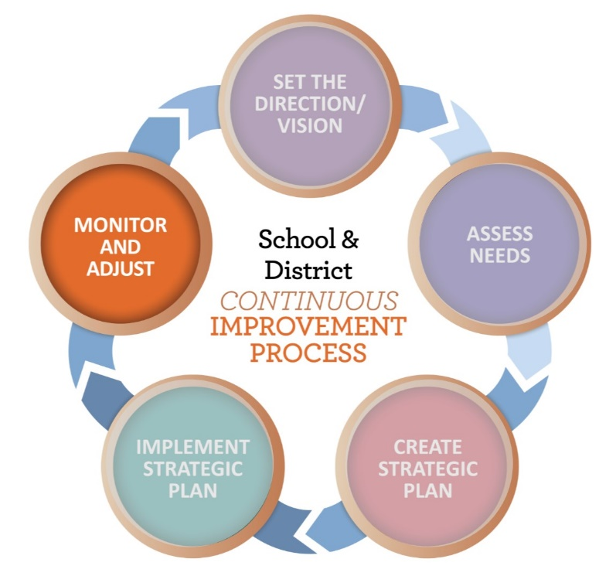
Routines
Who?
District and school teams
What?
The collection & evaluation of formative data which is summarized, analyzed and used to determine plan progress and next steps
Serves as the basis of communications & feedback loops
When & Where?
Quarterly (at least) ½ a day typically
This doesn’t preclude the amount of time we meet in between the routine as we “work” over the course of the year
Why?
To develop a shared understanding of progress
To flesh out our work plans and work loads, know when to stay the course and when to adjust
What next?
Resources, next steps or course corrections are made & recorded
Information is used to define/refine goals and strategic plans

Slide 27
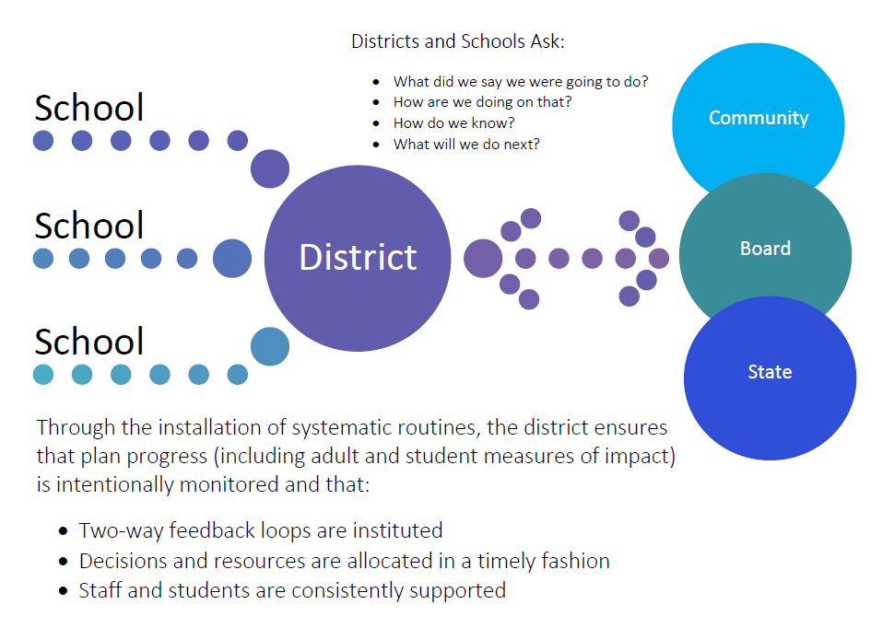
Routines inform Feedback Loops

Slide 28
Effective Routines
Have a common purpose
Get the right people at the table
Are driven by a shared view of performance and progress
Result in identifying and solving problems
Encourage learning and collaboration
Rely on committing to clear next steps
Know the purpose of your routine support or accountability?

Slide 29
Preparing for Routines
Focus, Outcomes & Structure | Examples
What are the most important aspects of our plan to monitor? What is the scope of our review? | Adult/Implementation Progress? Student Outcomes? District Level School Level Both
What is the best structure for our routines? | Consider Alternating Meetings Focus on plan implementation Focus on school/student progress
Who will organize, prepare and facilitate the routine meetings? | Provide person(s) with access to data
Who are the members of our team and how often will we meet? | At least quarterly
What will we do with the information? | Support our staff Reallocate resources Adjust our plan Communicate & celebrate progress

Slide 30
Activity – Getting Reading for Routines Partner or Team up & Jigsaw
What are the characteristics of a strong routine? (p. 4 – Appx 1)
What is the routine purpose? (p. 5)
How does a district or school team define the goals/strategies for focus? (p. 6 – Appx 3)
Who should be involved in the routine? (p. 7 – Appx 2)
How does a team measure progress, make decisions and solve problems? (pp 9-11 – Appx 4, 5 and 6)
What preparation is needed to run the first routine? (pp 12-14 – Appx 3)

Slide 31
ESSA Partner Districts Districts with CSI and TSI schools
Installation of routines are best practice and also required
ODE will ask you to share back with us (and your community) information about:
How your routine went
What measures you examined
What progress is being made toward your strategies and goals and how your plan is evolving based on this examination
There is likely going to be a survey to share this information.
More to come – First Routines Winter 2020

Slide 32
“The CIP”
The CIP | The Big 5 | Implementation Plan Vision Mission Goals/Strategies Action Steps Routine to Monitor/ Adjust | Reviewed for districts with CSI – TSI schools and allocation of federal school improvement funds Opportunity to inform SIA applications
 | The Supplemental 10 | Questions that describe how the districts will address state and federal requirements | Reviewed to ensure compliance with state and federal law Required to submit budget narrative
The CIP (Improvement Plan and Supplemental questions) are uploaded HERE:
ODE – Schools & Districts – Continuous Improvement Process & Planning – “Click here to access the CIP Submission Form”

Slide 33
Creating Your Roadmap
What are your next steps?
What do we need to know to better support you?

Slide 34
Questions can be emailed to the District and School Effectiveness Team Thank you!

