Slide 1
Title I-A Coordinators Conversation
January 19, 2017

Slide 2
Agenda
Private School Consulations
Budget Considerations
  Census, district private school allocations, etc
District Annual Review Tool using Indistar
Spring Regional Monitoring Technical Assistance
Topics from Coordinators
Notes:
Russ

Slide 3
Introductions
(Who’s online & in the room?)
Notes:
Russ

Slide 4
Private School Consulations
Russ Sweet

Slide 5
Private School Consultation – Budget Considerations

Slide 6
Private Schools
Non-Regulatory Guidance was released on November 21, 2016 (NON-REGULATORY GUIDANCE: FISCAL CHANGES AND EQUITABLE SERVICES REQUIREMENTS UNDER THE ELEMENTARY AND SECONDARY EDUCATION ACT OF 1965 (ESEA), AS AMENDED BY THE EVERY STUDENT SUCCEEDS ACT (ESSA))
State-appointed Ombudsperson
Consultation
Equitable Share Calculations
State Private School Advisory Committee

Slide 7
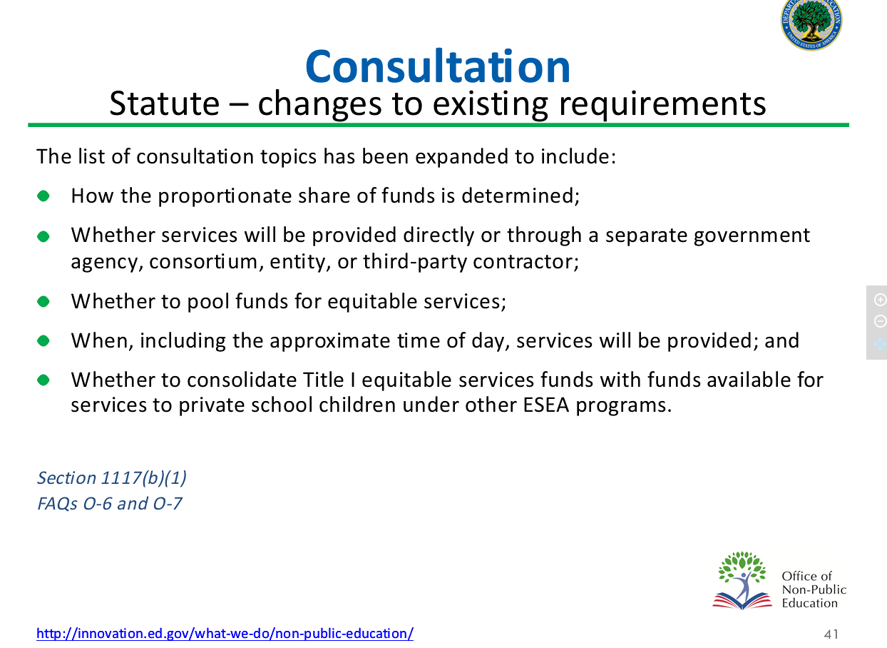
Consultation Statue – changes to existing requirements

Slide 8
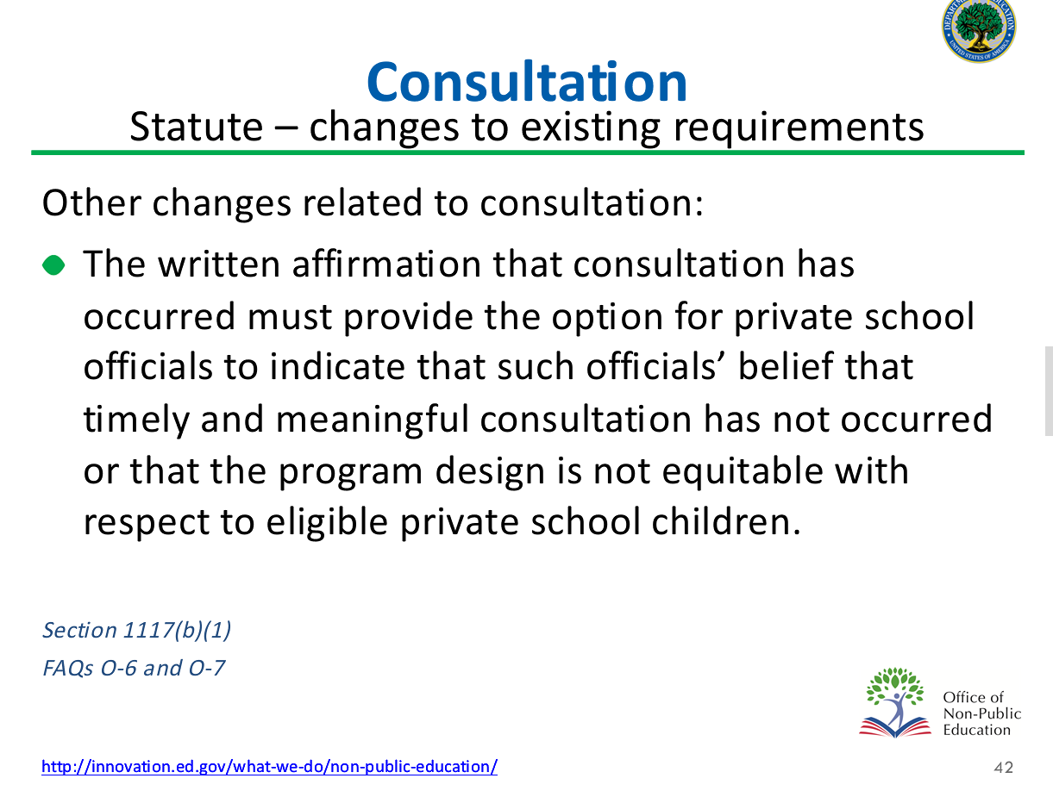
Consultation Statute – changes to existing requirements

Slide 9
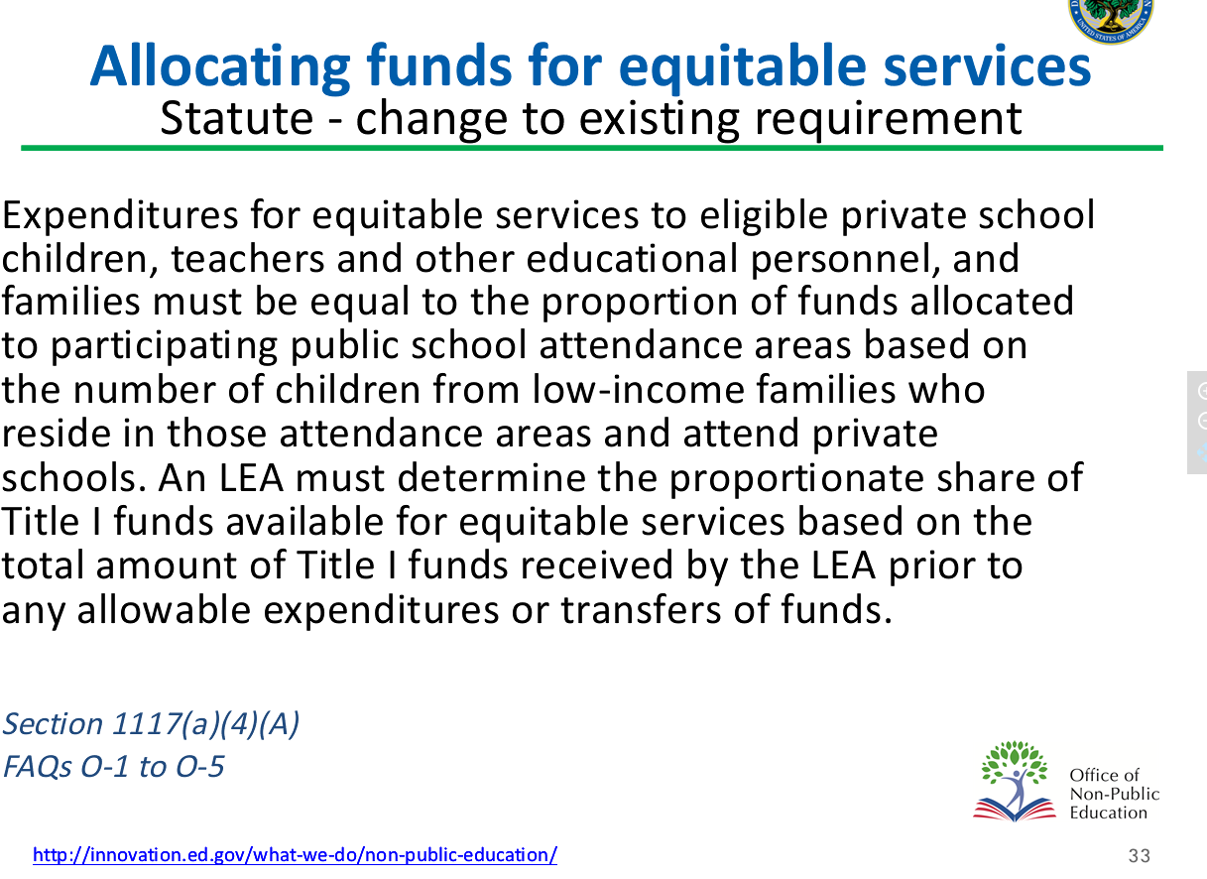
Allocating funds for equitable services – statute-change to existing requirement

Slide 10
Allocating funds for equitable services
Guidance – proportionate share
Example of Determining the Amount of Title I Funds for Equitable Services
Public School Attendance Area | Number of Public School Low-Income Children | Number of Private School Low-Income Children | Total Number of Low-Income Children
A | 500 | 120 | 620
B | 300 | 9 | 309
C | 200 | 6 | 206
D | 35 | 15 | 365
Total | 1350 | 150 | 1500
Proportionate Share | 90% $900,000 | 10% $100,000

Slide 11
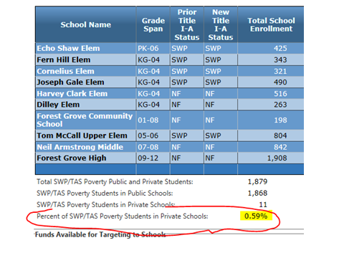
CIP Budget Narrative - Targeting

Slide 12
Coming Soon
The role of the state ombudperson
Further guidance from ODE on calculating the equitable proportion for Title I-A

Slide 13
Contact with Questions
Russ Sweet
  russ.sweet@state.or.us
  503-947-5638

Slide 14
Budget Considerations

Slide 15
New Census data
Reviewing Census data at http://www.census.gov/did/www/saipe/index.html
Click on SAIPE Interactive Data tool
Apply the following filters:
  Ages 5 to 17 in Families (school district)
  States: Oregon
  School Districts: (select your district)
  Year: 2015
  OR click on the “Table” tab and select multiple years.

Slide 16
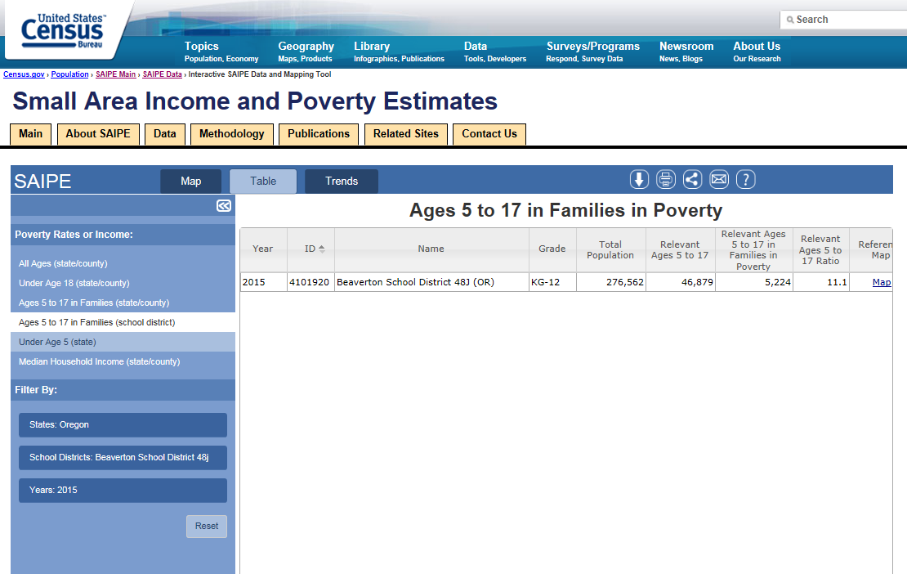
Small Area Income and Poverty Estimates webpage from the United States Census Bureau

Slide 17
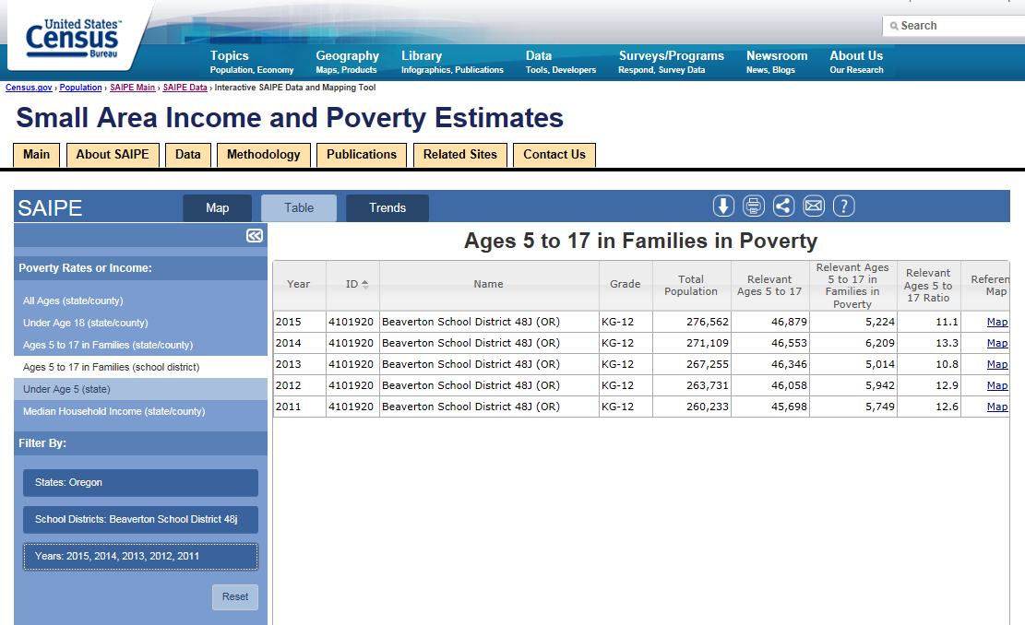
Small Area Income and Poverty Estimates webpage from the United States Census Bureau

Slide 18
Remember for Title IA . . .
Basic
At least 10 children of poverty (per census data)
Concentration
More than 6,500 children of poverty OR
Higher than 15%
Targeted
Must have at least 10 children of poverty AND
Higher than 5%
EFIG
Must have at least 10 children of poverty AND
Higher than 5%

Slide 19
Oregon Overall Numbers
Oregon’s overall population is increasing
BUT students of poverty are decreasing
Therefore we are anticipating a reduction in State Title IA dollars

Slide 20
What to consider for budgeting
2017-18
  No hold harmless (resets)
  SEA School Improvement set-aside increases from 4 – 7%
  Private School proportional share comes off the top of LEA total allocation (see Russ’ slide)
2018-19
  Hold harmless resumes

Slide 21
District Review Process for Indistar
Notes:
Melinda

Slide 22
SEA Annual Review Process of Title IA Plans
SEA Annual Review Process of Title IA Plans
Schools input / transition plans into Indistar
Districts review plans annually & submit their reviews in Indistar using the SEA District School Level Plan form.
SEA reviews district submissions of plans
If District DOES NOT SUBMIT a review of a plan
SEA will review the plan and the district will have 60 business days to submit a review addressing the SEA’s comments of the plan.
If Districts review is INCOMPLETE or DOES NOT DEMONSTRATE a sufficient review.
SEA will review the plan and the district will have 60 business days to submit a review addressing the SEA’s comments of the plan.
If District’s review is COMPLETED and provides sufficient feedback
SEA may review the plan to look for exemplars in planning
In addition, this non submission will INCREASE the district’s risk factor in being monitored for the upcoming year.
In addition, this would be a CONSIDERATION when determining the district’s risk factor for being monitored for the upcoming year.
In this case, a district’s risk factor for being monitored would be LOWER.
Notes:
Melinda

Slide 23
Current Status . . .
Submitted & Accepted
~48%
Submitted BUT insufficient
~22%
Did not submit
~30%
District will need to review plans again by Sept 2017
ODE will send feedback to districts by Mar 2017
ODE is reviewing what’s in Indistar and providing feedback to districts
Monitoring impacts

Slide 24
IF you need a reminder about submitting . .

Slide 25
Annual Review Process for
School Level Plans in Indistar

Slide 26
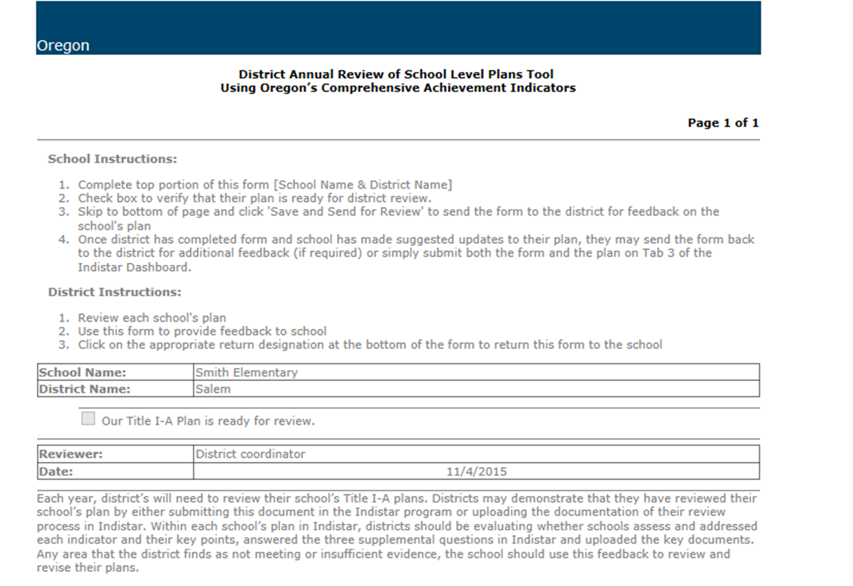
Annual Review of School Level Plans Tool

Slide 27
Step 2 District Evaluation

Slide 28
Forms for Review in Indistar

Slide 29
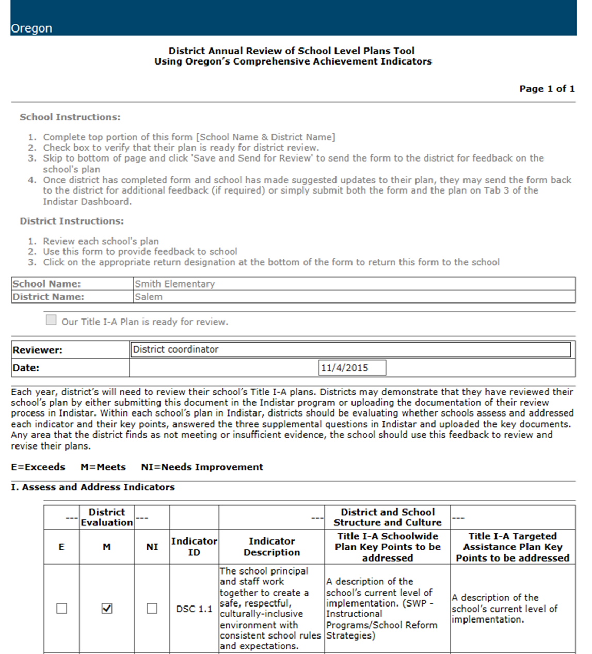
Annual Review of School Level Plans Tool continued

Slide 30
Step 3 District Acceptance or Return to the School for further revisions

Slide 31
Step 4 School Submission of Annual Review to the state

Slide 32
Annual Review of School Level Plans Tool continued

Slide 33
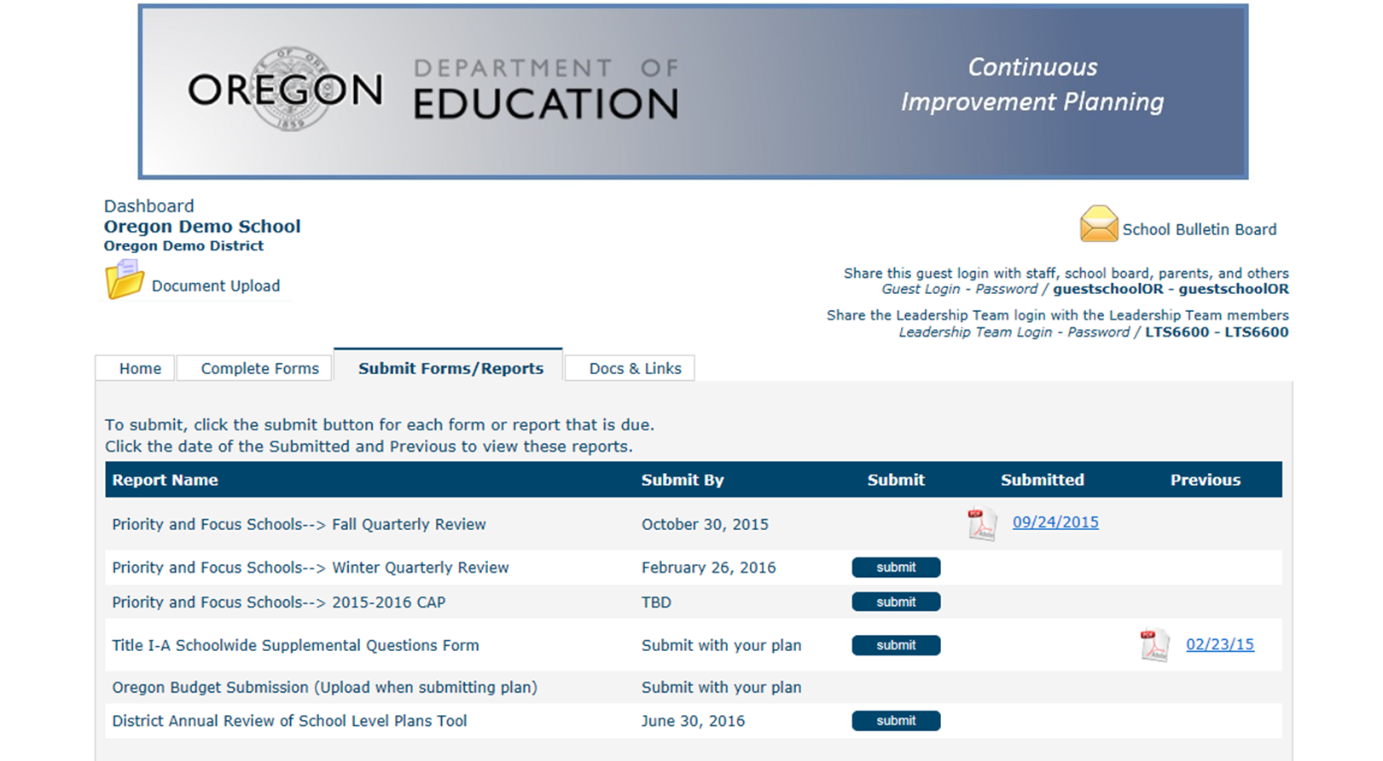
Submit Forms/Reports tab in Indistar

Slide 34
Submit Forms/Reports tab in Indistar once submitted

Slide 35
Step 5 State Receives & Reviews

Slide 36
Spring Regional Monitoring Assistance

Slide 37
Spring Regional Monitoring Assistance
March 7^{th -} Lane ESD
March 13th - LaGrande High School
March 14th – Intermountain ESD
Appointments will be coordinated through Ann Kaltenbach at ann.kaltenbach@ode.state.or.us

Slide 38
Topics from Coordinators?

Slide 39
Title IA Team
Director:
  Theresa Richards
Education Specialists:
  Melinda Bessner, District contact for E-P
  Lisa Plumb, District contact for A-D
  Russ Sweet, District contact for Q-Z
Support Staff
  Emily Swope
  Ann Kaltenbach

Slide 40
Questions?
PowerPoint & Webinar
will be posted at
http://www.oregon.gov/ode/schools-and-districts/grants/ESEA/IA/Pages/Title-IA-Coordinators.aspx

