Slide 1
Title V, Part B: REAP and RLIS
Completing the CIP Budget Narrative

Slide 2

Outcomes
Overview of Title V, Part B
Review CIP Budget Narrative components
Resources
Oregon Department of Education

Slide 3

Purpose of Title V-B
Title V-B programs are designed to assist rural school districts in improving the quality of instruction and student academic achievement by providing greater flexibility in the use of formula grant funds
Notes:
The purpose of Title V-B is to provide flexibility to rural school districts to allow them to maximize the use of funds. The formula grant funds and the fund use flexibility available under REAP enable these rural LEAs to participate more fully and effectively in many of the ESEA programs and allow them to provide better educational services to their students.

Slide 4
Title V-B: Two Programs
RLIS
Rural and Low Income Schools
Rural
Low Income
SRSA
Small, Rural School Achievement Program
Small
Rural
**Administered directly through U.S. Department of Education
Notes:
Title V-B has two distinct programs that serve rural schools. They are referred to as “SRSA” and “RLIS”
SRSA: Small & Rural (APPLIED FOR THROUGH US DEPARTMENT OF EDUCATION)
RLIS: Rural & Low Income (applied for through ODE)

Slide 5
Small Rural School Achievement Program (SRSA)
Eligible districts receive SRSA grant directly from U.S. Department of Education
Alternative Funds Use Authority (AFUA)
  Flexibility in spending funds under Titles I-A,
  II-A, IV-A and V-B
In CIP Budget Narrative this flexibility shows up
as a “REAP” application
  Title II-A + Title IV-A
SRSA
Small
Rural
Notes:
Apply for funds directly to USED
Districts that are SRSA eligible fall under “Alternative Funds Use Authority.” An LEA eligible for the SRSA program not only benefits from SRSA grant program funds, but also may exercise a key flexibility provision in the ESEA. Section 5211(a) of the ESEA, known as AFUA, which gives an eligible LEA broad authority to spend funds the LEA receives under selected ESEA programs on activities authorized under several additional ESEA programs. The authority is specifically designed to give small, rural LEAs greater latitude to spend their Federal funds in ways that best address an LEA’s particular needs.
For these districts, it simply combines Title II-A and Title IV-A funds and makes them more flexible. There is not a “REAP grant” This explains why REAP districts will claim funds in EGMS under Title II-A and IV-A, but will apply under a REAP application.

Slide 6
Rural Low-Income Schools (RLIS)
Also a grant from USED, but it is administered by ODE
In CIP Budget Narrative RLIS districts will see an RLIS application in addition to their other title grants
  I-A
  II-A
  IV-A
  RLIS
RLIS
Small
Low Income
Notes:
Districts that are rural and low income, receive RLIS funds. There is flexibility in how districts can spend RLIS funds, but Alternative Funds Use Authority (AFUA) which allows SRSA districts to combine their Title IIA and Title IVA funds does NOT apply to RLIS districts.

Slide 7
Supplement Not Supplant
Federal funds cannot be used to supplant, or take the place of, state and local funds that would have been spent if federal funds were not available
  Test I: Are the services that the district wants to fund with ESEA funds required under state, local, or another federal law? If they are, there could be the presumption of supplanting.
  Test II: Were state or local funds used in the last year to pay for these services? If they were, there could be a presumption of supplanting.
ESSA Quick Reference Brief: Supplement Not Supplant
Notes:
There is a federal provision of supplement, not supplant in ESSA: Funds received under this subpart shall be used to supplement, and not supplant, non-Federal funds that would otherwise be used for activities authorized under this subpart.
To determine whether a fiscal expenditure supplements and does not supplant, school districts must run the following tests:
Test I: Are the services that the district wants to fund with ESEA funds required under state, local, or another federal law? If they are, there could be a presumption of supplanting.
Test II: Were state or local funds used in the past to pay for these services? If they were, there could be a presumption of supplanting.
It is possible for districts to overcome the presumption of supplanting. Overcoming the presumption of supplanting requires that districts keep documentation (e.g., budget information, planning documents, or other materials). In general, a district must determine what educational activities it would support if no ESEA funds were available. If it is clear that no State or local funds remain available to fund certain activities that previously were funded with State or local resources, then the district may be able to use ESEA funds for those activities.

Slide 8
CIP Budget Narrative

Slide 9
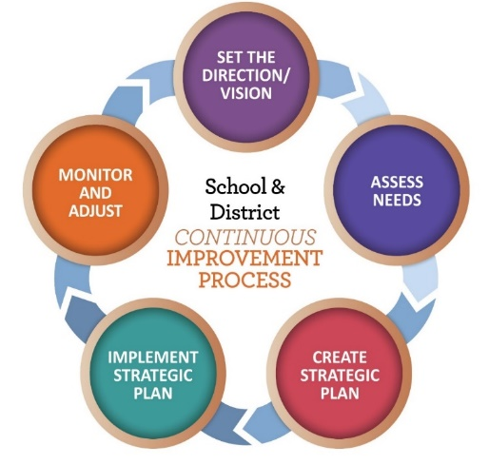
REAP Application Requirements
Overview
  What are our needs? (WHY)
Budget Narrative
  WHAT are we going to do?
  WHO is going to participate?
  HOW will we measure impact?
Oregon Department of Education
Notes:
There are two primary sections in the Title VB CIP Budget narrative:
Overview
Budget Narrative
As a reminder, REAP applications are a combination of a district’s Title IIA and IVA funds and as a result all activities should be tied to an identified need.
Districts can flexibly spend the funds across a variety of Title Programs and the Budget narrative page should describe what the district is going to do with those funds.
9

Slide 10

REAP Application
Activities authorized under:
  Title I-A (Improving Basic Programs)
  Title II-A (Supporting Effective Instruction)
  Title III (Language Instruction for English Learners and Immigrant Students)
  Title IV-A (Student Support and Academic Enrichment)
  Title IV-B (21st Century Community Learning Centers)
Funds must be claimed out of original grant in EGMS
Notes:
Grantees may use REAP funds to carry out activities authorized under any of the following federal programs:
Funds remain in EGMS under the original grant award and must be claimed by the district as such.

Slide 11
RLIS Application
Activities authorized under:
  Title I-A (Improving Basic Programs)
  Title II-A (Supporting Effective Instruction)
  Title III (Language Instruction for English Learners and Immigrant Students)
  Title IV-A (Student Support and Academic Enrichment)
  Parent Involvement Activities
Funds must be claimed out of original grant in EGMS
Notes:
All RLIS activities must include a clear description how these funds are being used to provide supplemental services and/or support that addresses the priorities identified in the comprehensive needs assessment. Be specific and list FTE (with job title) funded by this source only.
Grantees may use RLIS funds to carry out activities authorized under any of the following federal programs:
Funds remain in EGMS under the original grant award and must be claimed by the district as such.

Slide 12
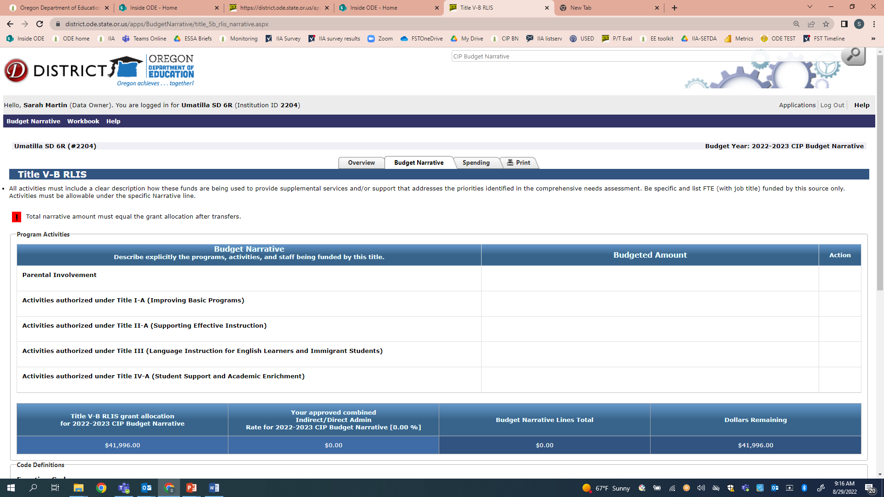
Budget Narrative
Oregon Department of Education
Notes:
For both RLIS and REAP districts enter activities by program. The flexible spending provisions of both these programs mean that districts can spend all their funds on allowable activities from any program. Districts have the added flexibility with RLIS to spend the funds on parent involvement activities.
12

Slide 13

Resources
REAP Informational Document
ODE Title V-B webpage
Oregon Federal Funds Guide
CIP Budget Narrative Checklists
CIP Budget Narrative User Guide
SRSA Applicant Information (USED)
RLIS web page (USED)
Notes:
There are a wide variety of resources available to support districts. The CIP Budget Narrative User Guide and Checklists are particularly helpful tools when submitting the narrative application.

Slide 14
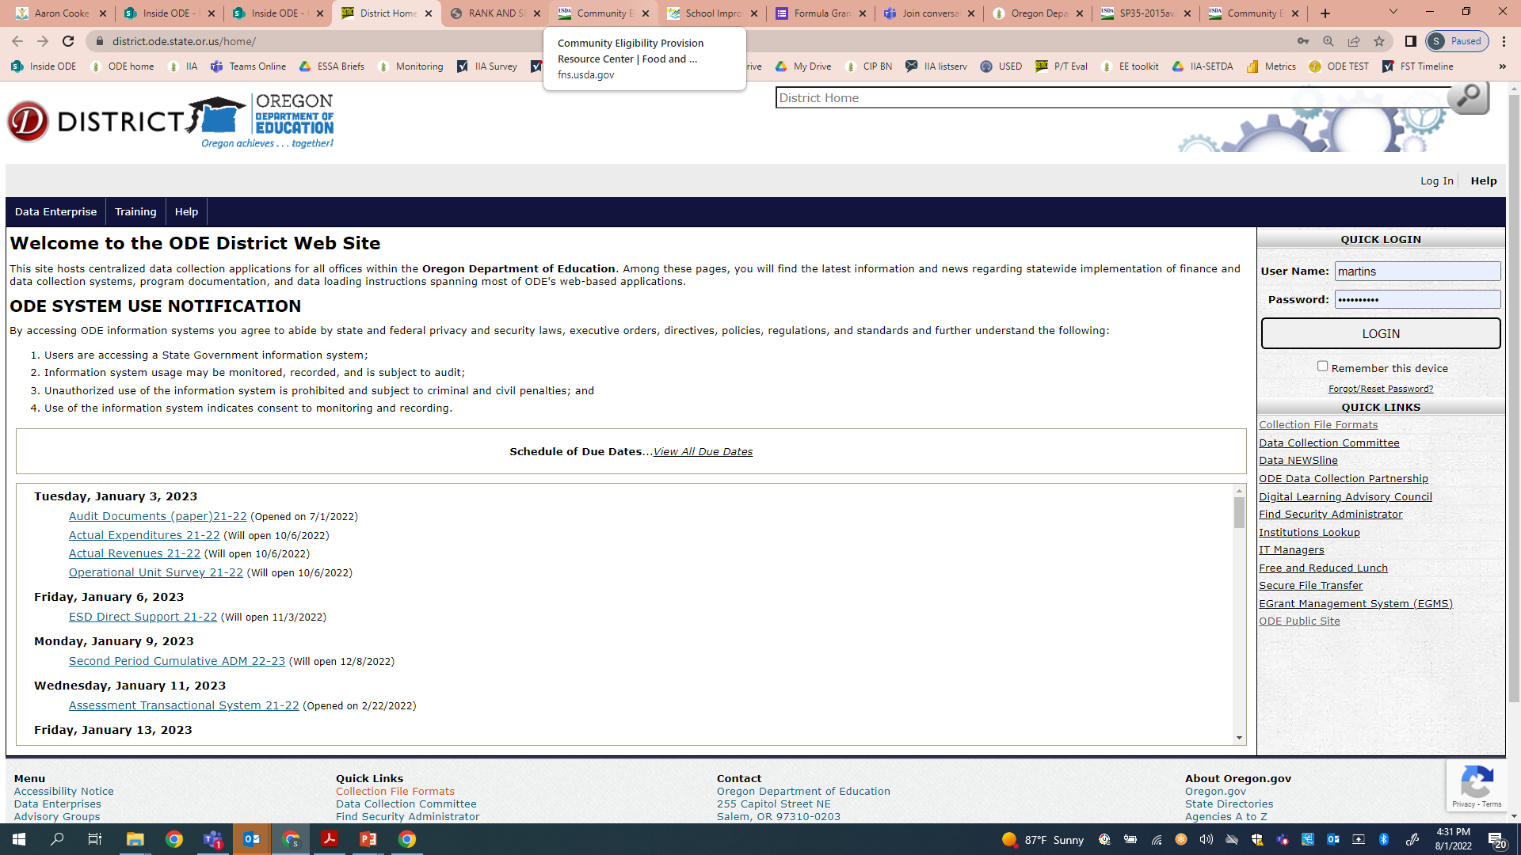

Take a look!
District Secure Site
Notes:
You can log into your CIP Budget Narrative Dashboard through the ODE district secure site. If you do not have access to the dashboard contact your district Security Administrator for access.

Slide 15
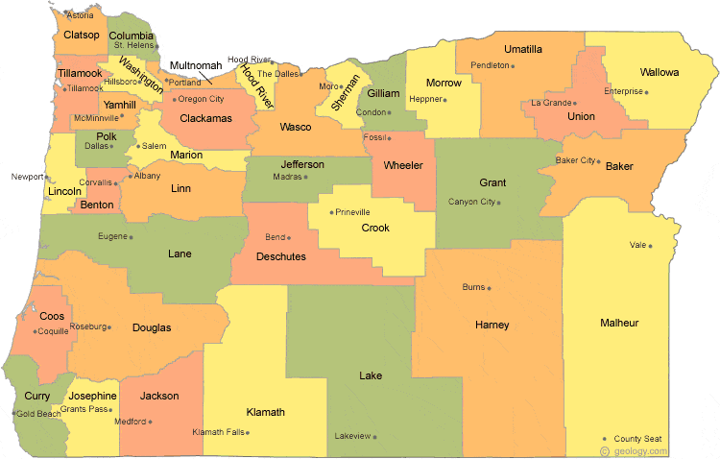
Regional Contacts by ESD
Jen Engberg
  Clackamas, Columbia Gorge, Multnomah and Northwest Regional
Sarah Martin
  Douglas, Lake, Malheur, South Coast and Southern Oregon
Lisa Plumb
  Lane, Linn Benton Lincoln and Willamette
Amy Tidwell
  Grant, Harney, High Desert, InterMountain, Jefferson, North Central and Region 18

Slide 16

Please reach out!
Jen Engberg
Jennifer.Engberg@ode.oregon.gov
Sarah Martin
Sarah.Martin@ode.oregon.gov
Lisa Plumb
Lisa.Plumb@ode.oregon.gov
Amy Tidwell
Amy.Tidwell@ode.oregon.gov
Notes:
Our team has moved from a programmatic model to a regional support model. Each of us has taken a section of the state to support across Titles IA, IIA, IVA and VB.

