Slide 1
2023-2024 October Caseload Title I-D Subpart 2
Data Collection Webinar
Notes:
Materials can be found at the following website:
http://www.oregon.gov/ode/schools-and-districts/grants/ESEA/ID/Pages/Reporting.aspx

Slide 2
Agenda
Support Materials
Purpose & Important Dates
October Caseload “To Do” List
Submitting the Data
Questions and Discussion

Slide 3
Support Materials
October Caseload Resources
PowerPoint
Webinar Recording
October Caseload – How To Count (Example)
October Caseload FAQ
October Caseload CSV Template:
  Available by email or in the Data Collection Documents
October Caseload File Format
File Format User Guide
Student Collections User Guide
Notes:
Put link in chat
The CSV Template is available by email because this format is not accessible
Student Collections User Guide- this has the instructions on how to submit the student level SSID data collection
A User Guide specific to the October Caseload Data Collection will not be created, as there are only a few elements specific to this data collection.

Slide 4
Purpose of the Data Collection
The October Caseload Data Collection determines the next year’s allocations for districts with eligible Neglected and Delinquent Facilities:
  Neglected (funded through Title I-A)
  Delinquent (funded through Title I-D Subpart 2)

Slide 5
Data Collection Window
Opens
October 26, 2023
Closes
December 1, 2023

Slide 6
October Caseload To Do List
Determine eligible facilities
Determine 30-Day “Snapshot” Window
Count & Collect student level data from each facility
Submit Data

Slide 7
Determining Eligible Facilities
A locally operated (public or private) facility within school district boundaries.
Delinquent Facility
Students and youth who have been adjudicated delinquent, or in need of supervision.
Neglected Facility
Students receive care due to abandonment, neglect, or death of their parents and guardians

Slide 8

30-Day “Snapshot” Window
30 consecutive days, one of which is in October.
The Facility or Program Start Date is the 1st day of the 30 consecutive days.
  Must be in the range of September 2nd, 2023 to October 31st, 2023.
The Facility or Program Start Date must match for all students at that facility
District or facilities choose the date range.
Notes:
30 consecutive days
One of the 30 consecutive days must be in October
The Facility or Program Start Date is the 1st day of the 30 consecutive days and must be in the range of September 2nd to October 31st
The Facility or Program Start Date must match for all students at that facility
The End Date is the 30th day of the 30 consecutive days
This is auto-filled for Web Submission, but must be entered for the File Upload
The 30-day span should be chosen (by the facility or the district) according to the 30 consecutive days that has the most unique student enrollments

Slide 9
Eligible Student
An eligible student:
Is ages 5 through 17 (as of the Facility or Program’s 30-day “snapshot” window “Start Date”)
Was served for at least one day during the 30-Day “snapshot” window
Notes:
ODE verifies October Caseload and Subpart 1 reporting and will nullify student enrollments reported where the student was also reported in a state run facility.
Note:
A student may be reported for multiple facility enrollments, as long as each enrollment was unique.

Slide 10
Counting Enrollments
Count eligible students served during a 30 consecutive day “snapshot” window.
If an eligible student is released and re-enrolled, count the student again for each re-enrollment during that 30-day “snapshot” window.

Slide 11
How to count student enrollments
Student | Day 1 | Day 2 | Day 3 | Day 4 | Day 5 | Day 6 | Student Enrollment
Bruce | Being served | Released |  |  |  | Re-enrolled | 2
Sue | Being served | Being served | Being served | Being served | Being served | Being served | 1
Charles | Being served | Being served | Being served | Released |  |  | 1
Felicia |  | Enrolled | Being served | Being served | Being served | Being served | 1
Doug |  |  | Enrolled | Released |  | Re-enrolled | 2
Notes:
The 6 days in this chart are representing the 30-Day Consecutive Day Snapshot Window
Notice, each time a student is released and then re-enrolled during the snapshot, the student is counted again

Slide 12
Data Needed for Submission
School District Institution ID#
Facility or Program Name
Facility or Program 30-day “snapshot” window “Start Date”
Students’ SSID #’s
Number of enrollments per student:
  Once (1) if served during the 30-day “snapshot” window
  An additional count for each re-enrollment of same student during the 30-day “snapshot” window

Slide 13
Every Student Must Have an SSID #’s
To search for or generate an SSID# for a student:
Login to the District website & select “Consolidated Collections”
Under the “Student Collections” tab select “SSID (Secure Student ID) System”
Choose the “Data Submission” tab
Choose the “Web Submission” tab
Type in the Student’s:
  First Name
  Last Name
  Date of Birth
  Gender
Click “Request”
If there is an SSID# associated with that student, the student’s record will come up.
If there is not an SSID# associated with that student, a record will come up with the label “NEW”, once you fill in all necessary information for that student’s record and click “Save” an SSID# will be created for that student.

Slide 14
Submitting the Data
Data is submitted through the Consolidated Collections Application:
Hover over the “Student Collections” tab
Hover over “ESEA Title ID: October Caseload 23-24”
Hover over “Data Submission”
Choose “File Upload” or “Web Submission”

Slide 15
Data Submitting Options
File Upload
(150+ Students)
Web Submission
(0-149 Students)

Slide 16
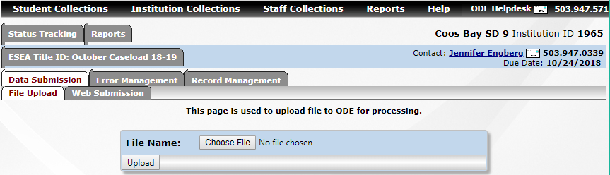
File Upload
This way is recommended when reporting 150+ student enrollments
Add data to the .csv Template
Populate the .csv Template according to the File Format

Slide 17
File Format Reminders
Facility or Program: Refer to the File Format’s Core Code Tables tab for the Facility or Program’s code
Start Date: Must be the same for every student at the facility or program
End Date: Is the 30th day of the 30-day “Snapshot” Window

Slide 18
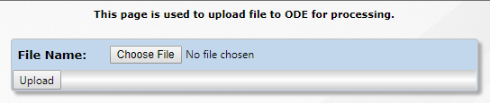
Uploading the File Format Template
Select “Choose File”
Navigate to and select the saved completed file
Select “Upload”

Slide 19
File Upload Errors
To clear errors from the file upload, using the following menu prompts:
Student Collections
  ESEA Title ID: October Caseload 23-24
    Error Management
      Review Errors
        Fix Errors: Review each record, make needed changes and save (submit)
        Download Errors: Download the file, make needed changes, re-upload (the corrected records will save over the previous records with errors)
Notes:
Review Queue: shows the files that have been uploaded
Review Email: shows the emails generated to the district by the collections application
Review Errors: This is where the district can view and fix errors:
“Fix Errors” Action: Click on “Fix Errors” in the “Action?” column, the list of records with errors will come up and the district can:
Click on the green checkmark of each student’s record, fix the issue in the student’s record, and save. The record should disappear from the list of records with errors unless a new error was generated by this action
Click on the red x button if need to delete because a student was submitted twice, etc.
“View Error Records” Button: will show the errors but cannot make edits here
“Download Errors” Button: the district can download a list of the records with errors, make the needed edits to the file and re-upload the file. The fixed records will be saved over the previous records with errors

Slide 20
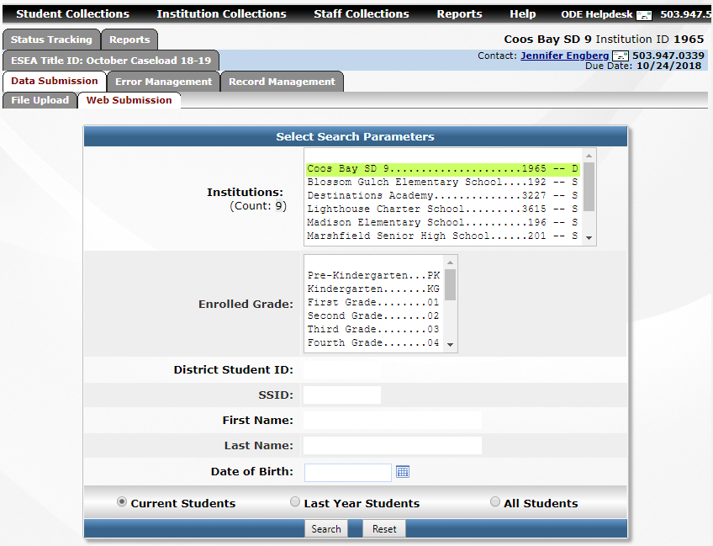
Web Submission
This way is recommended when reporting 1-149 student enrollments
Student information will be added or updated manually via the “Web Submission form.

Slide 21
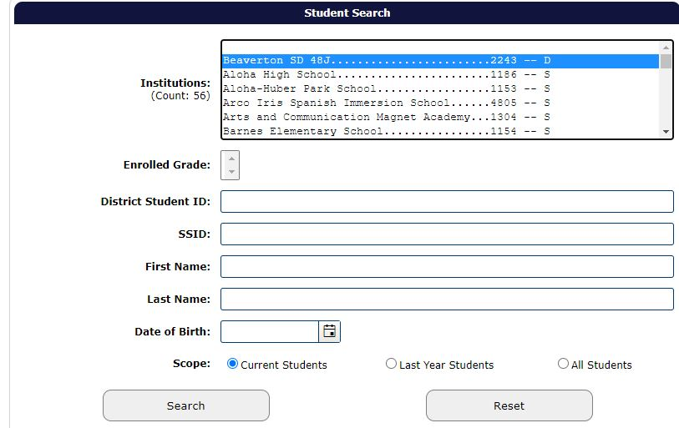
Web Submission – Open Student’s Record
Enter the student’s SSID# and select “Search”

Slide 22
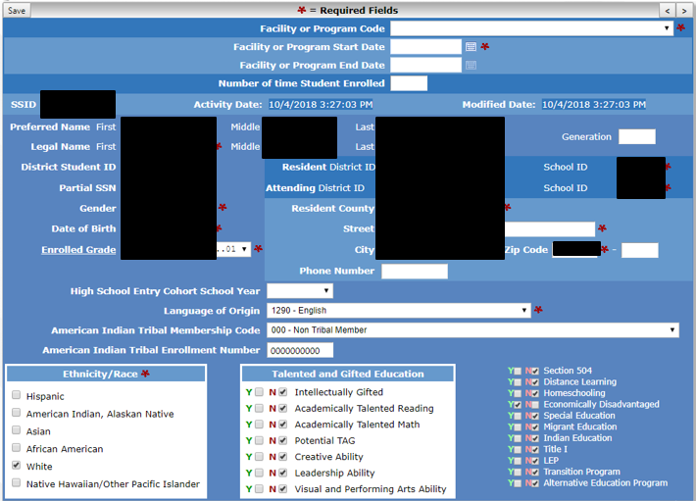
Student Information Screen
Red Arrows indicate the fields you will be updating in the student information screen.

Slide 23
Web Submission – Enter Student’s Information
Facility or Program Code (drop-down menu)
Facility or Program Start Date
  Must be same date for all students of that facility/program
  “End Date” is auto-filled
Number of time student enrolled
  Once (1) if served during the 30-day “snapshot” window
  An additional count for each re-enrollment of same student during the 30-day “snapshot” window
Select “Save”
Repeat process for each student reporting

Slide 24
Web Submission Errors
You will not be able to save (submit) a student’s record for the data collection with an existing error. Follow the error prompt to correct the error then you will be able to “save”, submitting the student for the data collection.

Slide 25
Common Errors: District ID#
Issue or Error:
“Submitter Institution ID is not authorized to submit for the District or School Institution IDs provided…“
“Attending School Institution ID must be administered by the Attending District Institution ID in the Institution Boundaries Database.”
Solution:
Enter the School District’s ID# for ALL FOUR (4) of these fields:
  Resident District ID
  Resident School ID
  Attending District ID
  Attending School ID
Notes:
Errors:
“Submitter Institution ID is not authorized to submit for the District or School Institution IDs provided. Please contact the ODE Helpdesk if you should have rights to submit for this intuition.”
Or
“Attending School Institution ID must be administered by the Attending District Institution ID in the Institution Boundaries Database.”
Do NOT contact the helpdesk, just follow the slide’s instructions. Reach out to Kyle if the error persists.
If you are receiving this error, do this even if the facility/program has its own ID#
This will not change these data elements in the SSID collection or any other collection for that student
it will ONLY affect that student’s record for your district’s October Caseload data collection submission.

Slide 26
Other Common Errors
A facility/program was not chosen from the list
The student was not in the 5-17 year range at the time of the “Start Date”
The “Start Date” is not in the September 2 – October 31 range
The student enrollment was not between 0 and 30
When submitting a student not in your district, your district’s ID# was not entered
The “End Date” was not correctly entered in the File Upload

Slide 27
Production Download
After File Upload or Web Submission be sure to run a Production Download Report
Verify the data ODE accepted matches the data you reported
If a student’s record isn’t listed:
  There was an error with the student’s record submission
  The student’s record was not submitted

Slide 28
Submission Window
A district must submit their October Caseload Data Collection within the data collection window.
The count is submitted to the U.S. Department of Education and it is final.
The U.S. Department of Education uses the report to determine Oregon’s federal allocation. The state is not permitted to amend these counts for additional funds at a later date
Every effort is made to contact districts to ensure the count is completed on time.
Notes:
We will be contacting districts if they submitted last year and have not this year.

Slide 29
25% Difference Validation
If a facility’s total enrollment has a 25% increase or decrease from the previous year, ODE will be requesting the rationale for the increase/decrease.
This information is requested by the U.S. Department of Education upon submission.

Slide 30
Contact Information
For Title I-D Program questions:
Jen Engberg, Education Specialist | (971) 208-0326
  Jennifer.Engberg@ode.oregon.gov
For data entry technical support:
Kyle Walker, Education Specialist | (503) 689-0479
  kyle.walker@ode.oregon.gov
For questions/problems with the web-based tool:
ODE Helpdesk (503) 947-5715
  ode.helpdesk@ode.oregon.gov

Slide 31
Questions?

