Slide 1
2024-2025 Consolidated District Performance Report (CDPR)
ESEA CDPR Title ID: Academic Outcomes 2024 – 2025
And
ESEA CDPR Title ID: Programs & Facilities 2024 – 2025
Notes:
Thank you for joining this webinar. Today’s we will be looking at the 2024-2025 Consolidated District Performance Report Data Collections for Title I-D, which are the Academic Outcomes and the Programs and Facilities data collections.
I am Kyle Walker, a Program Analyst on the Federal Systems Team in the Office of Teaching Learning and Assessment. I am joined today by Jen Engberg, our Title I-D education specialist, and Serena Robinson, our team’s Administrative Specialist who will be providing technical support.
Today’s goal is to provide you with the support and guidance you need in order to make these two data collection go as smoothly and efficiently as possible.
There are 13 districts we are expecting to receive CDPR Title I-D data for, so I will go ahead and post that list in the chat.

Slide 2
Agenda
Data Collection Window
Resource Materials
Changes for the 2024-2025 collections.
Data Elements
  Data Preparation
  Title I-D Validations Worksheet Entry
    Academic Outcomes
    Programs and Facilities
  Consolidated Collections Entry
Questions and Discussion
Notes:
Here is our agenda for today:
We’ll look at the
Data collection window
The resource materials available to you
Discuss changes to the 2024-25 Title I-D CDPR Data Collections
Give tips on data preparation
Show you step by step how to use the Title I-D Validations Worksheet
Show you steps on how to submit the data in the Consolidated Collections application
Finally, we will give you a chance to ask any questions that have not been answered yet.

Slide 3
Data Collection Window
Opened: August 7, 2025
(approx. 2:00 PM)
Closes: September 26, 2025
(approx. 11:59 PM)
Notes:
The data collection window for both of the ESEA CDPR Title I-D collections opened around 2:00 PM on August 7th, 2025, and closes at 11:59 PM on September 27th, 2025.
Just a note, that this is the only data window for this data collection. This is the same time frame as the Title I-A CDPR collection. All of this data is then compiled and validated at the state level, then given to the U.S. Department of Education as the Consolidated State Performance Report.
Acknowledging the short data collection window, and knowing this is an incredibly busy time for districts, we want to provide you with the tools you need so you can begin the process in a timely manner.
Thank you ahead of time for your time and effort on this.

Slide 4
Resource Materials
Consolidated District Performance Report (CDPR): Data Collection User Guide
Today’s PowerPoint Presentation
CDPR Title I-D Validations Worksheet
CDPR FAQ
Link to all Resource Materials:
  http://www.oregon.gov/ode/schools-and-districts/grants/ESEA/ID/Pages/Reporting.aspx
Notes:
Here are the support materials to help you through this process:
CDPR Data Collection User Guide - this has the instructions on how to submit the data collection within the Consolidated Collections application.
Today’s PPT slides and recording
CDPR Title I-D Validations Worksheet – a place to enter data and fix data errors before submission
CDPR FAQ– this document was created to answer common questions and to give clarification on some of the more complex data elements
All of this will be on our website.
This PowerPoint is really meant to be something you can view as you work on the data collection. Please feel free to download this PowerPoint and use as a guide as you work through this data collection process.

Slide 5
CDPR Title I-D Validations Worksheet
The CDPR Title I-D Validations Worksheet provides:
  A “savable” place to collect and enter your data
  Clarification on the data points you are entering
  A place to see your data errors and fix them before submission
The Consolidated Collections web application:
  Does not allow entering data and coming back to it later
  All data must be entered all at once
  It will show errors, but not explanations
Notes:
The Title I-D Validations Worksheet can help you gather the data in an efficient and accurate manner prior to entering it into the web-based application. (read slide)
It’s important to note that the web-based application does not allow you to log in, enter some data, log out and enter in more data at a later date. It has to be entered in all at once.
This is why we’re encouraging districts to use the Title I-D Validations Worksheet and have all the data points needed prior to logging in to the web-based application.

Slide 6
Validations in the Title I-D Data Collections
ESEA CDPR Title ID: Academic Outcomes 24 – 25
ESEA CDPR Title ID: Programs and Facilities 24 – 25
Title I-D Validations within the Consolidated Collections application are internal to the individual data collection.
Title I-D Validations within the CDPR Title I-D Validations Worksheet include both internal individual data collection Title I-D Validations and cross-over Title I-D Validations between the data collections.
By utilizing the Title I-D Validations Worksheet prior to entering data into the web-based application, the chance for errors will be greatly reduced.

Slide 7
CDPR FAQ
The FAQ document includes the following for all CDPR data collections:
Reporting Students – Who should be reported?
Access to Data – Who can help me?
Consolidated Collections Web Applications – How do I login?
Common Validation Sheet Errors – What does “this” error really mean?

Slide 8
Changes for SY 24-25 Collections
For ESEA CDPR Title ID: Academic Outcomes 24-25 & ESEA CDPR Title ID: Programs & Facilities 24-25
Expansion of program/facility types:
  From 5 options: At-Risk, Neglected, Juvenile Detention Program, Locally Operated Juvenile Correctional Facility Program, Other
  To 11 options: At-Risk, Neglected, Juvenile Detention Centers, Long-Term Secure Juvenile Facilities, Adult Correction Institutions, Community Day Programs, Shelters, Group Homes, Ranch/Wilderness Camps, Residential Treatment Centers, Other

Slide 9
Changes for Programs & Facilities 24-25
For ESEA CDPR Title ID: Programs & Facilities 24-25
New field: Average Number of Days Served
  The average number of days served for neglected and delinquent students.
Steps for tracking Average Number of Days Served
Facility tracks and counts the number of days each student receives services in the program funded by Title I, Part D between July 1 and June 30.
Sum the total number of days each student that received services.
Divide the sum by the total number of duplicated students. (Note: The duplicated count of students should be used in this process. Students may exit and re-enter the program throughout the year and should be counted during both stays.)

Slide 10
Questions for Changes
Do you think any of your programs/facilities would be reported as a different type in 2024-2025?
Do you experience any challenges in collecting the Average Number of Days Served in 2024-2025? Do you expect any challenges in collection Average Number of Days Served in 2025-2026?
Any questions about these upcoming changes?

Slide 11
Types of Title I-D Programs
At-Risk Program
Neglected Program
Juvenile Detention Centers
Long-Term Secure Juvenile Facilities
Adult Correction Institutions
Community Day Programs
Shelters
Group Homes
Ranch/Wilderness Camps
Residential Treatment Centers
Other Program
Notes:
Let’s start with some Definitions.
There are now 11 types of programs to choose from for these collections. We’ll walk through the definition of each in just a moment. There are two key points I want to address before we move on:
1. Remember: You are reporting on the facilities and programs served by Title I-D funds. This may or may not be the same facilities you count for the October Caseload Count. Think about where the funds are going and report on those programs.
2. It’s important to be consistent as possible in how a facility is reported from year to year. For example, a facility should not be reported as “delinquent” one year and “neglected” the next. Many times this happens because there is a drastic population change, etc. The only way the designation can be changed is through state approval and a change in the charter of the facility. If this is something you feel is necessary, please don’t hesitate to contact Jen Engberg.

Slide 12
At-Risk Program Definition
At-Risk Program
  Programs operated in local schools that target students who:
  are at risk of academic failure,
  have a drug or alcohol problem,
  are pregnant, or parenting,
  have been in contact with the juvenile justice system,
  are at least 1 year behind the expected age/grade level,
  have limited English proficiency,
  are gang members,
  have dropped out of school in the past, or
  have a high absenteeism rate.
Notes:
(Read slide)
District run teen parent education program
Transition programs
Behavioral type programs (not SPED)

Slide 13
Neglected Program Definition
Neglected Program
Public or private residential facilities, other than foster homes, that are operated primarily for the care of children or youth who have been committed to or voluntarily placed in the facility under applicable State law due to:
  abandonment,
  neglect, or
  death of their parents or guardians
These facilities should be reported in the October Caseload Count Data Collection.
Notes:
(Read slide)
These programs are generally funded through Title I-A.
Neglected facilities should be reported in the October Caseload Count Data Collection

Slide 14
Juvenile Detention Centers Definition
Juvenile Detention Centers
A juvenile detention center is a shorter-term institution that provides care to children who require secure custody pending court adjudication, court disposition, or execution of a court order, or care to children after commitment.
Previously called Juvenile Detention Programs

Slide 15
Long-Term Secure Juvenile Facilities Definition
Long-Term Secure Juvenile Facilities
A long-term secure facility is a public or private residential facility that provides confinement of its residents, for the care of children who have been adjudicated to be delinquent or in need of supervision.
Previously called Locally Operated Correctional Facility or Juvenile Correctional Programs

Slide 16
Adult Correction Institutions Definition
Adult Correction Institutions (New in 2024-2025)
An adult correctional institution is a facility in which persons, including persons 21 and under, are confined as a result of conviction for a criminal offense.

Slide 17
Community Day Programs Definition
Community Day Programs (New in 2024-2025)
The term “community day program” means a regular program of instruction provided at a community day school operated specifically for neglected or delinquent children and youth.

Slide 18
Shelters Definition
Shelters (New in 2024-2025)
A shelter is a short-term facility that provides temporary care similar to that of a detention center, but in a physically unrestricting environment. The Department notes that it is unlikely that most shelters will meet the definition of an institution for delinquent children and youth.

Slide 19
Group Homes Definition
Group Homes (New in 2024-2025)
A group home is a long-term facility in which residents are allowed extensive contact with the community, such as attending school or holding a job. Includes halfway houses.

Slide 20
Ranch/Wilderness Camps Definition
Ranch/Wilderness Camps (New in 2024-2025)
A ranch/wilderness camp is a long-term residential facility for persons whose behavior does not necessitate the strict confinement of a long-term secure facility, often allowing them greater contact with the community. Includes ranches, forestry camps, wilderness or marine programs, or farms.

Slide 21
Residential Treatment Centers Definition
Residential Treatment Centers (New in 2024-2025)
A residential treatment center is a facility that focuses on providing some type of individually planned treatment program for youth (substance abuse, sex offender, mental health, etc.) in conjunction with residential care. The U.S Department of Education notes that it is unlikely that most treatment centers will meet the definition of an institution for delinquent children and youth.

Slide 22
“Other” Program Definition
Other Program
Any other programs, not defined in the 10 other program types, which receive Title I, Part D funds and serve neglected or delinquent children and youth.
These program types are rare. If you believe there is a program that falls into the category, please reach out to Jen Engberg (jennifer.engberg@ode.oregon.gov).

Slide 23
Long Term Student Definition
Long-Term Students:
“Students who spent 90+ consecutive days in the facility”
Notes:
(Read slide, emphasize CONSECUTIVE days).

Slide 24
Getting the Data
Contact the staff at the facilities receiving Title I-D funds to gather the data needed for both the Academic Outcomes and Programs and Facilities collections.
Note: ONLY the students who received Title I-D services, regardless of the program/facility they are in or how it was funded should be included in the counts.
Notes:
Communication between the school district and the Title I-D facilities can be a challenge for some school districts, please be sure to begin this process early.

Slide 25
District Security Administrator
Contact your District Security Administrator for:
Help on preparing and entering the data
Permissions to be able to view and submit the data collection
  If you select “Save” and nothing happens, you don’t have the needed permissions.
Find your District Security Administrator: https://district.ode.state.or.us/apps/login/searchSA.aspx

Slide 26
Using the Data Validations Worksheet
Open the CDPR Title I-D Validations Worksheet
Save the worksheet
Read the “Instructions” Tab
Enter data, saving as you go
Note:
  Once you have entered all your data (for both collections), BLACK cells indicate errors.
  An explanation of what would make a cell BLACK is next to the data point.
  Correct all errors before submitting the data collection online.
Notes:
However, if something wrong does happen, you can always download a fresh new worksheet from the website.
(open Title I-D Validations Worksheet and read Instructions Tab)

Slide 27
Data: Academic Outcomes
Notes:
As we go through these slides you will see “Validation” notations, these explain the Title I-D Validations that are in the CDPR Title I-D Validations Worksheet. We will go back and forth between the powerpoint and the worksheet for these next few slides.

Slide 28
Title I-D Validations Worksheet Tab
Go to the “Title I-D Academic Outcomes” tab in the Title I-D Validations Worksheet
First answer “Yes” or “No” for types of programs that received Title I-D services/funds within your district.
The cells will highlight to reflect your answers
Crossover Validation: you must select the same type of programs for both data collections.

Slide 29
Items #1-16: Student Counts
In the Program
Earned high school credits
Enrolled in a GED program
Enrolled in the local district
Earned a GED
Earned a high school diploma
Accepted/enrolled in post-secondary
Enrolled in job training
Obtained employment
Within 90 Days of Exiting the Program
Earned high school credits
Enrolled in a GED program
Enrolled in the local district
Earned a GED
Earned a high school diploma
Notes:
Now we start on the data…
For items 1-16 there are 8 questions, each asked twice, once for the time that the students were in the program, and second, within 90 days of exiting the program.
(read slide emphasizing the two timeframes)
Again, these are students who were served using Title I-D funds.
A caveat to note here, is that a student might be counted in both categories, in the program, and within 90 days of exiting the program.
For example, if a student earned high school credits while in the program, and then went on to earn high school credits within 90 days of exiting the program, the student would be counted for both.
(Title I-D Validations Worksheet: Show the screen to enter these items, NOT the error yet)

Slide 30
If You Don’t Track 90 Days After Exit
If your district does not collect student outcomes after exit, please enter zeros (0) for each “Within 90 Days” data element.
For Item #31 “Collect Student Outcomes After Exit” select “NO”
Validation: If you enter counts in the “Within 90 Days” data elements but enter “No” for #31 there will be an error in item #31.
Validation: If you enter “0” for all “Within 90 Days” data elements but answer “Yes” for #31 there will be an error in item #31.
Notes:
Now, tracking students within 90 days of exiting the program may be problematic. There’s a way to note that.
(Read slide emphasizing that if this is the case, the zeros must be manually entered and item 31 must be marked NO).
(Title I-D Validations Worksheet: Demonstrate error for #31)
This is something we struggle with nationwide, so we are hoping in the future to be able to have data in these categories. This will help inform us on how to best reach these students for the long term.

Slide 31
Items #17-30: Long-Term Students
Items 17-30 only refer to Long-Term Students.
If there are NO long-term students (those who spent 90+ consecutive days) in the facility then enter zero (0) for items 17-30.

Slide 32
Revisions to Reading & Math Performance Fields
Data Field Language Revision
Revised the description language on the reading/math assessment student count fields from “a pre- and post-test” to “an initial and follow-up assessment and received a score”.
For example the description of the Pre-Post Data Reading Student Count field:
Previously read as: “Count of long-term students in programs (enrolled for at least 90 consecutive days within the reporting year) that have completed pre-post data in Reading.”
Now reads as: “Count of long-term students in programs (enrolled for at least 90 consecutive days within the reporting year) that have completed an initial and follow-up assessment and received a score in Reading.”
Historically, the tracking of “pre- and post- tests” for students in Title I-D programs has been challenging for districts across the country, as many students either refuse to take the tests or exit the programs before a test is conducted. This language change signifies that we should only be reporting on those students that completed both an initial and follow-up assessment.
Notes:
This revision happened two years ago, for the 2022-2023 data submission, but I wanted to highlight it again.

Slide 33
Items #17–23: Reading Performance
Item 17: How many long-term students in Title I-D program (enrolled for at least 90 consecutive days within the reporting year) have completed an initial and follow-up assessment and received a score data in Reading.
Item 18: In their INITIAL assessment, how many long-term students tested below their grade level (this is referring ONLY to initial results, not students who tested below their grade level in the follow-up assessment).
Items 19–23: In their FOLLOW-UP assessment, how many long-term students are represented in each category. The sum should match #17’s.
Validation: The total count of Items 19–23 must match the number entered in Item 17.
Notes:
Let’s have a look at items 17-23 for Reading Performance.
(Validation Worksheet: Demonstrate the below grade for PRE test element, and the summing of the other elements)

Slide 34
Items #24-30: Math Performance
Item 24: How many long-term students in Title I-D program (enrolled for at least 90 consecutive days within the reporting year) have completed an initial and follow-up assessment and received a score data in Math.
Item 25: In their INITIAL assessment, how many long-term students tested below their grade level (this is referring ONLY to initial results, not students who tested below their grade level in the follow-up assessment).
Items 26–30: In their FOLLOW-UP assessment, how many long-term students are represented in each category. The sum should match #24’s.
Validation: The total count of Items 26–30 must match the number entered in Item 24.
Notes:
Now we get to Items 24-30 which refer to Math Performance. This is the same process as described for the reading metrics.

Slide 35
Items #31 & 32
As mentioned on slide #20
Item 31: If you do NOT collect student outcomes after exiting the program, answer “No”. If you do, answer “Yes”.
Validation: If you entered counts in the “Within 90 Days” data elements but enter “No” for #31 there will be an error.
Validation: If you entered “0” for all “Within 90 Days” data elements but answer “Yes” for #31 there will be an error.
Item 32: How many students in the facility received transition services that addressed further schooling and/or employment (does NOT only refer to Long-Term Students)
Notes:
Define “transitional services” think outside the box. You are likely servicing these students, but may not be counting them. For example: transition process to school? Career counseling? School counseling? Credit Recovery?
For more information please feel free to contact Jen Engberg

Slide 36
Questions on
Academic Outcomes?

Slide 37
Data: Programs & Facilities

Slide 38
Title I-D Validations Worksheet
Go to the “Title I-D Programs & Facilities” tab in the Title I-D Validations Worksheet
First answer “Yes” or “No” for types of programs that received Title I-D services/funds within your district.
The cells will highlight to reflect your answers
Crossover Validation: you must select the same type of programs for both data collections.
Notes:
(Title I-D Validations Worksheet: demonstrate facility types between the collections errors)
Yes and No needs to be the same as for the Academic Outcomes data collection.

Slide 39
Item #1: Title I-D Program Count
#1: Title I-D Program Count
This is the number of PROGRAMS that received Title I-D funds, not the number of students.
Validation: If you enter a number over “8” the cell will turn BLACK in order for you to confirm you are entering the PROGRAM count and not the student count. It is not an error, it is just a notification.
Notes:
The first item is about the number of Title I-D programs.
(Read slide emphasizing number of programs, NOT number of students).
(Validations Worksheet: demonstrate Program count in BLACK)

Slide 40
Item #2: Average Length of Stay Days
#2: Average Stay Days
What is the average length of stay (or number of days) in the facility or program?
The average length of stay days cannot exceed 365
To calculate the average length of stay days:
  Divide the combined total of each student’s length of stay by the number of students. The result is the average length of stay.
Validation: You must enter an average length of stay that is 365 or less

Slide 41
Item #3: Unduplicated Student Count
#3: Unduplicated Student Count
How many students in total were served in the program?
This includes all students served in the program, whether it was just for one day, or for 100 days.
Only count each student once (unduplicated)
Validation: The totals for Race, Gender, and Age/Grade must equal the number for Unduplicated Student Count

Slide 42
Item #4: Long-Term Student Count
#4: Long-Term Student Count
Long-Term Student:
“Students who spent 90+ consecutive days in the facility”
Notes:
Item 4 is just for the long term student count, those students who spent 90 or more consecutive days in the facility.

Slide 43
Items #5-8: Race/Ethnicity
#5: American Indian/Alaskan Native
  Report student if identifies ONLY as American Indian/Alaskan Native
#6: Asian
  Report student if identifies ONLY as Asian
#7: Pacific Islander
  Report student if identifies ONLY as Pacific Islander
#8: Black
  Report student if identifies ONLY as Black/African American
Notes:
Total unduplicated count of students in each category

Slide 44
Items #9-11: Race/Ethnicity
#9: Hispanic Student Count
  Report student if identifies as Hispanic/Latino ethnicity regardless of the race they identify.
  Report student if identifies as 2+ races/ethnicities if one of them is Hispanic/Latino.
#10: White
  Report student if identifies ONLY as White
#11: Multi-Racial
  Report student if identifies as two or more races and none of them are Hispanic/Latino.
Validation: The Race/Ethnicity data element (Items #5-11) total must equal the Item #3 Unduplicated Student Count.
Notes:
Total unduplicated count of students in each category

Slide 45
Items #12-31: Gender and Age
#12-14: Female, Male, Non-Binary
Unduplicated gender count of students within the facility
Validation: The Gender total must equal the #3 Unduplicated Student Count.
#15-31: Age
Unduplicated age count of students within the facility
Validation: The Age/Grade total must equal the #3 Unduplicated Student Count.
Notes:
Total unduplicated count of students in each category
The addition of Non-Binary gender option was added in 2018-2019.
This data element is defined as: “Non-Binary people, including intersex and gender-fluid individuals.”
The hyperlink to the official memo regarding the Non-Binary data element that went out to the field is included in the notes of this PowerPoint.
The hyperlink for the memo that went out: https://www.oregon.gov/ode/about-us/Documents/Executive%20Numbered%20Memo%20Gender%20ID%20for%20data%20collections.pdf

Slide 46
Item #32: Students with Disabilities
#31: Students with Disabilities
The number of Students with Disabilities who received Title I-D services. This includes students who have an:
  Individualized Education Program (IEP)
  Individualized Family Service Plan (IFSP), or a
  Services plan.
Validation: This number cannot be greater than #3 Unduplicated Student Count.

Slide 47
Item #33: English Learners
#32: English Learners
The number of English Learners who received Title I-D services.
Validation: This number cannot be greater than #3 Unduplicated Student Count
Big one for USED to check, a high number of student count with no students reported here will require a rationale.

Slide 48
Item #34: Average Number of Days Served
#34: Average Number of Days Served (NEW IN 2025)
The average number of days that students received Title I-D services.
Validation: This number cannot be greater than 365
Steps for tracking Average Number of Days Served
Facility tracks and counts the number of days each student receives services in the program funded by Title I, Part D between July 1 and June 30.
Sum the total number of days each student that received services.
Divide the sum by the total number of duplicated students. (Note: The duplicated count of students should be used in this process. Students may exit and re-enter the program throughout the year and should be counted during both stays.)

Slide 49
Questions on
Programs & Facilities?

Slide 50
Validations Check
Check both data collections for BLACK highlighted cells.
BLACK highlighted cells indicate a data error and must be corrected before submitting within the Consolidated Collections application.
Resources:
“Validations Explanation & Etc.” column explains the error
“CDPR FAQ” gives more clarification.
Questions? Contact Kyle Walker (kyle.walker@ode.oregon.gov)

Slide 51
Submission: Academic Outcomes
Login to the ODE District webpage at https://district.ode.state.or.us/home/
Choose “Consolidated Collections” from the Applications list
Hover over the “Institution Collections” tab
Hover over “ESEA CDPR Title ID: Academic Outcomes 24-25”
Click on “Submission/Maintenance”
Click on “Insert”

Slide 52
Submission: Programs & Facilities
Login to the ODE District webpage at https://district.ode.state.or.us/home/
Choose “Consolidated Collections” from the Applications list
Hover over the “Institution Collections” tab
Hover over “ESEA CDPR Title ID: Programs and Facilities 24-25”
Click on “Submission/Maintenance”
Click on “Insert”

Slide 53
Same Data Entry Process
Both data collections follow the same process. Which we will now review.
Don’t forget to use the Title I-D Validations Worksheet as reference.

Slide 54
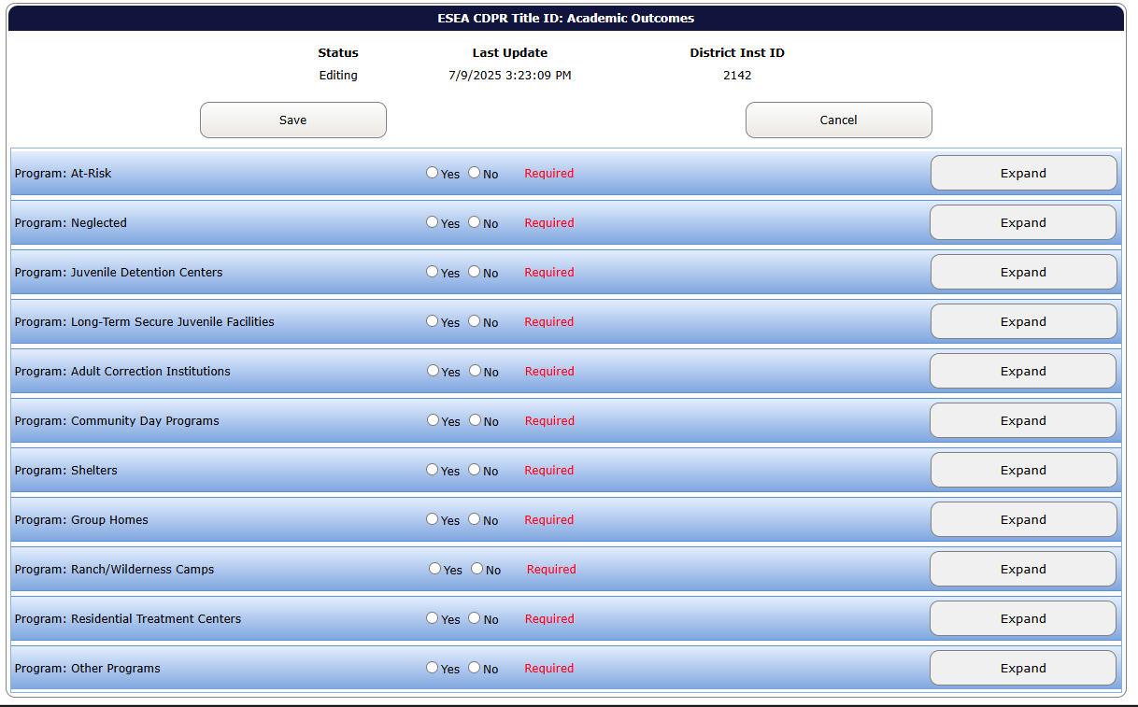
Submission Screen
Notes:
This view is the same for both Title I-D data collections, this one is for the Programs and Facilities data collection.
On this screen, you’ll see the 5 type of program choices.
When “No” is selected it will give you a message “This will zero out all counts for this program. Are you sure?” Go ahead and select “OK”, if you are sure.

Slide 55
Yes or No for Program Types
Did that program type receive Title I-D services/funds in your district?
Select YES or NO for each of the 11 program types:
(Just as you did in the Title I-D Validations Worksheet)
Notes:
You’ll select either yes or no on each type, just as you did initially on the Validations Worksheet.
When “No” is selected it will give you a message “This will zero out all counts for this program. Are you sure?” Go ahead and select “OK”, if you are sure. This will put the digit “0” in all data fields for that program type.
When you select “yes” it will expand that facility. Just select “collapse” if you want to check all the yes and no’s to begin with. You can then select “Expand” to fill in the data later.

Slide 56
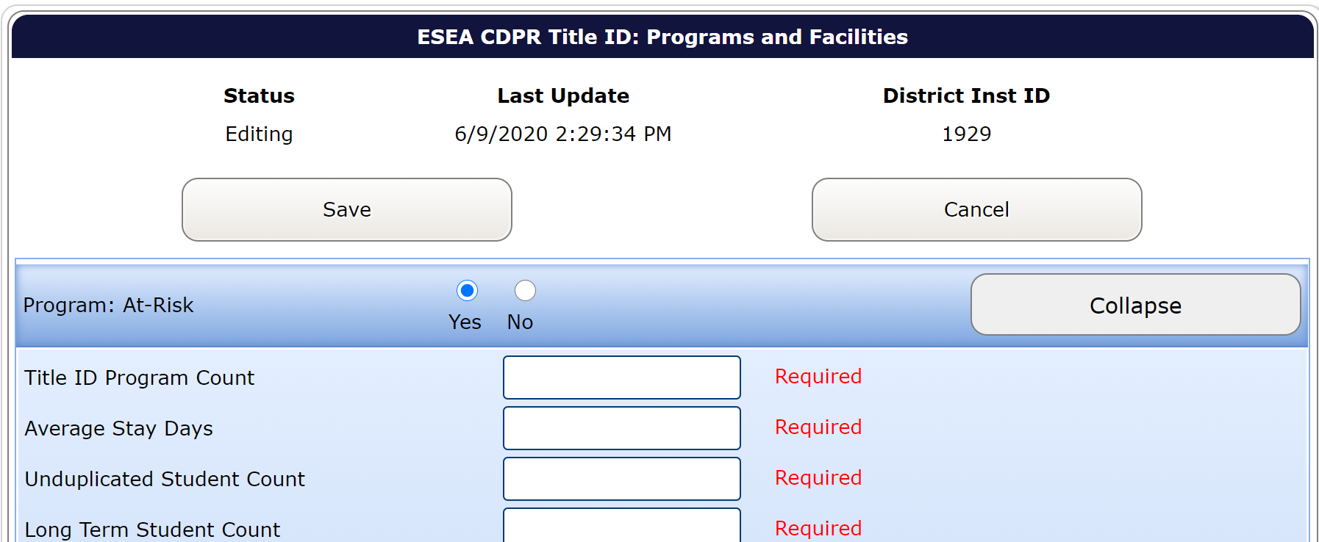
Data Entry Screen

Slide 57
Entering Data
While referring to the Title I-D Validations Worksheet, enter the data for each program.
If there is not a count for a data element, you MUST enter “0” or you won’t be able to submit
Once you have finished entering the data from the CDPR Title I-D Validations Worksheet for all program types that you answered “Yes” for, select “Save”
If you cleared all errors in the Title I-D Validations Worksheet, you should have no errors when submitting in the Consolidated Collections.

Slide 58
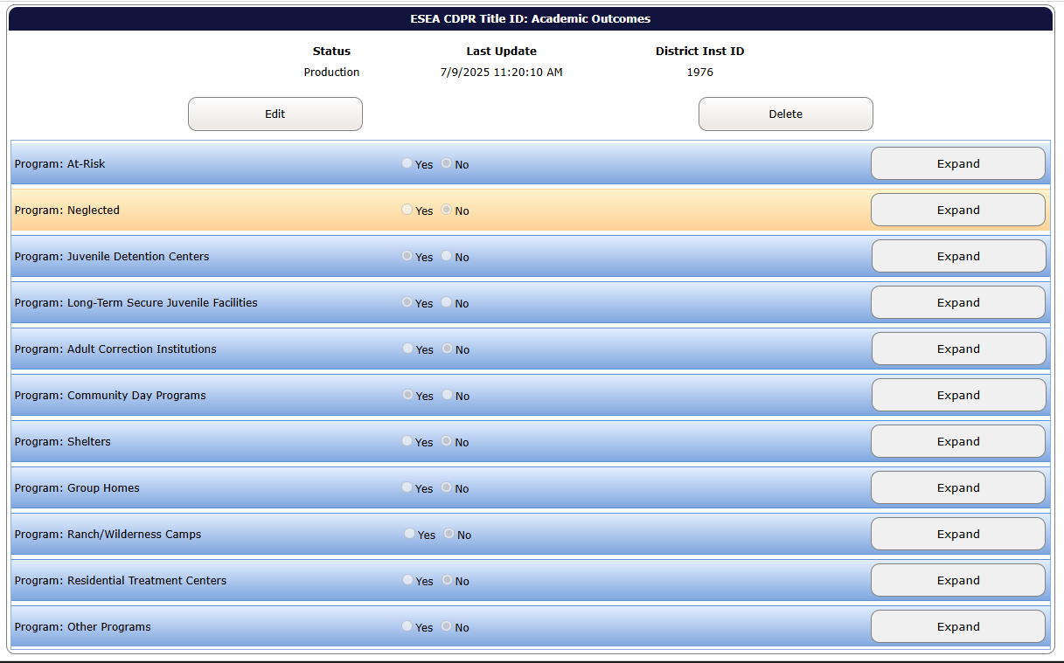
Data Submitted Screen
If you entered the data and there were no errors you should see this screen:

Slide 59
If there are data errors:
If there are data errors, when you select “Save”:
You will not see the data submitted screen
Errors will be listed at the top of the screen
Data Fields associated with the error will be framed in red
What you need to do:
Make the needed corrections to the data error(s)
Select “Save”

Slide 60
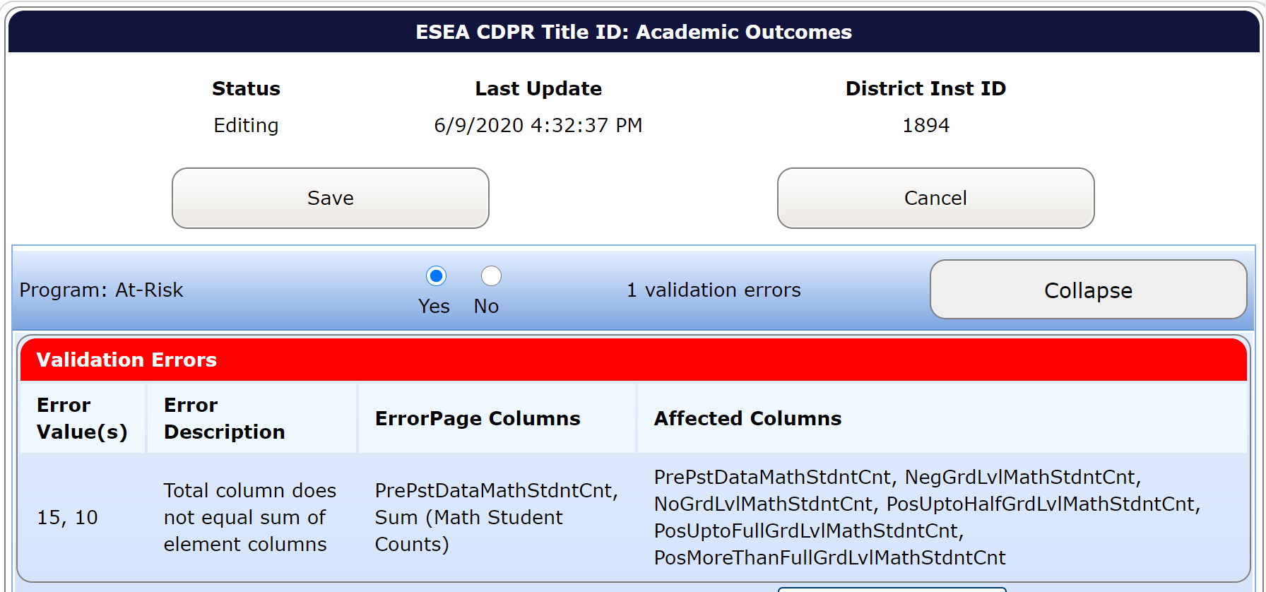
Data Errors Screen
Notes:
This is an example of what you will see on the data error screen. This shows that the Pre-Post Test Math Count Totals does not match the total of the Math Performance categories.

Slide 61
Assistance
If you are still having trouble submitting within the Consolidated Collections application after you have:
  Cleared all data errors within the Validations Worksheet
  Entered the data correctly from the Title I-D Validations Worksheet into the Consolidated Collections
  Checked that there are no data elements without a digit
Contact Kyle Walker (kyle.walker@ode.oregon.gov)

Slide 62
Contact Information
For program questions:
Jen Engberg, Education Specialist | (971) 208-0207
  Jennifer.Engberg@ode.oregon.gov
For data questions:
Kyle Walker, Program Analyst | 503-689-0479
  kyle.walker@ode.oregon.gov
For questions/problems with the web-based tool:
ODE Helpdesk | (503) 947-5715
  ode.helpdesk@ode.oregon.gov

Slide 63
Questions?

