Slide 1
Title I-D, Subpart 2
2025-26 Quarterly Meeting 1
October 2, 2025

Slide 2

Outcomes for Today
Welcome & Introductions
Title I-D Overview and Requirements
October Caseload Count
New Resources for 2025-26
Calendar and Important Dates

Slide 3

Hello! Please introduce yourself
Name & School District
Years working with federal grants/Title I-D
Favorite fall food or activity

Slide 4
Title I-D Overview

Slide 5

Purpose of Title I-D, Subpart 2
The purpose of Title I-D, Subpart 2 is to improve educational services for students in locally operated facilities for neglected or delinquent students to:
Provide opportunity to meet state standards
Improve transitions into community
Prevent drop out and return to facilities
Notes:
The purpose of Title I-D is to improve educational services for students in local, tribal, and state facilities or institutions for neglected (N), delinquent (D), or at-risk youth. These students have increased rates of absenteeism, dropping out, and not meeting state academic standards.
Title I-D provides federal funding to state agencies and districts that provide educational services to this population with the following intentions:
Improve educational services for neglected, delinquent, or at risk students, so they have the opportunity to meet state academic standards.
Improve student transition between correctional facilities or institutions and community programs in education, technical training, or employment.
Prevent at-risk students from dropping out of school or returning to correctional facilities. This includes providing support systems to ensure continued education for these students.

Slide 6
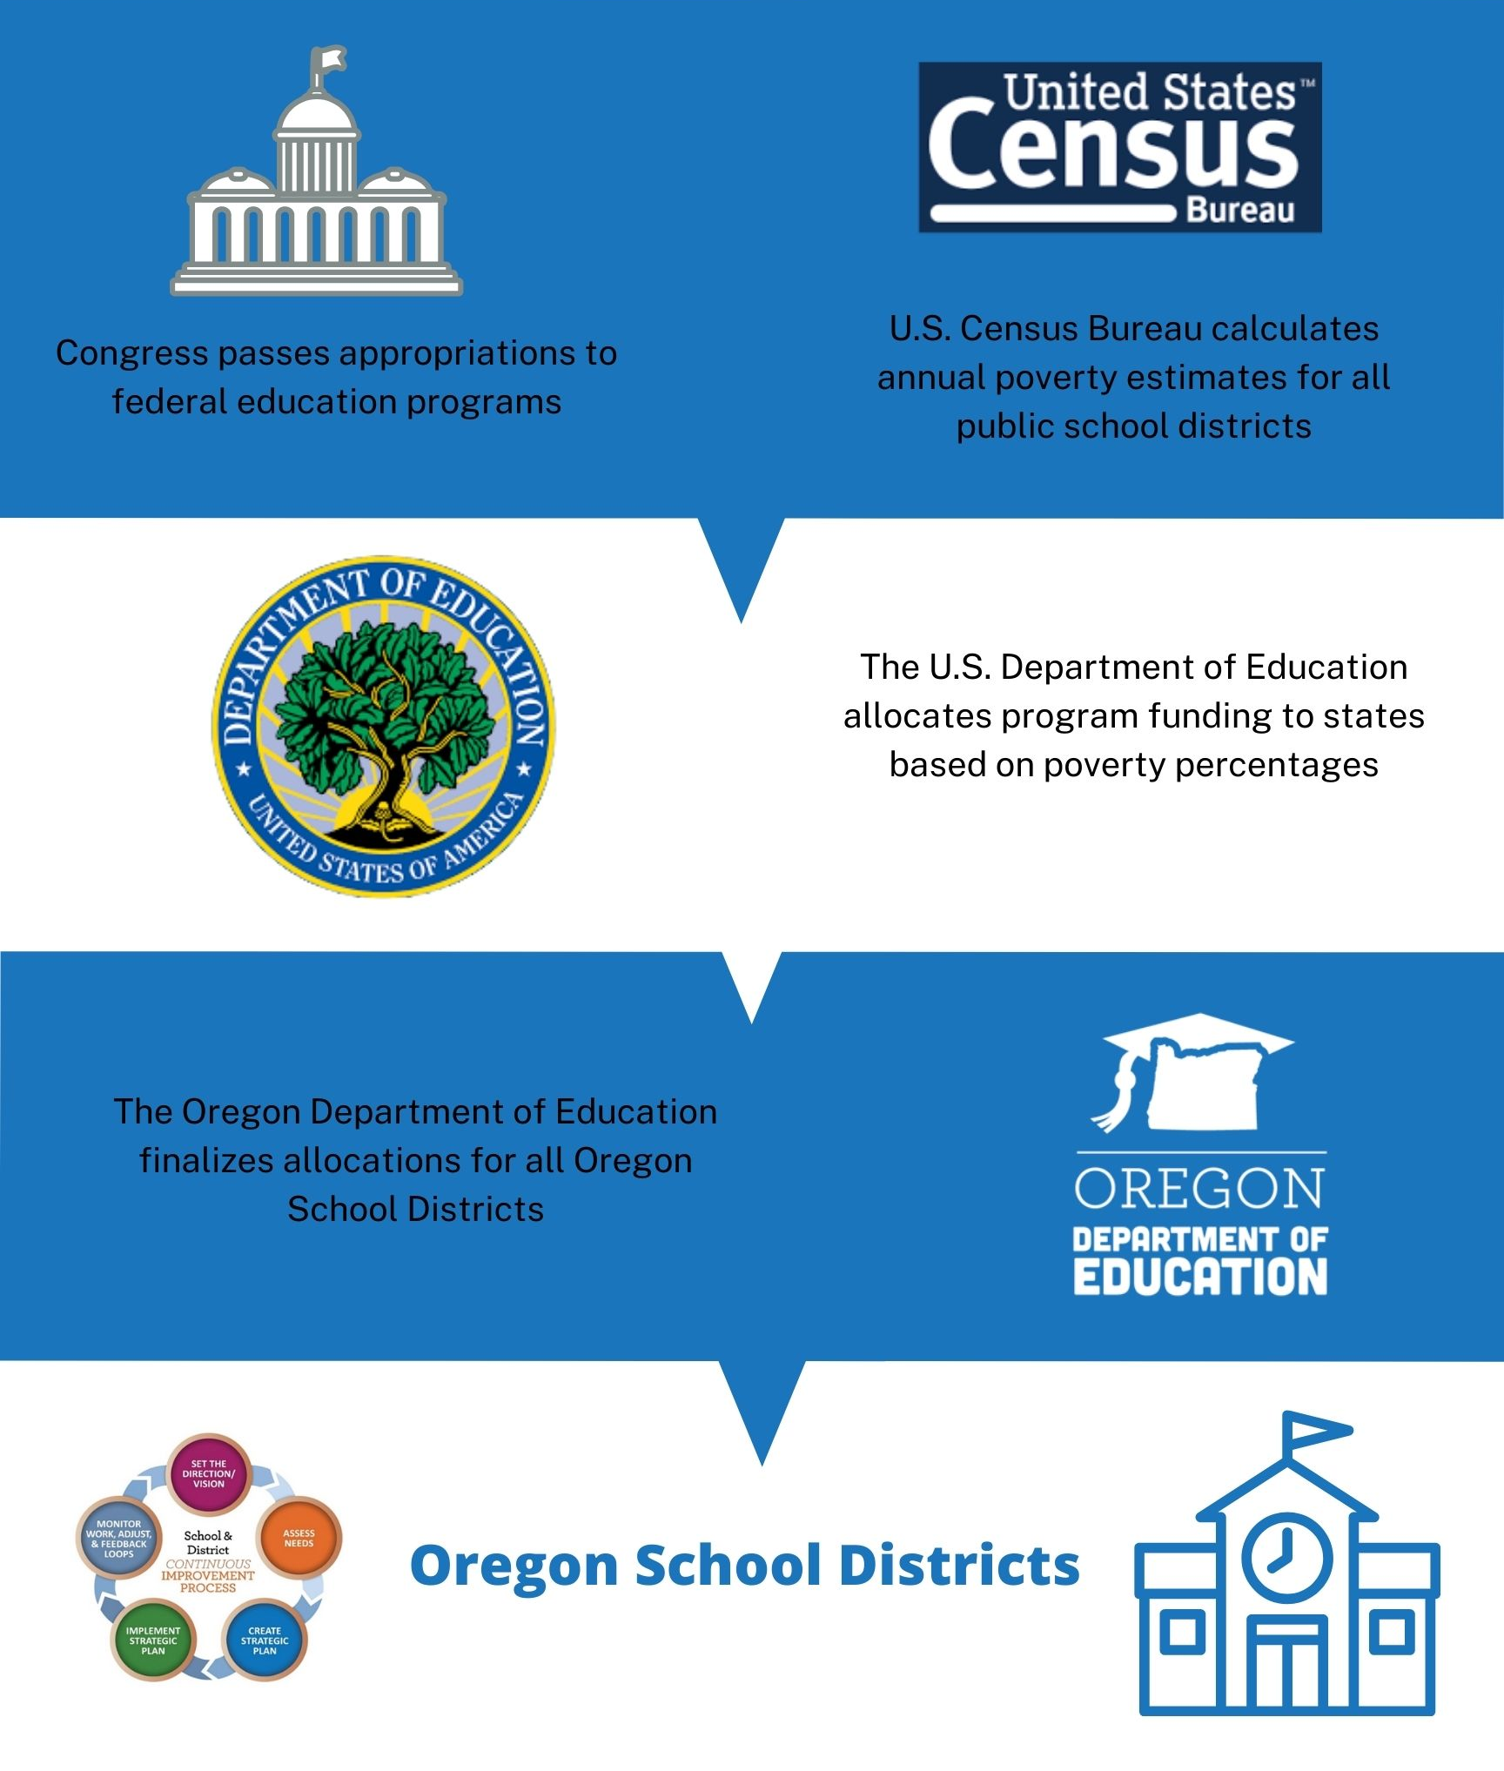
Eligibility and Funding
Eligibility:
An LEA is eligible to receive funds if there is a locally operated facility within its geographical boundaries
Funding:
Determined by annual October Caseload Count
Neglected funds flow through Title I-A
Funds can be used at facility, district, and school levels
Notes:
For a district to be eligible for a Title I-D Subpart 2 grant, there must be a qualifying locally operated facility for neglected or delinquent youth within district geographical boundaries.
Locally Operated facilities are those run by county or city agencies or that are privately ran. This does NOT include state run agencies. For example, facilities ran by the Oregon Youth Authority or (YCEP) programs are not considered a locally run facility . McClaren, the YCEP facility may be in Woodburn school district boundaries, but the school district does not qualify for a Title I-D Subpart 2 grant because it is a state-run facility.
A Juvenile Detention or (JDEP) facility, such as Marion County JDEP is ran by the county, and therefore the local school district is eligible to receive funds. In other to receive funding, that district submits an October Caseload Count, which generates funds for the following school year.
It should be noted that districts that report a neglected facility, receive funds through Title I-A. No matter how the funds are generated, there are a variety of allowable uses.

Slide 7
How can funds be used?
Funds MUST be used to:
Funds CAN be used to:
Prepare students to complete high school, enter trade programs, or further education
Facilitate transition
Dropout prevention programs
Prioritize support for students involved in the justice system
Coordinate health and social services
Mentoring & peer mediation
Career and Technical Education
Provide Prevention Services
Notes:
Title ID funds can be used to:
Carry out high-quality education programs that prepare children and youth to complete high school, enter training or employment programs, or further their education;
Provide activities that facilitate the transition from the correctional program in an institution to further education or employment; and
Operate dropout prevention programs in local schools for children and youth who are at-risk of dropping out or youth returning from correctional facilities.

Slide 8

LEA Requirements
Title I-D Program Plan & Evaluation
Budget Narrative
Data Collections
Notes:
Like other grants, there are activities that districts must do every year to qualify for funds. We’ve broken down the Title I-D requirements into 3 categoires:
Title I-D Subpart 2 Plan: Evaluate annually, with partners
Needs Assessment: Once every 3 years
Budget Narrative: Annually
Data Collections: October Caseload Count
Consolidated District Performance Report

Slide 9

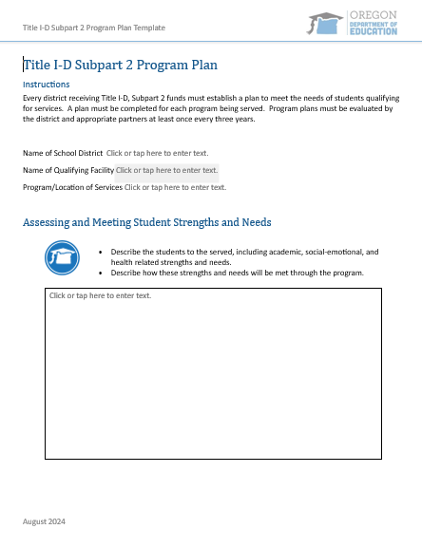
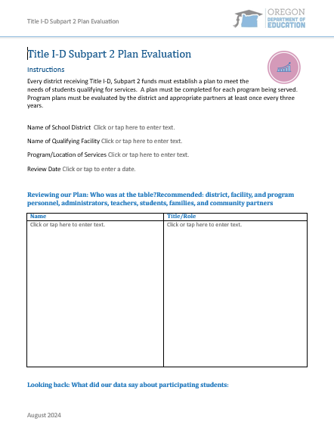
Title I-D Program Plan and Evaluation
Program Plan
Currently in the CIP Budget Narrative
Completed Annually
Evaluation
Collaborate with local facilities annually
Collected during ESEA Monitoring
See the Title I-D Handbook for Templates and Guidance!
Notes:
The Title I-D Plan and Evaluation is required for all programs.
Plan is currently in the budget narrative, but this may change in the future as we transition out of CIP BN.
Evaluation of the plans should be done annually in partnership with local facilities
We will collect a copy of the evaluation plan during monitoring

Slide 10

Budget Narrative
Description of Title I-D funded activities
Plans are Dynamic!
Revise as needed
Due October 31, 2025
Approval is needed to release 100% of funds in EGMS
Notes:
Budget narratives still completed in the CIP BN.
No changes
Please revise as needed and claim funds regularly

Slide 11

Data Collections
October Caseload Count
How many students are enrolled in eligible local facilities?
Data is used to determine 2026-27 funding
Due December 5, 2025
Consolidated District Performance Report (CDPR)
How are students being served?
Similar to the Title I-A CDPR
Collections closed on September 26, 2025
Notes:
Data Collections: October Caseload Count
Consolidated District Performance Report

Slide 12

Check in:
How confident are you feeling about the annual requirements?
I have questions. I’d like to meet virtually.
Ah yes! This sounds familiar, but I may reach out with questions.
Piece of cake. I’m feeling confident.
Notes:
Before I hand it over to Kyle Walker, I want to check in with everyone.

Slide 13
Data Collections: October Caseload Count
Notes:
KYLE

Slide 14
October Caseload Count: Important Dates
The ESEA Title ID: October Caseload 25-26 Data Collection determines the 2026-2027 allocations for districts with eligible Neglected and Delinquent Facilities:
Neglected (funded through Title I-A)
Delinquent (funded through Title I-D, Subpart 2)
OPENS: October 23, 2025
CLOSES: December 5, 2025
Notes:
KYLE

Slide 15
October Caseload Count: Resources
Training: Tentatively scheduled for Monday, October 27th. ODE will conduct Office Hours through November for support. Watch for a communication with registration links and resources in the next few weeks.
New Facilities: Please review the List of Facilities reported in the 24-25 October Caseload Collection.
Please let us know if any new facilities opened since the last collection, or if any of these facilities have since closed, by October 3rd.
Notes:
Link to list of facilities: https://docs.google.com/spreadsheets/d/1clu35_LmNODt0XGfKTDcW8qAt_5camMzlLBT4u_T6OY/edit?usp=sharing

Slide 16
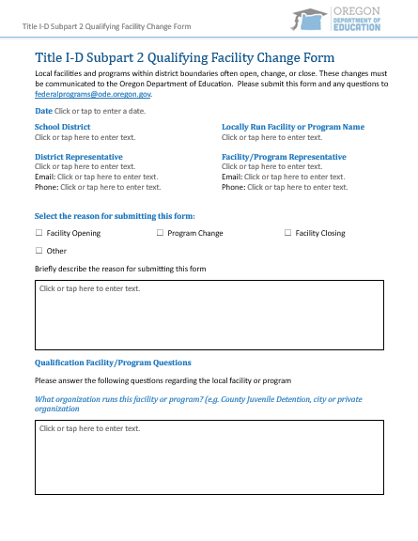
Facility Change Form
Communicate changes to ODE regarding:
Facilities Opening
Program Changes
Facilities Closing
Email: federalprograms@ode.oregon.gov

Slide 17
New Title I-D Resources
We are pleased to debut…
Notes:
JEN

Slide 18
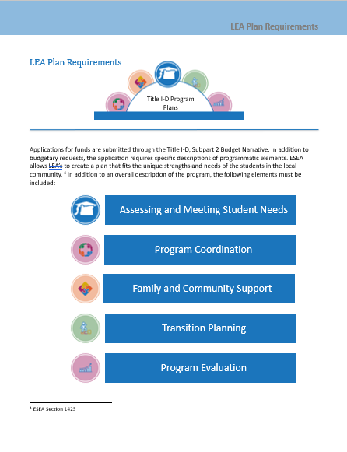
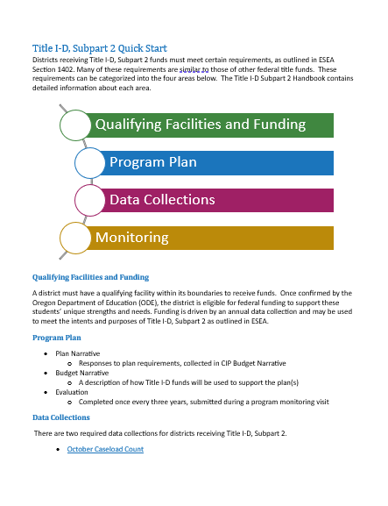
Title I-D Subpart 2 Handbook
New!
Qualifying Facilities and Funding
Title I-D Plan Requirements
Data Collections
Monitoring
Definitions

Slide 19
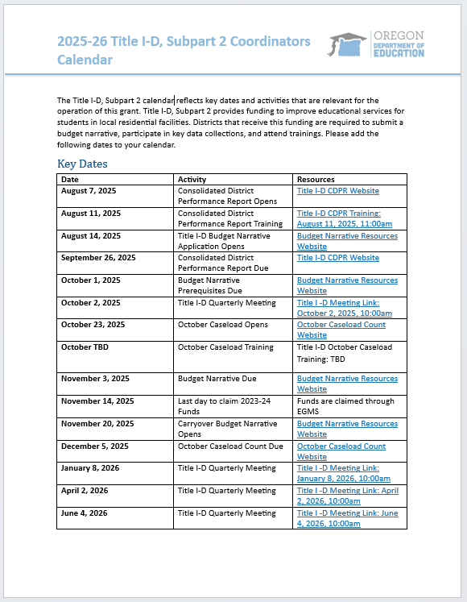
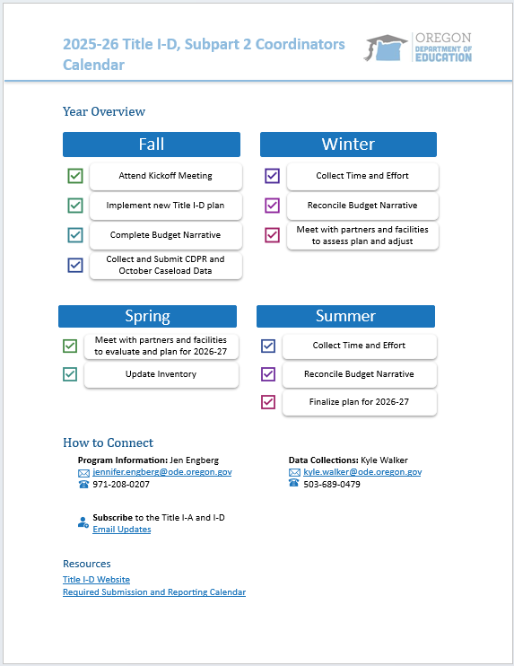
2025-26 Title I-D Calendar
Key Dates: Don’t miss these!
Data Collections
Due Dates
Meetings
Year Overview
Required and Recommended Activities

Slide 20

Discussion & Hot Topics
What do you need most?
How can we make the best use of our time this year?
Next Meeting: January 8th, 10am (Handbook Deep Dive)
October Caseload opens: October 23rd
CIP Budget Narratives due: October 31st
October Caseload due: December 5th

Slide 21

Resources
Oregon Department of Education Title I-D
Oregon Department of Education Youth Corrections Juvenile Detention Education Programs
Oregon Department of Education Long Term Care and Treatment Education Programs
USED: Title I-D: Neglected , Delinquent, and At-Risk Youth Non-regulatory Guidance
National Technical Assistance Center for the Education of Neglected or Delinquent Children and Youth (NDTAC)
National Center for Juvenile Justice

Slide 22

Please reach out!
Jen Engberg jennifer.engberg@ode.oregon.gov
Kyle Walker
kyle.walker@ode.oregon.gov

