Slide 1
Welcome to today’s Webinar We will begin shortly…
Materials can be found here:
ODE Title I-D Website

Slide 2
Title I-D Overview & Budget Narrative Training
Fall 2018
Notes:
Good Afternoon!
Thank you for joining us and welcome to the 2018-2019 Title I-D Overview and Budget Narrative Training!
My name is Jen Engberg, the Title I-D Coordinator for the state of Oregon.
I have a few colleagues with me for support. I’ll ask them to introduce themselves…
Thank you so much. I’d like to take a quick poll of who is online. If anyone is new if you could raise your hand…

Slide 3
Today’s Agenda
Introductions
2018-2019 Overview
What’s new from Washington
CIP Budget Narrative Training
Coming Attractions
Notes:
My goal for today is to give a refresher on the purpose of this grant, share information we received from Washington D.C., and walk you through the new CIP Budget Narrative. These opened yesterday. Has anyone had a chance to see them? Allocations are also posted on our website.
(Read Slide)

Slide 4
2018-2019 Overview
Notes:
School Year 2018-2019. What’s changed and what has stayed the same?
The good news is there have been no drastic changes since last year in regards to eligibility or the law. Now that ESSA is growing up, the focus is on how to implemented some of those big ideas behind the laws. We will talk more about that in just a minute. The biggest change is how you will go about applying for Title I-D funds. Our hope is that this process will be easier than it was in the past: at least it will be electronic!

Slide 5
Title I-D Neglected & Delinquent
Districts are eligible for Title I-D Subpart 2 funds if there is a locally ran facility for neglected or delinquent youth within its boundaries
Yes: residential treatment facilities, day treatment centers, county juvenile detention programs
No: State ran facilities, foster homes
Notes:
First, I do want to take a minute to go over eligibility for Title I-D funds. It’s always good to refresh ourselves on the basics. Also, in my first year here at ODE, I’ve found that there are a few districts that were eligible, but didn’t know it. It never hurts to spread the word.
(Read Slide)
Examples: residential treatment facility, county run juvenile detention program
NOT: Foster Homes, OYA or state ran facilities
These are the types of facilities that make a district eligible. Allowable activities can be much different.

Slide 6
Title I-D Funded Activities
At-Risk Program
Neglected Program* (funded through I-A)
Juvenile Detention Program
Locally Operated Juvenile Correctional Facility Program
Notes:
Title I-D funds can be used to support activities designed to supplement educational opportunities for these students. The range of allowable activities is large. They include:
At Risk:
Programs operated in local schools that target students who are at risk of academic failure, have a substance abuse problem, are pregnant or parenting, have been in contact with the juvenile justice system, are at least 1 year behind academically, have limited English proficiency, are gang members, have dropped out of high school in the past, or have a high absenteeism rate.
Neglected: Public or private residential facilities, other than foster homes, that are operated primarily for the care of children or youth who have been committed to or voluntarily placed in the facility under applicable State law due to:
abandonment,
neglect, or
death of their parents or guardians
Juvenile Detention Program
Locally operated short-term private or public facilities that provide care to children who require:
secure custody pending court adjudication,
court disposition or execution of a court order, or
care to children after commitment.
Locally Operated Correctional Facility (Juvenile Correctional Program)
A facility in which persons are confined as a result of a conviction for a criminal offense. It can also include a local public or private institution, community day program or school not operated by the State.
I’d like to emphasize the creativity and flexibility that can be taken here. Think about serving those students before, during, and after a stay in secure care. This can mean transition, continuity of education, and prevention from an extended stay. Many districts partner with local facilities to provide education. Regardless of how it’s done, think about wrap around services. This is what ESSA calls for and is really what the US Dept of Ed is calling out now.

Slide 7
Updates from Washington
Juvenile Justice & Delinquency Prevention Act Reauthorization
Statutory Changes Emphasizing:
Tribal Institutions
Involvement of families & communities
Increased opportunities for earning credits
Prioritizes high school diploma
Notes:
In July, ODE traveled to D.C. to hear the latest from the federal folks in terms of changes, etc. The big news right now is the reauthorization of the Juvenile Justice and Delinquency Prevention Act. Education is a small portion of it, but obviously important. It stresses making that connection for students returning to community schools and helping to maintain a consistent and quality education for these highly mobile students. We don’t expect this reauthorization to make a huge splash or have changes for Title I-D, but we will keep it on the radar and pass things on to you.
The overall focus in D.C. right now is the implementation of ESSA. The statutory changes that occurred with ESSA are really being called out now and are serving as a compass for the work in education. For Title I-D, ESSA called out the following: (Read slide)

Slide 8
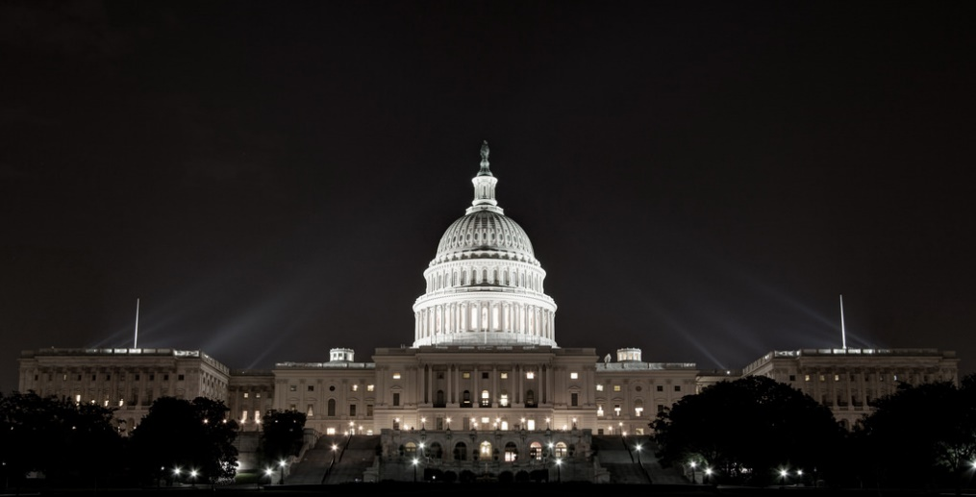
Washington Wonderings cont…
Transition, Transition, Transition
Streamlining of students movement
Timely Enrollment
Is it working? (Accountability)
Notes:
(Read Slide)

Slide 9
What’s ODE working on?
LEA Transition Contact Requirement
More information to come soon
Program Evaluation
Friendly data options
Virtual Learning for students
Notes:
All of the things that the US Department of Ed and NDTAC (define) are pointing out are the same things that ODE put in our state ESSA plan for Title I-D. This year, these are the biggest items we are focusing on:

Slide 10
Questions?

Slide 11
New Budget Narrative
Notes:
One big project we’ve been working on is how to streamline the application process for Title I-D. During this part, I’ll jump back and forth between this and screenshots so you can see exactly how it works. If you have questions, please type them in the chat box and we will answer them along the way.

Slide 12
Federal Requirements
LEA Application
Use of Funds
Correctional Facility Agreements
Accountability (CDPR data)
Program Evaluation
Notes:
There are 5 basic federal requirements for Title I-D programs. They are (Read Slide)
In changing the budget narrative, the goal was to combine what we could electronically to avoid paperwork and confusion.

Slide 13
What’s Changed?
2016-2018
2018-2019
Paper application
Submitted every 2 years via email.
Budget Narrative in ODE’s program.
Application requirements completed through:
CIP Budget Narrative
General Assurances (submitted through district)
Benefits
Updated information
Less Paperwork!
Streamlined process
Notes:
So what has changed?
Previous, we had a two year cycle for everything except for the budget narrative. (Read Slide)
The paper application consisted of about 10 questions that will filled out manually and then emailed. It was good for 2 years, however things rarely stay the same over two years and so at the end we had paperwork that was outdated and didn’t make sense.
For 2018-2019, the paper application has been eliminated. We took those 10 questions that are required by law and split them up between the budget narrative and general assurances. Here’s where we landed:
(Show screen shot)

Slide 14
6 Areas of Information
LEA Based Programs
Coordination of Opportunities
Formal Agreements & Partnerships
Special Education Support & Coordination
Transition
List of Programs
Notes:
There are six narrative areas that you will need to fill out. These take the place of the paper questions that we could not roll into general assurances. The areas are:
LEA Based Programs (things the district is doing or supporting).
Coordination of Opportunites (how will the district coordinate other initiatives for these students, such as CTE)
Formal Agreements
Special Education
Transition Activities
List of programs (this is logistical)

Slide 15
Narratives
Please enter a description for each area
Notes:
Previously, the budget narrative tab had one line, you typed in as much as you could, and budgeted money. Now, there are six lines we are asking you to address. You must enter something into each area. Even if it is non-applicable.

Slide 16
Sample Narrative

Slide 17
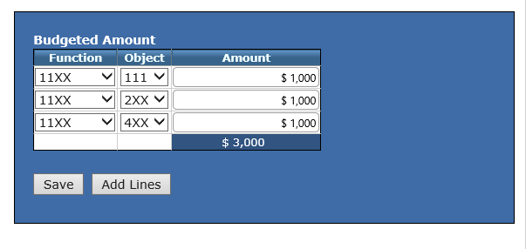
Budgeted Amount
Notes:
To the side of each narrative box is an opportunity to place budgeted amounts. For this part, I ask that you use your best judgement. Will it be perfect? No. The goal is to get an idea of where money is being spent. If something doesn’t fit exactly into one of these categories, but is allowable, that’s ok. Choose the one that fits best.

Slide 18
Troubleshooting
All 6 boxes must have a narrative in it. (“Not Applicable” will work)
Budgeted Amount can be left blank if no expenditures are planned.
Make sure “Dollars Remaining” equals zero.
Notes:
(Read slide)

Slide 19
Tips & Tricks
Use your best judgement to categorize expenditures in the 5-6 areas.
Consult with outside folks ahead of time.
If you need help, please call or send me an email.
Send feedback!
Notes:
(Read Slide)

Slide 20
Questions?

Slide 21
This year…
2018-2019 Activities Calendar
CDPR: Opens 8/8
Assurances Due: 10/1
October Caseload: opens 10/25
Monitoring & Site Visits
All sites have been monitored in the last three years.
Cross-office effort to combine monitoring efforts.
Notes:
So this year shouldn’t be drastically different than any other. The activities calendar is posted on the website. Here are some important upcoming dates:
CDPR (training is on the website)
Assurances: On our website and in the CIP budget narrative application. (Instructions to send to Emily Swope).
Monitoring & Site Visits (Read Slides)
Cross Office Effort: Help improve communication with districts and JJ sites.

Slide 22
Spring Site Visits
Baker School District
Bend-LaPine School District
Coos Bay School District
Crook County School District
Eugene School District
Klamath Falls City School District
Medford School District
ODE will contact districts in early 2019 to schedule.
Notes:
These are the districts we will be visiting this year. Again, these are informal visits and part of my personal goal to get out and see programs and support you.

Slide 23
Information Needed
Training Needs/Wants
Survey!!
Feedback on Budget Narrative
Other?

Slide 24
Questions?

Slide 25
Jen Engberg Title I-D Coordinator
Phone: 503-947-0339
jennifer.engberg@state.or.us

