Slide 1
Title I-D, Subpart 2
Fall Webinar
September 15, 2022

Slide 2

Outcomes for Today
Welcome & Introductions
Brief overview of Title I-D
Data Collections Check In
Planning for 2022-23

Slide 3

Purpose of Title I-D, Subpart 2
The purpose of Title I-D, Subpart 2 is to improve educational services for students in locally operated facilities for neglected or delinquent students to:
  Provide opportunity to meet state standards
  Improve transitions into community
  Prevent drop out and return to facilities
Notes:
The purpose of Title I-D is to improve educational services for students in local, tribal, and state facilities or institutions for neglected (N), delinquent (D), or at-risk youth. These students have increased rates of absenteeism, dropping out, and not meeting state academic standards.
Title I-D provides federal funding to state agencies and districts that provide educational services to this population with the following intentions:
Improve educational services for neglected, delinquent, or at risk students, so they have the opportunity to meet state academic standards.
Improve student transition between correctional facilities or institutions and community programs in education, technical training, or employment.
Prevent at-risk students from dropping out of school or returning to correctional facilities. This includes providing support systems to ensure continued education for these students.

Slide 4
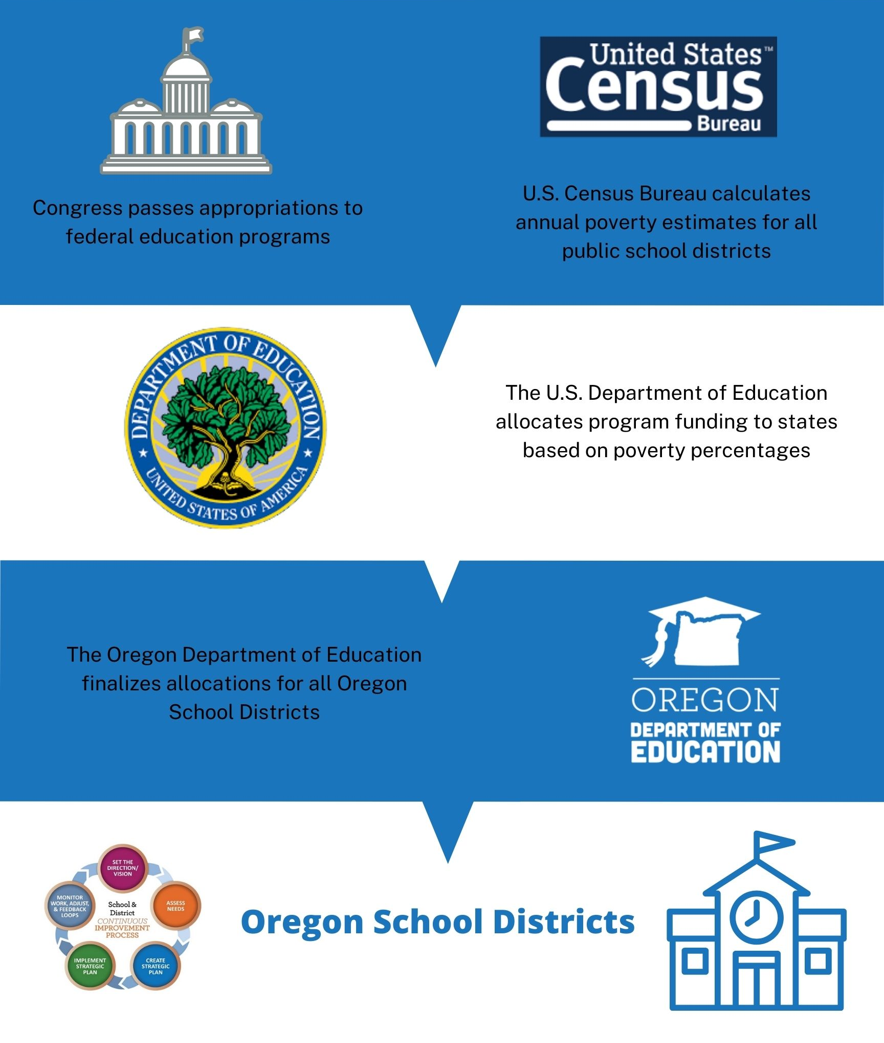
Eligibility and Funding
Eligibility:
  An LEA is eligible to receive funds if there is a locally operated facility within its geographical boundaries
Funding:
  Determined by annual October Caseload Count
  Neglected funds flow through Title I-A
  Funds can be used at facility, district, and school levels
Notes:
For a district to be eligible for a Title I-D Subpart 2 grant, there must be a qualifying locally operated facility for neglected or delinquent youth within district geographical boundaries.
Locally Operated facilities are those run by county or city agencies or that are privately ran. This does NOT include state run agencies. For example, facilities ran by the Oregon Youth Authority or (YCEP) programs are not considered a locally run facility . McClaren, the YCEP facility may be in Woodburn school district boundaries, but the school district does not qualify for a Title I-D Subpart 2 grant because it is a state-run facility.
A Juvenile Detention or (JDEP) facility, such as Marion County JDEP is ran by the county, and therefore the local school district is eligible to receive funds. In other to receive funding, that district submits an October Caseload Count, which generates funds for the following school year.
It should be noted that districts that report a neglected facility, receive funds through Title I-A. No matter how the funds are generated, there are a variety of allowable uses.

Slide 5

Allowable Uses of Title I-D, Subpart 2
Requirements
  Prepare students to complete high school, enter training or employment programs, or further education
  Facilitate transition
  Dropout prevention programs
Suggestions
  Serve “at-risk” youth
  Coordinate health and social services
  Mentoring & peer mediation
  CTE, special education, career counseling
Notes:
Title ID funds can be used to:
Carry out high-quality education programs that prepare children and youth to complete high school, enter training or employment programs, or further their education;
Provide activities that facilitate the transition from the correctional program in an institution to further education or employment; and
Operate dropout prevention programs in local schools for children and youth who are at-risk of dropping out or youth returning from correctional facilities.

Slide 6
Data Collections: CDPR - Closes Friday, September 23rd
What implications are there for this data?
CDPR (Consolidated District Performance Report) is collected and then sent to U.S Department of Education in the CSPR (Consolidated State Performance Report) in December.
CDPR is how we as a state report the students served with Title I-A and Title I-D funds in the previous school
CDPR data doesn’t directly affect funding but is a requirement of districts that receive Title I-A & Title I-D funds. We as a state are also responsible for addressing any missing or incorrect data. Consistent incorrect/missing data could potentially lead to monitoring.
Data is reviewed and validated by USDE before it is eventually published publically. Inaccurate data will be suppressed.

Slide 7
Data Collections: CDPR - Closes Friday, September 23rd
How do we handle pre/post data?
You will need pre- and post- test Reading/Math data for all Long-Term students or: “Students who spent 90+ consecutive days in the facility”
The documenting and reporting for Pre- and Post- test data for Reading and Math is a nationwide issue when it comes to Title I-D. Reporting as accurately as possible shows that we are at least doing our due diligence.
In conversations with a few of our Title I-D districts, we spoke about recording those students who refused to complete the tests as either “Negative Grade Level Change” or “No Grade Level Change” depending on if previous grade data information existed.
  For example if a student completed the pre-test but refused to complete the post-test, counting them as “Negative Grade Level Change” might be the best way to show that within the parameters of the data collection; even if it doesn’t tell the whole story of that student’s experience.
If a program is unable to account for all Long-Term Students in the pre- and post- test Reading Math counts, please provide us with an email explaining the context around the discrepancy in counts. That way we will be able to forward this information to U.S. Department of Education when they reach out during their review of the CDPR data in January.

Slide 8
Data Collections: October Caseload Count
The 2022-2023 October Caseload Data Collection determines the 2023-2024 allocations for districts with eligible Neglected and Delinquent Facilities:
Neglected (funded through Title I-A)
Delinquent (funded through Title I-D Subpart 2)
OPENS: October 27, 2022
CLOSES: December 2, 2022

Slide 9
Data Collections: October Caseload Count
Training: Aiming to schedule for Friday, October 28. Will set in stone after IT testing occurs next week. Will also be conducting Office Hours through November for support. Will send out a communication with registration links and resources in the next few weeks.
New Facilities: Please review the list of facilities reported in the 21-22 October Caseload Collection.
Please let us know if any new facilities opened since the last collection or if any of these facilities have since closed before September 23rd.
Notes:
Link to list of facilities: https://docs.google.com/spreadsheets/d/1clu35_LmNODt0XGfKTDcW8qAt_5camMzlLBT4u_T6OY/edit?usp=sharing

Slide 10

Discussion & Hot Topics
What do you most need?
How can we make the best use of our time?
Next Meeting: Thursday, December 15th 1pm
CDPR Closes: Friday, September 23rd
October Caseload Opens: October 27th
CIP Budget Narratives Due: November 1st

Slide 11

Resources
Oregon Department of Education Title I-D
Oregon Department of Education Youth Corrections Juvenile Detention Education Programs
Oregon Department of Education Long Term Care and Treatment Education Programs
USED: Title I-D: Neglected , Delinquent, and At-Risk Youth Non-regulatory Guidance
National Technical Assistance Center for the Education of Neglected or Delinquent Children and Youth (NDTAC)
National Center for Juvenile Justice

Slide 12

Please reach out!
Jen Engberg
jennifer.engberg@ode.oregon.gov
Kyle Walker
kyle.walker@ode.oregon.gov

Slide 13
Questions?

