Slide 1
Good Morning! We will begin shortly. Please mute yourself as you enter the webinar.
Title IIA Technical Assistance Webinar May 22, 2019
Notes:
Introductions

Slide 2
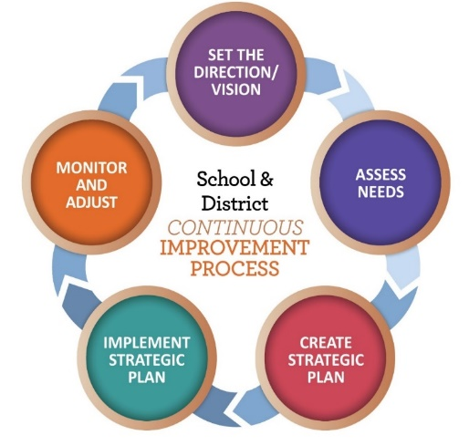
Outcomes for Today
Review IIA application requirements through the lens of continuous improvement
Share requirements for Private Schools
Provide update on allocations
Answer questions
Notes:
The primary goal today is to draw connections between the continuous improvement efforts that all districts are engaged in and the use of Title IIA funds.
We have had questions this year regarding requirements for private schools so I want to make sure we are calibrated on the roles and responsibilities of districts and PS relative to IIA
Answer questions

Slide 3
Goal of Title IIA
Ensure equity of educational opportunity
Attract, select, place, support and retain excellent educators
Provide greater access to effective educators to students of low-income families and minority students
Prepare students to succeed in college and career
Notes:
We start our webinar each year with this reminder about the purpose of Title IIA. The goal of IIA is to improve outcomes for students – making sure that they are prepared for success beyond K-12. The focus is on supporting educators so that they can support students. And most importantly, how are we ensuring that all students have access to excellent educators?

Slide 4
Creating Systems of Support
Building Systems of Support for Excellent Teaching and Leading
Guidance highlights ways Title IIA funds can be used “more strategically and for greater impact”
Support for Educators
Equitable Access to Excellent Educators
Strengthening Title IIA Investments
Notes:
As the IIA guidance released in September 2016 illustrates, the focus is on systems - systems designed to support educators, systems designed to support students in accessing effective educators and systems to maximize the use of funds.

Slide 5

Continuous Improvement Cycle
Notes:
To that end, as we go through the components of the Title IIA application today, we’ll be highlighting the connections to the continuous improvement process. This graphic is one I am sure you are all familiar with illustrating the continuous improvement cycle. One of the shifts ODE wants to support districts in is thinking about how all of the initiatives at play in a district, including title programs, can be used to support the priorities and goals that are identified as part of the district’s continuous improvement planning process. What are the priorities of the district? How can our Title IIA resources support those priorities? Instead of planning for funds, how can we fund a plan?

Slide 6
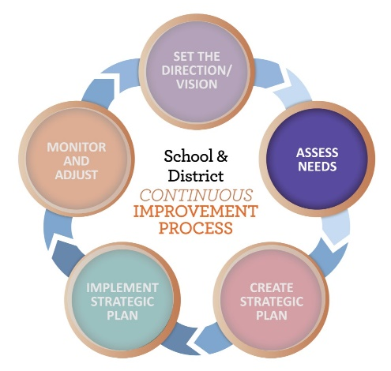
Assessing Needs
Notes:
We are going to start with the second step in the continuous improvement process, Assessing Needs.

Slide 7
Comprehensive Needs Assessment
WHAT
A systematic process that assists district and school teams in identifying systemic inequities, strengths and opportunities
WHY
To select priorities and goals based on needs and strengths
HOW
Examination of multiple sources of data
Notes:
Title IIA is one of several federal programs that requires a needs assessment as part of the application. As we have shared every year in this technical assistance webinar, the application does not require its own NA. Whatever comprehensive needs assessment process the district uses, the IIA application is asking for a summary of that process.

Slide 8

Data Sources
Student data
e.g.; Achievement, growth, graduation, discipline
Perception data
e.g.; Surveys, interviews, focus groups, TELL
System health data
ORIS Systems Health Assessment
Notes:
Multiple sources of data are key to a comprehensive needs assessment. Surveys, while providing valuable information, are not what is meant by “needs assessment” in the context of IIA.
Student learning data is only one source of data about students. In addition to statewide and local assessment data, demographic data, perception data and process data are all valuable sources of data that provide a more complete picture of student needs.
Student level data encompasses more than just academic information - • PreK/early learning experiences children have had before arriving in kindergarten • Academic outcomes (state level data and local assessment data) • Discipline rates • Attendance and mobility • Rates of participation in academic, social-emotional supports • Graduation rates • 9 th Grade on track • Course grades Oregon Department of Education, Fall 2018 • Credits earned • Rates of participation and success in college level courses • Rates of participation
Perception data is a valuable source, but should not be the only source. Think about who your stakeholders are (including parents and students) and how you are collecting data from them. The TELL survey is one source that many districts tap in addition to district-created surveys for students, staff and parents.
System health – This is data gathered about the systems within the district. This includes your educator evaluation data. You may have heard of ORIS – the Oregon Integrated Systems Framework. The ORIS framework elevates 5 evidence-based domains that are important in healthy systems. Leadership, Talent Development, Coordinated Learning, Stakeholder Engagement and Inclusive Policies and Practices are the five domains described in ORIS.
ODE has developed a number of tools aligned to ORIS including a school level and district level needs assessment tool. These can be accessed on the Continuous Improvement page of the ODE web site.

Slide 9
Connecting to the application…
Data Sources
List data sources analyzed to determine need
Data Analysis
Summarize trends or gaps in performance
Prioritized Needs (please number)
Identify support educators need
Plan Development
Describe process for developing plan
Notes:
This is the place in the application where you summarize the needs assessment your district has completed. You are simply sharing the highlights in these four categories.
DATA SOURCES – This is a list of what data you looked at, both statewide and local data.
ANALYSIS
In this section you are creating a clear connection between the activities/strategies you plan to undertake and how they relate to what the data show about needs. Remember, achievement data is only one source. Any data that tells you about the students can be used (behavior, attendance, surveys, etc.) If you conducted the ORIS Needs Assessment, you can identify what was elevated as a result of that process in the Data Analysis section.
PRIORITIZED NEEDS
Trying to address every identified need may result in no need being addressed well, so “prioritized” is the operative word.
All strategies/activities that are included in the budget narrative must be tied back to a prioritized need. Needs should be numbered to make reference to them in the narrative easier.
PROCESS
Districts are asked to describe their process for developing the plan and including the necessary stakeholders (How parents and other relevant school personnel, including paraprofessionals where appropriate, were engaged in this process). Many districts already include this as part of their description of the data analysis in section 2. If this is the case, you can reference that information or repeat it.

Slide 10
Charter Schools
District-sponsored charters are
district schools
Data must be considered as part of CNA
Consider ways to meet their unique needs
Creating a line item for each charter
District line item specifically calling out charter school participation
Notes:
It is important to keep in mind that district-sponsored charter schools are a part of the district. The needs of their teachers and students must be included as part of the data that is analyzed when determining prioritized needs.
Once priority needs are determined it is always possible that the strategies identified will not directly impact all teachers (.e.g., focus on K-3 reading and HS teachers).
While charter schools do not get an “allocation” like private schools, they do have unique needs that should be considered. There are several different approaches to supporting charter schools that districts have taken. Ultimately it comes down to good communication between districts and charters.

Slide 11
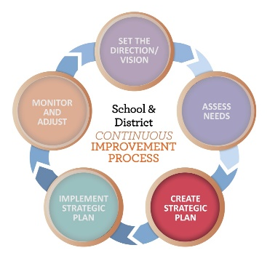
Creating a Plan
Notes:
We are going to shift to step 3 in the Continuous Improvement Process, creating a plan. As I mentioned at the start of the webinar, ideally the district’s “plan” for IIA is just the part of the larger district plan for improvement that is being funded through IIA.

Slide 12
Priorities vs. Goals vs. Strategies
Priorities should describe where we aim to go,
but don’t tell us how we’ll get there. (Needs Assessment)
Goals should be ambitious (rigorous) and aspirational (may take several years). They are student focused, measureable and supported by strategies.
Strategies should describe the work we will undertake in pursuit of our goals. Strategies are powerful, high leverage work that build capacity and change practice, behavior and belief so students are more successful. (Budget Narrative)
Notes:
Often in IIA applications priorities are written as strategies or even actions (e.g., Fully implement AVID, send teachers to constructed meaning training). Priorities identify where we want to go, but don’t say how we will get there. That is because there are multiple efforts or strategies we can undertake to get there (improve outcomes for English learners).
With each layer (priority/ goal/strategy), we are getting more specific about how we are going to get where we are going.
Goals articulate outcomes for students and are written to be measureable. Those goals may take several years to achieve. Consider how this can inform the way you will measure (HOW) the strategies you are undertaking.
Strategies describe the work we are going to do THIS YEAR to move us toward our goals. Strategies are different from actions which are the nuts and bolts.

Slide 13
Strategies as a Theory of Action
If we (evidence-based practice - the work we will do)
then (direct short term impact – what change adults will make)
and (the longer term impact - for students)
IF we support teachers with professional learning in the role academic language plays in content learning,
THEN teachers will implement appropriate, explicit oral and written language instruction and practice,
AND academic achievement of English learners will improve.
Notes:
In our support to districts around continuous improvement planning we have shared the concept of writing strategies as a theory of action.
If we… The “If” part of the statement describes or is aligned to the evidence-based practice that will be implemented
Then… what changes we will see in adult behavior/practice
And…outcomes we are seeking for students.
As we think about what we are trying to achieve, the TOA model allows us to communicate what evidence-based practice we are implementing, what change we will see in educator practice and the ultimate impact we expect it to have on student learning. This can then help identify the actions to take to implement that strategy as well as the measures needed to determine progress.

Slide 14
Connecting to the application…
WHAT is the intended objective?
List the prioritized need the activity addresses
Briefly describe the activity including the knowledge and skills staff will receive
Indicate how the strategy meets the USED definition of professional learning
WHO will participate?
List the type and number of staff participating (e.g., 10 teachers, 1 principal)
Notes:
The “Create a plan” part of the IIA application is “Budget Narrative” section. The format that we have asked districts to use when describing strategies for use of IIA funds is “WHO, WHAT and HOW”.
WHAT
Thinking about the Theory of Action we just discussed, the WHAT is describing the actions we are planning to take this year to implement our strategy. All actions must tie back to a prioritized need listed in the Needs Assessment. The description needs to provide reviewers with a picture of what knowledge and skills participants will walk away with. Specificity helps:
“Teachers will learn how to improve their use of academic vocabulary in elementary math classes” vs. “Teachers will learn best practices in math”.
The description should also give some idea of how the strategy or activity meets the USED definition of PL which we will talk about in a minute.
WHO
Indicate the type of staff and their numbers. If it is all staff, please include a number to provide context to reviewers. This helps in our determination of “reasonable and necessary”.
14

Slide 15
Defining Professional Learning
ESSA defines professional learning as:
“… high quality, sustained, intensive, and classroom-focused in order to have a positive and lasting impact on classroom instruction and the teacher’s performance in the classroom and not 1-day or short-term workshops or conferences.” [ESEA Section 8101(42)] ”
Notes:
There are many ways to think about professional learning. PL is not just sitting in a class or a training. Professional learning is most effective when it is ongoing, job-embedded, differentiated, and collaborative. As part of the reauthorization of ESEA under ESSA the USED reemphasized the definition of PL, reminding states and districts that one-day conferences and workshops, when done in isolation, do not meet this requirement.
In terms of meeting the definition of professional learning, consider addressing the frequency and how the strategy is part of a sustained, job-embedded plan for professional learning in your description of WHAT.

Slide 16
Conferences and Workshops
Conferences and workshops are approvable when they are included as part of larger strategy, not as an end in themselves
How is the conference part of a sustained, job-embedded plan for professional learning?
What is the plan for delivering the content so that the learning extends beyond those who attended?
Notes:
This USED definition brings up the issue of conferences and workshops. Sending individuals to conferences is a common practice and can be a valuable one when it is part of a larger strategy. Many districts use a “train the trainer” approach sending a few individuals to bring back information.
Some questions to consider when thinking about conference attendance include:
What is the role of the conference in meeting the prioritized need? How is it part of a sustained, job-embedded plan for professional learning?
What is the plan for delivering the content so that the learning extends beyond those who attended?
If you include conference attendance as an activity and do not articulate how it will be part of a larger strategy (what will the follow up be?) your reviewer will ask you. ☺

Slide 17
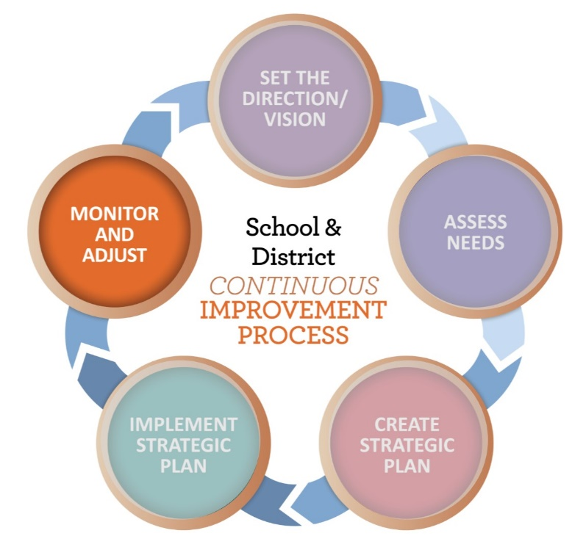
Measuring Impact
Notes:
The last step in the continuous improvement cycle is monitoring and adjusting. Evaluating the effectiveness of professional learning is arguably the most critical step. We usually have a clear vision and plan for implementation, but evaluation of PL is often overlooked. Treating evaluation as an afterthought or ignoring it altogether means there is no way of knowing whether the investment in that PL paid off. Knowing what we expect the impact/outcome of the PL to be helps in monitoring progress and ultimately deciding whether or not to continue that practice in the future.

Slide 18
Connecting to the application….
HOW is impact being measured?
Identify what measures will be used to determine whether the strategy is generating the results you expect
Matching the measure to the strategy
What are you trying to change?
One measure does not fit all strategies
Notes:
In terms of the IIA application, we call this the HOW. The HOW is about identifying the measure(s)/process you are planning to use to determine whether the strategy is generating the results you expect.
Just as we would not give students a multiple choice test to measure their demonstration of a performance-based skill, we need to make sure we have the right fit of the measure of our strategy for improving educator practice. What are we trying to change and how can we measure that change? Thinking back to our IF, THEN, AND conversation, student performance is always the ultimate goal. But change in educator practice is needed before we will see student results. What measures can we use to determine that change in practice?
It is important to note that impact is not restricted to student achievement, and can include impact on educator practice. Evidence of impact could include surveys, educator evaluation data, attendance, behavior, graduation rate, course participation, etc.

Slide 19
HOW: Measuring Impact
Strategy: Provide training to staff in trauma informed practices
Train staff to understand trauma informed practices and how these things impact learning, attention, and student behavior. Training/support will be provided to 40 teachers throughout the school year.
Impact:
climate surveys
student discipline data
focus walks
Notes:
In this example training is being provided to staff in TIP. Multiple measures have been identified, which is great, and appear to address both student outcomes and changes in educator practice. However, it has some pieces that are incomplete. How often will training and support be provided? Are the climate surveys for students and what do you expect them to show? What change in discipline data to you expect to see? What is the expected outcome of the focus walks?

Slide 20
HOW: Measuring Impact
Strategy: PD on Foundational Reading and Intervention Strategies
This training will provide 20 teachers of K-1 students (general ed, Title I, and Learning Specialists), with increased knowledge and skills around foundational reading skills and intervention strategies based on the district's universal literacy screener and diagnostic assessments. This activity will build capacity in understanding how to accurately interpret student assessment data, progress monitor students' development of early literacy skills. Teachers will meet weekly within PLCs to analyze data.
Notes:
This activity is focused on improving teacher knowledge and use of intervention strategies in reading as well as use interpret data to monitor student progress.

Slide 21
HOW: Measuring Impact
Impact:
DIBELS progress monitoring and Benchmark data will show an increase in percentage of students progressing towards mastery of skills.
Principal and coach observation data will show teachers are shifting core instruction to meet their students' needs.
PLC notes will show that teachers/teams are analyzing DIBELS data to inform planning and instruction.
Notes:
The description of impact in this example also includes multiple data sources, but includes specificity that articulates the target that you are shooting for. The more specific you are in describing evidence of success, the better able you’ll be to determine whether the strategy is working and whether you want to modify it or try something else.

Slide 22
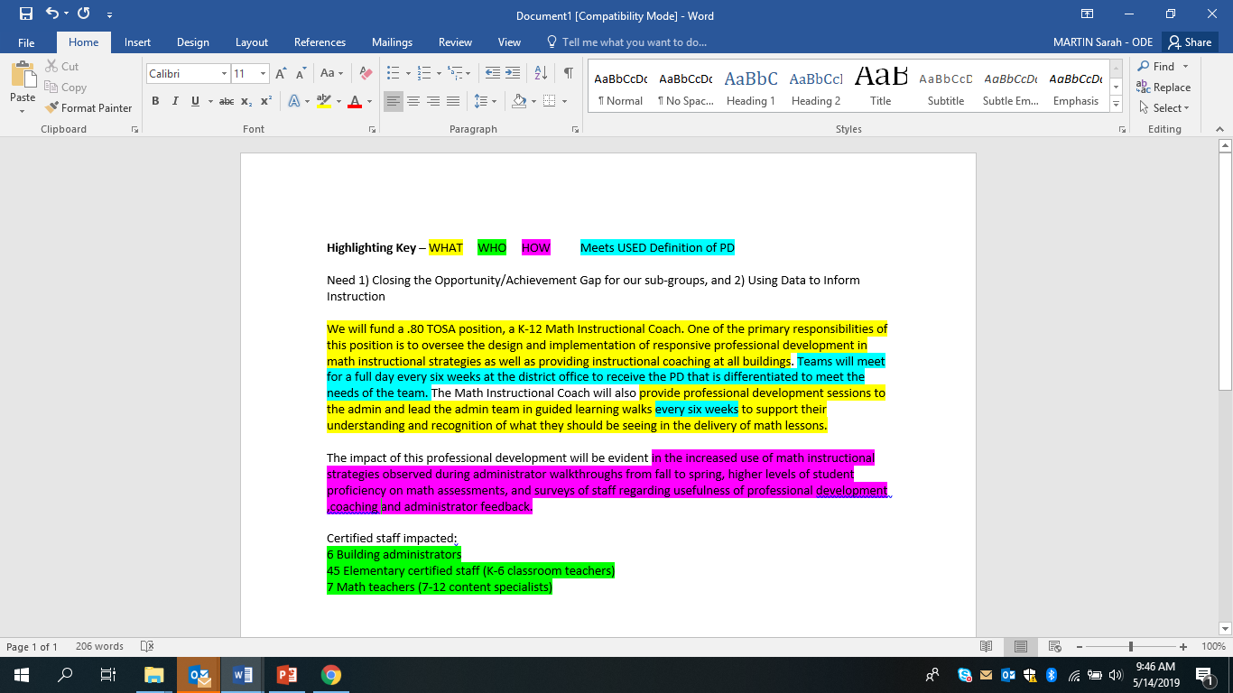
Example
Notes:
Here is an example we shared last year that illustrates the components that we’ve outlined – WHAT, WHO, HOW and how it meets USED definition of PL

Slide 23
Reminders
Ensure the narrative reflects the object codes selected
Activities repeated from year to year
Reconciling applications
New activities
Large changes in funding approved items
DO NOT resubmit Carryover applications once approved
Email Sarah regarding changes to Carryover
Notes:
Materials and supplies should be articulated in the narrative.
We know that the impact of strategies may take several years of implementation to show significant results. Districts are encouraged to continue implementing effective strategies. When carrying over strategies from year to year please include evidence of how you know the strategy is working.
We recognize that the application submitted represents the district’s plan, but that there are many reasons those plans can change. The only cases in which changes to the plan should be resubmitted to ODE are when a planned activity was not conducted and something new is proposed in its place, or when the district is seeking to shift a significant amount of funds between approved items.
Due to technical issues on ODE’s end, once a carryover application is approved it cannot be resubmitted. If you need to make changes to your carryover application please contact your reviewer.

Slide 24
Private Schools
Equitable Services

Slide 25
Consultation
The goal of consultation is agreement between the LEA and appropriate private school officials on how to provide equitable and effective programs for eligible private school children.
Notes:
25
Districts must annually notify private schools of their eligibility to participate. Districts are responsible for calculating the equitable service amounts for private schools and submitting that calculation as a part of the online submission.

Slide 26
Consultation
Annual consultation that is “timely and meaningful”
Recommend late February/early March
Ensure the topics on the Verification of Annual Private School Consultation TransAct® form are covered
Private School Participation webpage
Notes:
26
Districts must annually notify private schools of their eligibility to participate. Districts are responsible for calculating the equitable service amounts for private schools and submitting that calculation as a part of the online submission. Many resources are provided on the Private School Participation Under ESSA webpage which is linked of the Title IIA main page.

Slide 27
PS Roles and Responsibilities
Conduct a needs assessment and identify prioritized needs
Provide district with plan for IIA funds that includes WHAT, WHO, HOW and how the strategy meets the USED definition of “professional development”
Work with district contact to arrange for billing and payment
Notes:
The private school’s primary responsibility is to be in communication with the district regarding the school’s needs and plan for use of its equitable share.
Private school line items should mirror those of the district. As we discussed on slides 14 and 18, each strategy should be tied to an identified need and articulate what knowledge and skills will be obtained, who is participating and how effectiveness of the strategy will be measured.
The district serves as the fiscal agent for the school. Schools cannot be reimbursed for costs. Costs for registering for conferences, travel, materials, etc. should be coordinated through the district.

Slide 28
District Roles and Responsibilities
Contact all eligible private schools within district for consultation
Calculate equitable share for each participating private school
Review PS requested activities to assure alignment with IIA requirements
Create a unique line item in district narrative for each school’s selected activities
Act as the fiscal agent for the school
Notes:
The primary role of the district is to serve as the guide and resource for the school regarding Title IIA, much like ODE does for districts. This means that the district should review and work with the PS to adjust any activities to ensure they meet IIA requirements.
Every private school should have its own line in the district’s budget narrative that includes school name, the date of initial contact, and in the information provided by the school regarding their chosen strategies/activities. Please do not include the information about the needs assessment process of data. The name of the identified need, WHO,WHAT HOW is the only information needed by reviewers. Please be as concise as possible.
Submit district application when district is ready, regardless of submission from private school
· If private school plans are provided after district submission, revise district IIA submission to reflect private school strategies once received
The district serves as the fiscal agent for the school and cannot reimburse the school directly. If a private school does not use its funds during the 15 months of allocation (July 1 through September 30 of the following year) equitable service funds become part of the district’s carryover funds.

Slide 29
Calculating Equitable Services
Equitable service amounts are based on the LEA’s total allocation less administrative costs
Costs to operate the grant at both the district and private school (e.g.; conducting meetings, negotiating contracts, accounting activities, etc.)
Total for administrative costs deducted for the purpose of calculating equitable share cannot exceed the district’s indirect rate
Note: Total enrollment for IIA is all students in district and private school, not the same as IA
Notes:
The amount an LEA must reserve to provide equitable services for private school teachers and other educational personnel for Title II, Part A services is based on the LEA’s total Title II, Part A allocation less administrative costs.
The district can deduct administrative costs for administering IIA in private school programs. In Oregon that means only the costs that are incurred in operating the grant. This includes things like conducting meetings, negotiating contracts, processing purchase orders, accounting activities, file maintenance, conference registration, etc.
Any additional costs to manage the grant that exceed the indirect rate are taken out of the district’s allocation.
It is important to keep in mind that when calculating total enrollment on the ES worksheet – all students in the district and PS are included which is different from Title IA.

Slide 30
Reminders
PS activities are based on the school’s needs assessment
Non-Allowable
Salaries/benefits, substitutes
Secular content only
Districts may transfer funds between federal programs
Must be part of annual consultation
Schools may not be reimbursed
Notes:
A few reminders that we get questions about every year:
The school determines their activities based on their needs. Districts are welcome to invite PS to attend district PL, but that cannot be the only option for PS use of IIA funds.
Private schools can engage in all the same strategies and activities that districts can with two large exceptions: salaries and substitutes. Additionally, they must ensure that any IIA funds allocated for attendance at religious conferences are only used to support attendance for secular content.
Districts must ensure that private schools have access to their equitable share. If the district chooses to transfer funds between federal programs, private schools must be made aware of their eligibility to participate and the impact the transfer of funds will have on their equitable share. Private schools should not expect their allocations to change mid-year due to a district decision to transfer funds.
The district is the fiscal agent for the school. The district should be purchasing materials, paying contractors, etc. You do not reimburse the school for costs.

Slide 31
Ombudsman
May attend consultations
Ensures compliance with ESSA
Handles complaints for Private School
Collects documentation of consultation
Joni Gilles – joni.gilles@state.or.us
Notes:
To help ensure equitable services and other benefits for eligible private school children, teachers and other educational personnel, and families, an SEA must designate an ombudsman to monitor and enforce ESEA equitable services requirements under both Title I and Title VIII. The role of the Ombudsman is to serve as an SEA’s primary point of contact for addressing questions and concerns from private school officials and LEAs regarding the provision of equitable services under Titles I and VIII. In addition, the ombudsman is required to monitor and enforce the equitable services requirements. Joni Gilles has been hired by ODE in this capacity and is available to work with districts and schools as questions or concerns arise.

Slide 32
Funding Update
States will receive IIA funding for 2019-2020
Oregon’s preliminary allocation from USED very similar to last year
Changes to district allocations for 2019-20 will be the result of changes in district census poverty numbers
ESSA Allocations
Notes:
ODE will receive information on the final state IIA allocation in late June or early July. Based on those figures district allocations will be determined and communicated as quickly as possible. Amounts will be posted on the Allocations and Budget Narrative page as well a link provide through the listserv.

Slide 33
Timeline For Funds
Grant funds available for 27 months
July 1, 2019 until September 30, 2021
Funds not obligated by September 30, 2020 become “Carryover” funds
All activities funded through Carryover must be completed by September 30, 2021
Notes:
33

Slide 34
Dates to Remember
August 15 – 2019-20 application opens (approximate date)
September 30 – End of initial period of 2018-19 allocation
November 1 – Due date for 2019-20 applications
November 15 – Carryover application opens (approximate date) for remaining 2018-19 funds
February/March – Consultations with PS
Notes:
34

Slide 35
Resources
Title IIA web page
Title IIA Listserv
Federal Non-Regulatory Guidance
Oregon Federal Funds Guide
Course to Endorsement Catalogue
Standards for Professional Learning (Learning Forward standards)
Continuous Improvement Planning Guidance
Notes:
There are a number of resources available on the ODE Title IIA website. We are working to update the guidance documents to align them with changes from ESSA. A consolidated guidance document of all federal programs has been drafted and is anticipated to be available by the end of May.

Slide 36

Questions?

Slide 37
Contacts
Sarah Martin
Sarah.martin@state.or.us
Susanne Daggett
Susanne.daggett@state.or.us
Rendy Jantz
Rendy.jantz@state.or.us

