Slide 1
21st Century Community Learning Centers (21st CCLC)
2023 RFA Technical Assistance Webinar
April 14, 2023
10:00-11:00 AM

Slide 2


Introductions
1. Please Update your Zoom Name
First & Last (Pronouns) Organization, Title
Example: Jenn Smith (she/they) Oregon Academy, Principal
2. Introduce Yourself in the Chat,
Share your name and what you are hoping to learn today.
3. Please utilize the chat to ask questions throughout the session. We will address as many as we can at the end. A FAQ will be created posted on the 21st CCLC website.
Notes:
https://www.oregon.gov/ode/schools-and-districts/grants/ESEA/21stCCLC/Pages/Grants-Guidance.aspx

Slide 3

Welcome!
Purpose:
The purpose of this session is to:
Ground prospective grant applicants in the purpose and goals of a 21st Century Community Learning Center Grant;
Review the Request for Application (RFA) ODE released last week;
Provide clarity on the key requirements of this federal grant.

Slide 4

Agenda
3:30- Welcome, Agenda, Grounding in RFA
3:40- Purpose, Goals and Vision of 21st CCLC Programs
3:55- Eligibility & Funding
4:05- Key Requirements
4:15- Application Instructions
4:20- Resources & Q & A
4:30- Thank you!
Notes:
put slide deck in chat

Slide 5

Grounding
Federal Grant- Title IV-B Celebrating 25 years!
21st CCLC Website
Request For Application
Part 1: General Information (dark blue)
Part 2: Application Instructions (Teal)
Part 3: Application Template (light green)
Appendices (dark blue)
Glossary
Selection Criteria & Rubrics
Copy of Attachment 1- Cover Page
Copy of Attachment 3- Lead Applicant/Partner Form
Notes:
We’ve provided a lot of information on slides because it is very important you closely read application and this document can be a resource for you.

Slide 6
Purpose, Goals, and Vision of 21st CCLC Programs

Slide 7
What is a Community Learning Center?
According to ESSA the term “community learning center” refers to an entity that:
Assists students to meet the challenging State academic standards by providing the students with academic enrichment activities and a broad array of other activities during non-school hours or periods when school is not in session (such as before and after school or during summer recess) that:
Reinforce and complement the regular academic programs of the schools attended by the students served; and
Are targeted to the students’ academic needs and aligned with the instruction students receive during the school day; and
Offers families of students served by such centers opportunities for active and meaningful engagement in their children’s education, including opportunities for literacy and related educational development.

Slide 8

What is Expanded Learning?
21st CCLC programs are also considered Expanded Learning programs. The following terms may be used interchangeably for before school, afterschool, summer learning, and periods when school is not in session.
Out-of-School Time
Expanded Learning
Summer Learning Programs
Afterschool (one word)
*We will talk about service options and requirements for 21st CCLC programs shortly.
Notes:
Tenneal

Slide 9
Purpose of the 21st CCLC Grant (ESSA)
The purpose of the 21st CCLC program is to establish or expand activities in community learning centers [§4201(a)]. 21st CCLC services focus on helping children in schools who serve a large portion of students navigating poverty succeed academically through the application of evidence-based practice by:
Providing opportunities for academic enrichment, including providing tutorial services to help students, particularly students who attend low-performing schools, to meet the challenging state academic standards in core academic subject such as reading, writing, and mathematics;
Offering students a broad array of additional services, programs, and activities, such as youth development activities, service learning, nutrition and health education, drug and violence prevention programs, counseling programs, arts, music, physical fitness and wellness programs, technology education programs, financial literacy programs, environmental literacy programs, mathematics, science, career and technical programs, internship or apprenticeship programs, and other ties to an in-demand industry sector or occupation for high school students that are designed to reinforce and complement the regular academic program of participating students; and
Offering families of students served by community learning centers opportunities for active and meaningful engagement in their children’s education, including opportunities for literacy and related educational development.

Slide 10
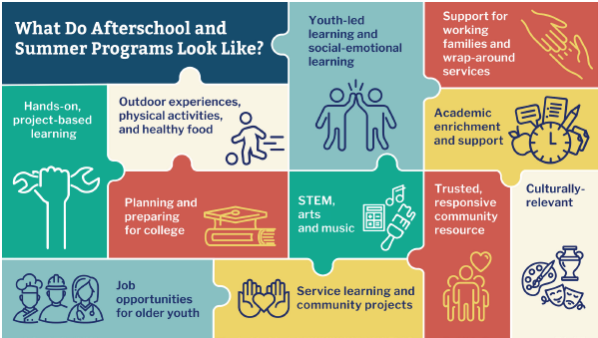
Comprehensive Programming

Slide 11

Oregon 21st CCLC Program Goals
Goal 1: Equitable Programming
21st CCLC Programs provide equity-driven expanded learning opportunities that support every child with equitable access to safe, inclusive, and welcoming learning environments.
Goal 2: Academic Enrichment
21st CCLC programs provide expanded learning opportunities for academic enrichment that explore and build on concepts from the school day to help students meet state and local student performance standards in core academic subjects including reading/language arts, math and science.
Goal 3: Youth Development
21st CCLC programs provide a broad array of student-centered, well-rounded enrichment opportunities that spark joy, connection and curiosity to deepen learning and promote positive youth development.
Goal 4: Family Engagement
21st CCLC programs engage caregivers and families at the individual and community level to co-create meaningful learning experiences and promote active engagement in students’ education.

Slide 12






Foundational Components to Equity-Driven, High-Quality Summer Learning Programs
Programs Intentionally built with both academics & enrichment
The length and duration of program supports likeness to reach goals
Programs provide free meals and transportation to all students
Participation matters!
Students regularly attend program
No costs or fees to families
Dedicated professional learning for program staff

Slide 13
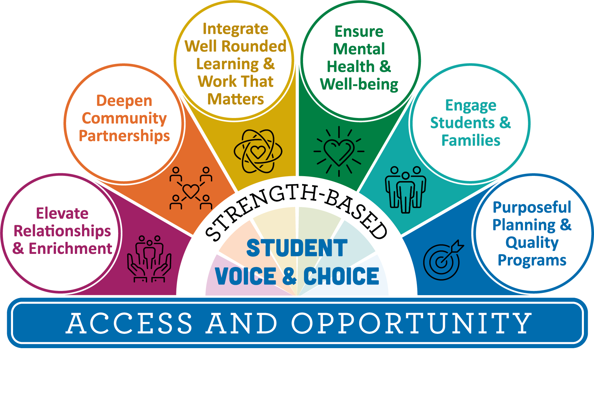
Quality Matters
Access alone is not enough: quality matters. These equity-driven key elements grounded in the science of learning and development can serve as a north star for 21st CCLC programs.
When we say High-Quality, we mean all of the high-leverage practices that are included in this concept system aligned to purpose and goals of the grant.

Slide 14

Dream Big!

Slide 15
Eligibility & Funding

Slide 16
Eligible Applicants
Eligible entities include, but are not limited to the following:
Local school districts, Local Education Agencies (LEAs),
Charter schools,
Education Service Districts (ESDs),
Tribes or tribal organization,
Educational consortia,
Non-profit agencies,
City or county government agencies,
Faith and community-based organizations,
Institutions of higher education, and
For-profit corporations.
Eligible entities must be able to demonstrate in the application that they have:
The expertise and capacity to reach the program requirements and grant goals,
Demonstrate a significant partnership between an LEA with one or more Title I-A eligible school and/or CSI/TSI School(s),
At least one entity that is not primarily a contracted service,
and prioritizes focal student groups.
Notes:
Applicants for 21st CCLC grants may be schools, youth-serving agencies, faith-based organizations, public agencies, private agencies, and other organizations who can demonstrate they have the expertise and capacity to reach grant goals.

Slide 17
Absolute Priority
Absolute priority is a requirement, and any application not meeting the absolute priority will not be considered for funding. Entities receiving absolute priority in this application are those that propose to serve students and the families of students who primarily attend:
Title I-A eligible schools; and/or
Schools implementing Comprehensive Support and Improvement (CSI) or Targeted Support and Improvement (TSI) under section 1111(d)(1) in ESSA; and
The program prioritizes focal student groups*; and
The program has formed a partnership* between at least one LEA receiving funds under Title I-A, and at least one public or private community organization.
*See definitions in RFA Glossary

Slide 18

Lead Applicant
One organization must be designated as the lead applicant. This can be a LEA (local educational agencies), CBO, or other public or private entity. If awarded, the single lead applicant will be the official grantee and the designated fiscal agent.
Contracted Services- up to 90% of grant
A lead applicant may submit only one application.

Slide 19
Partnership
"Partnership” means a group of organizations, Tribes, districts or individuals who agree to work together with a common interest and shared vision. In a partnership, there is a high level of trust and two-way communication, and differences in power and privilege are addressed. Roles and responsibilities on all sides are well-defined and developed with shared authority in decision making. There might be shared space and staff, with expectations and agreements in writing.
Notes:
significant partnership and create the partnership together-all partners had to sign off are there other ways to support and ensure this

Slide 20
Grant Size and Duration
5 year grant cycle (2023-2028)
Renewed annually
$50,000 to $500,000 per year
Expect to fund 20 to 30 grants
100% funding years 1-3, 90% funding in year 4, 80% in year 5. No program will receive less than $50,000 per year
Notes:
contingent upon federal funding for a 5-year grant cycle. Annual renewal is based on grantee compliance with federal statute, program requirements, and evidence of progress towards grant goals and objectives as documented in Local Evaluation Reports, Program Quality Reflections, and Action Plans.

Slide 21
Key Requirements

Slide 22
School Year Service Options
All programs are expected to operate from September through June and up to the last week of the regular school year.
Centers must be open 4 days per week during a typical school week
Centers are required to be open and offer at least 12 hours of programming per week
Centers must be open a minimum of 300 program hours per school year.
Services may be offered:
Afterschool (beginning when school dismisses)
Weekdays during the typical school year when school is not in session or afterschool after early dismissal (at least 4 hours per day),
Holidays and on weekends if centers are open for at least four hours per day.
NOTE: The requirements listed above must be applied to each program center for those operating multiple centers.

Slide 23
Optional Summer Service Options
Programs that desire to implement a summer learning program must develop a program that operates a minimum of:
four days per week
four hours per day
80 total hours of programming
Grant funds may be used to provide summer programming, but funds may not be used to fund only summer programs. Summer programs are expected to provide the full scope of programming aligned to 21st CCLC goals, objectives, and quality programming. Summer programs should collaborate with other programs providing summer services to coordinate and enhance programming for 21st CCLC students.
NOTE: The requirements listed above must be applied to each program center for those operating multiple centers.

Slide 24
Attendance
21st CCLC programs are not drop-in programs and should prioritize regular attendance for the duration of the program.
To be considered a regular attendee a student must attend a minimum of 90 program hours during the school year.
It is expected that 80 percent of participants in elementary and 60 percent of middle and high school participants will be regular attendees.

Slide 25
Meals & Transportation
Meals and Snacks
21st CCLC programs are expected to provide snacks/meals during typical program operations through the US Department of Agriculture (USDA) Child Nutrition Programs for which they qualify.
Transportation
Federal guidance advises that there can be no barriers preventing students’ participation in 21st CCLC. Programs must offer students a means of transport if they qualify for afterschool and are unable to walk to community centers. This includes students who are eligible for McKinney-Vento services and students who are in the Foster Care.

Slide 26

Optional State Competitive Priority Points
Mental Health & Well-Being (up to 10 points)
K-5 Literacy (up to 10 points)
Middle & High School Career and Technical Education (CTE) (up to 10 points)
Notes:
you can see these in previous grant-

Slide 27
Application Instructions

Slide 28
Application Electronic Submission
The application template located in Part 3 of the RFA is NOT the official submission application and is only meant to be used as template to work in prior to the submission through the Smartsheet 21st CCLC Application Portal.
It is strongly recommended that you work in the Word application template in the RFA and copy/paste your work into the Smartsheet 21st CCLC Application Portal as a last step in the grant writing process.
Notes:
Application Portal: https://app.smartsheet.com/b/publish?EQBCT=e6093a63816949ea864f943f2db1e8b4

Slide 29
Application Timeline
A completed application must be submitted via the Smartsheet 21st CCLC Application Portal by: May 26, 2023 by 11:59 PM, PT (Note: Any application after this deadline will not be accepted.)
Award notification emailed: July 2023
Program implementation may begin: September of 2023
New Grantee/21st CCLC Program Director Meeting: August 2023
New afterschool programs must start no later than: November 13, 2023

Slide 30


Summer Learning Resources
Releasing Soon!
2023 version of the Summer Learning Best Practice Guide and Toolkit.
Notes:
Summer learning website: https://www.oregon.gov/ode/schools-and-districts/grants/Pages/Summer%20Learning/Summer-Learning-Resources.aspx
Summer Learning Best Practice Guide: https://www.oregon.gov/ode/schools-and-districts/grants/Documents/ODE%202022%20Summer%20Learning%20Best%20Practice%20Guide.pdf
Summer Learning Toolkit
https://www.oregon.gov/ode/schools-and-districts/grants/Documents/ODE_Summer_Learning_Best%20Practice%20Toolkit.pdf

Slide 31

Upcoming Events
Mark Your Calendars for the Following Events:
Wednesday, April 12 & 14, 3:30 - 4:30 pm
21st CCLC Grant Competition Virtual Technical Assistance - April 12th - Registration Link
21st CCLC Grant Competition Virtual Technical Assistance - April 14th - Registration Link
Thursday, April 13th, 1:00 - 2:00 pm
Child Care: A critical link to supporting families in summer programs - Registration Link
Tuesday, April 18th, 11:00 am - 12:00 pm
Effectively Braiding Funds for Summer 2023 - Registration Link
Wednesdays, April 19 - May 17, 3:00 - 4:00 pm
21st CCLC Grant Competition Weekly Office Hours Link to Join
Informational Flyer
Notes:
https://www.oregon.gov/ode/schools-and-districts/grants/Documents/ODE_Summer%20Learning-One_Sheet_2023.pdf

Slide 32

Closing
There is no power for change greater than a community discovering what it cares about.
-Margaret J. Wheatley
Our gratitude for your time and participation today
Please email us at ODE.OR21stCCLC@ode.oregon.gov for any questions

Slide 33

Thank you!
Raquel Gwynn, ODE, 21st CCLC Education Specialist
Email: raquel.gwynn@ode.oregon.gov
Ron Speck, ODE, 21st CCLC Education Specialist
Email: ron.speck@ode.oregon.gov
Ellie Wright, ODE, 21st CCLC Office Specialist
Email: ellie.wright@ode.oregon.gov

