Slide 1
Charter Schools and Title I-A
April 25, 2023

Slide 2

Agenda for Today’s Session
Charter Schools in Oregon
Charter Schools and Federal Funds
Title I-A Requirements
Key Takeaways & Hot Topics

Slide 3

A charter school…
Is a public school
Authorized by a sponsor
Operates under a contract
Is semi-autonomous
Notes:
In Oregon, a charter school is a public school that is authorized by a sponsor, typically school districts, and operate as semi-autonomous schools under a contract or "charter" between the members of the charter school governing board and the sponsor’s board. Under Oregon law, a charter school is a separate legal entity operating under a binding agreement with its sponsor. A public charter school must comply with many of the foundational education laws, but has flexibility from some requirements to foster innovation.

Slide 4
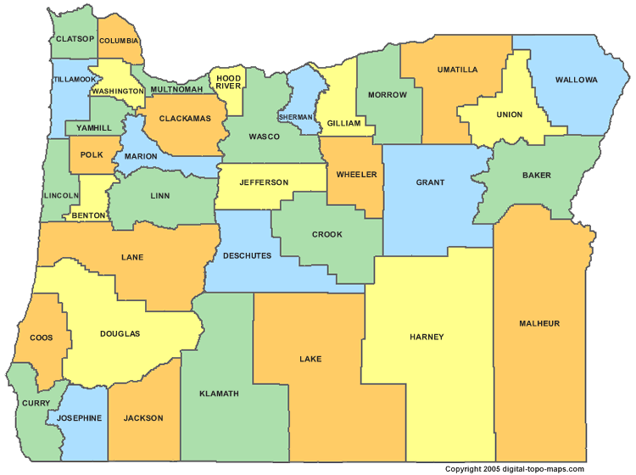
Charter Schools in Oregon
132 brick and mortar charter schools
20 virtual charter schools
All but four are district-sponsored
Notes:
Most charter schools in Oregon are district sponsored. There are only 4 that are sponsored by ODE.

Slide 5
Charter Schools and Federal Programs
Charter data should be included as part of the district needs assessment
Inventory must be tracked
No “equitable share”
Consider ways to meet unique needs under Titles II-A and IV-A
Notes:
When it comes to federal funds, district-sponsored charter schools are like any other school in the district
NEEDS ASSESSMENT: Charter school data should be included as part of the district needs assessment process.
INVENTORY: Charter schools are not private schools. With the exception of Title I-A, funds are not allocated to charter schools
While charter schools do not get an “allocation” like private schools, they do have unique needs that should be considered. There are several different approaches to supporting charter schools that districts have taken. Ultimately it comes down to good communication between districts and charters.
MEETING UINIQUE NEEDS: Possible options -
Creating a line item for each charter
District line item specifically calling out charter school participation

Slide 6

Title I-A:
Rank & Serve Requirements
Charter schools must be included in the rank and serve process
A charter school must be served if 75% or more of its students are experiencing poverty
A charter school may be eligible to be served, depending on how the district chooses to rank and serve its remaining schools
Oregon Department of Education
Notes:
The intent of Title I-A is to concentrate the funds in schools with the highest percentages of children from families experiencing poverty and to provide sufficient funds to make a difference in the academic performance of these students. In order to determine which schools will receive Title I-A funds, each district must put its schools in rank order from highest to lowest concentrations of children from families experiencing poverty.
Charter schools may qualify for Title I funds and must be included in the rank and serve process in the same manner as all other schools in the district. When 75% or more of the students within a charter school are experiencing poverty the school must be served with Title I-A funds. Charter schools with less than 75% of students experiencing poverty may also be eligible, depending on how the district chooses to rank and serve its remaining schools.

Slide 7
Considerations for Virtual Charter Schools
Virtual charter schools may qualify for I-A funds
All enrolled students are included when determining rank and serve
Notes:
Virtual charter schools are district-sponsored schools and as such, all students enrolled in a virtual charter school are considered district students. The students become residents of the sponsor district. This means all students who attend a virtual charter school must be included in the student count when determining total enrollment and the number of students experiencing poverty.
It is important to note that while districts receive state funds based on the enrollment of students within a virtual charter school, Title I-A funds are allocated based on the number of students experiencing poverty who live within district boundaries.
NOTE: Allocation of federal funds is based on the number of students who live within district boundaries, not on the number of enrolled students

Slide 8

Selecting Measures of Poverty
Charter schools must provide data to the district about the number of students experiencing poverty
Whenever possible, charter schools should use the same measure as other schools in the district
Family Income Survey under CEP Resources
  English
  Spanish
Notes:
ESEA outlines the required steps for ranking and serving schools under Title I-A , including selecting the measure for determining poverty. Whenever possible, charter schools should use the same measure used by other schools in the district (e.g.; National School Lunch Program data). Charter Schools that do not sponsor or participate in a national school breakfast or lunch program should use the Oregon Family Income Survey. More detailed information about the rank and serve process can be found in this ESSA Quick Reference Brief.

Slide 9
Collaboration is Key
Charter School
District
Collect poverty data
Provide data to district
Partner with families
  Review and evaluate plan annually
  Conduct annual meeting
  Compact
  Build family capacity to support students
Consider charter data in decision-making
Include charter schools in rank and serve
Review and post school plan on website
Notes:
RECOMMENDATION: Invite charter school administrators to school leader meetings

Slide 10
A few other things to keep in mind…
Teachers must meet state licensure requirements
Paraprofessionals must meet OAR requirements
Time and Effort rules apply when staff are paid with federal funds
  Contractors are exempt from T&E requirements
Notes:
Teacher Licensure – Under ESEA, districts are required to ensure that all teachers working in a Title I-A funded schools meet state certification and licensure requirements. In Oregon, this means any person employed as a teacher in a public charter school must be licensed or registered to teach by the Teacher Standards and Practices Commission (TSPC).
The requirements for paraprofessionals apply to charter schools in the same manner they apply to other public schools. Paraprofessionals hired to work in programs supported with Title I-A funds must have a high school diploma or its recognized equivalent. They must also have:
• completed at least two years of study at an institution of higher education, or
• possess at least an associate’s degree, or
• demonstrate subject matter competence through a formal State or local assessment.

Slide 11

Resources
Allocating Funds to Charter Schools (USED)
Impact of Title I-A on Charter Schools (USED)
Within District Allocations under Title I, Part A (USED)
ESSA Quick Reference Briefs
  Rank and Serve under Title I-A
  Charter Schools & Title I-A
  Schoolwide Programs
  Targeted Assistance Programs
OAR regarding Educational Assistants

Slide 12

Please reach out!
Amy Tidwell
amy.tidwell@ode.oregon.gov
Jen Engberg
jennifer.engberg@ode.oregon.gov
Sarah Martin
sarah.martin@ode.oregon.gov
Lisa Plumb
lisa.plumb@ode.oregon.gov
Kate Pattison, Charter School Specialist
kate.pattison@ode.oregon.gov

Slide 13
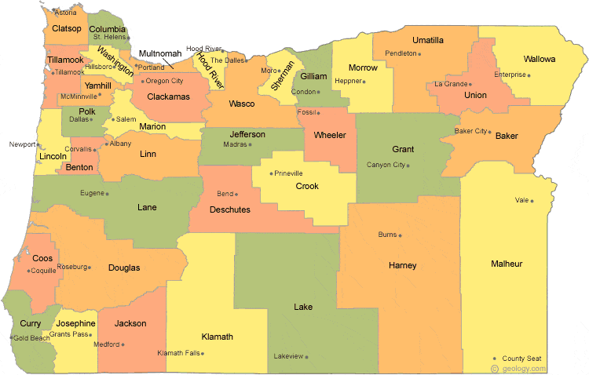
Regional Contacts by ESD
Jen Engberg
  Clackamas, Columbia Gorge, Multnomah and Northwest Regional
Sarah Martin
  Douglas, Lake, Malheur, South Coast and Southern Oregon
Lisa Plumb
  Lane, Linn Benton Lincoln and Willamette
Amy Tidwell
  Grant, Harney, High Desert, InterMountain, Jefferson, North Central and Region 18

