Slide 1
Title I, Part A: Comparability

Slide 2

Outcomes
Comparability Basics
Demonstrating Comparability
Exceptions & Exemptions
Resources
Oregon Department of Education

Slide 3
Supplement Not Supplant
Federal funds cannot be used to supplant, or take the place of, funds that would have been spent if Title I-A funds were not available
Comparability is one of three fiscal tests for Title I-A
through which districts demonstrate that their use of
Title I-A funds is supplemental
ESSA Quick Reference Brief: Comparability
Title IA Fiscal Requirements
Supplement not Supplant
Comparability
Maintenance of Effort
Oregon Department of Education
Notes:
There are three fiscal tests for Title I-A:
Maintenance of Effort (MOE) – LEAs must maintain a consistent floor of state and local funding for free public education from year-to-year.
Supplement Not Supplant (SNS) – LEAs must distribute state and local funds to schools without taking into account a school’s participation in the Title I program.
Comparability – state and local funds are used to provide services that, taken as a whole, are comparable between Title I and non-Title schools.
Title I-A funds are required to supplement, and not supplant existing state and local funding. In plain language, this means that federal funds should add to, and not replace, state and local funds. Before ESSA, Title I-A’s ‘supplement, not supplant’ requirement was tested through three presumptions that looked at each activity supported with Title I-A funds to determine if it was something an LEA or school would have paid for with state and/or local funds if Title I-A funds were not available.
The reauthorization of ESEA under the Every Student Succeeds Act (ESSA) changed the way supplement, not supplant (SNS) compliance is tested for districts and schools that receive Title I-A funds. ESSA’s revised SNS test does not look at how districts and schools spend Title I-A funds as a specific cost test, but instead looks at how districts distribute State and local funds to Title I-A schools.

Slide 4

Comparability Basics
What: A comparison of the use of funds in Title I-A and non- Title I-A funded schools
Why: To determine whether the distribution of State and local funds and resources to schools are comparable regardless of Title I-A status
When:
  October 1: CIP Budget Narrative Assurances
  December 1: Comparability Report
Oregon Department of Education
Notes:
Comparability is a school-level calculation that measures the level of State and local funds and resources provided to a district's Title I-A and non-Title I-A schools. The goal is to determine whether the distribution of State and local funds and resources to schools are comparable regardless of Title I-A status.
Districts must annually demonstrate that they have met comparability requirements through two actions:
Submission of the CIP Budget Narrative Assurances for ESEA programs. Assurances form a binding agreement between the local district, the Oregon Department of Education (ODE), and the U.S. Department of Education (ED) that assures all legal requirements are met in accordance with state and federal laws, regulations, and rules. District superintendents must sign and submit these assurances by October 1 each year. In the assurances the district attests that it has implemented:
an LEA wide salary schedule;
a policy to ensure equivalence among schools in teachers, administrators, and other staff; and
a policy to ensure equivalence among schools in the provision of curriculum materials and instructional supplies.
Submission of the Comparability Report. The Comparability Report demonstrates that the district’s policies described in the assurance result in comparable distribution of funds between Title I-A funded and non-Title I-A funded schools. ODE provides an Excel document that automates many of the comparability calculations. Districts complete and return the template to ODE no later than December 1 each year, along with the signature of the district superintendent.

Slide 5
Assurances
District superintendents sign and submit these assurances by June 30 each year for the subsequent year. In the assurances the district attests that it has implemented:
  an LEA wide salary schedule;
  a policy to ensure equivalence among schools in teachers, administrators, and other staff; and
  a policy to ensure equivalence among schools in the provision of curriculum materials and instructional supplies.

Slide 6

Methods for Demonstrating Comparability
Student-Instructional Staff Ratio
Student-Instructional Staff Salary Ratio
Per Pupil Expenditures
Resource Allocation Plan based on student characteristics
Notes:
Districts have several options for demonstrating comparability. The simplest and most frequently used is the Student to Instructional Staff ratio.

Slide 7
Student-Instructional Staff Ratio
Comparison of the average number of students per instructional staff in I-A funded and non I-A funded schools
  Count student enrollment and staff assignment on the same day
  Do not include staff whose full salaries are paid with federal dollars
Instructional staff are defined as “anyone who provides direct instruction to children or who assists or supervises those staff members who provide instruction.”
Notes:
This is the most commonly used method, in which districts compare the average number of students per instructional staff in each Title I-A school with the average number of students per instructional staff in schools not participating in Title I-A. Instructional staff are defined as anyone who provides direct instruction to children or who assists or supervises those staff members who provide instruction. A district should not include non-instructional paraprofessionals in comparability calculations, but should include personnel such as music, art, and physical education teachers; counselors; speech therapists; and librarians.
There are two important considerations to keep in mind when using this method:
Student enrollment and staff assignments should be counted on the same day.
Staff members whose full salaries are paid with federal dollars should not be included.
Using this method, a Title I-A school is comparable if the school’s average student/teacher ratio does not exceed 110 percent of the average student/teacher ratio of schools not participating in Title I-A. For example, if the average ratio of students to instructional staff is 20 to 1 for an LEA’s non-Title I-A schools, the ratio at each Title I-A school can be no higher than 22 to 1.

Slide 8
Alternate Methods
Student-instructional staff salary ratio
  Comparison of average salary expenditure per student
  Uses the base salary for each type of FTE, not actual cost
Per Pupil Expenditure
  Comparison of allocation of funds for the purchase of instructional staff and materials
Resource Allocation Plan
  Allocations to schools based on student characteristics (i.e.; weighted student formula)
Notes:
Student-instructional staff salary ratio. In this method, the district compares the average instructional staff salary expenditure per student in each Title I-A school with the average instructional staff salary expenditure per student in non-Title I-A schools. When employing this method the district should include expenditure costs related to the base salary for each type of FTE within a building, not actual salary costs.
Using this method, a Title I-A school is comparable if the average per pupil salary expenditure for each school falls within a range that is between 90 and 110 percent of the per-pupil expenditure for the grade span, or within 90 and 110 percent of the per-pupil average for the grade span as compared to the other schools of its size.
Per Pupil Expenditures. As an alternative to the student-staff ratios, districts can demonstrate comparability through an expenditure method that looks directly at allocation of State and local education funds per child for the purchase of instructional staff and materials.
Using this method, a Title I-A school is comparable if the per-child amount for each school falls within a range that is between 90 and 110 percent of the per-pupil average for the grade span, or within 90 and 110 percent of the per-pupil average for the grade span as compared to the other schools of its size.
Resource Allocation Plan based on Student Characteristics. Using this method the district allocates State and local funds to schools based on a standard formula in which dollar amounts are allocated based on objective student characteristics (e.g.; students experiencing disability, emergent bilingual students). This is sometimes referred to as a “weighted student formula”.
Using this method a district is comparable if it can provide evidence of its schedule of allocations and demonstrate that funds have been allocated according to the district schedule.

Slide 9
Comparability At-a-Glance
 |  | Exceptions
Which districts? | All public school districts that accept Title I-A funds. | Districts with one building per grade span.
Which schools? | All schools in the district, including charter schools. | A school with fewer than 100 students enrolled.
Which students? | All K-12 students in the district, whether enrolled in a Title I-A or non-Title I-A school.
Which staff? | All certified and non-certified instructional staff who are paid with State and local funds. | Non-instructional educational assistants; staff whose full salary is paid with federal dollars.

Slide 10
Exemptions & Exclusions
LEAs are exempt from demonstrating comparability when there is one school per grade span
Schools with fewer than 100 students may be excluded from the calculation
State/local funds that can be excluded from calculation
  Language instruction for emergent bilingual students
  Excess costs of providing services to students experiencing disability
  Staff salary differentials for years of employment
  Supplemental programs that meet the intent and purpose of Title I
Oregon Department of Education
Notes:
10

Slide 11
Let’s look at some scenarios!
District #1:
• One elementary school, grades K-5 (Title I schoolwide)
• One middle school, grades 6-8 (Title I targeted assistance)
• One high school, grades 9-12 (non-Title I)
This district is NOT required to complete the Comparability Report because there is only one school per grade span.

Slide 12
Let’s look at some scenarios!
District #2:
• Three elementary schools, grades K-5 (all Title I schoolwide)
• One middle school, grades 6-8 (Title I targeted assistance)
• One high school, grades 9-12 (Title I-A targeted assistance)
This district is required to complete the Comparability Report to demonstrate comparability among the elementary schools only. The district is not required to complete the Comparability Report for the middle and high school because there are no other schools in those grade spans to which they can be compared.

Slide 13
Let’s look at some scenarios!
District #3:
• Two elementary schools, grades PK–2 and 3–5
• One middle school, grades 6–8
• One high school, grades 9–12
The two elementary schools receive Title I funds.
This district is NOT required to complete the Comparability Report because the grade spans in the elementary schools do not overlap.

Slide 14
Let’s look at some scenarios!
District #4:
• One elementary school, grades PK–5 (Title I schoolwide)
• One middle school, grades 6–8 (Title I schoolwide)
• One high school, grades 9–12 (Title I targeted assistance)
• One alternative high school, grades 9–12 (non-Title I)
This district is required to complete the Comparability Report only if the alternative high school has an enrollment greater than 100 students.
Notes:
REASON: More than one school in the same grade band

Slide 15
Comparability Report
In order to meet the annual target date of December 1, an LEA should collect the comparability report information by October 1 of each school year
The information on the Comparability Report needs to match the information on the Title I-A Budget Narrative regarding schools being funded
Once completed, the district’s Comparability Report is accompanied by a Signature Page, signed by the district’s Superintendent
Relevant documents can be found on the Title I-A Data Collection webpage

Slide 16

Resources
ESSA Quick Reference Brief: Comparability
Sample Comparability Timeline
Supplement not Supplant under Title I, Part A
Oregon Federal Funds Guide
Comparability Report FAQs
Title I-A Data Collections

Slide 17

Please reach out!
Jen Engberg
Jennifer.Engberg@ode.oregon.gov
Sarah Martin
Sarah.Martin@ode.oregon.gov
Lisa Plumb
Lisa.Plumb@ode.oregon.gov
Amy Tidwell
Amy.Tidwell@ode.oregon.gov
Kyle Walker
Kyle.walker@ode.oregon.gov
Notes:
Our team has moved from a programmatic model to a regional support model. Each of us has taken a section of the state to support across Titles IA, IIA, IVA and VB.

Slide 18
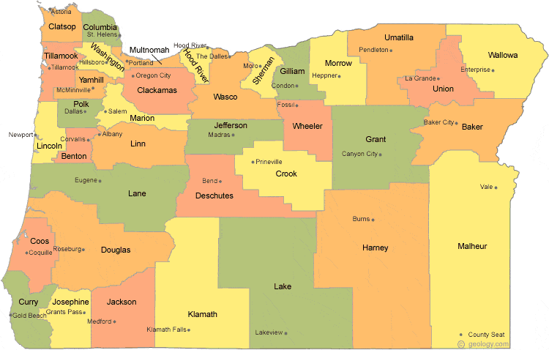
Regional Contacts by ESD
Jen Engberg
  Clackamas, Columbia Gorge, Multnomah and Northwest Regional
Sarah Martin
  Douglas, Lake, Malheur, South Coast and Southern Oregon
Lisa Plumb
  Lane, Linn Benton Lincoln and Willamette
Amy Tidwell
  Grant, Harney, High Desert, InterMountain, Jefferson, North Central and Region 18

