Slide 1
Collaboration Makes a Difference: McKinney-Vento, Foster Care, and Title I-A
Lexi Neemann
Marlie Magill

Slide 2

Agenda for Today’s Session
“Getting to Know You” – Requirements under ESEA
“We’re All in This Together” – Building Your Team
“Imagine” – The Power of the Title I-A Set-Aside
“Lean on Me” – Resources and Supports
Notes:
Today we’re exploring the beautiful music created by the trio of these programs and discuss how to blend the voices each program represents.

Slide 3
Getting to Know You: Requirements under ESSA

Slide 4
McKinney-Vento Act
Subtitle VII-B of the McKinney-Vento Act, as reauthorized by ESSA in 2015, entitles homeless children and youth to a free, appropriate public education, including a preschool education.
The Act applies to State educational agencies (SEAs) and LEAs, including children in public preschool programs.

Slide 5

McKinney-Vento and Title I-A
Children and youth navigating housing instability are automatically eligible for Title I-A services, regardless of whether they attend a Title I, Part A school, or meet the academic standards required of other students for eligibility (20 U.S.C. § 6315(c)(2)(E); ED, 2017, p. 39).
Automatic Title I-A eligibility allows students navigating housing instability who are doing well academically to receive additional non-instructional, education-related support services needed to succeed in school.
Notes:
Students experiencing homelessness are part of Title I, Part A’s target population of disadvantaged students; however, the high mobility, trauma, and poverty associated with homelessness create unique educational barriers and challenges that Title I, Part A students with fixed, regular, and adequate housing may not face. Homelessness can be associated with lower standardized test scores in reading, spelling, and math (Obradović et al., 2009; Rafferty, Shinn, & Weitzman, 2004).
Students experiencing homelessness also transfer schools more often, which requires them to adapt to new curricula, teachers, and peers, while increasing the risk of “broken bonds,” all of which impact learning negatively (Cunningham, Harwood, & Hall, 2010; Obradović et al., 2009).
Thus, students in homeless situations often require supports beyond what typically may be offered to other students to support their academic success.
Automatic eligibility acknowledges that the experience of homelessness puts children and youth at significant risk of academic failure, regardless of their previous academic standing.

Slide 6
Foster Care
OAR 413.105.0010 defines foster care as “substitute care for children placed by the Department of Human Services or a tribal child welfare agency away from their parents and for whom the department or agency has placement and care responsibility…”
The requirements for ensuring educational stability for children in foster care apply to all children in foster care enrolled in schools in the SEA.
Notes:
ESEA Section 1111(g)(1)(E)
The foster care provisions of Title I, Part A emphasize the importance of collaboration and joint decision-making between child welfare agencies and educational agencies at the state, district, and regional level.

Slide 7
Foster Care and Title I-A
ESEA Section 1112(c)(5)(A, B) — District Assurances
Keep students in School of Origin unless BIF determines otherwise
Provide immediate enrollment when a new school is in the student’s best interest
Promptly request/transfer records
Designate Point of Contact
Develop/implement written SOO transportation procedures & provide transportation promptly
ESEA Section 1111(g)(E)(i-iv) — State Agency Requirements
Monitor compliance and support district implementation
Collaborate with ODHS to ensure educational stability
Provide technical assistance, guidance, and accountability

Slide 8

Foster Care Requirements for Districts
Every district, regardless of whether it receives or accepts federal funds, must:
  Allow students in foster care to remain in the school district/school of origin even when the foster home placement changes.
  Immediately enroll students in foster care after a school move.
  Identify a foster care point of contact (FCPC).
  Develop plans for school district/school of origin transportation to maintain a foster student attendance in the school district/school of origin.
  Track achievement and graduation data for students in foster care; disaggregation requirement.
Notes:
Title I-A of the Every Student Succeeds Act (ESSA) requires State Educational Agencies and Local Education Agencies to support the educational rights and opportunities of students in Child Welfare or Tribal Foster Care. Student rights and services include:
School of Origin;
Immediate Enrollment;
Records Transfer;
Transportation;
State and Local Points of Contact; and,
Data Disaggregation.
At each school district, the designated Foster Care Point of Contact must:
Collaborates with caseworkers, Resource parents, Tribes, and community partners
Trains school staff on their role in supporting students in Foster Care
Engage with ODE on matters of professional development and technical assistance

Slide 9
We’re All in This Together: Building Your Team

Slide 10

MV Statutory Requirements for Cross Program Collaboration
Appoint district homeless education liaison who coordinates with other school personnel in providing services to students experiencing housing instability
District liaison consulted in completion of the district I-A plan, including the homeless set aside
Notes:
To identify and address the needs of students experiencing homelessness more effectively, both the McKinney- Vento Act and Title I, Part A require cross program coordination.
The McKinney-Vento Act requires every school district to appoint a local homeless education liaison to serve as the district’s key homeless education contact, and oversee the implementation of the Act in schools throughout the district [42 U.S.C. § 11432(g)(1)(J)(ii)].
As part of their responsibilities, local liaisons must coordinate and collaborate with other school personnel responsible for providing services to students experiencing homelessness [42 U.S.C. § 11432(g)(6)(C)].
Title I, Part A requires that programs operated under its authority coordinate at the State and local levels. All districts receiving Title I, Part A funds must include in their local plans a description of how the district’s Title I, Part A program is coordinated with its McKinney-Vento program [20 U.S.C. § 6312(a)(1)(B)].
The development of the local plan should include timely and meaningful consultation with the local liaison [20 U.S.C. § 6312(a)(1)(A)], and must describe the Title I, Part A services that will be provided to students experiencing homelessness, including through the homeless set-aside (20 U.S.C. § 6312(b)(6); see Serving Students Experiencing Homelessness with Set-Aside Funds below for more information).

Slide 11
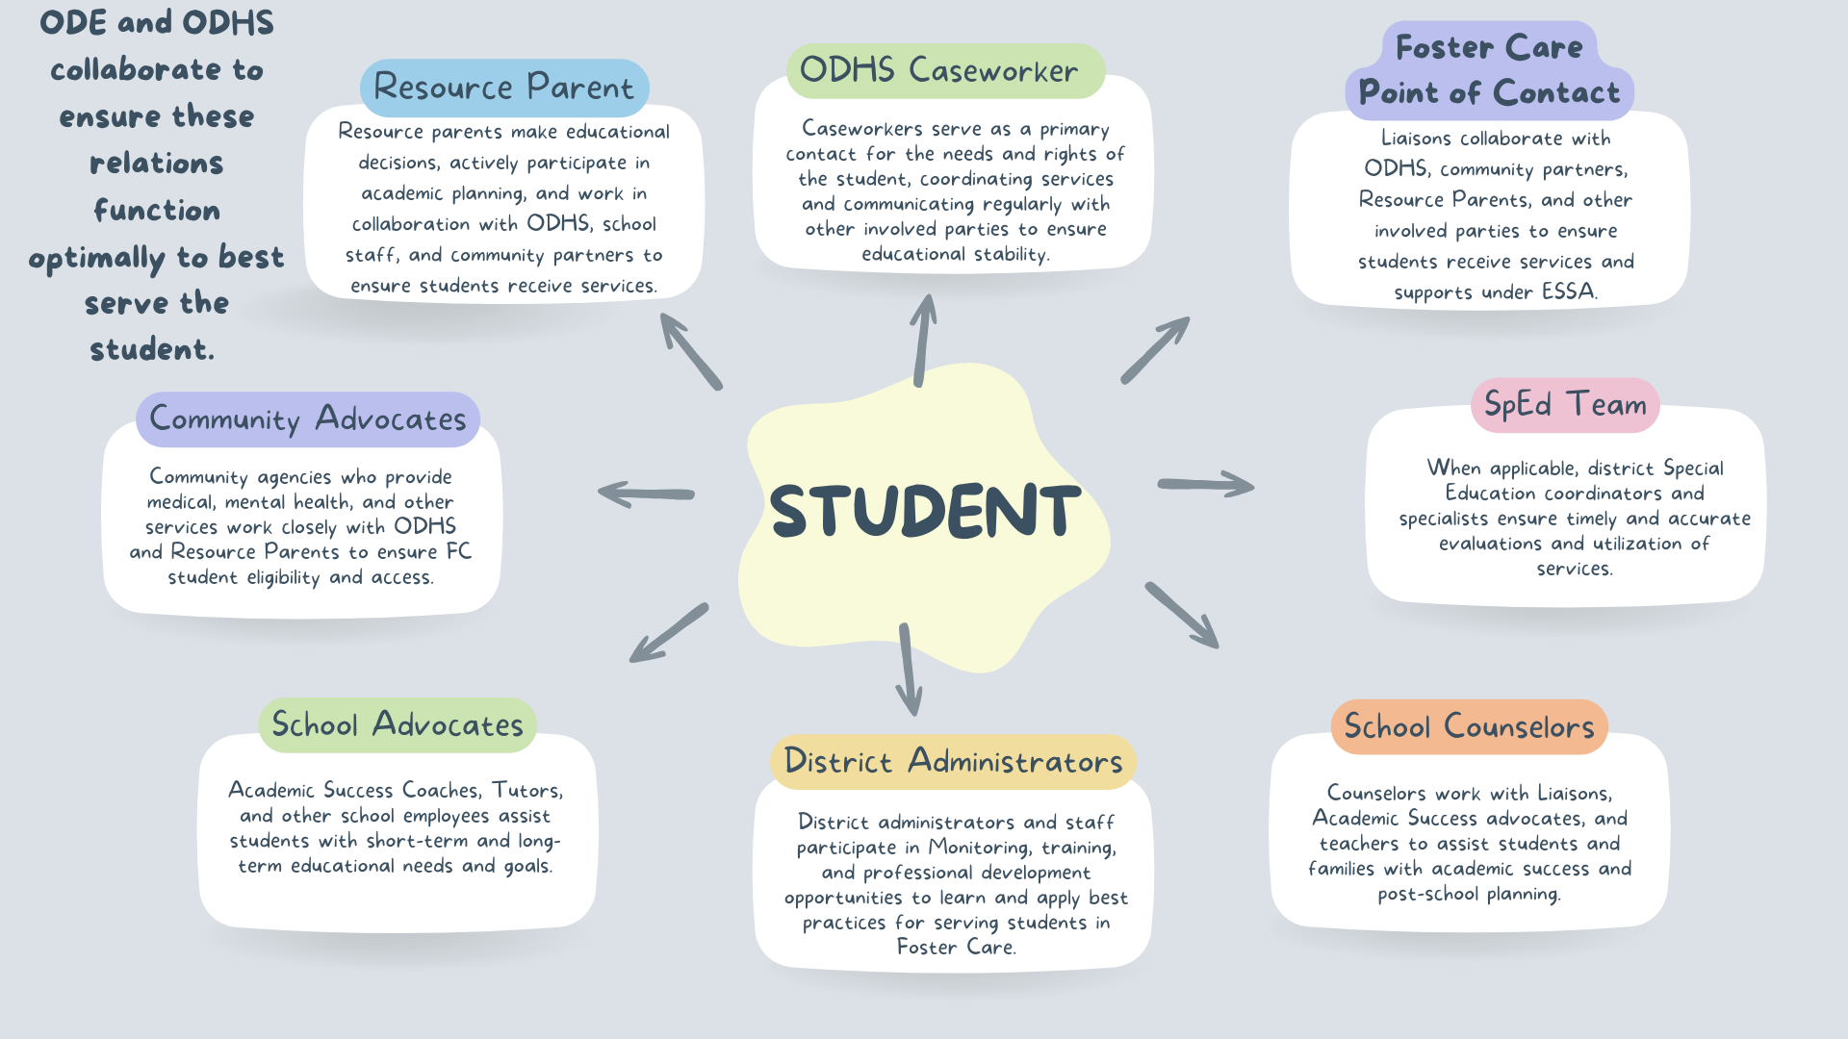
Foster Care Roles and Relationships

Slide 12

Strategies that Work
Regular training and collaboration between Title I-A coordinator, liaisons, and transportation staff
Involve liaisons in the creation of schoolwide, targeted assistance, and school improvement plans
Use data from a variety of sources to determine appropriate set-aside funding levels and activities
Include parents/guardians navigating housing instability and foster/resource parents in Title I-A family engagement activities to build capacity in supporting their children’s education

Slide 13
Imagine: The Power of the Title I-A Set Aside

Slide 14

Homeless Set Aside
All LEAs that receive Title I, Part A funds must reserve funds for services for students navigating housing instability
MV liaison must be included in determining the set aside amount
  Consider including transportation staff as well
Amount should be informed by data
If needed, carryover funds can also support MV eligible students
Notes:
ODE suggests that the LEA’s Title I, Part A Director and McKinney-Vento liaison work collaboratively to review data and determine the appropriate amount of Title I, Part A funds to set aside to meet the needs of students navigating housing instability. School-level staff should be included in the completion of the needs assessment whenever possible. LEAs are required to provide transportation supports to students and as a result districts are encouraged to include staff responsible for transportation logistics so that they can discuss routes/needs/costs/etc.
If an LEA is required to spend a specific amount of its Title I-A allocation each year for a specific purpose (e.g., family engagement), the LEA must meet that obligation. If it does not do so in the year for which funds were allocated, unspent funds must be carried over and spent for the specific purpose the following year. Because there is no requirement on how much must be spent on the MV set aside, districts are not obligated to carryover unspent MV funds. However, if circumstances change (e.g., natural disaster, additional students move into the district) carryover funds can be used to provide additional supports.

Slide 15
Governing Principles of the MV Set-Aside
The services must be reasonable and necessary to assist students experiencing homelessness to take advantage of educational opportunities (ED, 2017, p. 41)
The funds must be used only as a last resort when funds or services are not available from other public or private sources ( ED, 2017, p. 41)
Notes:
Example: birth certificates for McKinney-Vento students
https://www.oregon.gov/oha/PH/BIRTHDEATHCERTIFICATES/Pages/OrderBirthCertificate.aspx - Oregon
https://housingca.org/resources/community/individuals/get-ca-birthcert/- California

Slide 16
Possible Methods for Determining Set-Aside
Determine a percentage of the district’s Title I-A funds to reserve.
Multiply the number of students experiencing houselessness by the district’s Title I-A per-pupil allocation.
Match the amount of Education of Homeless Children and Youth (EHCY) subgrant dollars received by the LEA, if applicable.
Use an assessment of the needs, as well as the number of students navigating housing instability within the district, to determine the set-aside amount.

Slide 17
Needs Assessment
Questions to Consider:
  How many students are currently navigating housing instability?
  How many students received services in the past few years?
  What are the trends in your district/community?
Updated optional needs assessment worksheet now available!
Notes:
OPTIONAL TOOL
Guiding questions focused on capacity and needs
Much more detailed layout than the original version

Slide 18
Allowable Uses of MV Set Aside Funds
Clothing and shoes (to meet PE or uniform requirements)
Student fees that are necessary to participate in the general education program
Personal school supplies
Immunizations; medical and dental services; eyeglasses and hearing aids
Liaison salary costs
Emergency food and bottled water (especially for unaccompanied youth)
Counseling services to address anxiety related to homelessness that impedes learning
Outreach services to students living in shelters, tutoring services
Excess costs of transportation
If you are unsure of allowable uses, reach out and ask!

Slide 19

What to describe in CIP Budget Narrative
How funds provide direct services to students to remove barriers to engagement and participation in school
Additional partners or funding sources, if any, that are used to support students, in addition to the set-aside
Notes:
All districts must be prepared to support MV eligible students whether any are currently enrolled or not. This includes costs for free lunch and transportation to school of origin.
Liaison costs are allowable and encouraged, but set-aside should also clearly address individual student needs.
No “one size fits all” in terms of amount or support because every district’s context is different, however we may ask for additional information if the set-aside is small
Remember that MV eligible students in district sponsored charter schools should be supported through the set-aside

Slide 20
Foster Care Set-Aside (Optional)
“Additional” set aside section in the Title I-A CIP Budget Narrative
Allowable Uses*
  Provision of services for students experiencing foster care which may include excess costs for school of origin transportation
  Liaison salary costs
  Transportation for summer programming
  Necessary supplies for school or school activities
  Fee waivers (e.g., sports, testing)
  *Not an exhaustive list
Notes:
Costs to supports students experiencing foster care can be include in the “additional” set asides section of the CIP Budget Narrative. Many of the same allowable uses as MV apply. This is not an exhaustive list.

Slide 21

Changes to the Set-Aside should be made when…
More students require services than originally projected
New services or supports are implemented
Unforeseen events such as natural disasters or housing/community development infrastructures changes
Addressing monitoring resolutions
Changes in or additions to district contacts

Slide 22
Why it Matters
While students experiencing high mobility often have substantial needs and face unique educational barriers, Title I-A, McKinney-Vento, and Foster Care programs compliment each other by sharing the common goal of identifying and meeting the educational needs of these students.
Cross-program partnerships not only meet each program’s statutory requirements for collaboration, but have the potential to significantly improve the academic outcomes for students and youth.

Slide 23
Lean on Me: Resources and Supports

Slide 24
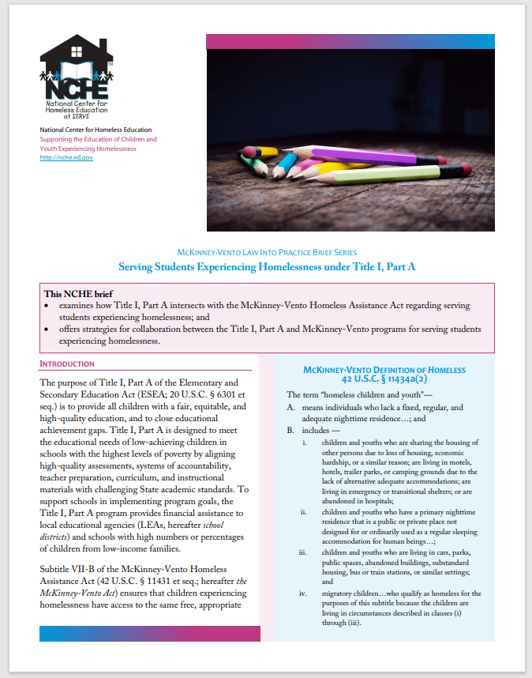
Resources – McKinney-Vento
USED Non-Regulatory Guidance
McKinney-Vento Subgrant Authorized Activities
National Center for Homeless Education (NCHE): Topics
ODE McKinney-Vento webpage
Serving Students Experiencing Homelessness under Title I, Part A (ed.gov)

Slide 25
Links and Resources – Foster Care
FactSheet_Class-of-2020-Juvenile-Justice-Overview_2023-04-25.pdf (ocid-cebp.org)
Legal Center for Foster Care & Education (fostercareandeducation.org)
Education+Outcomes+final-combined.pdf (squarespace.com)
LGBTQ+ Youth in Foster Care 2023 Fact Sheet (childrensrights.org)
Oregon Health Authority : Student Health Survey : Health Surveys : State of Oregon
ODHS School Notification Form
ODHS Transportation Request Form
Transition Time
Resource Parent Training
Foster Care Key Messages
Notes:
<1min

Slide 26

Please reach out!
Lexi Neemann, State Coordinator for Houseless & Unaccompanied Youth
  lexi.neemann@ode.oregon.gov
  571-208-1777
Marlie J. Magill, Foster Care State Coordinator
  marlie.magill@ode.oregon.gov
  503-580-4857
Jennifer Sappington, MV and Foster Care Transportation Support
  FosterCare@ode.oregon.gov
  OR-MV@ode.oregon.gov

Slide 27
Questions?
Notes:
15-20+min
Both

