Slide 1
IDEA Part B Application and MoE Compliance and Assurances
April 30th and June 4th, 2026
Office of Enhancing Student Opportunities
IDEA Fiscal Team
Notes:
Good morning, and welcome to the Office of Enhancing Student Opportunities training on the LEA IDEA Part B Application and Maintenance of Effort (MoE) Compliance and Assurances. Throughout this presentation the two Excel workbooks will be referred to as the IDEA Application.
This session is intended for staff who are responsible for submitting both.
My name is Tracy Hensley.
Heather Shinn is co-presenting with me today.
Thea Donovan is here to support answering questions.
Monitoring the chat and taking notes is Barb O’Neill.
We are Program Analysts on the IDEA Fiscal Team within Research, Management and Operations. Sheel Jagani is the Director of Research, Management and Operations within the Oregon Department of Education, Office of Enhancing Student Opportunities.
Today, we’ll provide an overview of the IDEA application, walk through the major components, and answer your questions.
This training is for you, so please feel free to ask questions at any time—either by raising your hand or typing them into the chat.
Please note that we will not be recording this session due to confidentiality considerations related to FERPA.
We will drop in the chat the link to the ODE District IDEA Applications and Assurances website with links to the 2026-27 IDEA Application: https://www.oregon.gov/ode/schools-and-districts/grants/spedfunding/pages/district-idea-applications-and-assurances.aspx

Slide 2
Webinar Agenda
About IDEA Application and MoE Compliance and Assurances
Timeline
Key Updates
  Subrecipient Fiscal Risk Self-Assessment
  Accessibility Features
Submission Forms
Making Corrections
Best Practices with Examples
Reminders
Notes:
These are the topics we will be reviewing today during our webinar:
About IDEA Application
Submission Timeline
Key Updates with subsequent slides covering
Subrecipient Fiscal Risk Self-Assessment
Accessibility Features
IDEA Submission Forms
How to Make Corrections
Best Practices of How to Label Correspondence and Documents with Examples
Final Reminders

Slide 3
About IDEA Part B Application and MoE
Local Education Agencies (LEAs) are required to apply annually to the Oregon Department of Education to receive IDEA Part B Funding.
LEAs submit IDEA Part B application and MoE Compliance and Assurances to the ODE through Smartsheet, an online software program.
LEAs are required to review and sign assurances to receive federal funding as well as submit other information required by the state (e.g., to funding elections, MoE budget, GEPA Section 427, and a subrecipient fiscal risk self-assessment.)
The IDEA Fiscal Team reviews and approves the district and issues a grant award notification to the LEA.
Notes:
About the IDEA application
Local Education Agencies (LEAs)/Districts are required to apply annually to the Oregon Department of Education to receive IDEA Part B Funding.
Districts submit their IDEA application to the ODE through a Smartsheet form, which is an online software program.
As part of the submission process, Districts are required to review and sign assurances to receive federal funding as well as submit other information required by the state that includes but is not limited to funding elections, MoE budget, GEPA Section 427, and a subrecipient fiscal risk self-assessment.
Following receipt of the IDEA Part B application and MoE Compliance and Assurances Forms, the IDEA Fiscal Team reviews and approves the district and issues a subgrant award notification to the LEA. Receiving a subgrant award notification (SAN) lets you know that your district has met the MoE eligibility requirement and your funds have been flowed through to you. This is separate from the MoE compliance requirement notification, which comes as an MoE determination letter in the fall.

Slide 4
Timeline IDEA Part B Application and MoE
Collection opened:
Thursday, April 30, 2026
Collection closes:
Monday, June 22, 2026.
Completing both can be a time-intensive task. Allow time for:
Collecting information and determining selections
Submitting both forms
Contacting ODE for questions
Receiving support prior to the submission deadline
Districts choosing to waive their IDEA funds must still complete both forms to formally indicate their decision.
Notes:
IDEA Part B Application and MoE open on Thursday, April 30, 2026, and closes on Monday, June 22, 2026.
We have a few tips:​
It is best not to wait for the last week to work on submitting both forms, completing the IDEA Part B Application and MoE can be a time-intensive task if a district does not have all the information readily available.
Please contact us with any questions early and often, it is important to receive support prior to the submission deadline.
Districts choosing to waive their IDEA funds must still complete both forms to formally indicate their decision.
Please respond to a call or email from us so we know you are working on completing the forms. We do not want anyone to be late – we do not want to hold up allocating district awards. Before the June 22nd, 2026 deadline we send out email reminders and begin calling districts who are have not submitted.

Slide 5
Summary of Updates in the 2026 LEA IDEA Part B Application
IDEA Award: As of April 28th, 2026, the ODE has not received the State IDEA Grant: IDEA Part B, Section 611 and 619 Award amounts are the 2025-2026 final awards.
Maintenance of Effort (MoE) Compliance and Assurances: Separate
Excess Cost Assurance: Removed
Risk Assessment: Revised
Accessibility Features: Expanded
Notes:
There are five key updates in the 2026 IDEA Application
As of April 28th, 2026, the ODE has not received the State IDEA Grant. The awards amounts displayed are the 2025-2026 final awards.
The Maintenance of Effort (MoE) Compliance and Assurances:
Will continue to be separate from the 2026 LEA IDEA Part B Application this year.
The Excess Cost Assurance was removed.
The assurance was added last year as the IDEA Fiscal Team consulted with our technical assistance partners on different opportunities to complete the Excess Cost Collection. The recommendation was to continue the Excess Cost Collection in the current format.
Risk Assessment
In consultation with our technical assistance partners the IDEA Fiscal Team is rolling out a new Risk Assessment. We will be taking a deeper dive into the new Risk Assessment later.
Accessibility Features – In compliance with state and federal law, accessibility features have been greatly expanded. We will be taking a deeper dive into the new accessibility features later.

Slide 6
What is the Subrecipient Fiscal Risk Self-Assessment
IDEA requires that SEAs evaluate each subrecipient’s risk of noncompliance with federal statutes, regulations, and the terms and conditions of the subaward to determine appropriate subrecipient monitoring activities (2 CFR 200.332(c)).
OESO uses this risk assessment to determine each LEA’s fiscal risk level, and is one aspect considered when determining the overall risk of a subrecipient related to IDEA Part B funds.
All indicators must be answered to be considered complete. Upon receipt, the OESO will review and validate specific risk indicators for completeness and accuracy.
Notes:
What is the Subrecipient Fiscal Risk Self-Assessment:
IDEA requires that every state agency evaluates each subrecipient’s risk of noncompliance with federal statutes, regulations, and the terms and conditions of the subaward to determine appropriate subrecipient monitoring activities (2 CFR 200.332(c)).
The Oregon Department of Education (ODE), Office of Enhancing Student Opportunities (OSEO) uses this risk assessment as a method to determine each LEA’s appropriate fiscal risk level, and is one aspect considered when determining the overall financial risk of a subrecipient related to IDEA Part B funds.
All indicators must be answered to be considered complete. Upon receipt of the completed risk self-assessment, the ODE OESO Team will review and validate specific risk indicators for completeness and accuracy.

Slide 7
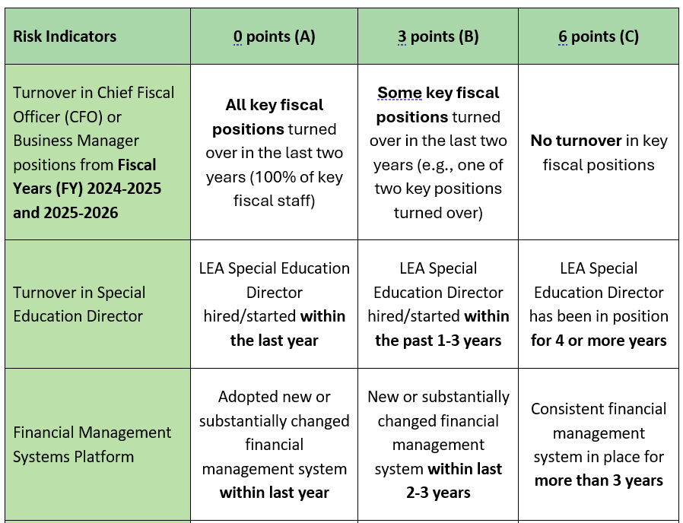
New Subrecipient Fiscal Risk Self-Assessment Overview, Part 1
Notes:
We have a new Subrecipient Fiscal Risk Self-Assessment for Fiscal Year 2025-2026.
The next three slides introduce the new Subrecipient Fiscal Risk Self-Assessment. We will share the Risk Indicators and then provide time for attendees to read through the them and ask questions.
These three indicators capture the longevity of fiscal systems in the district, including management and human capital systems.
The Risk Indicators are on the left, districts review the three options, A -0 points, B -3 points, C -6 points and select an answer. The score will display automatically. A higher score indicates less risk. ODE OESO will select districts for IDEA B focused fiscal monitoring based on the scores of this risk assessment.
Questions that have come up in previous presentations.
Regarding CFO or Special Education Director Turnover: If a person is new to their position or district it is considered turnover. Example, a Special Education Director is hired as a Special Education Director in a new district.

Slide 8
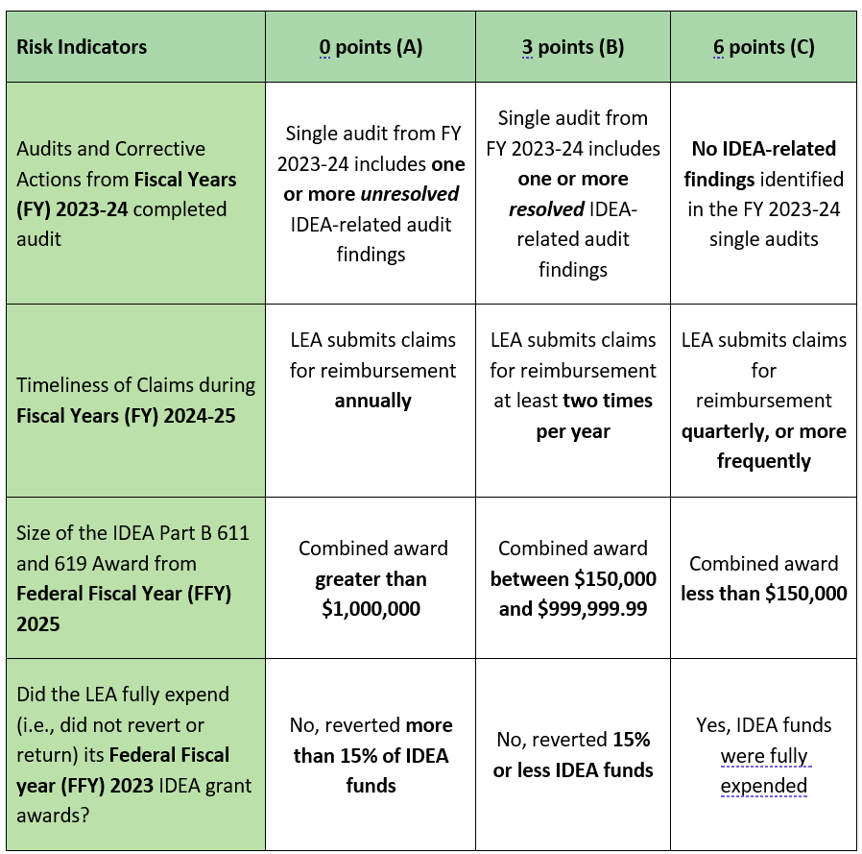
Part 2
Notes:
Here are the next four risk indicators, please take a moment to review and ask any questions.
These dive deeper into specific fiscal health indicators within the district and best practices for managing the IDEA B award.
Questions that have come up in previous presentations.
Timeliness of Claims during FY 2024-25: Refers to any claim across all active IDEA awards. If a district has 2023-24 and 2024-25 awards available for reimbursement in FY 2024-25, a district could be claiming quarterly across two awards once a quarter on 2023-24 award dollars for quarter one, and once a quarter on 2024-25 award dollars for quarters two through four.
Did the LEA full expend (i.e., did not revert or return) its Federal Fiscal Year (FFY) 2023 IDEA grant awards?: The IDEA grant dollars are no longer available for reimbursement after the award period ends. The least risk is associated with fully claiming all IDEA dollars awarded to the district.

Slide 9
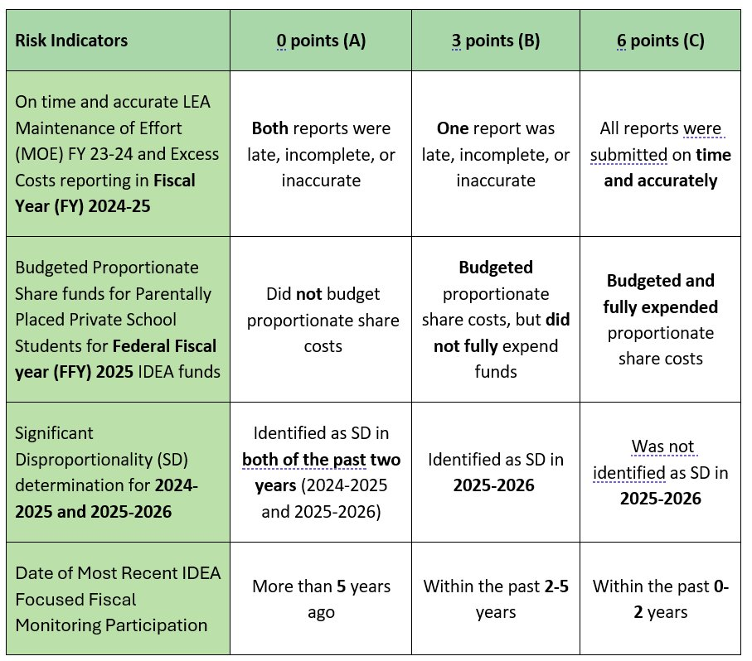
Part 3
Notes:
Here are the next four risk indicators, please take a moment to review and ask any questions.
Questions that have come up in previous presentations.
On time and accurate LEA MOE FY23-24 and Excess Costs reporting in FY2024-25: The LEA MOE FY23-24 report is submitting on time last year’s (2023-24) MoE Compliance and Assurance Form. Excess Cost reporting in FY 2024-25 is the Excess Cost Collection submitted January-March 2026.
Date of Most Recent IDEA Focused Fiscal Monitoring Participation: if a district was monitored within the past 0-2 years, they have undergone a focused fiscal monitoring recently and undergone corrective actions – if necessary, versus a district monitored more than 5 years ago, the current fiscal activities are less certain because they have not been reviewed in a while.
Budgeted Proportionate Share funds for Parentally Placed Private School Students for Federal Fiscal Year (FFY2025) IDEA funds: If you have zero students and you have a budget of zero, you receive 6 points (C). You have Budgeted and fully expended proportionate share costs.
On the next slide Heather will talk about our accessibility features

Slide 10
Accessibility Features
For Screen Readers
We removed most merged cells
Cell A1 and spaces intentionally left blank
Visual Support
Dropdown enabled cells have "(Select)" prompt
Increased cell margins
Better text contrast
*Column A Red/Green border
Signatures Tab Red/Green list
Notes:
Heather
Read slide then:
Removing merged cells changes the look of each page somewhat. Instructions may no longer centered above fillable fields like in the past.
Read slide then:
Blank cells are not blank. They have navigational information for screen readers. It is white text on white background for less visual distraction. They are not secret. If you click on a blank cell, you will be able to read its contents in the formula bar.
Read next items then:
Not new but Pages with a red border will turn green when every required selection is made. We are aware the border on the Fiscal assurances tab is not functioning correctly. It is an Excel issue that we are unable to fix at this point.
Signature tab has a list of tabs at the bottom of the page. Those should all be green if everything is complete.
Reach out if any other feature isn't working properly.
Then next slide we'll talk about how to submit your documents.

Slide 11
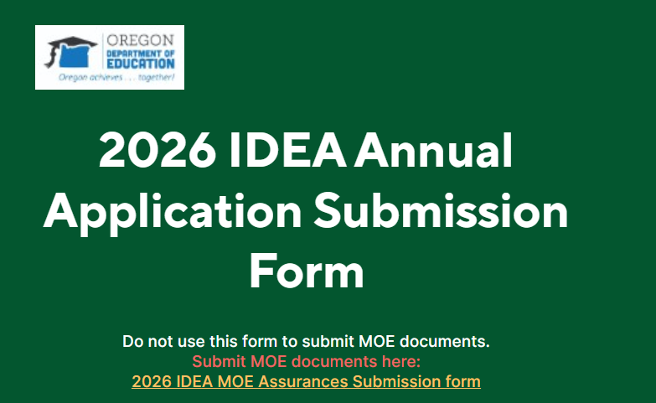
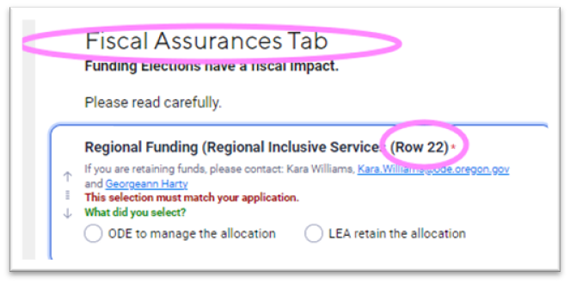

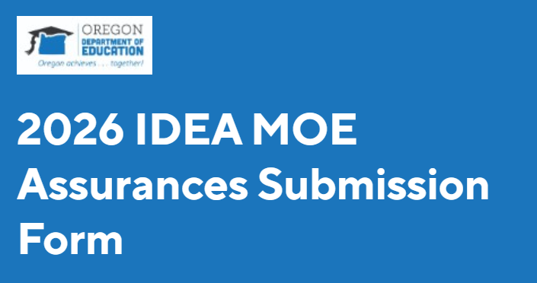
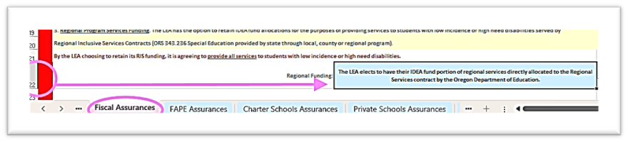
Submission forms
Example of guidance on a form to help find the item in the Excel workbook.
Notes:
Heather
Direct attention to the 2 forms snapshots on the slide. then:
The IDEA application and the MOE assurances have different Smartsheet (SS) submission forms that look like this.
Links to each form are located in their respective application excel document on the signatures tab.
Each form has information, guidance and instructions. You will be entering data points from the respective Excel document.
The submission form will tell you exactly where to look to find what information we want you to enter.
Direct attention to the example to locate the Regional funding selection. Then:
Apologies for the blurry images. Powerpoint wouldn't crisp them up.
The top image is from the Application submission form. It is showing that the following answers in this section are found on the Fiscal Assurances tab in the Excel document
It is showing that specifically Regional Funding is located on Row 22 in the Excel document.
The next image is a snapshot of the Fiscal assurances tab in the Excel document with row 22 circled and an arrow pointing the selection was made in the cell on that row.
Your submission creates a row on the respective SS.
Use the form only 1 time-otherwise it creates a new record that cannot be merged with a previous submission or moved to another Smartsheet.
Smartsheet still does not automatically save form progress.
Have your Excel document and any attachments handy so you don't have to pause for long periods.
In the next slide we'll talk about what else happens when you hit submit.

Slide 12
What Happens after Submission
Each Smartsheet alerts the IDEA Fiscal Team as new application or MoE submissions come in.
The first review pass is completed within a few days of receipt.
The fiscal review pass may take longer depending on what is found.
If corrections are needed:
We compile a list of application corrections before reaching out to districts.
We compile a separate list for MoE.
MoE Form:
Final determinations occur once all corrections and MoE process is complete.
Determination letters are sent out late fall.
Notes:
Heather
Read slide Green section then:
We try to review in the order received.
2. The first review pass, of Application or MoE submission, is to check for completion of all required fields and congruency of SS responses to the Excel document.
To cut down on how many emails you receive from us we try to clearly list the needed corrections. Then Read Blue Section
Read Burgundy section:
All application and MOE corrections must be complete
On the next slide we'll talk more about how to make corrections and what it looks like when we reach out to you.

Slide 13

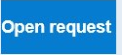
Making Corrections
The IDEA Fiscal Team will reach out to district contacts via regular email or a Smartsheet update request.
Smartsheet "Update Requests" look similar to an email, but under the body of the message will have a blue button to click near the bottom.
We do not send you the original documents to correct.
Districts correct their own saved copy and resave it as revised and attach the revised copy where indicated.
Notes:
Heather
Read the slide bolded section then
Regular emails you will reply like normal and attach documents to that.
However...Read to Blue button
Then: You will click that instead of normal replying
Anything you update or attach to that request goes with your record and sends us an alert. No need to email anything when using this feature.
Also know>Read the slide (after blue button) Then:
Another thing to remember:
Do not try to submit corrections through the submission form again.
Email the IDEA Assurances mailbox
With questions,
Forgotten documents if we have not realized it yet,
Or If Smartsheet features are not working properly.
On the next Slide We will talk about what happens when you click the blue button

Slide 14
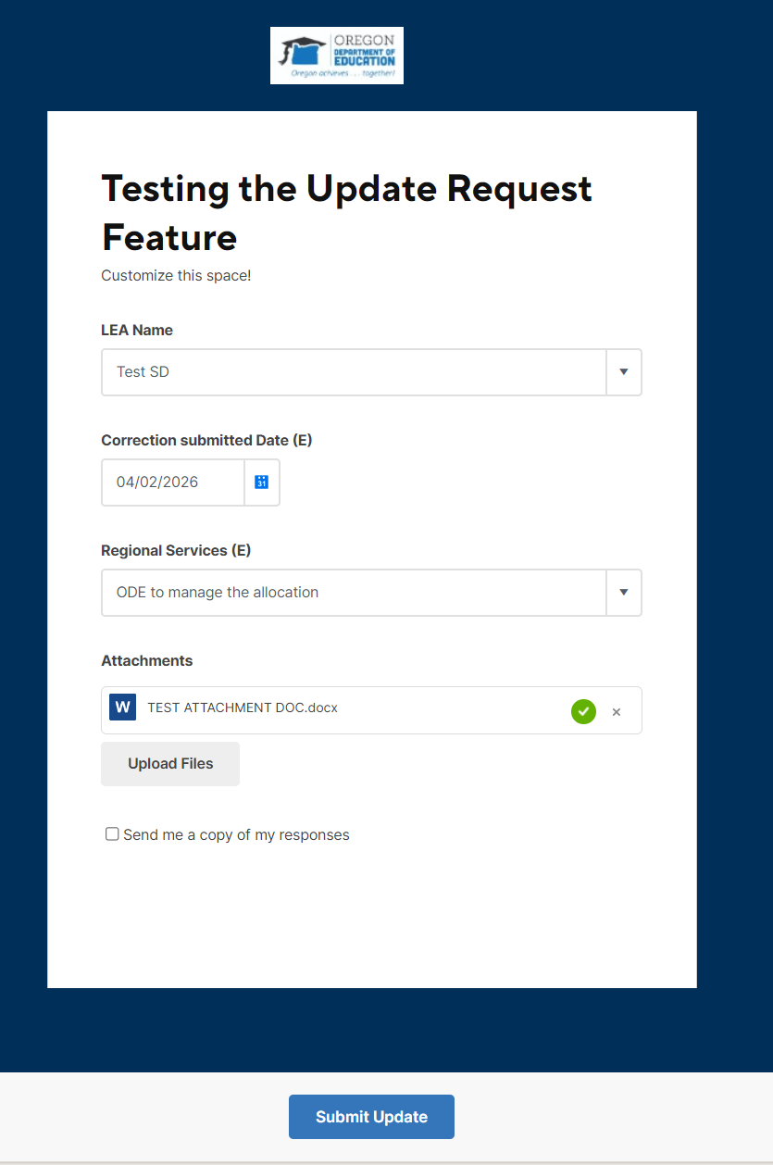
Making Corrections, part 2
When you click the button, a new page opens.
You will be able to see the requestors instructions.
Add a date.
If shown, make any changes to Smartsheet selections.
Attach any documents.
Click "Submit Update" at the bottom.
Notes:
Heather
Read slide then:
As mentioned, Smartsheet update requests are linked directly to your submission row. So the items you see in this window are based on smartsheet fields.
Read the slide to go over each feature.
Then:
We encourage you to check the box to send yourself a copy of your response for your records.
Sometimes we make mistakes too.
When we prepare a SS Update Request we have to select the SS items to include....such as "Attachment" or a field to change.
If we forget to do this and you are not able to complete all the instructions in the request, you can:
Forward the request alert email to the Assurances mailbox with your attachments attached to the email.
In the message body, let us know if you were unable to update SS form sections.
Give us explicit permission to update those on the SS for you.
On the next slide we will look at the best way name your files before attaching them

Slide 15
Best Practices with Examples
Document Naming
LEA Name first
Federal Fiscal Year
Email Subject line
LEA Name First
Subject
Revised Documents
LEA Name First
Doc title
Revised/corrected
(optional) +item name (if only one thing updated)
Title of doc
Dallas SD FFY 2026 IDEA App
Salem Keiser SD MoE Question
Klamath Falls City Sch FFY 2026 IDEA App Corrected Consents
Oregon SOS Records Management Basics Guide to file naming and organization
Notes:
Heather
Best practices for naming are found in the Oregon Secretary of State Records Management Basics Guide linked at the bottom of this slide.
The main thing to note: Start with your LEA Name
We get hundreds of emails and documents.
Leading with the LEA name helps us find specific items quickly
Use your official LEA name as listed in dropdowns.
Spell it out (mostly). Some brevity is ok if it will be universally understood. ie N. Douglas or S.Wasco or Klamath Falls City Sch.
(Next slide-Questions)

Slide 16
Questions
Notes:
Any questions?

Slide 17
Reminders
Application and MoE submission window: Thursday, April 30th-Monday, June 22nd
If you are experiencing issues with Excel please notify us.
Send questions to our ODE IDEA Assurances Mailbox: ODE.IDEAAssurances@ode.Oregon.gov
Please CC the person with the expertise you need:
Tracy Hensley | IDEA Fiscal Program Analyst (Lead) Tracy.Hensley@ode.oregon.gov | Excel workbook functionality and data tables. Application response, eligibility and approvals.
Heather Shinn | IDEA Fiscal Program Analyst Heather.Shinn@ode.oregon.gov | Smartsheet functionality and general questions application questions.
Sheel Jagani | Director of Resource Management & Operations Sheel.Jagani@ode.oregon.gov | General OESO fiscal team policy and procedure concerns.
Notes:
Thank you for coming today, we have a few reminders on the screen and contact information. We will be staying on the call to answer any questions you may have. We can also pull up the LEA IDEA Part B Application and MoE Compliance and Assurances if you have a particular question about any of the sections.

Slide 18
Thank You
Notes:
Thank you!

