Slide 1
Incident Command System for Schools
Presenter
Date
Conference/Meeting Name

Slide 2
Presentation Overview
Today’s Agenda
Before we begin
Purpose of the ICS
Structure of the ICS
ICS: Key Concepts
Where you fit into an ICS
Conclusion

Slide 3
Before we begin…
Coordination With Community Partners
Emergency management and first responders will be in your schools during an incident.
Prior coordination with them will ensure a smooth transition during an emergency.
Coordinate before an emergency happens so that first responders are not surprised by your school’s structure, environment or organization.

Slide 4
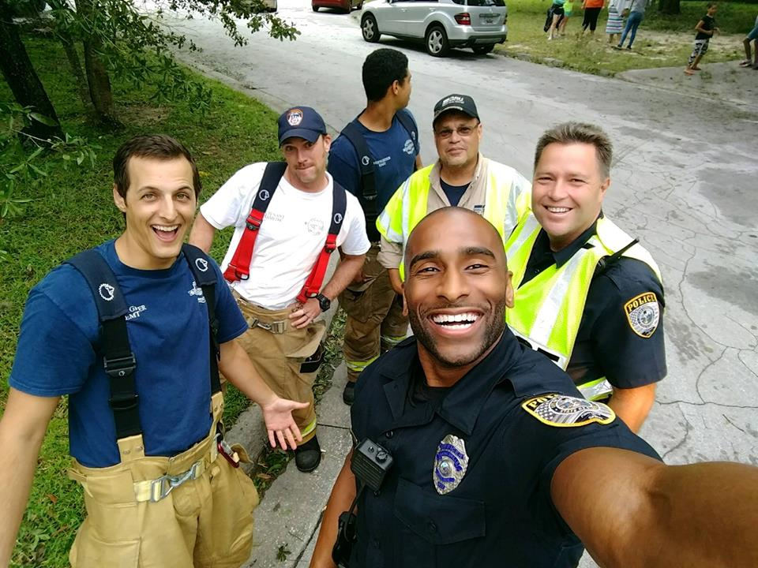
Purpose of the ICS
Incident Command System: Why?
Inadequate management is the leading cause of incident response failures.
Clear and definable command structure ensures unity of purpose during an incident.
The ICS is part of the National Incident Management System—part of a top-down approach.
The use of ICS is a requirement for all schools and school districts receiving emergency preparedness funding.

Slide 5
Structure of the ICS
Incident Command System: How it is structured
Incident Commander
PIO
Safety
Liaison
Operations
Planning
Logistics
Finance/ Admin

Slide 6
Structure of the ICS (explained)
Incident Command System: How it is structured
The ICS is adaptable and scalable—you only activate the sections you need.
The incident commander is responsible for the work of the sections that are not independently staffed.
The command staff assists and advises the incident commander.
Public information officer.
Safety officer.
Liaison officer.
The departments engage in incident response.

Slide 7
Structure of the ICS (Sections)
Operations Section
The operations section conducts the response.
Likely the first section that will be set up during initial response.
Planning Section
The planning section plans out the response.
Coordinates with the other sections for continued response.
Logistics Section
Responsible for supplying and providing function to the incident response.
Responsible for communications, transportation and supply staging.
Finance and Administration Section
The finance and administration section ensures the bills get paid and people get tracked.

Slide 8
ICS: Key Concepts
Unity of Command
Each person should only report to one supervisor to avoid confusion.
Chain of Command
There should be a clear line of responsibility to avoid command overlap.
Unified Command
When multiple organizations work together with independent commands they should work together to avoid conflicts of command.

Slide 9
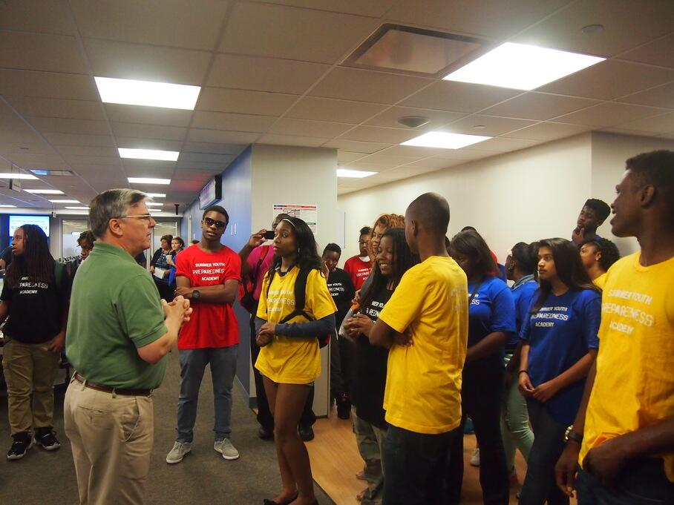
ICS: Keep in Mind
When an ICS is established for an incident or event in a school:
There is no correlation with the school administrative structure.
The ICS structure is different from the daily administrative structure in order to avoid confusion over whom you should take direction from.
The supervisors of the Incident Command should use the correct ICS titles; these will be different from their daily school position titles.

Slide 10
Where You Fit (into the ICS)
Initial Response:
Eventually, police, fire, emergency medical services or another external agency will manage response to the incident.
First response will be by the people in the building already: you!
You must act as a bridge from the time of initial response until first-responders arrive.
Consider:
ICS can also be used as an effective management strategy for non-emergency events.

Slide 11
ICS in Action (examples)
Incident Command System: What happens when…?
What happens when you have a missing student?
The principal may assume all roles in the ICS structure with only a couple jobs delegated to other staff members.
Probably don’t need to involve first responders just yet.
What happens when you have a fire in the building?
The principal may initially take command.
Teaching staff would be the operations section.
What other roles may be enacted before first responders arrive?

Slide 12
Conclusion
Federal Emergency Management Agency Resources
A brief (8-page) document that explains ICS in a school environment: https://training.fema.gov/emiweb/is/is100c/handouts/ics%20for%20schools.pdf
Additional training that covers the ICS in greater detail: https://training.fema.gov/is/courseoverview.aspx?code=IS-100.c

Slide 13
End on a Quote!
“The only way you are going to have success is to have a lot of failures first.”
-Sergey Brin (co-founder of Google) (supposedly)
Notes:
This is a joke. Let’s plan on not having any failures during an emergency response.

