Slide 1
Metro Area
Cooperating Educator
Orientation
As you enter, please sign in and take some dots to complete the consensogram charts located around the room.
Notes:
Consensogram examples:
I have worked in education for… (1-5 years, 6-10 years, 11-20 years, 21-25 years, 26-30 years, 31+ years)
I serve students in… (Primary Grades, Elementary School, Middle School, High School)
I have supported an educator candidate before (No - this is my first!, Yes - a couple times, Yes - many times!)

Slide 2
Welcome
Welcome
Introductions
Please share your name, where & what you teach,
if you’ve been a Cooperating Educator before
Agenda Overview

Slide 3

Markers Along the Journey
Markers Along the Journey
Think about someone you consider a mentor (or perhaps a composite of mentors) in your own life who made a positive impact on you.
Think about where you were, when the relationship occurred, who the person was, and what attributes made them effective.
Write down your thoughts.
Turn to a partner and share stories.
Be ready to share out/identify attributes of your mentors and impacts on you with the whole group.

Slide 4
Attributes of Effective Mentors
Attributes of Effective Mentors
Dispositions: Effective mentors are… | Knowledge: Effective mentors know how and understand… | Skills: Effective mentors have the ability to…
Lifelong learners Reflective about their own practice Committed to supporting the learning of others Respectful of their colleagues Problem posers and problem solvers Able to see, seek, and apply humor in appropriate ways even in challenging situations Able to recognize the positive impact of teaching philosophies and strategies that both include and differ from their own | Roles and responsibilities of mentoring candidates Necessary and available resources to support and enhance teaching and learning Organizational structure, policies, and practices of their school and community contexts Needs of candidates Conferencing strategies Coaching observation techniques Effective teaching strategies for all learners Curriculum they are responsible for teaching, including the full K-12 scope and sequence Various formal/informal assessment methods Ways to promote positive group interactions and communication (e.g., norms) Adult development Change process (e.g., Concerns-based Adoption Model) Cultural proficiency Various strategies to promote adult learning and reflection Different ways people process information, make decisions, and communicate thinking (e.g., Myers-Briggs Type Indicator, Keirsey Temperament Sorter) | Apply knowledge in developmentally appropriate ways when working with candidates Consistently demonstrate effective teaching, learning, and assessment strategies within their own classrooms Effectively manage and resolve conflict in their interactions with others Be consistently culturally proficient in their engagements with others whose backgrounds are different from their own Enroll others to participate in and support the mentor program Collaborate with and influence decision makers within their settings Use a variety of data sources to refine their practice – as teachers, mentors, and leaders

Slide 5

Attributes of Effective Mentors continued
Attributes of Effective Mentors
Highlight which attributes on the handout are also on your list.
What’s missing from your list that’s on the handout?
What’s missing from the handout that’s on your list?
2. Self-Reflection:
Plus sign (+) next to attributes you possess/are strengths
Delta ( ) next to attributes you’d like to grow/improve upon

Slide 6
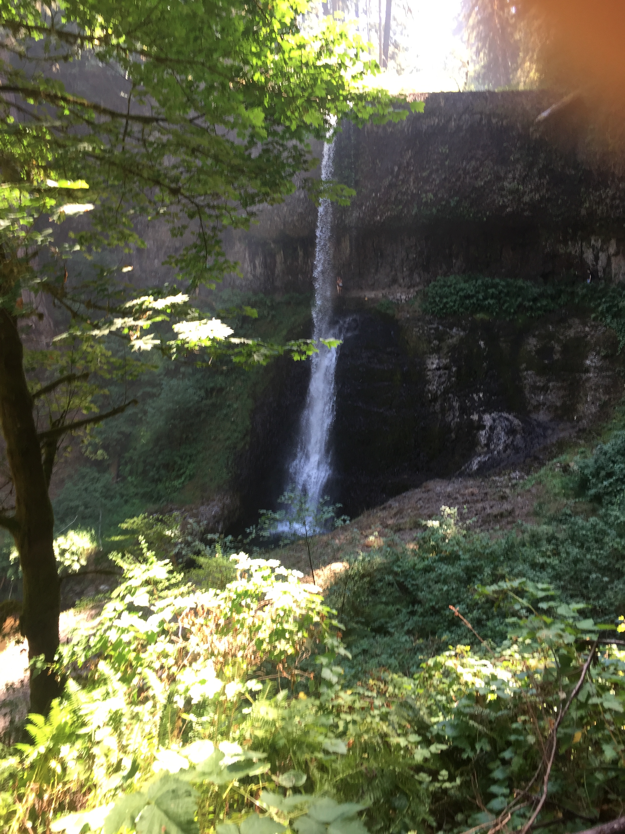
Building Trusting
Relationships
Share excitement about your work and the opportunity for growth for you both
Get to know each other (see Getting to Know You Tool)
Listen openly to needs & concerns
Provide assistance
Set goals

Slide 7

Culturally Relevant Classrooms
Environment
Student Interactions
Instruction

Slide 8
Equality/Equity
EQUALITY is everybody gets a pair of shoes
EQUITY means everybody gets shoes that fit
Culturally Responsive Education =
EVERYBODY gets shoes that match their style
Notes:
University representative share what CRT work is being done and what teacher candidates are expected to know/understand before entering a classroom.

Slide 9
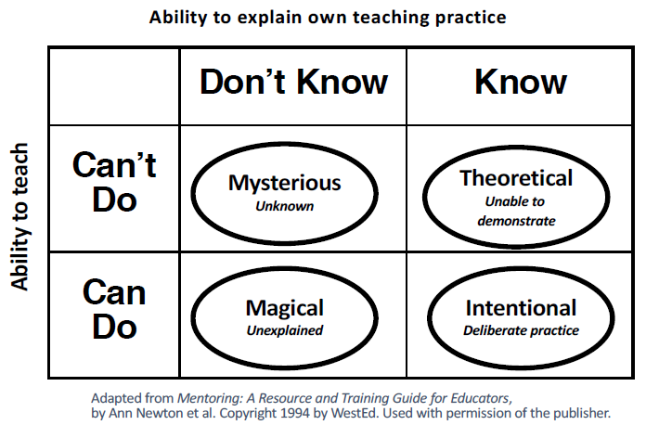
Window into Teacher Thinking
Window into Teacher Thinking
Adapted from Mentoring: A Resource and Training Guide for Educators, by Ann Newton et al. Copyright 1994 by WestEd. Used with permission of the publisher.
Notes:
Discuss what is meant by the diagram on “A Window onto Teacher’s Thinking.” which is also in their participant packet
Remember, a mentor’s or coach’s primary purpose is to help another teacher become more INTENTIONAL in his or her practice.
What is meant by "intentionality?”
1.When teachers do not understand or have the ability to perform a specific aspect of teaching, it is mysterious (unknown). These teachers are not aware of what contributes to a successful performance.
2.When teachers can understand or explain a specific instructional strategy, but lack the ability to perform it, their understanding is theoretical (unable to demonstrate). For instance, teachers may be able to explain what an inquiry lesson should be like but cannot implement such a lesson.
3.Conversely, when teachers are able to teach in a particular way (even masterfully), but are unable to articulate their reasons for why they do so, we refer to this situation as magical (unexplained). Such teachers operate on intuition, or may not remember what they figured out a long time ago. They may explain their practice in words such as, "I've been teaching for 25 years. I just teach.”
4.When teachers know what they are teaching, why they are teaching it in particular ways for particular groups of students, what they would do differently (or keep) the next time and why, these teachers are intentional (deliberate) about their practice.
**Remind the cooperating teachers to use their weekly meetings with the candidate to share their work
Second Level:
Where are the teacher candidates coming from? Will they always be in the same quadrant? How will you mentor them when they are in different quadrants?

Slide 10
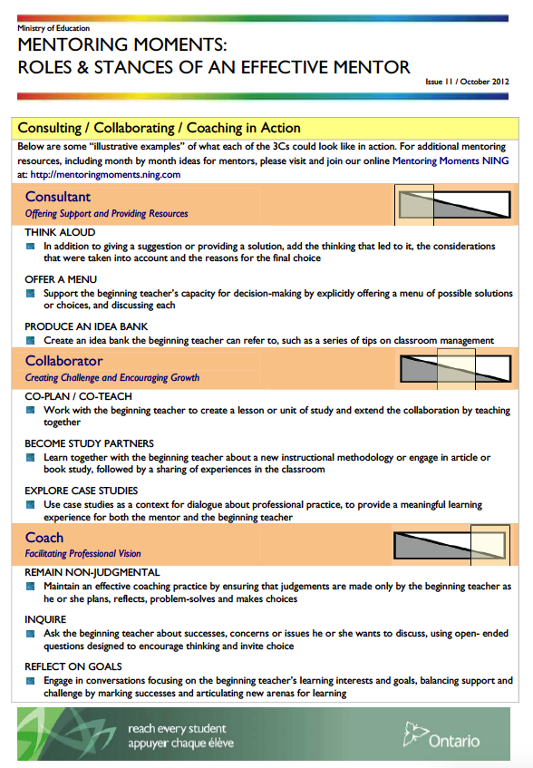
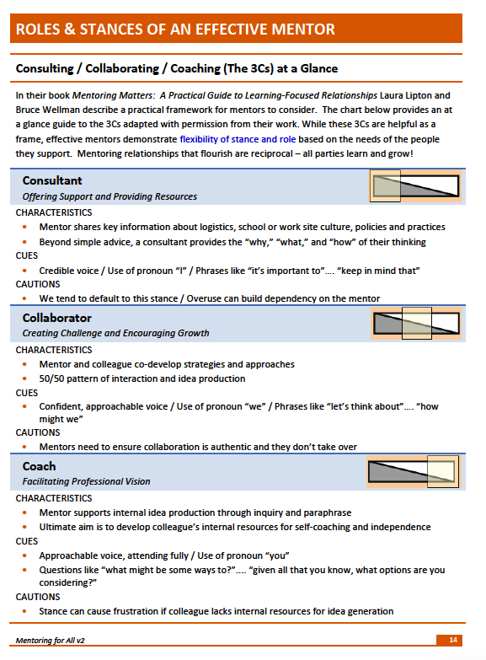
Mentoring Moments

Slide 11
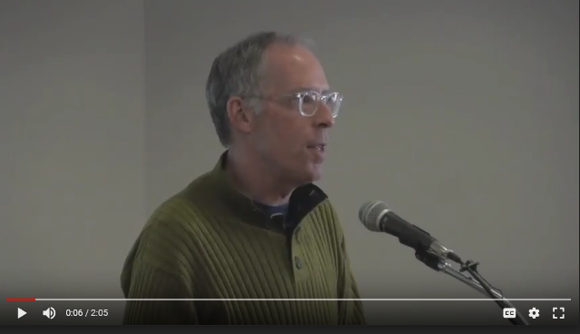
The Three C’s (Consultant/Collaborator/Coach)
Associate Teacher Partnership Project - Lakehead University

Slide 12
Mentoring Language Chart
Mentoring Language Chart
Paraphrasing | Clarifying | Mediational Questions
Paraphrasing communicates that the listener has… HEARD what the speaker said UNDERSTOOD what was said CARES Paraphrasing involves either: RESTATING in your own words SUMMARIZING Some possible paraphrasing stems include the following: So, … In other words, … What I’m hearing then, … What I hear you saying, … From what I hear you say, … I’m hearing many things, … As I listen to you I’m hearing, … | NOTE: WHY tends to elicit a defensive response Clarifying communicates that the listener has… HEARD what the speaker said BUT does NOT fully UNDERSTAND what was said Clarifying involves ASKING A QUESTION to: Gather more information Discover the meaning of the language used Get clarity about the speaker’s reasoning Seek connections between ideas Develop or maintain focus Some possible clarifying stems include the following: Would you tell me a little more about …? Let me see if I understand … I’d be interested in hearing more about … It’d help me understand if you’d give me an example of… So, are you saying/suggesting …? Tell me how that ideas is like (different from) To what extent …? I’m curious to know more about … I’m intrigued by …/I’m interested in…/I wonder… | Mediational questions help the colleague: HYPOTHESIZE what might happen, ANALYZE what worked or didn’t IMAGINE possibilities COMPARE & CONTRAST what was planned with what ensued Some Mediational question stems include: What’s another way you might …? What would it look like if …? What do you think would happen if …? How was…different from (like) …? What sort of an impact do you think …? What criteria do you use to …? When have you done something like … before? What do you think …? How did you decide … (come to that conclusion?) What might you see happening in your classroom if …?

Slide 13
MLC continued
Suggestions | Teachable Moments | Non-Judgmental Responses
“OPEN” suggestions… Are expressed with invitational, positive language and voice tone Offer choices to encourage ownership Are often expressed as a question (or include a “tag question”) to invite further thinking Are achievable: enough to encourage, but not to overwhelm May provide information about the mentor’s thinking and decision-making Suggestion Stems: One thing I’ve learned/noticed is … A couple of things to keep in mind … From our experience, one thing we’ve noticed Several/some teachers I know have tried a couple of different things in this sort of situation and maybe one might work for you What I know about _______________ is … Something/some things to keep in mind when dealing with… Something you might consider trying is … There are a number of approaches … Sometimes it’s helpful if … Try following suggestion with a question that invites the teacher to imagine/hypothesize how the idea might work in his/her context. How might this look in your classroom? To what extent might that work in your situation/with your students? What do you imagine might happen if you were to try something like that with your class? Which of these ideas might work best in your classroom? | Teachable moments are spontaneous opportunities that offer the mentor a chance to: Fill in instructional gaps Help the teacher make good choices/decisions Help the teacher to take “the next step” When taking advantage of a teachable moment, it’s important to: Share in the spirit of support Be brief: focus on the essential Be strategic Avoid using jargon or sounding pedantic (not talking down to them) Some possible stems include the following: One thing to keep in mind is … If you’re interested in _____, it’s important to … What I know about ______ is … It’s sometimes/usually helpful to _____ when … | Non-Judgmental Responses help to: Build trust Promote an internal locus of control Encourage self-assessment Develop beginning teacher autonomy Foster risk-taking Possible examples: Identify what worked and why I noticed how when you _____ the students really _____ Encourage It sounds like you have a number of ideas to try out! It’ll be exciting/interesting/great to see which works best for you! Ask the teacher to self-assess How do you think the lesson went and why? Ask the teacher to identify her/his role What did you do to make the lesson so successful? Listen Ask sincere questions Show enthusiasm for and interest in the teacher’s work and thinking I’m interested in learning/hearing more about … I’m really looking forward to … DANGER: Too much praise is detrimental

Slide 14
Making Teaching Transparent
Practicing with vignettes
Form pairs, assume role of candidate or mentor.
Read vignette - discuss
Mentor uses Mentor Language Stems
Identify Mentoring Stance & cite evidence
(10 min. each role, 5 min debrief)

Slide 15
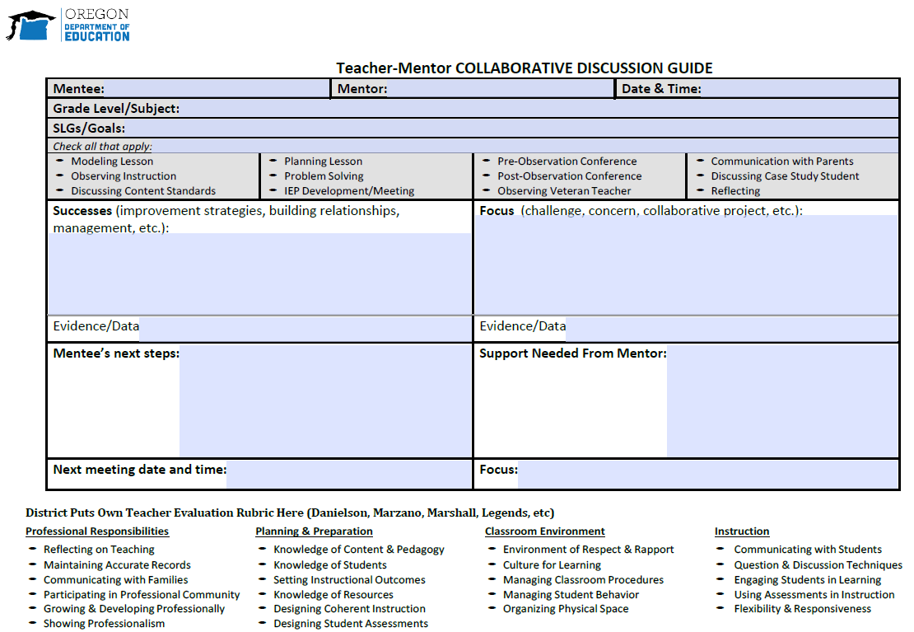
Teacher Mentor CDG

Slide 16
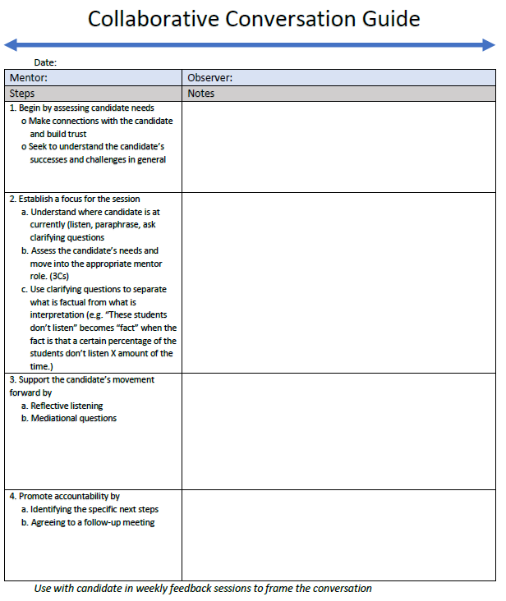
CDG continued

Slide 17
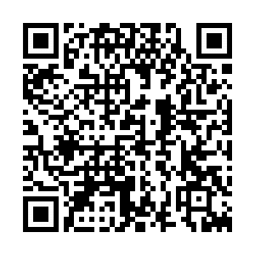
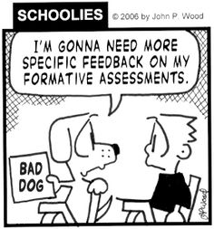
Feedback & Next Steps
bit.ly/MAPP-feedback

