Slide 1
GROWS MODEL
FOR MENTORING PROBLEM SOLVING
Adapted with permission
from
Ohio Education Dept.

Slide 2

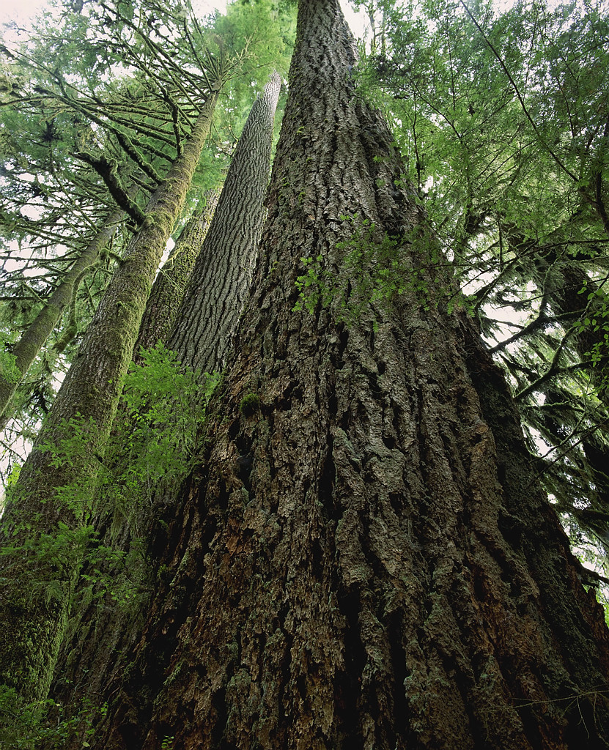




The GROWS Model
Goal
Reality
Options
Way Forward
Summary
Notes:
Introduce the GROWS model: The GROWS model is a way to shape every conversation with your Admin. Mentee.
Refer to the Handout: Mentoring Performance Checklist (GROWS Model section).
Explain that we will go over each letter in a moment.

Slide 3
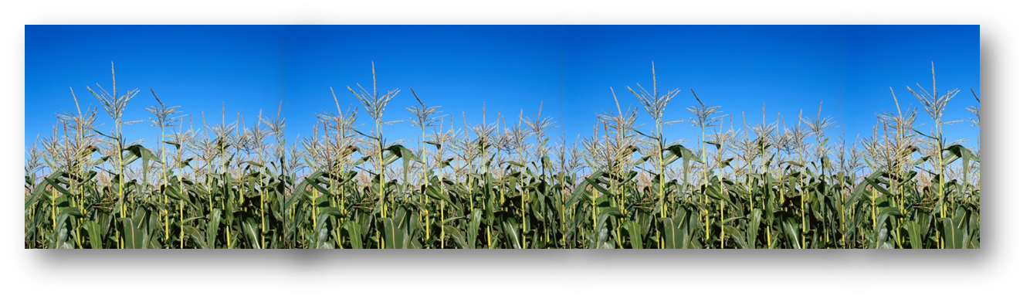
Purpose of the GROWS Model
Provides a “systematic” structure for mentoring conversations
  Each letter in sequence
  All letters in each conversation
Helps mentors guide mentee’s own problem-solving and decision-making
Help IPPs GROW as independent leaders!
Notes:
Present:
Systematic structure - This is a model you can use in almost EVERY SINGLE one of your mentoring conversations. It provides you with a context and structure to help focus your discussion toward outcomes.
Each letter in the acronym represents part of your conversation.
Because it “systematically structures” mentoring conversations, this means that mentors should move through each letter in sequence, and all letters should be covered to a greater or lesser extent in each conversation. For example, you may spend the first 45 min of an hour-long conversation just defining a clear, useful “goal.” That’s ok and you should bring as much clarity to the “”G” portion of your conversation before moving on and sharpening the focus of the conversation even further by discussing “R” for the reality of the problem at hand, “O” for your available options, “W” for your chosen way forward, and “S” to action step and summarize—even if the R-O-W-S parts of the discussion must take place in your few remaining 15 minutes.
Guides problem-solving and decision-making – Support the mentoring role as “facilitator” and helps avoid advice-giving, talking about what you once did in a similar situation, or solving problems for the new principal. All of that is fine in some instances, but your main objective in mentoring is to develop THE NEW PRINCIPAL’S ABILITY to arrive at sound conclusions by carefully processing the options and gaining a sense of wisdom.
Growth and independence – By mentoring using this model, the mentor helps the new principal learn new skills and work toward career metrics, including learning the skills and tapping into the internal guidance needed to make independent decisions and solve problems.

Slide 4
Slide 4
Goal
Agree on a goal that addresses the basic problem.
Focused
Specifically addresses one identified problem
Outcome-oriented
Rather than what you don’t want, state in affirmative language what you do want
Positive
What should be
Notes:
Present the slide.
Revisit one of the mentee’s problem situations that volunteers have already shared in previous Needs of Beginning Principal’s (Topic 2) exercises.
Option: Ask another mentor to provide a new mentee’s problem situation.
Option: Prepare some problem situations ahead of time to present as options for this exercise.
Facilitate the person or partners to formulate a goal that is focused, outcome-oriented, and positive.
Bring out these points as you facilitate the goal statement:
Asking simple questions helps the mentee to figure out the main problem and a goal that will specifically address it. Mentees will start out with a whole bunch of problems. They will need help sorting them out in order to “sift out” the main problem and a goal to address it. The key is to get the person to FOCUS and to facilitate them out of drowning in the details of several different, related problems.
You’re final goal statement should describe “What should be—what you wish was happening now, but isn’t.”
It should always be stated in positive, affirmative language.
The mentee will tend to vent about the various issues surrounding the problem. That’s ok. But once they’ve communicated the details, it’s time to help them get focused and results-oriented about the main problem and the desired goal. So, goal definition is a collaborative, results-oriented process.
Record the participant’s or pairs goal statement or statements (volunteers) on the flipchart.
Ask: Is this goal focused? Is it outcome-oriented, describing what should be? Is it stated in positive language?

Slide 5
Slide 5
Goal Example
Mentee: (obsessively): I need to discipline a teacher that everyone loves. I don’t want to hurt Mrs. Smith’s feelings and I don’t want others to be mad at me.
Mentor: Sounds like you’re really conflicted. Is that accurate? Could there be some fear on your part about being the bad guy?
Mentee: Yes, definitely.
Mentor: Well, what would you like this situation to look like in the end?
Mentee: I guess I have to begin a Professional Development Plan. But also, so many of the teachers…I think there’s a morale problem too.
Mentor: Maybe there is. But let’s go back to the discipline issue for a moment. By taking those development steps, what will it look like when you know the steps worked? What’s your goal here?
Mentee: I just want her to stop dropping the ball!
Mentor: How can you say this more specifically and in positive language? In other words, what exactly should be happening?
Notes:
Present examples:
The mentee says that she needs to discipline a teacher that everyone loves. The mentee, in an almost obsessive manner, talks on and on about her conflicted feelings with regard to this matter.
The mentor might use some reflective questions to begin directing her into a focus, such as, “Sounds like you’re really conflicted. Is that accurate?” Followed by the question, “Could there be some ‘fear’ on your part about being the bad guy?”
Additional questioning would continue to drive the conversation toward a constructive focus: “Well, what would you like this situation to look like in the end?” Ultimately, what is your goal here?”
The mentee might say, “To have her stop doing XYZ!”
You would then guide the goal statement in a more positive direction and encourage the mentee to state what she does want to have happen. The mentee might say then, “To have her do ABC.”
You might then probe to find out what the mentee can do to that end. The mentee might say: “To develop the teacher.”
You might continue using strategic questions to get to the goal, “Developing the teacher is pretty general, but I think we may be heading in the right direction. What would you do, specifically, to develop the teacher?”

Slide 6
Slide 6
Goal Example
I think…what should be happening is…the goal is…Mrs. Smith will perform at the proficient level on all teacher standards consistently.
Notes:
Emphasize: Clarifying goals in a mentoring session could take the entire session, before you even get a chance to move on to the next stage of the GROWS model. That’s ok. You should not move on before getting as far as you can with the previous stage/letter first.

Slide 7
Slide 7
Reality
Describe the current reality (context) of the problem.
What IS going well
Possible root causes
What is NOT going well
Notes:
Present: Reality refers to defining the key parts of the problem, plus looking at situations in which the goal has been met, to any degree. Then you can look at both parts to the reality and ask: What is causing the undesired outcome(s), and what is causing the better outcome(s)?
Present example:
Perhaps there are too many referrals overall each month. That is what is NOT going well.
But then look at what IS going well: Are there teachers who hand out very few referrals? Were there months in which referrals were lower?
Take some time to look at both situation and ask: Why? What is causing the undesired outcomes and what is causing the better outcomes? What can we learn from this type of consideration?
Facilitate participants or pairs to describe the current reality of the problem they described earlier, when talking about Goals.
Record what is not going well, what is going well, and some possible causes of both.

Slide 8
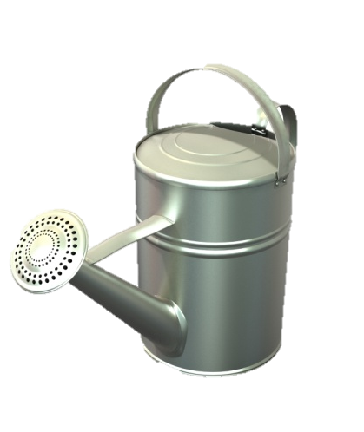
Slide 8
Options
Identify the possible ways to achieve the goal.
  What you’ve already tried and how each worked
  Various options and what to consider:
    Benefits and downsides of each option
    Likelihood of success for each option
    Factors which would impact the success of
    each option
  Additional options if obstacles were removed
Notes:
Present the slide.
Facilitate the large group to develop some optional ways to achieve the goal recorded on the flipchart.
Record the list of options on a flipchart.
Discuss the various considerations for each option as a large group.
Record notes on the flipchart beside each.

Slide 9
Slide 9
Way Forward
Review all factors and considerations.
Pick the best option for going forward and achieving the goal.
Notes:
Present: By examining your current reality and systematically exploring the various options, your mentee will now have a good idea of how he or she can achieve the goal. Now it’s time to pick the best option, or most workable way forward.
Facilitate the large group to identify the “best” option(s) for achieving the goal you recorded earlier on the flipchart.

Slide 10

Slide 10
Summary
Recap the conversation.
Notes:
Present: Finalize the meeting by recapping everything you talked about in the conversation.
Summarize what you and the large group have worked on through the GROWS process. For example:
So far,
we’ve identified a goal, talked about the reality and context of the problem,
generated some optional ways to approach the goal,
chose the best option.
Now it’s time to put together an action plan, or at least discuss next steps.

Slide 11

Slide 11
Summary cont.
Identify next steps/checkpoints and put dates to them.*
  List the steps from here to your goal
  Add end dates/date ranges for each step, if it makes sense
  Include strategies and a list of individuals or resources the IPP may need to connect with, in or out of the school system, to
  carry out the action plan and achieve the
  outcomes
*Could be full plan OR just next steps
Notes:
Present: Finalize the meeting by identifying next steps and putting a timeline on them. This could be a full blow action plan. Or, it could just be the very next thing you’re going to do to work toward goal achievement, such as:
When can you send me your action plan so we both know what you’re working on?
When can we touch base again?
What is your next step?
Can you summarize where you are right now and what you want to do next?
How can I help you connect with the individuals and resources you need?
Facilitate the large group to action plan the “best” option they chose in the last step for achieving the goal. Ensure the plan includes steps, dates, and needed resources.
Record the action plan on a flipchart.

Slide 12
Slide 12
Summary cont.
Identify next steps/checkpoints and put dates to them.*
  List the steps from here to your goal
  Add end dates/date ranges for each step
  Include strategies and a list of individuals or resources the mentee may need to connect with, in or out of the school system, to
  carry out the action plan and achieve the
  outcomes
*Could be full plan OR just next steps
Notes:
Refer to the issue of individuals and resources the mentee may need to connect with: This is an important part of your role as mentor.
Explain further on next slide.

Slide 13

Slide 13
Key Ideas About Resources
Partnerships are key.
Tied to Oregon State Leadership Standards.
Invite the mentee to events and groups that you are in.
Encourage mentee to reach out to others and not get isolated.
  You need internal resources* to “get things done around here.”
  You need external resources* to explore and learn from diverse experiences.
*Resource: Could be an expert or peer; could be person or other type of resource.
Notes:
Present:
Partnerships are key.
Tied to Leader Assessment of Performance Standards (LAPS) .
Invite the IPP to events and groups that you are in. Take them with you to businesses and business groups so they understand their communities better.
Encourage IPP to reach out to others and not get isolated.
You need internal resources to “get things done here.”
You need external resources to explore and learn from diverse experiences.
A resource might be an expert or just somebody else who is in the same boat.
This can be tied into trust building—when you trust someone with a valued connection or resource, they in turn will trust you more

Slide 14
Slide 14
Key Ideas About Resources
How can
resource-sharing build trust between you and the mentee?
Notes:
Ask the large group the question on the slide.
Suggested Response: When you share resources—or anything of value—with others, this requires trust. When you entrust another person, this creates a bond in which the trust becomes mutual. So, when you trust an mentee with a valued connection or resource, they in turn will trust you more.

Slide 15

Slide 15
Pair and Share About Resources
What connections do you currently have that would be helpful to the new mentee?
What types of resources did you find helpful, or would you have found helpful, as a new principal?
What steps will you take to connect mentee to other
people and resources?
Notes:
Time: 3 minutes
Tell participants to choose a partner from the SAME school system and share about the questions on the slide.

Slide 16

help
Summary cont.
3. Elicit feedback from the mentee. Examples:
  Did this conversation help?
  Has this mentoring process been helpful for you?
  What can I do to help you?
Notes:
Present:
Finalize the meeting by eliciting feedback from the mentee.
The slide lists the types of questions you might want feedback about from the mentee.
Ask participants.
So, did our large group discussion regarding your goals help?
Was the facilitated thought process we went through helpful for you?
What other help do you need now?
How can I help?

Slide 17






GROWing as You Go
Goal
Reality
Options
Way Forward
Summary
Notes:
Point out that GROWS is a model for structuring each interaction you have with mentees, but it also represents change over time. Both you and the mentee will be developing as you proceed along your mentoring journey together.

