Slide 1
9th Grade on Track & Data Literacy Oregon Department of Education August 29, 2019

Slide 2
Presentation Overview
Today’s Agenda
9th Grade on-Track Support
Why Data?
What Data?
Using Data?

Slide 3
Why is 9th Grade on-Track Important?
A 9th grader’s chances of graduating on time decreases by 30% for every full-year course failed.
9th graders on-track are 4x more likely to graduate on time.
“Those who fail just one or two classes in 9th grade are at higher risk of never graduating. In fact, 9th grade performance is a better predictor of who eventually will graduate from high school than either 8th grade test scores or background characteristics such as gender, race, and economic status.”
– The University of Chicago Research Brief, April 2014

Slide 4
How Can We Support 9th Grade Students?
Develop relationships with students
Interests, family life, hobbies, connect with other adults to determine what has worked
Dedicated time for teachers to discuss data and create intervention strategies
The end of the semester is too late.
Create a system that involves parents and gives them access to grades and attendance
Check grades every 6 weeks at a minimum and devise immediate interventions for those falling behind.
Think: What will be done differently in the 1st 6 weeks of school to ensure success?
Track daily attendance and intervene as soon as students are below your targeted %
Students with out-of-school suspensions are at a greater risk of not graduating
Look for ways to give authentic praise and encouragement
Schedule flexibility, students failing may need support class built in their schedule
Assign a mentor to those most at-risk
Examine your equity practices, looking for barriers for underrepresented students
After school tutoring
Don’t Give Up— kids want to know that YOU care

Slide 5
What Resources Are Available to Support the Implementation of your 9th Grade on-Track Work?
The University of Chicago’s 9th Grade on-Track Toolkit
Includes tools, model videos, and many additional resources
The Make-or-Break Year by Emily Krone Phillips
The Center for High School Success
Better Together

Slide 6
How Can We Get Creative with the School Schedule so Teams Can Meet Consistently?
Advisory Time
Late Start
Early Release

Slide 7
Who Else is Doing this Work?
Multiple districts are working with the Center for High School Success and using the Chicago model
Centennial School District has given 9th grade teachers extra prep periods to conduct 9th Grade on-Track meetings
Multiple districts have found success with 9th Grade on-Track and are expanding their efforts to 10th-12 grades
Look for Districts and Charter Schools highlighted in the High School Success Newsletter
If you are having success and want to share your strategies, please share your experience with us so we can highlight your school/district in an upcoming newsletter!

Slide 8
High School Success Data Use Using data to help identify gaps and inequities in our system

Slide 9
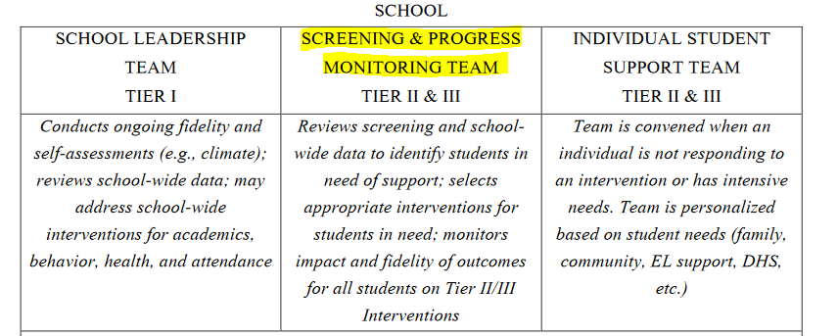
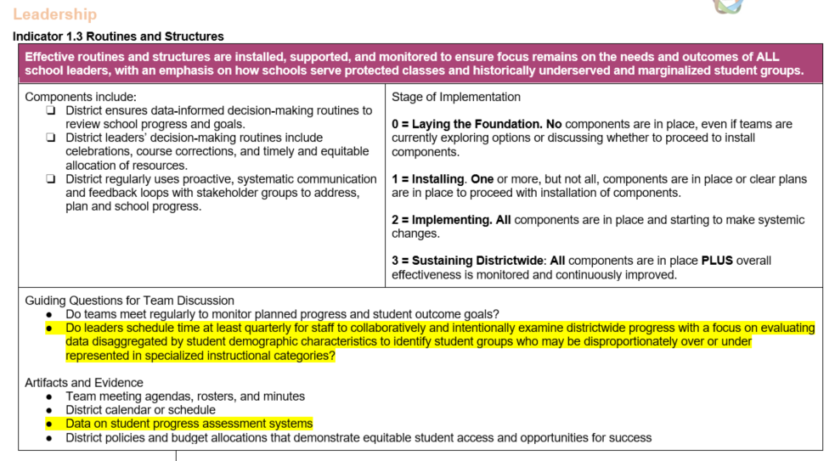
Initiatives
The use of data in district and school improvement efforts overlap the High School Success initiative, other initiatives such as Every Day Matters, Perkins/CTE, the Oregon Integrated Systems (ORIS) Framework Needs Assessment, and the Student Success Act (SSA). All highlight the need to have teams review data on a regular basis, both aggregated and by student population, to ensure the most underserved and vulnerable populations receive the supports needed to succeed.

Slide 10
High School Success – How Does Data Fit In?
High School Success requires the evaluation of middle and high school data on student attendance, participation, and outcomes to increase student retention and graduation rates.
Chronic Absenteeism
9th Grade on-Track
Four and Five Year Cohort Graduation and Completion Rates
Dropout Rates
CTE Participation/Concentration
Dual Credit Participation
All data points are disaggregated by student population to determine if there are groups that are disproportionately affected.

Slide 11
Connecting 9th Grade on-Track with High School Success
Eligibility Requirement to be “fully in place” by the end of the 2021 school year
Fully in place = meeting quarterly, monthly, every other week, or weekly
Specific to High School Success Law– a school district or charter will “provide sufficient time for teachers and staff of students in grade 9 to review data on students’ grades, absences and discipline by school and by course and to develop strategies to ensure at-risk students stay on track to graduate.”

Slide 12
What Data are Available to Districts Using data to help identify gaps and inequities in our system

Slide 13
Data Available to Districts via the Achievement Data Insight Application
When developing plans to implement initiatives or improve schools, there are a number of different data that can be looked at.
All data that are submitted to the ODE by the district/school, including:
Attendance/Membership (Cumulative ADM Collection)
Includes demographic variables
Class Size/Enrollment (Class Roster Collection)
Graduation/Dropout Status
Teacher/Staff turnover (Staff Position collection)
Special Education student count
English Learners
Discipline
Teacher Experience
CTE student participation/completion
Ninth Grade On Track
Student Mobility

Slide 14
Available Data Reports
Report Card Data produced by ODE
Individual Reports produced by ODE
Assessment Data
Special Education Report Card
TELL Survey Results
School Climate Surveys
Oregon Healthy Teens Survey

Slide 15
High School Success Data Sheets
Data sheets with information specific to High School Success plans have been created. Each district has its own sheet, with information such as graduation rates, 9th grade on-track, absenteeism, SBAC results, AP/Dual Credit enrollment, HSS funding, etc.
The sheets can be made publicly available.

Slide 16
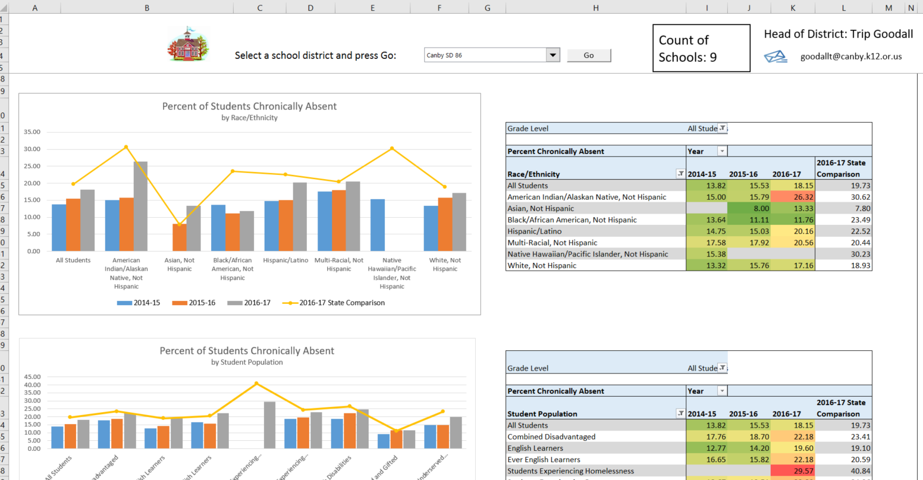
Chronic Absenteeism Data Dashboard
Data dashboards focusing on Chronic Absenteeism, with individual student populations over a three-year span have been created.
This dashboard can be downloaded here.

Slide 17
How Data Can be Used to Support Student Success
Questions to Consider:
Data Quality – How reliable is the data in your systems? Data Capacity – Does your staff know how to effectively utilize data? Data Culture – Is there buy-in amongst staff to use data for decision making?

Slide 18
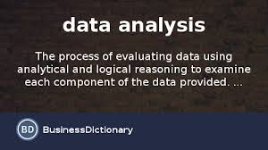
Data Can…
Provide historical trends to assist in establishing goals
Highlight what is working well within a system
Reveal areas of need
Move schools & districts from anecdotal to explicit evidence
Detect students at risk for being off-track

Slide 19
Data is Great! Where do we Start?
Develop teacher collaboration round data, beginning at the 9th grade level
Administration, Counselor, Teachers, Instructional Aides, Others
Representative of Skill Sets
Technical, organizational, interpersonal, etc.

Slide 20
First Steps
Data Inventory
What data do we have, need and want?
Where does the data live?
How often is it gathered?
Who has access to the data?
What tools are available to report the data?

Slide 21
We Have Data – What’s Next?
What does your data tell you?
How do student outcomes differ by demographics, programs (processes), and schools?
Have specific programs (processes), interventions, or systems improved outcomes?
How do absences and mobility affect outcomes?
What are the characteristics of students who are achieving? Of students who are not?
Are there achievement or equity gaps?

Slide 22
Indicators and Interventions Using data to help identify gaps and inequities in our system

Slide 23
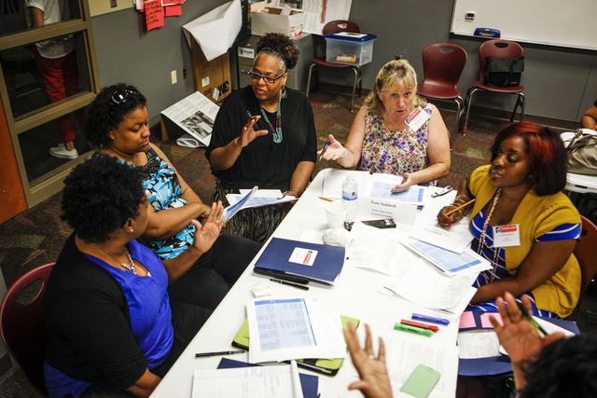
Student Focus – Next Steps
Teams have been formed
They’ve looked at data
They’ve determined broad areas of need
How do we identify at-risk students and what they need?

Slide 24
District Off Track Indicators
Use current, local data
Use indicators which are easily understood
Use indicators which are meaningful for your students
Use indicators which are actionable
Use indicators which will identify an appropriate number of students

Slide 25
Research Says…
Johns Hopkins University, School of Education
Team Playbook

Slide 26
Putting it All Together
Determine which interventions address specific indicators
Attendance vs. Behavior vs. Credit vs. Multiple
How many students can each intervention serve?
Ensure each student can receive adequate support
Are more resources needed?
Personnel
Space
Curriculum
Are there community, business, or high education partners who can assist?

Slide 27
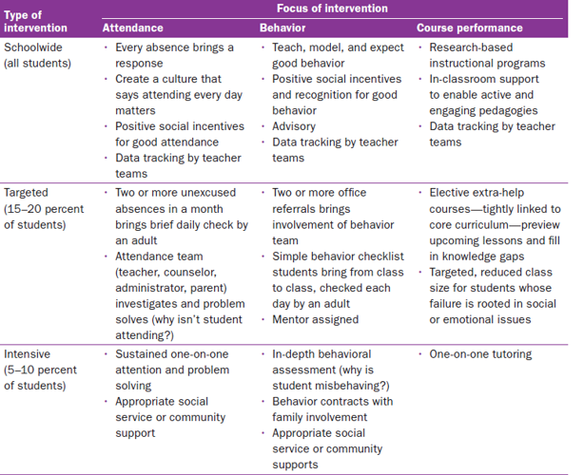
Interventions
Johns Hopkins University, School of Education
Team Playbook

Slide 28
How Will We Know if What We are Doing is Workings?
Collect before and after data
Collect intervention participation information
Did fully participating students drop out?
Are equity gaps expanding?
Are certain interventions providing better results?
Should some interventions be disbanded? Expanded?
Are there still student needs that aren’t being met?

Slide 29
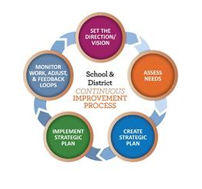
A Team’s Work is Never Done
Collecting data sets the stage
Analyzing data establishes goals
Soliciting input from stakeholders develops strategies & activities
Determine action plan, including steps each individual needs to take and how the team will determine effectiveness
Set calendar – when will the team re-convene for evaluation of steps
ACTION!
Repeat

Slide 30
Questions?
Contact Information
Cassie Medina
cassie.medina@state.or.us
Angie Gunter
angie.gunter@state.or.us
Michael Lindblad
michael.lindblad@state.or.us
Lillian White
lillian.white@state.or.us
David Jamieson
david.jamieson@state.or.us
Jennifer Bevers
jennifer.bevers@state.or.us

