Slide 1
Child Care: A Critical Link to Supporting Families in Summer Learning Programs
Oregon Department of Education
Sophie Hilton & Nancy Hauth, Federal Systems Team
April 13, 2023

Slide 2
Welcome and Introductions
Please introduce yourself, your role and the area of the state where you reside.
And share what you hope to learn today.

Slide 3
Webinar Overview
1:00 Welcome & Introduction
1:05 Grounding in Equity
1:10 Extending the Summer Program Day
1:15 Child Care Deep Dive
1:30 Planning Considerations
1:35 Resources
1:40 District Example
1:45 Break Out Groups
1:55 Wrap up and Closing

Slide 4
Why Extend the Summer Program Day?
Summer learning is an opportunity to support families at a time when many resources are turned off.
"Summer is the most unequal time in America."
-Matthew Boulay, founder and of the National Summer Learning Association
Students in Oregon summer programs - Summer 2021

Slide 5
Oregon Regional Landscape
We want to acknowledge this work will look different in our various regions in Oregon. There will be unique implications and approaches for our rural and urban communities.
This is not a one size fits all approach and should be tailored to meet the strengths and needs of your communities.

Slide 6
Approaches for Extending the Day
Child Care Partners and Agencies
Located at the school
Home-based child care
Located at another center
Community Based Organizations and Community Partners
Enrichment programs within the school
Located at another site/center
Field trips to opportunities outside the school

Slide 7
Child Care

Slide 8
Child Care Options
On-site: care provided before and after programming at the school
(Multiple approaches)
Off-site: care provided before and after programming with transportation
Home-based child care
Center-based child care
*Age eligibility for school-age child care is 5 - 12 years old.

Slide 9
Models of Child Care
Wrap-around care: before and after summer programming
Continuous care: all summer with wrap-around care during summer programming
Full-day and wrap-around care: for all children in school community even if not enrolled in summer learning program

Slide 10
How to Access Child Care Providers
Find Child Care Oregon
Enter school/district address
Program type (ages, hours open)
List of providers within a given radius

Slide 11
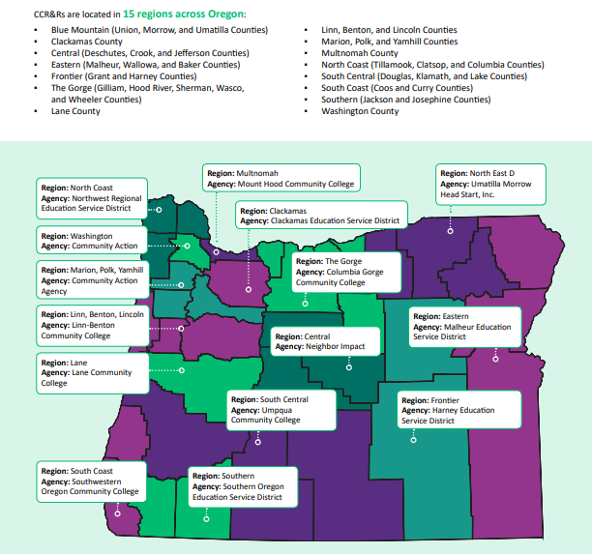
Child Care Resource and Referral (CCR&R)
First point of contact
Familiar with child care landscape in region
Can convene community meeting to determine best approach for a region
Supports intentional district-child care provider planning
Child Care Resource and Referral

Slide 12
Planning Considerations
Begin planning in the spring when possible.
Coordinate child care plans with additional summer programs in the school.
Build in time for summer staff and partners to meet before programs starts.
Invite child care staff to participate in family engagement events.
To support continuity of care for children:
Connect with existing programs in the community first. This may require bus transportation for off-site care.
Connect with local Head Start program director to coordinate schedules. Some programs may operate in the summer.

Slide 13
Grant Funding
Considerations for Jump Start Kindergarten and SSA Summer Grantees:
Consider reserving slots for prioritized families.
For off-site child care, bus transportation may be required.
Invite child care and community partner staff to summer planning meetings and PD (if applicable). Include compensation for planning time in the agreement.
Explore how to build in enrichment with partners.

Slide 14
District Example
.
Dr. Tricia Mooney
Superintendent of Schools
Hermiston School District

Slide 15
Tips and Strategies
Create a planning document to share with partners. Include logistics, points of contact, meals, transportation and more.
Consider how to best utilize staff in multiple programs and create full time opportunities.
Debrief in the fall to evaluate and reflect on extended day programming
Reach out to your regional Child Care Resource and Referral and ODE’s Expanded Learning team for support.

Slide 16
Resources
Resources will all be located in the Webinar Resource Folder
Partner agreements
MOU examples
Information about state-funded child care subsidies
Regional contact information

Slide 17
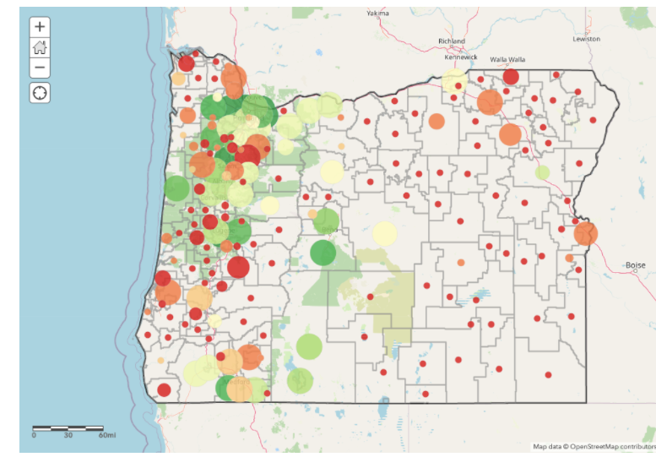
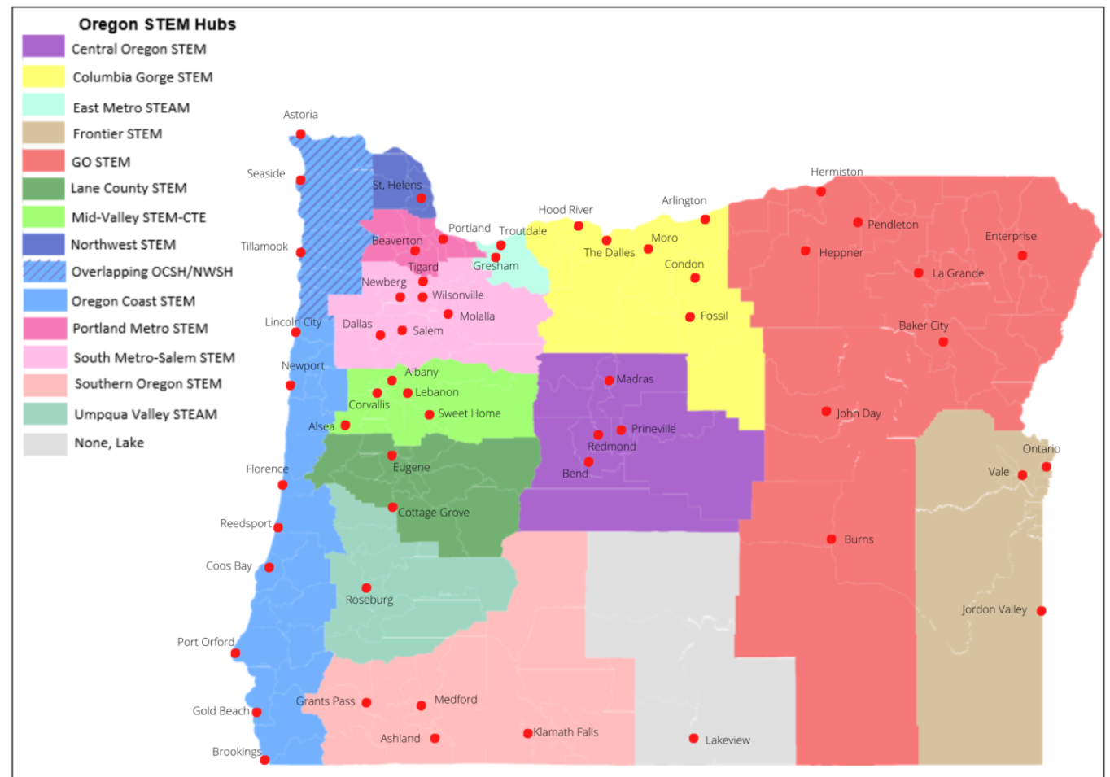
Building Community Partnerships & Enrichment
OregonASK Webpage
Regional Stem Hubs

Slide 18
Breakout Groups
Child Care Resources and Information
Community Based Organizations and Partnerships

Slide 19
Participant Feedback
Please complete this brief exit survey
to help ODE improve.
We appreciate your feedback!
Exit Survey

Slide 20
Wrap-up and Closure
Sophie Hilton
Oregon Department of Education
Federal Systems Team
Sophie.Hilton@ode.oregon.gov
Nancy Hauth
Oregon Department of Education
Federal Systems Team
Nancy.Hauth@ode.oregon.gov

